Slide 1
MOVEMENT OF UNANCHORED BENCHMARK RODS IN CONSOLIDATING SEDIMENT IN SOUTH LOUISIANA
Mark R. Byrnes
Syed Khalil
Rick Raynie
Darin Lee
Rob Hollis
Jennifer Berlinghoff
Ben Beasley
State of the Coast 2023 May 31, 2023
MOVEMENT OF UNANCHORED BENCHMARK RODS IN CONSOLIDATING SEDIMENT IN SOUTH LOUISIANA

Slide 2
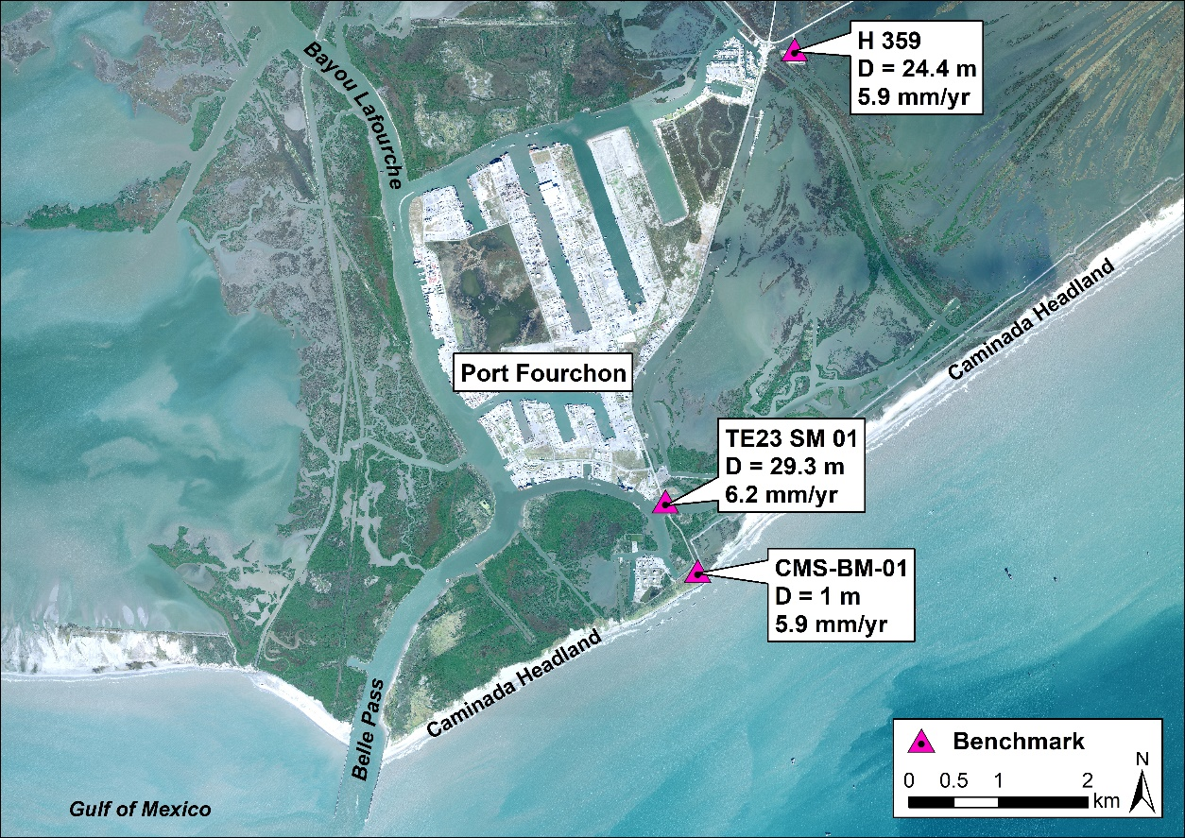
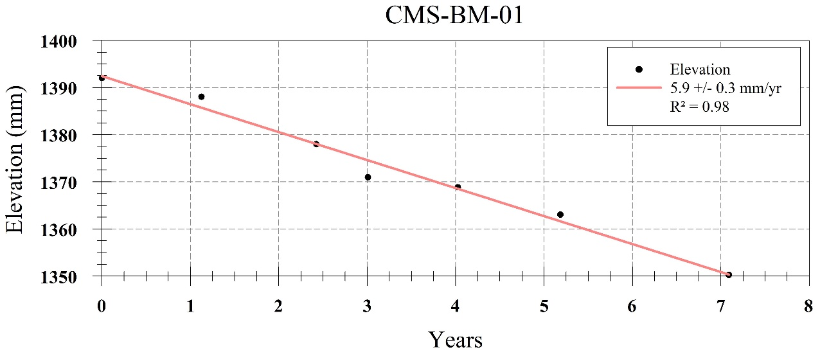
Project Background
Began a recent subsidence monitoring and evaluation study in 2016 in Barataria Basin and observed that benchmark monument type did not impact subsidence rates
Surface monument CMS-BM-01 documents total subsidence, a velocity equivalent to the adjacent two deep-rod monuments.
MOVEMENT OF UNANCHORED BENCHMARK RODS IN CONSOLIDATING SEDIMENT IN SOUTH LOUISIANA

Slide 3
Project Background
Shinkle and Dokka (2004) made a similar observation when analyzing south Louisiana level-line survey data; however, a cause was never provided.
Recently had completed the initial phases of a consolidation settlement project at Caminada Headland where geotechnical engineers installed anchored benchmarks to isolate settlement associated with specific geologic horizons
Focused our interest on the impact of naturally consolidating sediment on unanchored benchmarks (geotechnical and benchmark installation literature)
Both technical literature sources identified the importance of consolidating sediment and its impact on benchmark rod and pile installation
MOVEMENT OF UNANCHORED BENCHMARK RODS IN CONSOLIDATING SEDIMENT IN SOUTH LOUISIANA

Slide 4
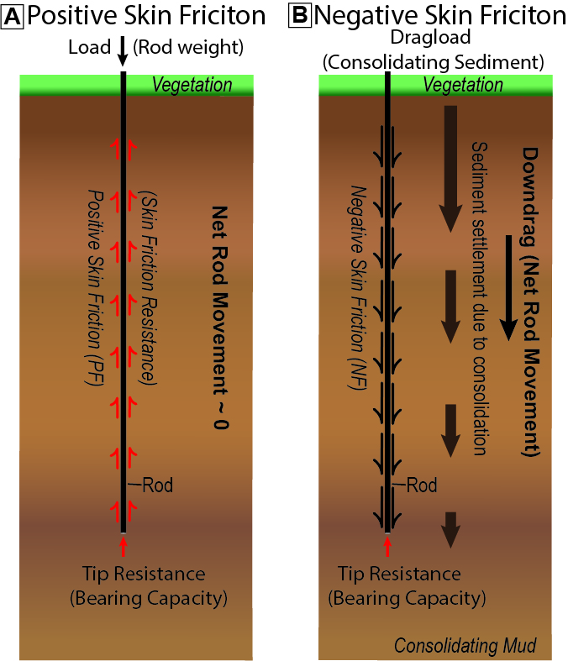
Project Background
Two forces that impact unanchored benchmark rod stability
Positive Skin Friction [A]
Negative skin friction [B]
Positive skin friction and tip resistance are maximized when a rod or pile is driven to “refusal” (ΔZ ~ 0)
To maintain ΔZ ~ 0 in consolidating sediment, a settlement point anchor must be deployed to counteract downdrag.
Downdrag is the downward force exerted on a rod/pile by surrounding consolidating sediment. When a rod/pile is not anchored or shielded from this force, vertical displacement occurs.
MOVEMENT OF UNANCHORED BENCHMARK RODS IN CONSOLIDATING SEDIMENT IN SOUTH LOUISIANA

Slide 5
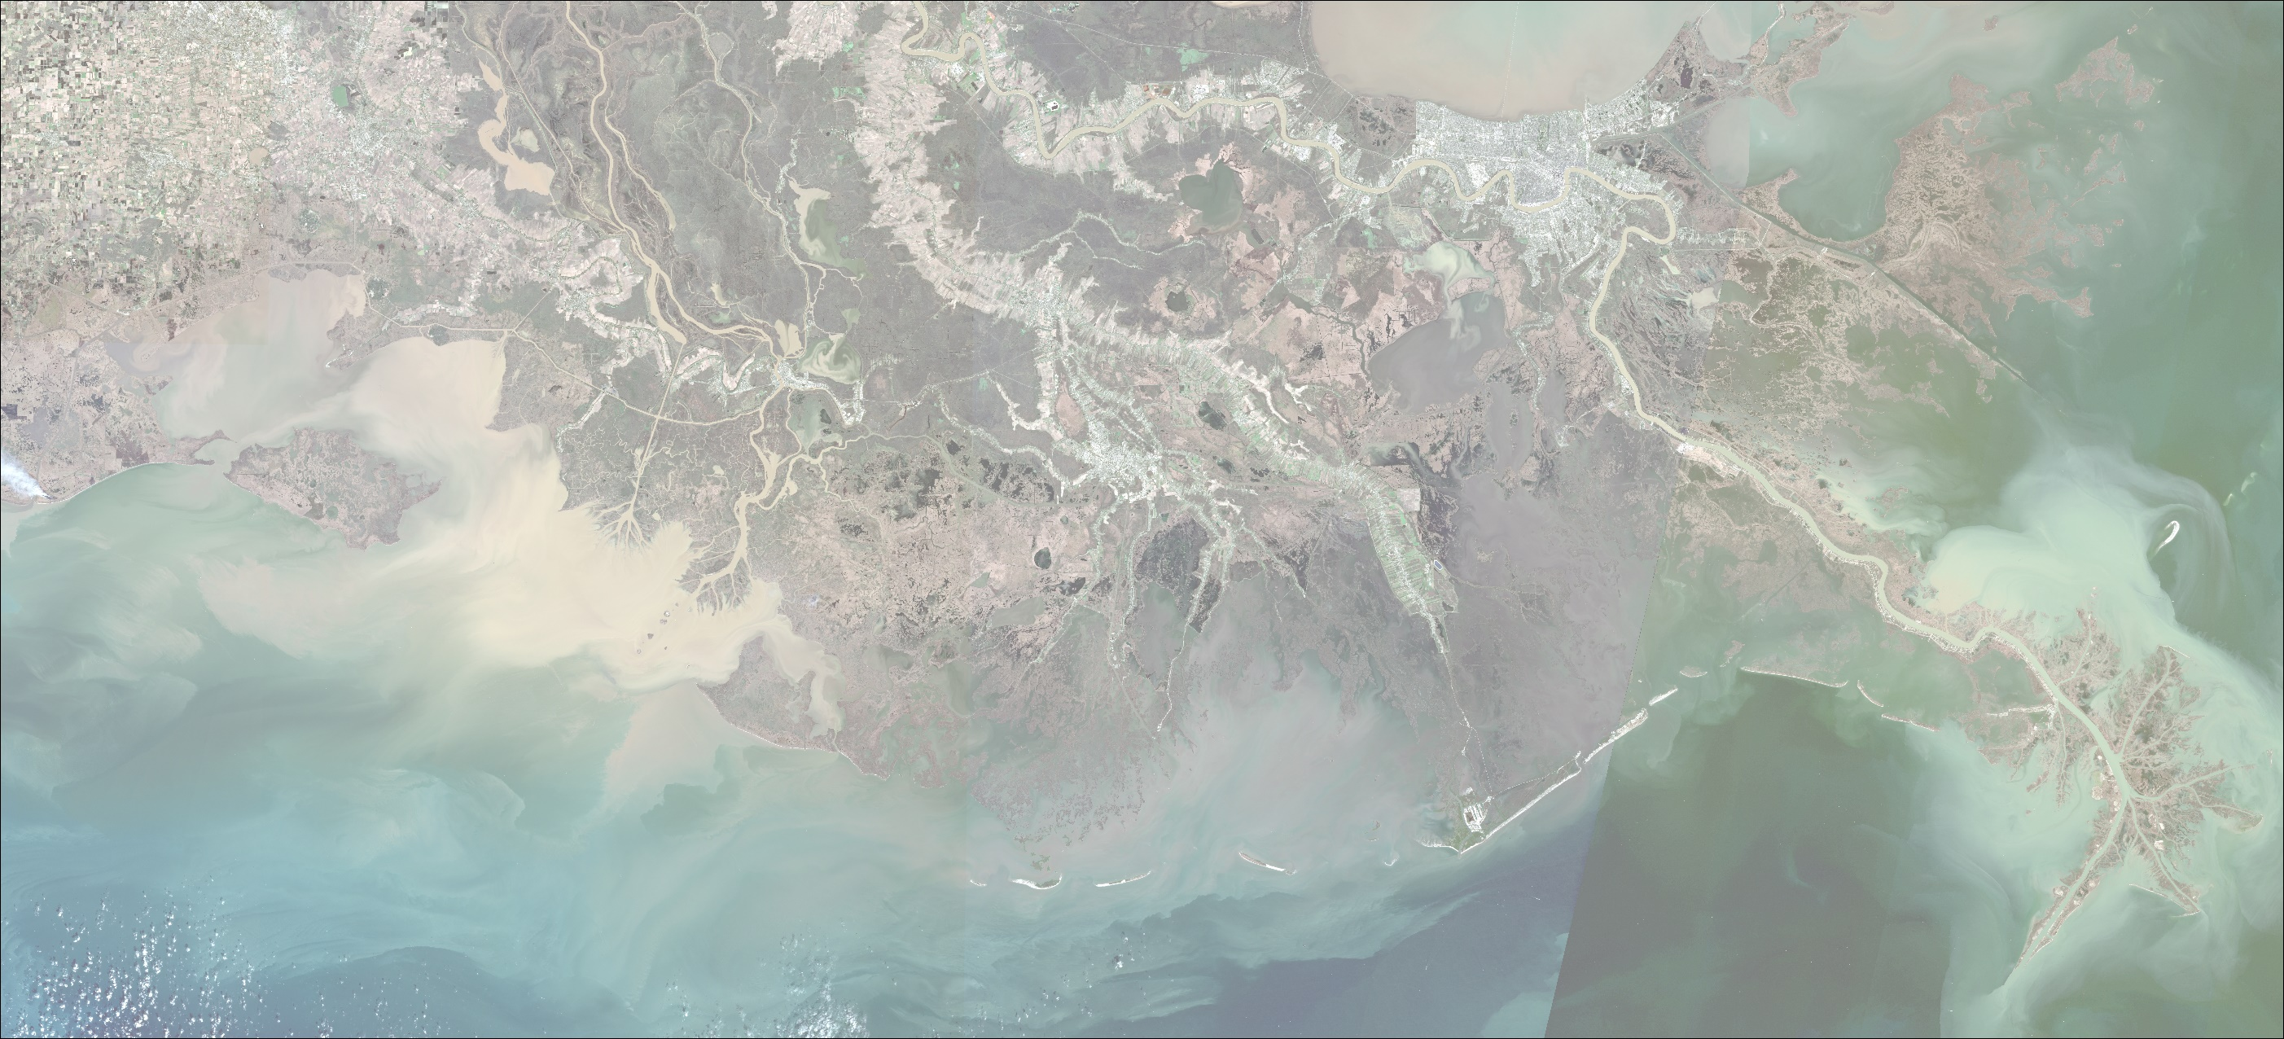
Experimental Design
Hypotheses: Benchmark rod length has no impact subsidence rates; settlement point anchors provide benchmark stability relative to the rod base
High-Accuracy Leveling Between Shallow- and Deep-Rod Benchmarks
Establish six benchmark pairs in Barataria and Breton Sound Basins
Establish one unanchored benchmark at Caminada Headland adjacent to an existing anchored benchmark to exactly the same depth at t = 0
Conduct high-accuracy leveling surveys at each benchmark pair to document differences in ΔZ
If differences in ΔZ = 0, settling rate is the same for shallow and deep benchmark rods
If ΔZ between the paired benchmark measurements at Caminada Headland is not equal, benchmark anchors are critical for attaining accurate subsidence measurements relative to the base of the rod
MOVEMENT OF UNANCHORED BENCHMARK RODS IN CONSOLIDATING SEDIMENT IN SOUTH LOUISIANA

Slide 6
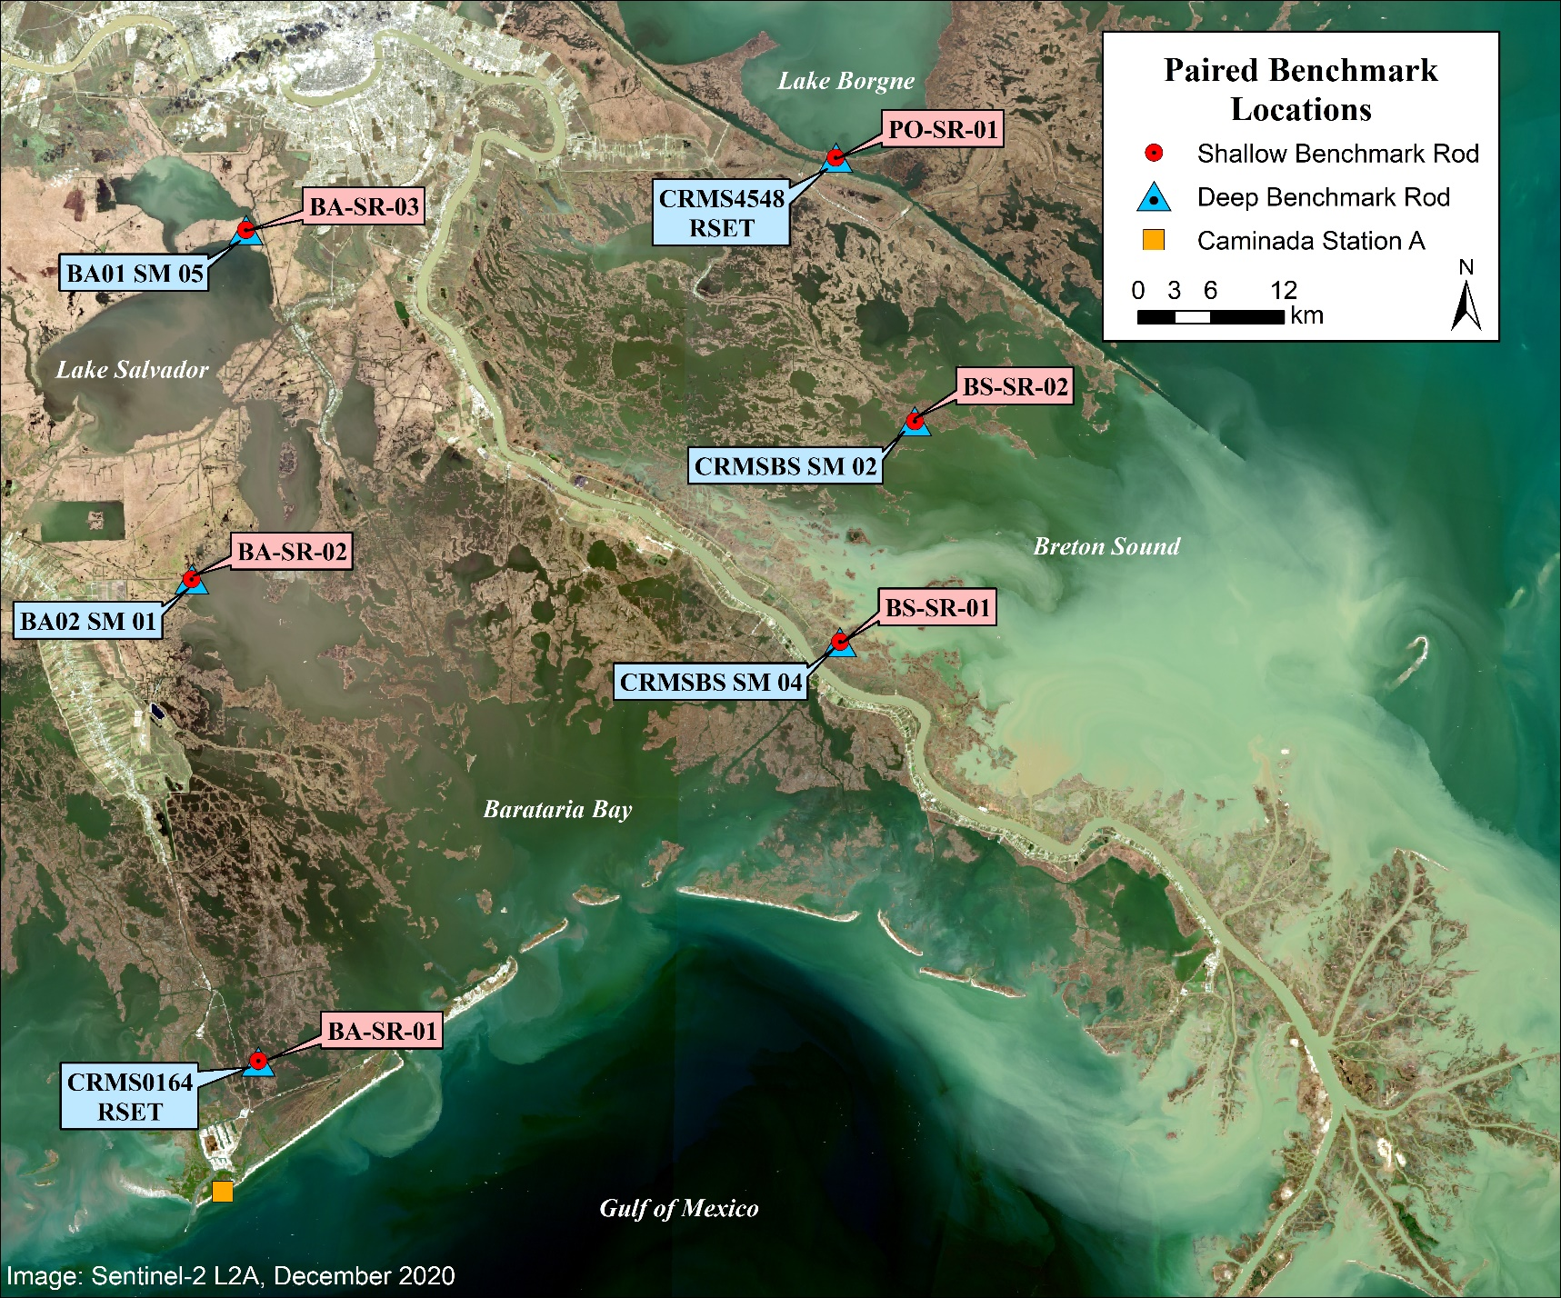
Paired Benchmark
Locations
Caminada unanchored benchmark installed April 2018
All other paired benchmarks installed February/March 2019
MOVEMENT OF UNANCHORED BENCHMARK RODS IN CONSOLIDATING SEDIMENT IN SOUTH LOUISIANA

Slide 7
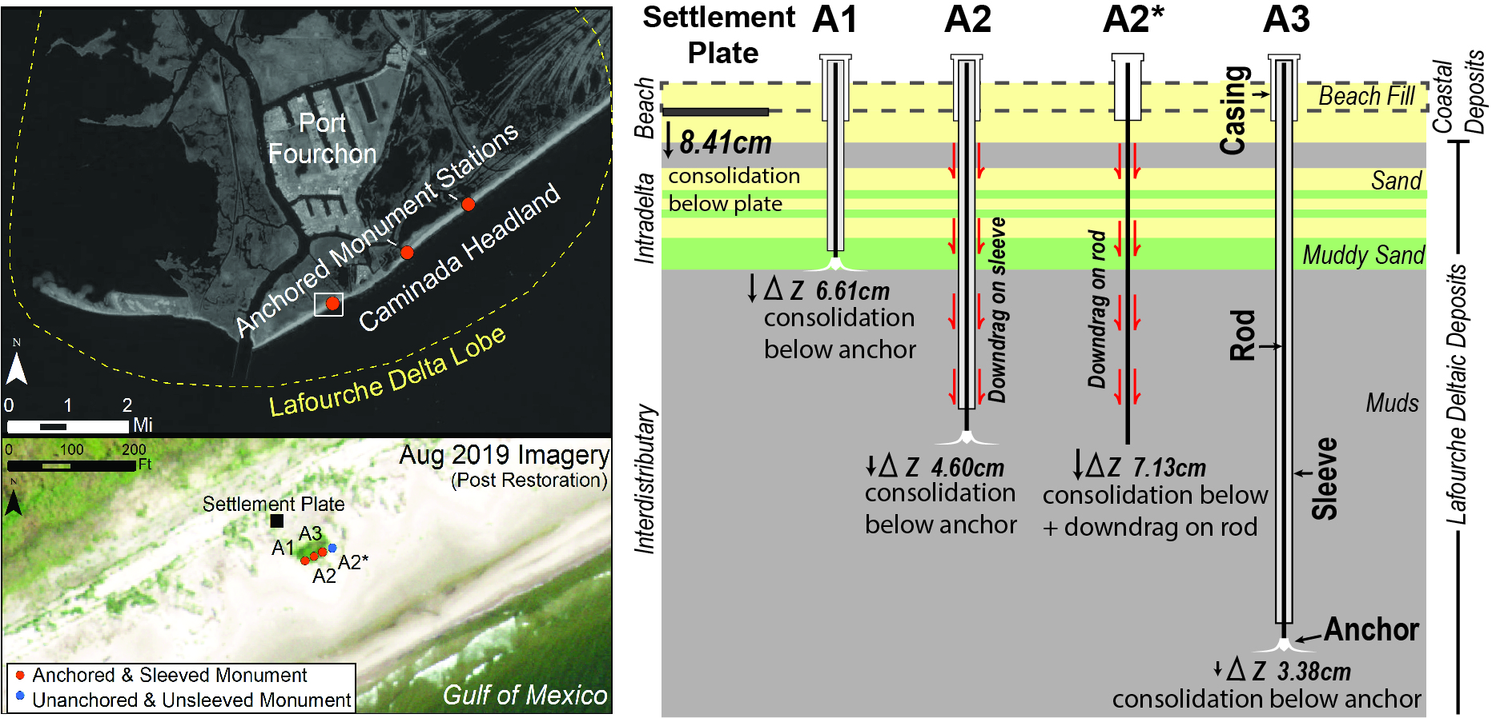
RESULTS
A2* (unanchored) settled 1.55 times faster than A2 (anchored) between April 24, 2018 and March 20, 2020 (both rod bases started at 12.5 m). A2* recorded approximately 85% of the settlement measured at the surface plate, illustrating the importance of anchoring for benchmark rod stability.
MOVEMENT OF UNANCHORED BENCHMARK RODS IN CONSOLIDATING SEDIMENT IN SOUTH LOUISIANA

Slide 8
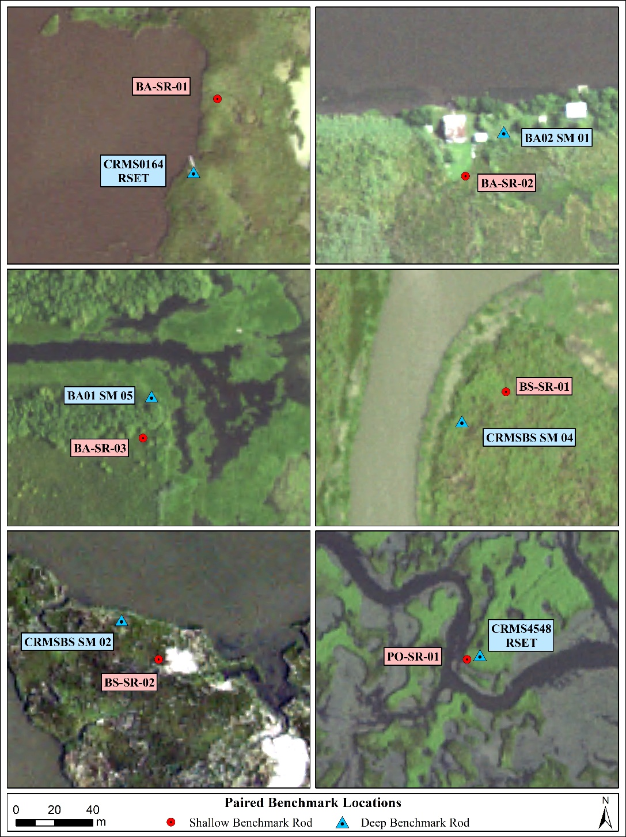
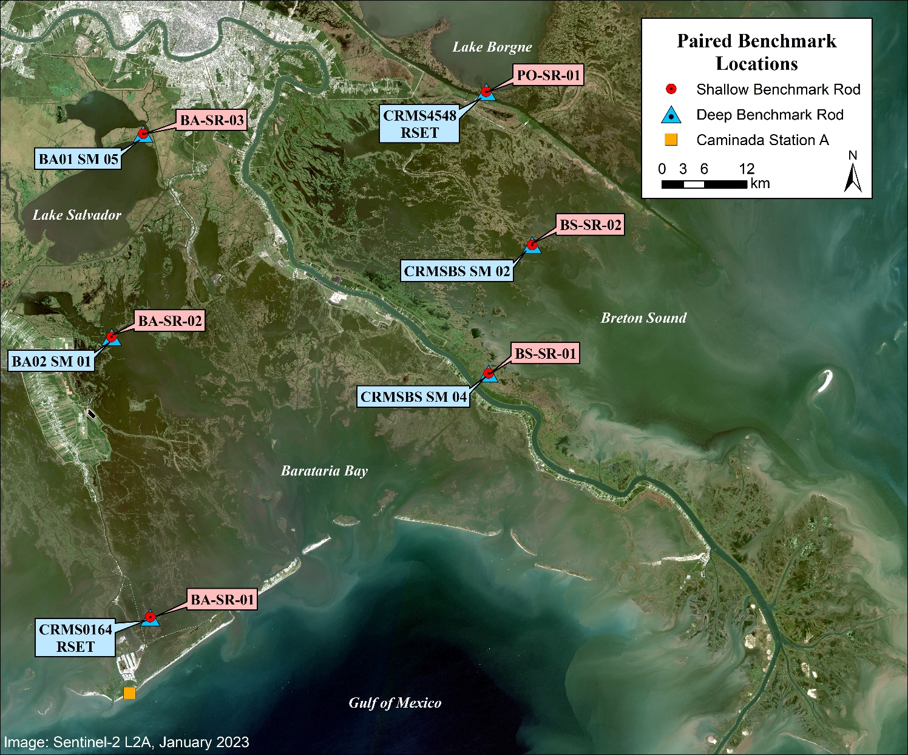
X
Paired Benchmarks Remaining after Hurricane Ida and Shell Beach Restoration
X
X
X
X
X
MOVEMENT OF UNANCHORED BENCHMARK RODS IN CONSOLIDATING SEDIMENT IN SOUTH LOUISIANA

Slide 9
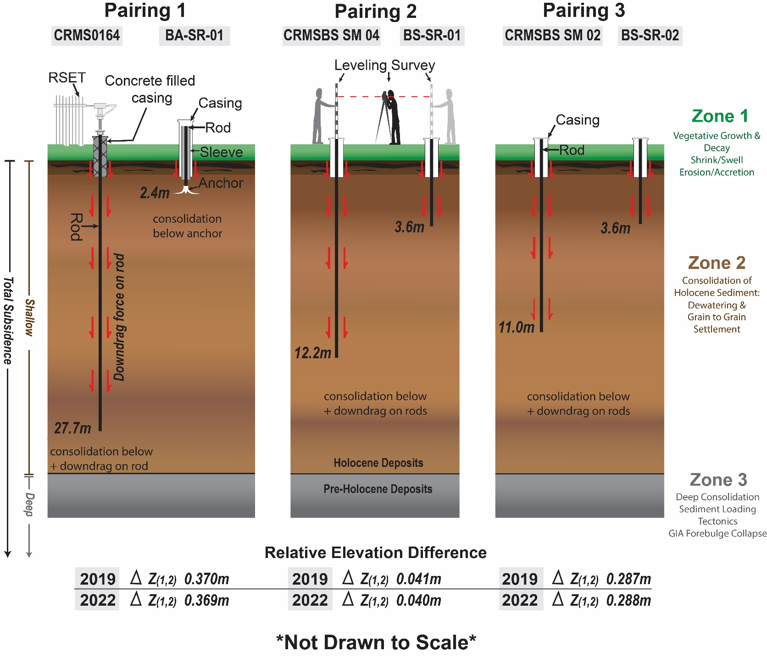
RESULTS
ΔZ illustrates no measurable change between shallow- and deep-rod settlement for the period Feb/March 2019 to August 2022 (3.5 years)
Subsidence is about 5 mm/yr in this area, which means net change was about 17.5 mm, far greater than the measurement uncertainty of +/- 3 mm.
MOVEMENT OF UNANCHORED BENCHMARK RODS IN CONSOLIDATING SEDIMENT IN SOUTH LOUISIANA

Slide 10
Observations
Measurements of elevation change at anchored and unanchored benchmark locations provide direct evidence of the impact of consolidating sediment on benchmark rod movement
Differences in elevation change between A2 and A2* at Caminada Headland illustrate the influence of consolidating sediment forces (downdrag) on benchmark rod movement
Comparison of ΔZ at the settlement plate (surface) and anchored benchmark A2 documents that a majority of subsidence (55%) occurs above 12.5 m deep
All three paired benchmark rods in Barataria and Breton Sound Basins recorded no measurable difference in elevation change over a 3.5-yr period, indicating that unanchored rods of any length record total subsidence
No difference in ΔZ at station CRMS0164 indicates the active marsh zone above 2.4 m does not contribute measurably to the total subsidence signal
MOVEMENT OF UNANCHORED BENCHMARK RODS IN CONSOLIDATING SEDIMENT IN SOUTH LOUISIANA

Slide 11
Questions???
FUNDING PROVIDED BY COASTAL PROTECTION AND RESTORATION AUTHORITY OF LOUISIANA

