Slide 1
2 june 2023
The needs and opportunities for Louisiana and the Coastal Protection and Restoration Authority regarding blue-green carbon
James pahl, cpra planning and research division senior scientist

Slide 2
Outline
Definitions
CPRA Considerations for Blue Carbon
2022 Louisiana Climate Action Plan
Uncertainty Bridging the Distance between Capturable Carbon and Credit Sales

Slide 3
Definitions
Blue Carbon
“Blue carbon is … carbon captured by the world's ocean and coastal ecosystems … Sea grasses, mangroves, and salt marshes …” (https://oceanservice.noaa.gov/facts/bluecarbon.html#:~:text=Blue%20carbon%20is%20simply%20the,dioxide%2C%20which%20contains%20atmospheric%20carbon)
Blue carbon is the carbon stored in coastal and marine ecosystems. The Blue Carbon Initiative currently focuses on carbon in … mangroves, tidal marshes and seagrasses …” (https://www.thebluecarboninitiative.org/)
Coastal ecosystems including mangroves, seagrasses and tidal marshes … remove carbon from the atmosphere and oceans, storing it in plants and sediment, where it is known as “blue carbon.” (https://www.conservation.org/projects/blue-carbon)

Slide 4
Definitions
Blue Carbon
“Blue carbon is … carbon captured by the world's ocean and coastal ecosystems … Sea grasses, mangroves, and salt marshes …” (https://oceanservice.noaa.gov/facts/bluecarbon.html#:~:text=Blue%20carbon%20is%20simply%20the,dioxide%2C%20which%20contains%20atmospheric%20carbon)
Blue carbon is the carbon stored in coastal and marine ecosystems. The Blue Carbon Initiative currently focuses on carbon in … mangroves, tidal marshes and seagrasses …” (https://www.thebluecarboninitiative.org/)
Coastal ecosystems including mangroves, seagrasses and tidal marshes … remove carbon from the atmosphere and oceans, storing it in plants and sediment, where it is known as “blue carbon.” (https://www.conservation.org/projects/blue-carbon)

Slide 5
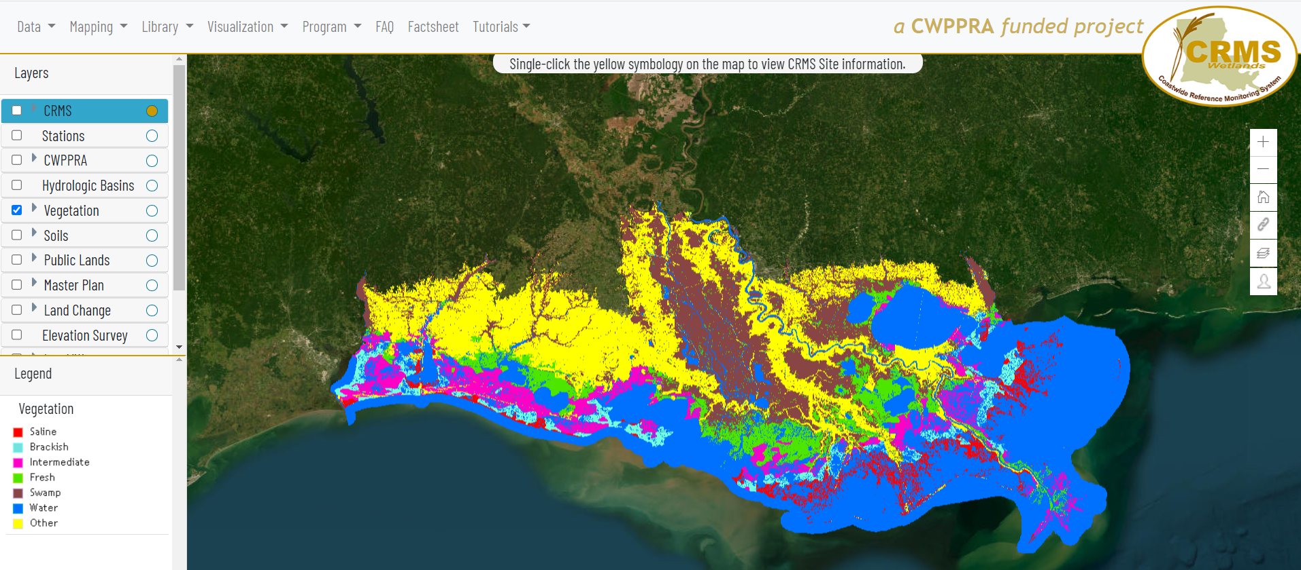
Definitions
Blue Carbon
Sea grasses, mangroves, and salt marshes
Swamp: 47%
Fresh Marsh: 19%
Intermediate Marsh: 17%
Brackish Marsh: 8%
Salt Marsh: 9%

Slide 6
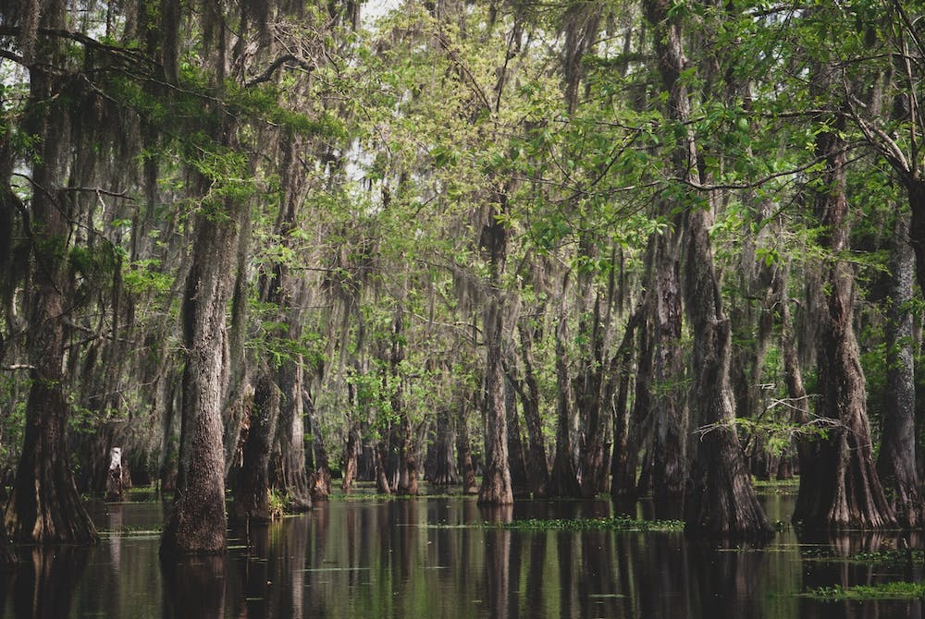
Definitions
Nola.com
Blue Carbon
Sea grasses, mangroves, and salt marshes
Swamp: 47%
Fresh Marsh: 19%
Intermediate Marsh: 17%
Brackish Marsh: 8%
Salt Marsh: 9%

Slide 7
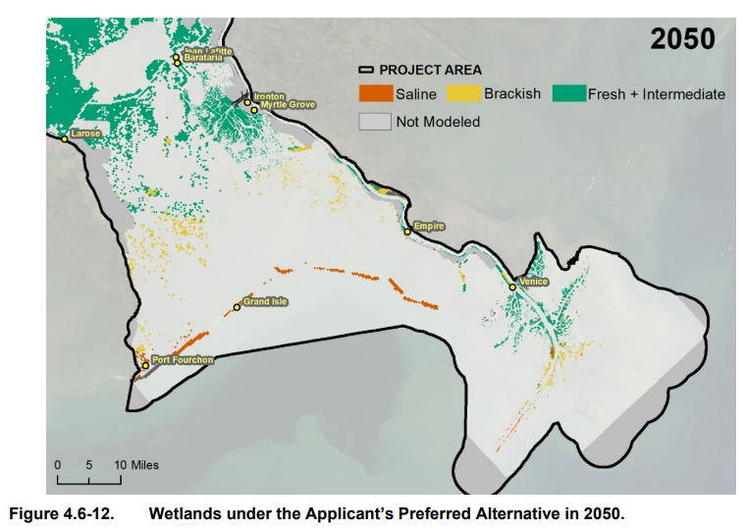
Definitions
Blue Carbon
Sea grasses, mangroves, and salt marshes
Swamp: 47%
Fresh Marsh: 19%
Intermediate Marsh: 17%
Brackish Marsh: 8%
Salt Marsh: 9%
USACE 2022

Slide 8
Outline
Definitions
CPRA Considerations for Blue Carbon
2022 Louisiana Climate Action Plan
Uncertainty Bridging the Distance between Capturable Carbon and Credit Sales

Slide 9
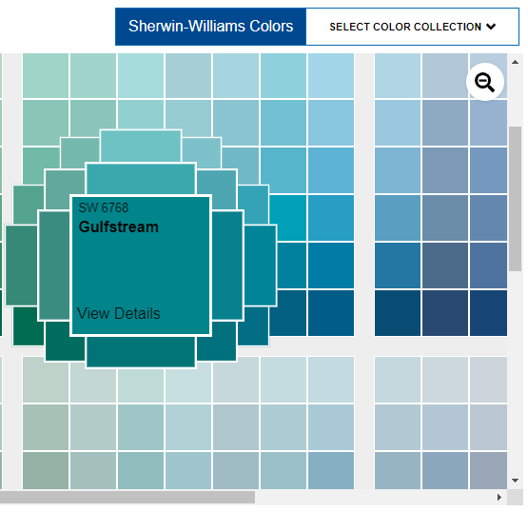
Outline
Blue-green?
Aqua?
Teal?
Gulfstream?
Coastal?
Definitions
CPRA Considerations for Blue Carbon
2022 Louisiana Climate Action Plan
Uncertainty Bridging the Distance between Capturable Carbon and Credit Sales

Slide 10
Outline
Definitions
CPRA Considerations for Blue Coastal Carbon
2022 Louisiana Climate Action Plan
Uncertainty Bridging the Distance between Capturable Carbon and Credit Sales

Slide 11
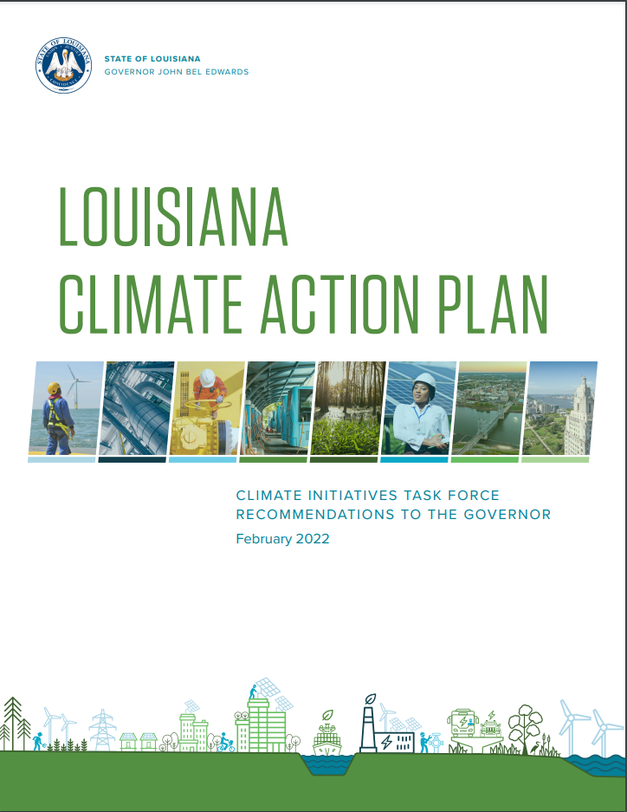
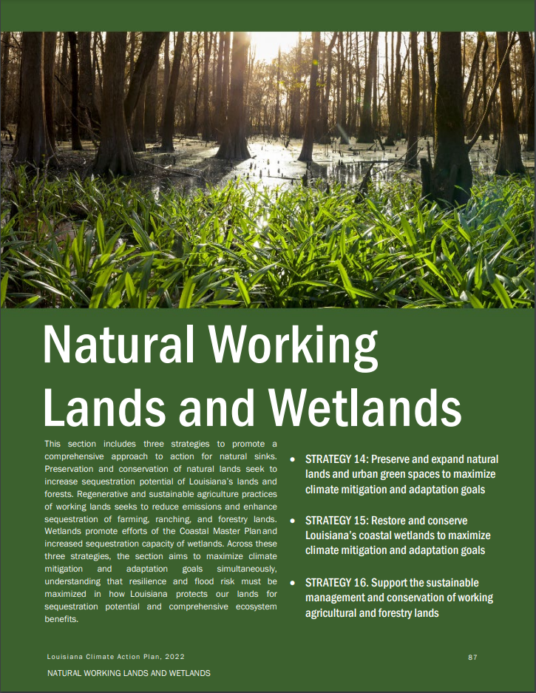
CPRA Considerations for Coastal Carbon
2022 Louisiana Climate Action Plan

Slide 12
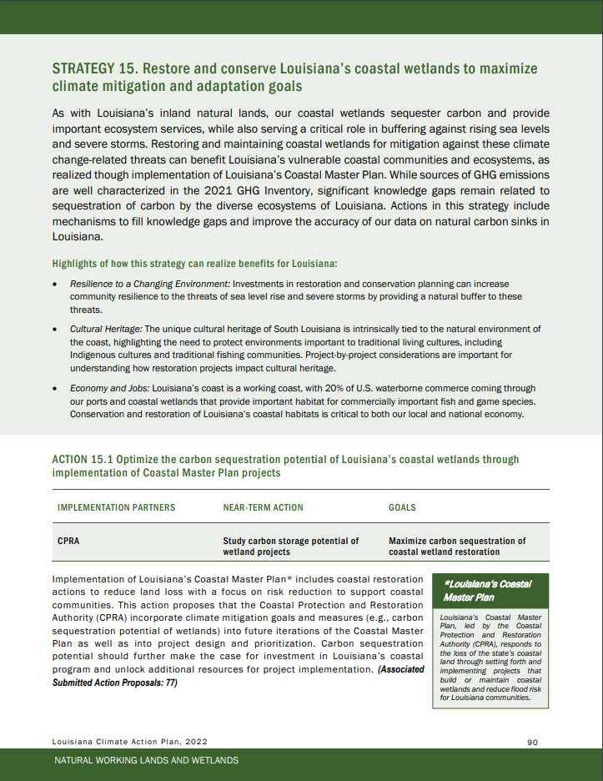
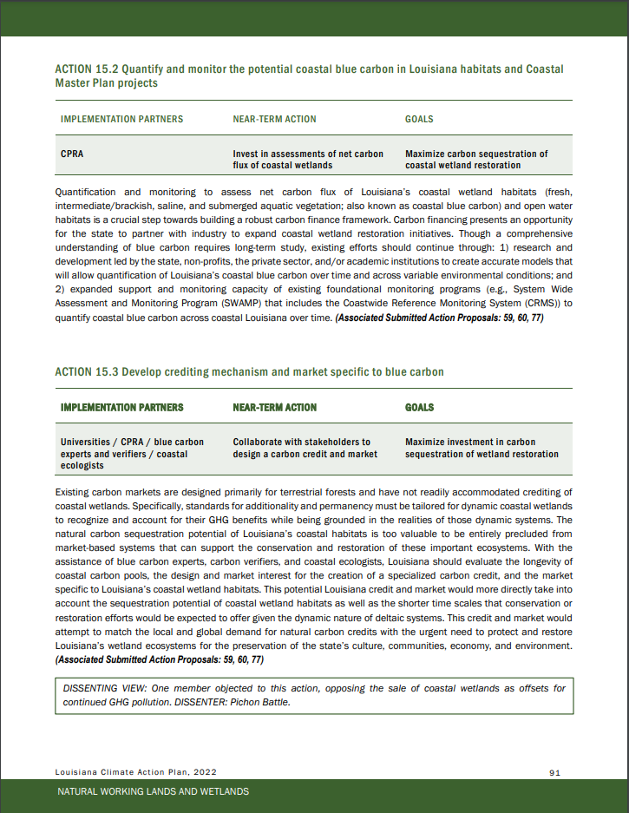
CPRA Considerations for Coastal Carbon
2022 Louisiana Climate Action Plan

Slide 13
CPRA Considerations for Coastal Carbon
Uncertainty Bridging the Distance between Capturable Carbon and Credit Sales

Slide 14
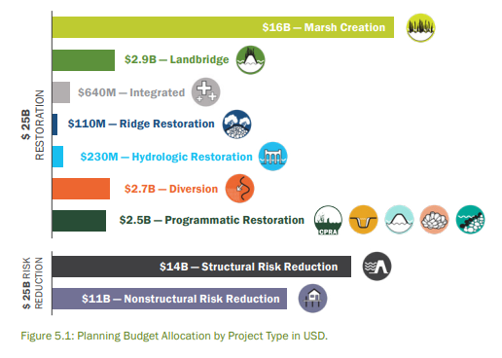
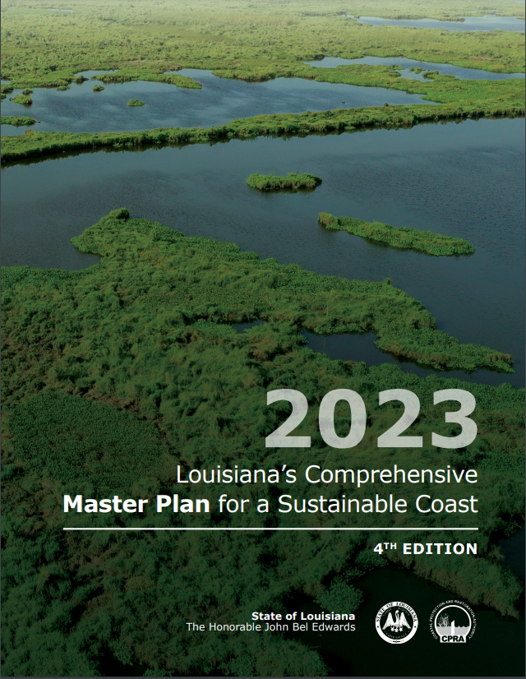
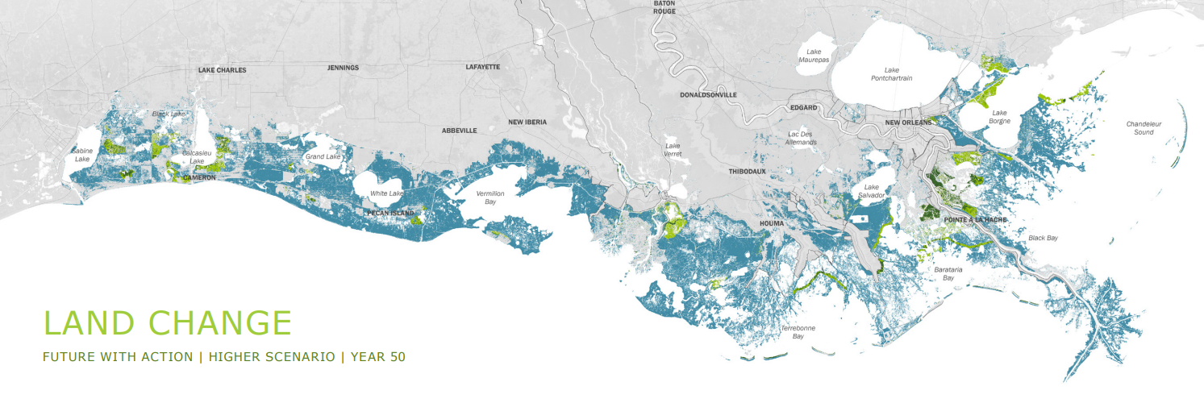
CPRA Considerations for Coastal Carbon
Uncertainty Bridging the Distance between Capturable Carbon and Credit Sales
Total Capturable Carbon (metric tonnes CO₂-equivalents)

Slide 15
CPRA Considerations for Coastal Carbon
Uncertainty Bridging the Distance between Capturable Carbon and Credit Sales
Total Capturable Carbon (metric tonnes CO₂-equivalents)
Policy/Programmatic Limitations
Technical, e.g. …
Additionality
Permanence
Uncertainty
Funding Program Rules (28!)
Which programs allow credit development?
Who claims the credits in program-funded actions?
Capturable Carbon (metric tonnes CO₂-eq)

Slide 16
CPRA Considerations for Coastal Carbon
Uncertainty Bridging the Distance between Capturable Carbon and Credit Sales
Total Capturable Carbon (metric tonnes CO₂-equivalents)
Policy/Programmatic Limitations
Capturable Carbon (metric tonnes CO₂-eq)
Project Construction Carbon Costs
Concrete and Other Hard Structures
Concrete diversion structure
Shoreline Protection rip rap
Dredge and Placement of Sediments (marshes, ridges, barrier islands)
Restoration and Risk Reduction Earthworks
Risk reduction levees
Terraces
Net Carbon (metric tonnes CO₂-eq)

Slide 17
CPRA Considerations for Coastal Carbon
Uncertainty Bridging the Distance between Capturable Carbon and Credit Sales
Total Capturable Carbon (metric tonnes CO₂-equivalents)
Policy/Programmatic Limitations
Capturable Carbon (metric tonnes CO₂-eq)
Project Construction Carbon Costs
Net Carbon (metric tonnes CO₂-eq)
Monetization Based on Market Conditions
Estimated Value ($) of Net Carbon

Slide 18
CPRA Considerations for Coastal Carbon
Uncertainty Bridging the Distance between Capturable Carbon and Credit Sales
Total Capturable Carbon (metric tonnes CO₂-equivalents)
Policy/Programmatic Limitations
Capturable Carbon (metric tonnes CO₂-eq)
Project Construction Carbon Costs
Net Carbon (metric tonnes CO₂-eq)
Monetization Based on Market Conditions
Estimated Value ($) of Net Carbon
Estimated Cost ($) to Monitor
Which is greater?

Slide 19
CPRA Considerations for Coastal Carbon
Uncertainty Bridging the Distance between Capturable Carbon and Credit Sales
Total Capturable Carbon (metric tonnes CO₂-equivalents)
Policy/Programmatic Limitations
Capturable Carbon (metric tonnes CO₂-eq)
Project Construction Carbon Costs
Net Carbon (metric tonnes CO₂-eq)
Monetization Based on Market Conditions
Estimated Value ($) of Net Carbon
Estimated Cost ($) to Monitor
Which is greater?
Develop agency-led approach for credits as agency income
Focus on agency activities as carbon strategy component, support outside-led approach for credits as private sector income

Slide 20
CPRA Considerations for Coastal Carbon
Uncertainty Bridging the Distance between Capturable Carbon and Credit Sales
Total Capturable Carbon (metric tonnes CO₂-equivalents)
Policy/Programmatic Limitations
Capturable Carbon (metric tonnes CO₂-eq)
Project Construction Carbon Costs
Net Carbon (metric tonnes CO₂-eq)
Monetization Based on Market Conditions
Estimated Value ($) of Net Carbon
Estimated Cost ($) to Monitor
Which is greater?
Develop agency-led approach for credits as agency income
Focus on agency activities as carbon strategy component, support outside-led approach for credits as private sector income

Slide 21
CONNECT WITH US!
SUBSCRIBE
@LouisianaCPRA
James Pahl james.pahl@la.gov

