Slide 1
Accessing Federal Funds for Resilient Coasts and Communities State of the Coast 2023

Slide 2
Session Objectives
Audience knows what federal funds are available;
They understand the purpose of the funds and what types of support is available; and
They will understand what it takes to be successful to obtain those funds

Slide 3
Session Panelist
Panelist - Federal
Carrie Selberg Robinson
Director, Office of Habitat Conservation
NOAA Fisheries
Marc Wyatt
Director, Gulf of Mexico Division
EPA
Ron Howard
Senior Advisor
USDA Gulf Coast Ecosystem Restoration Team
Panelist - Awardees
Zach Monroe External Affairs Manager
Office of Resilience and Sustainability, IIJA Task Force - City of New Orleans
Michael Biros
Restoration Program Director
Coalition to Restore Coastal Louisiana
Mark Berte
Executive Director
Alabama Coastal Foundation

Slide 4
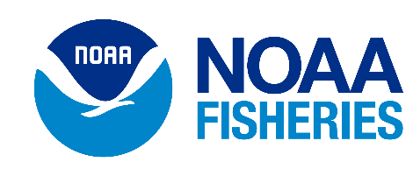
Habitat Restoration & Resilience Funding Opportunities
Bipartisan Infrastructure Law
Carrie Selberg Robinson
May 31, 2023

Slide 5
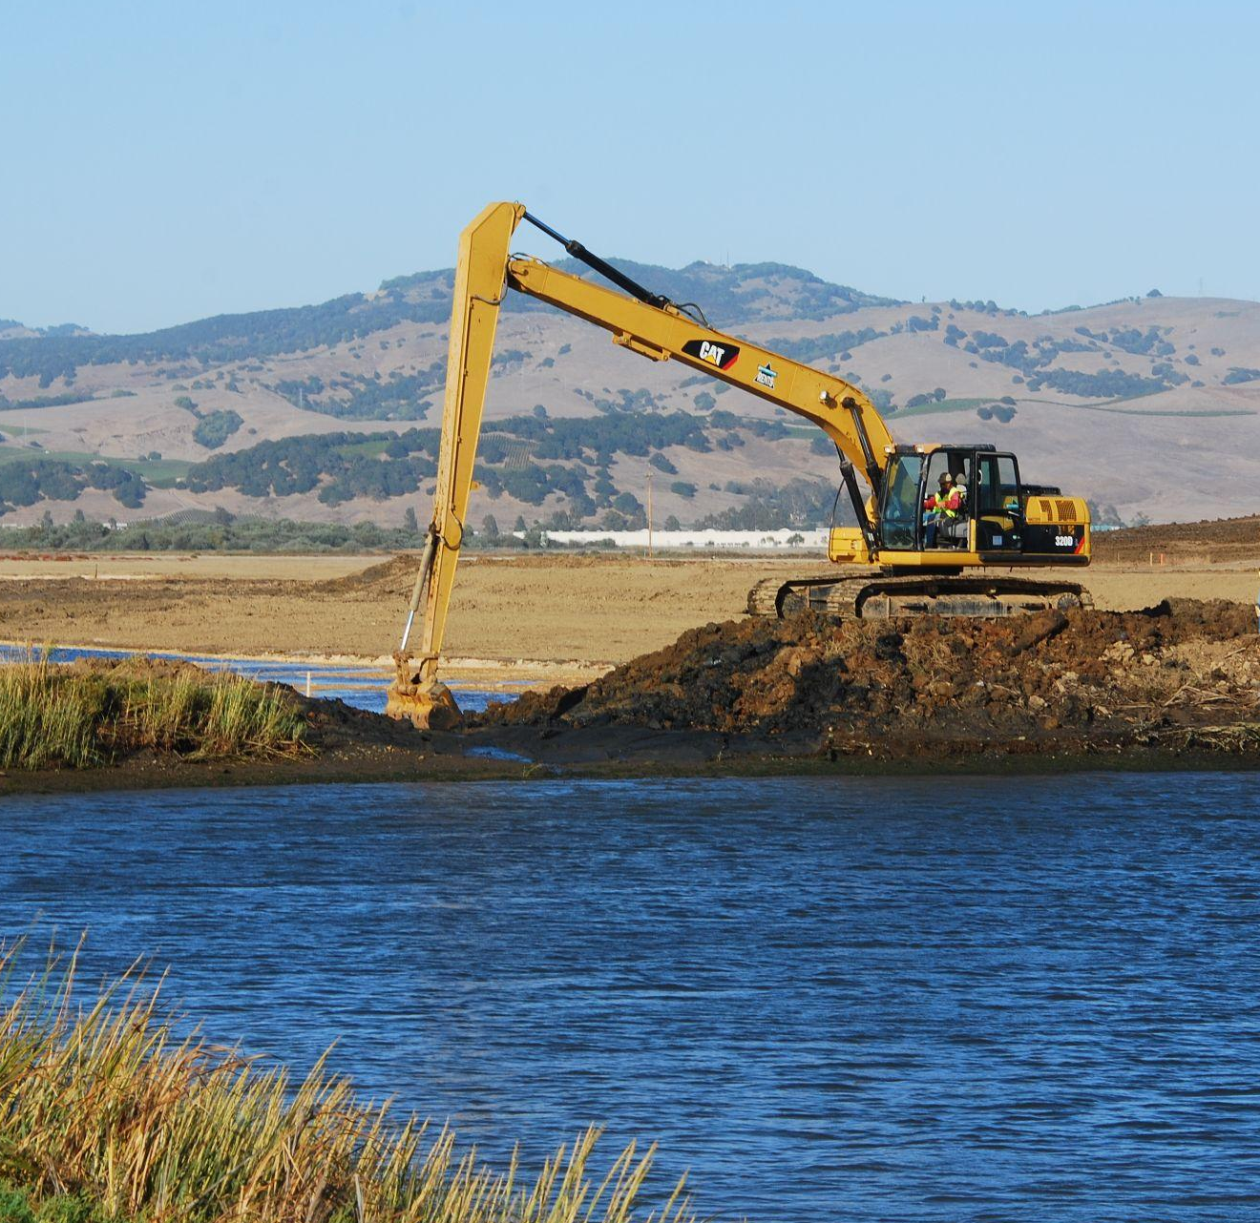
Bipartisan Infrastructure Law - Round 1
Unprecedented new resources for NOAA for habitat restoration, conservation, marine debris, and community and ecosystem resilience across several offices
Office of Habitat – 4 Competitions:
Fish Passage
Tribal Fish Passage
Transformational Habitat Restoration
Habitat Restoration for Underserved Communities
Demand for first year competitions was very high, $1.7B
Credit: Erika Nortemann

Slide 6
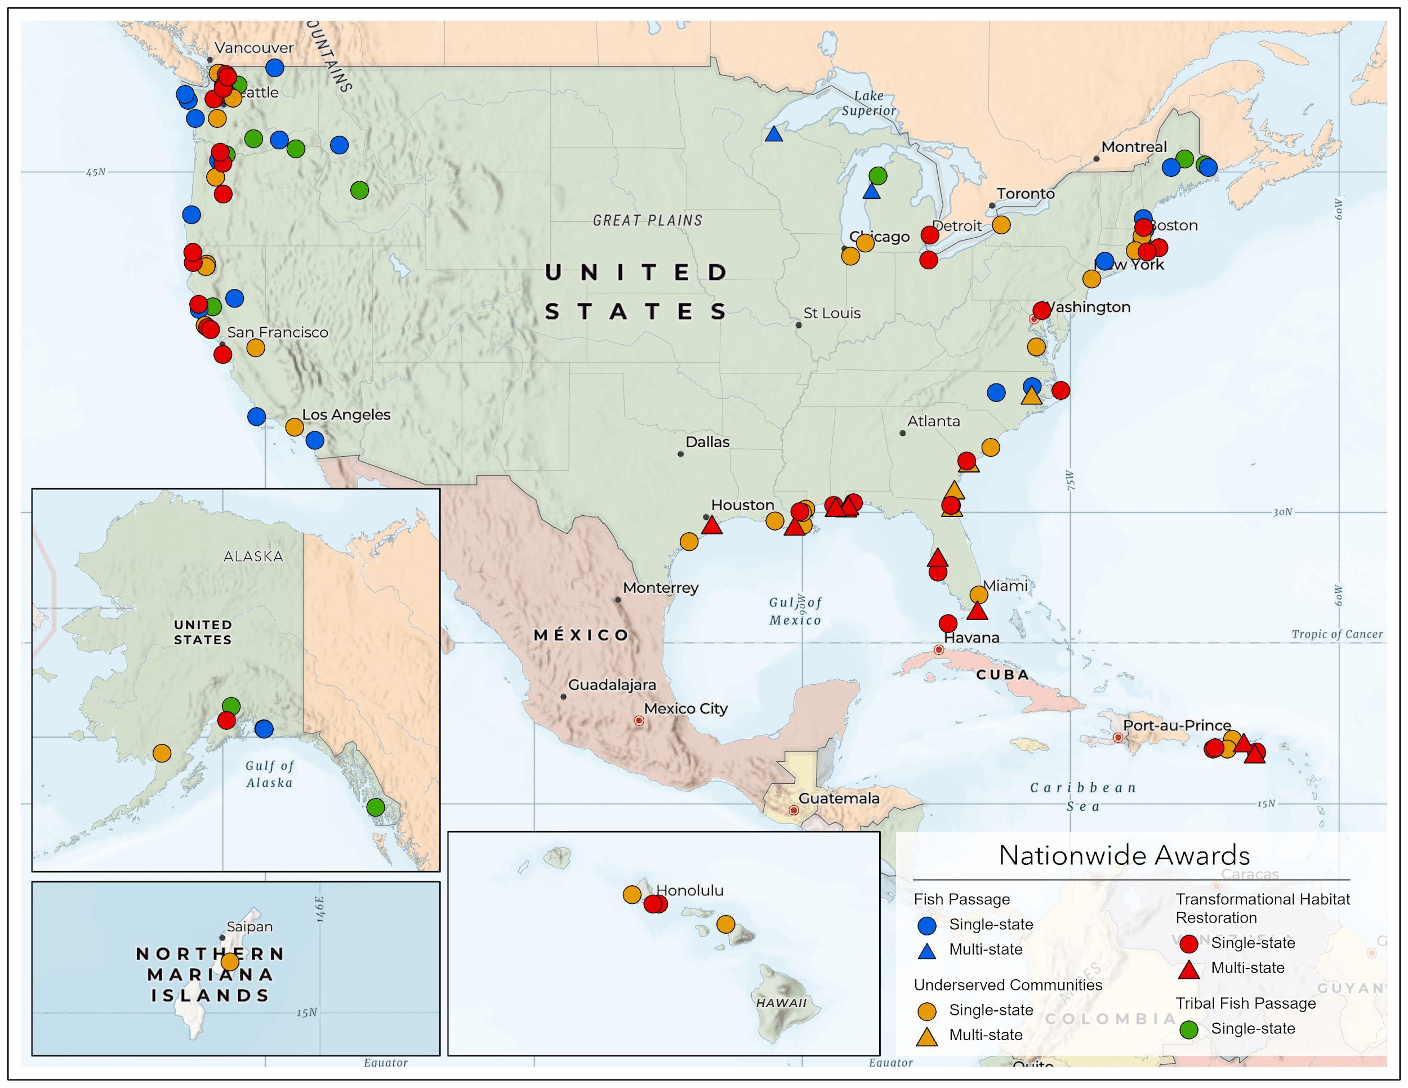
Our Projects!
109 Awards
$480M

Slide 7
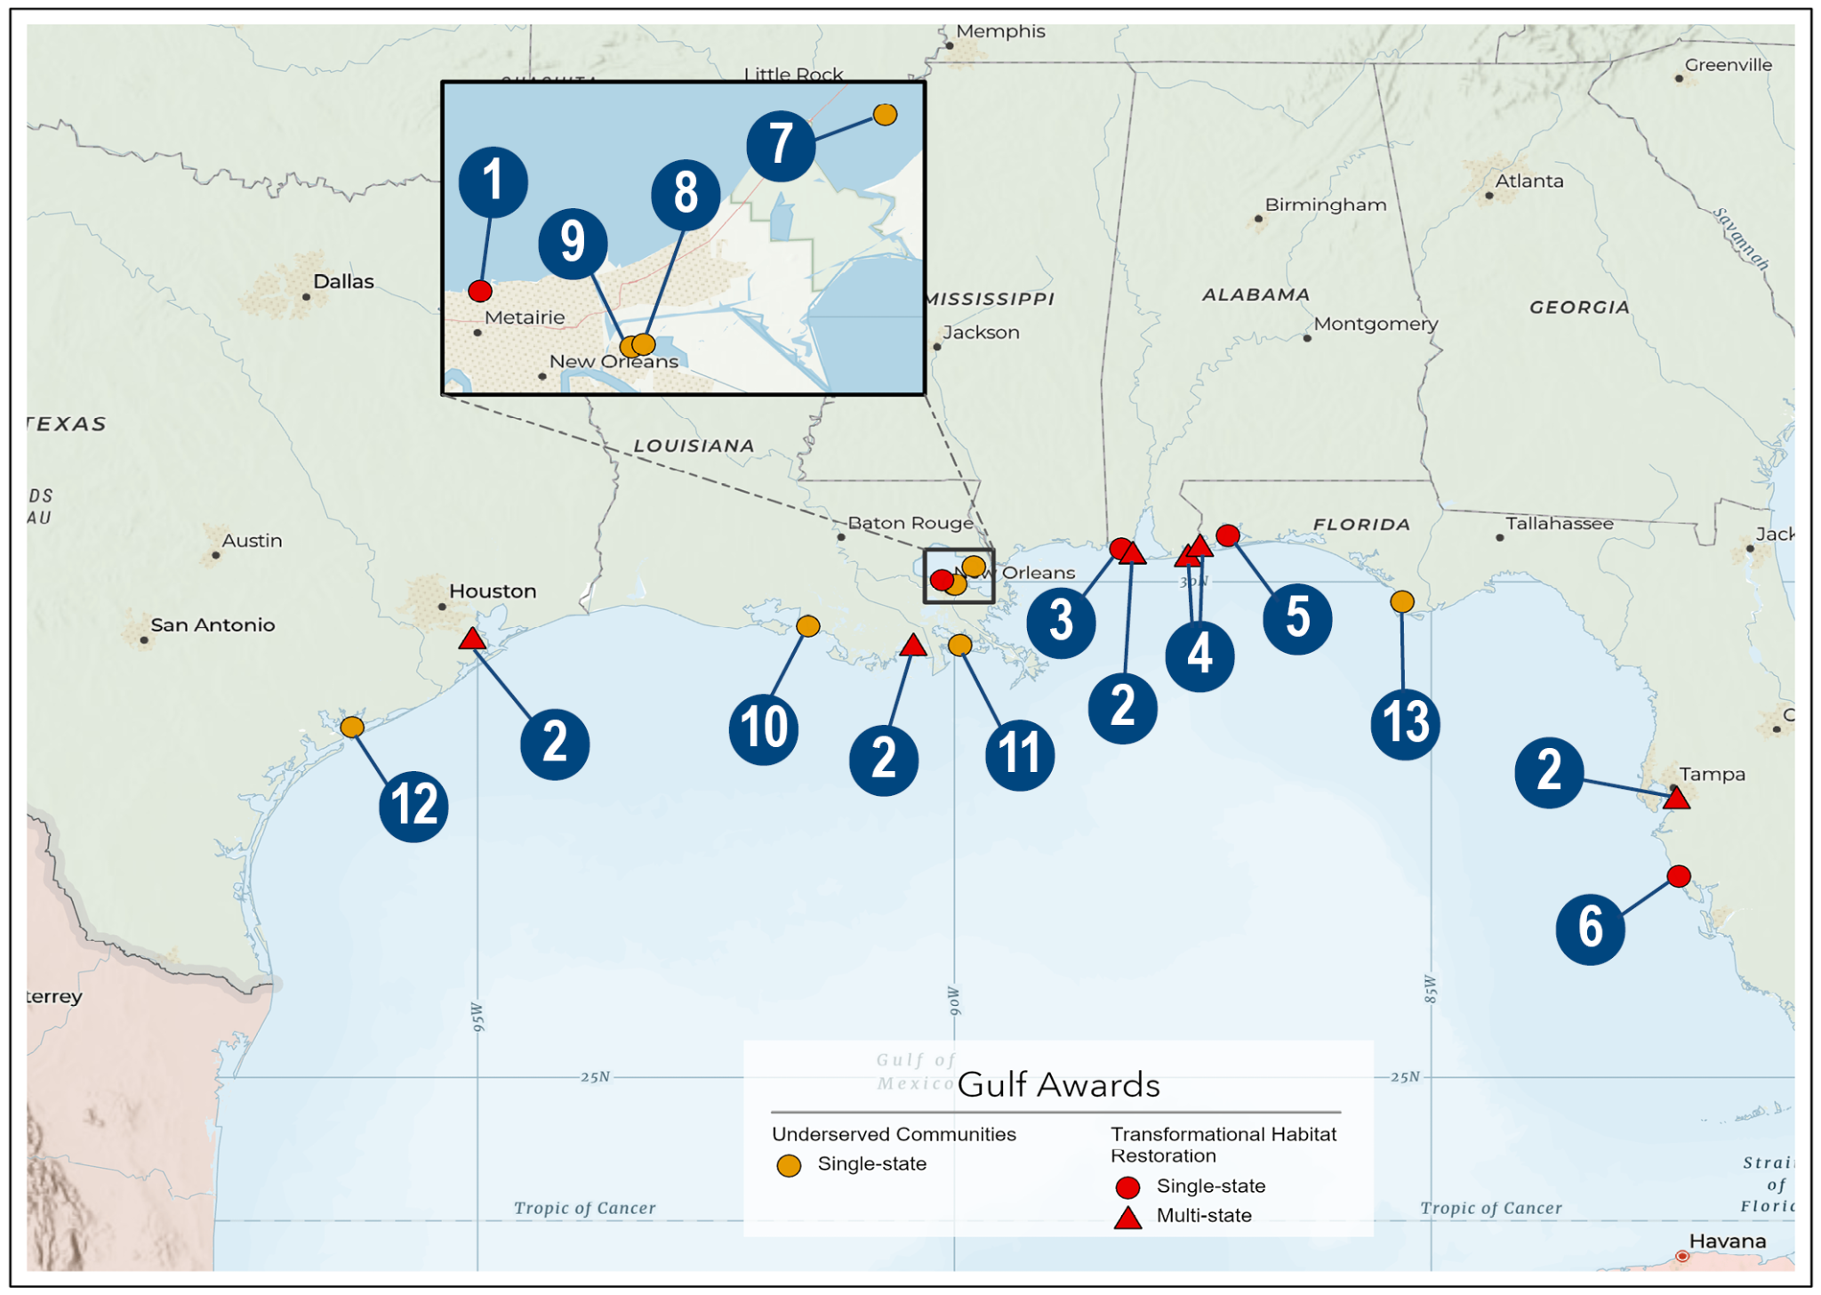
Gulf of Mexico Projects
Jefferson Parish
RAE
TNC
TNC
Escambia County
Sarasota County
Water Institute
CRCL
New Orleans
Wayti Services, LLC - Chitimacha Tribe
Terrebonne Parish
Matagorda Bay Foundation
Port St. Joe

Slide 8
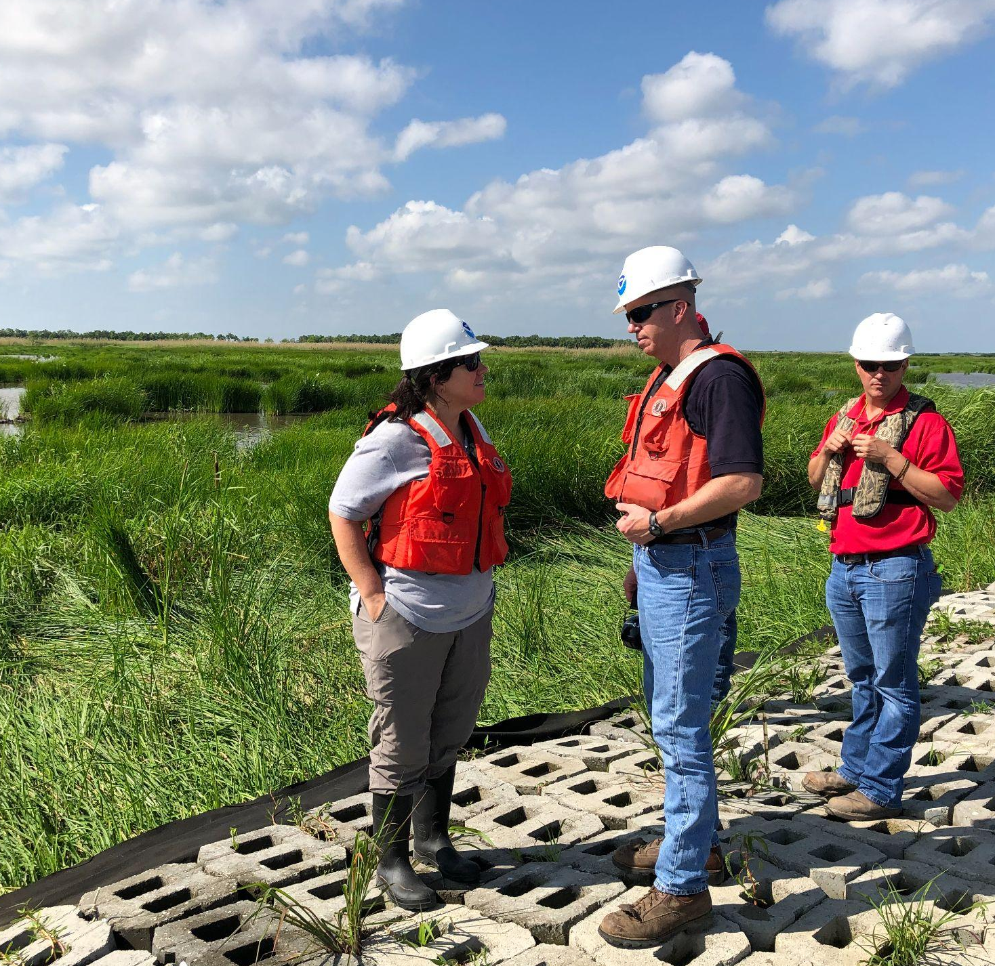
What’s Next? Let’s Get Ready for Round 2!
Continued Technical Assistance for our partners
Working together on selected projects
Working together on project ideas for our 4 competitions and other competitions
Gathering lessons learned as we embark on the next round
Staggered release and longer application times
More clarity around ‘meaningful engagement’ and ‘capacity building’

Slide 9
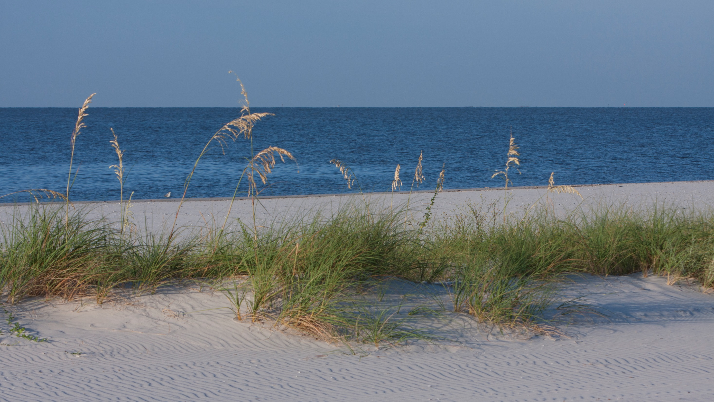
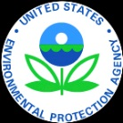
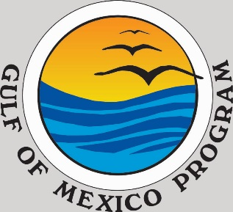
Gulf of Mexico Division
Marc Wyatt, Director
https://www.epa.gov/gulfofmexico

Slide 10
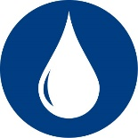
Program Goals
Improving and/or restoring water and habitat quality in watersheds throughout the five Gulf States and the Mississippi River Basin
Target is to restore 350 acres annually
Promoting and supporting environmental education and outreach
Target is to reach 10,000 individuals annually
Supporting development and implementation of coastal improvement programs, projects and tools to enhance community planning, risk assessment, green infrastructure, and smart growth implementation
Target is to reach 40 communities annually
Protecting, enhancing, and/or restoring coastal and upland habitats
Target is to improve 6 water quality health indicators annually

Slide 11
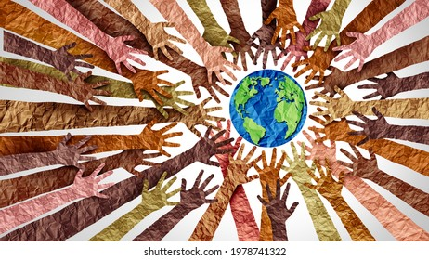
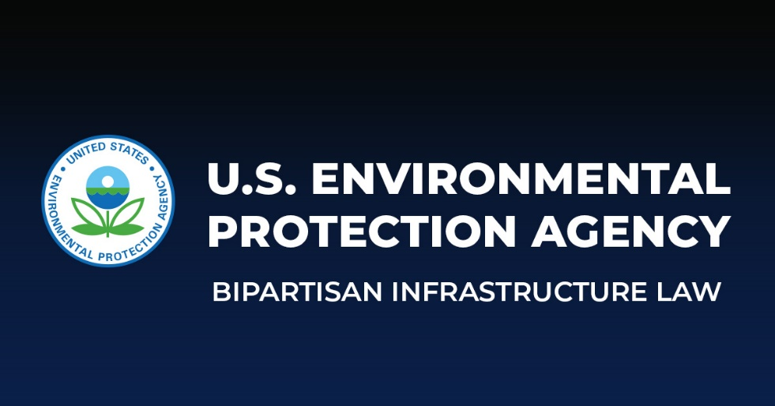
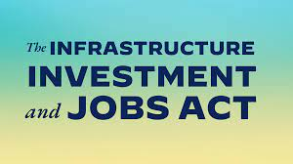
Upcoming Timelines or News
Environmental Justice Grants Program RFA
$12.5 million investment
May 8 – RFA closed for Gulf of Mexico Environmental Justice Grants Program
June/July 2023 – Anticipated Notification of Selection
September/October 2023 – Anticipated Award
Infrastructure Investment & Jobs Act (IIJA) RFA
$30 million investment
Anticipated RFA release date is Summer 2023

Slide 12
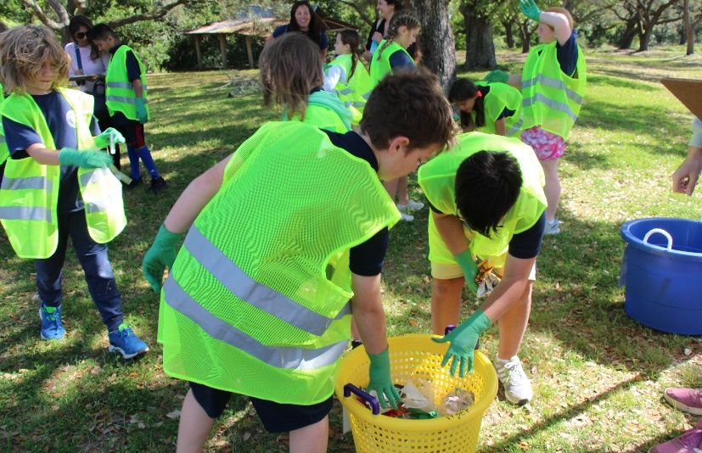
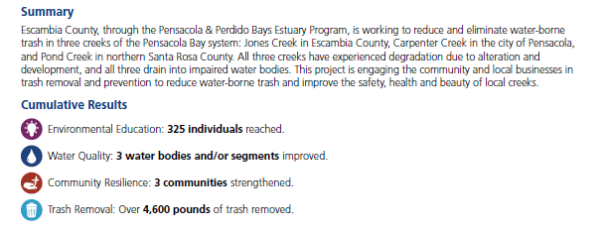
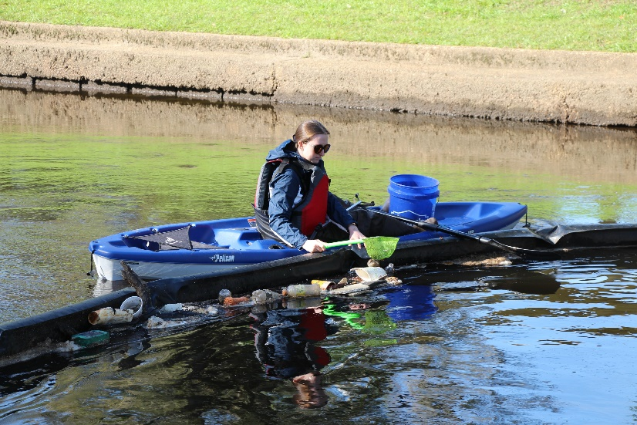

Slide 14
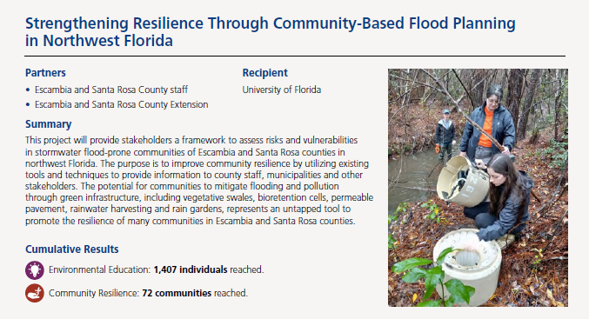

Slide 15
State of the Coast United States Department of Agriculture Gulf Coast Ecosystem Restoration Team Ronald Howard, Senior Advisor SOC2023

Slide 16
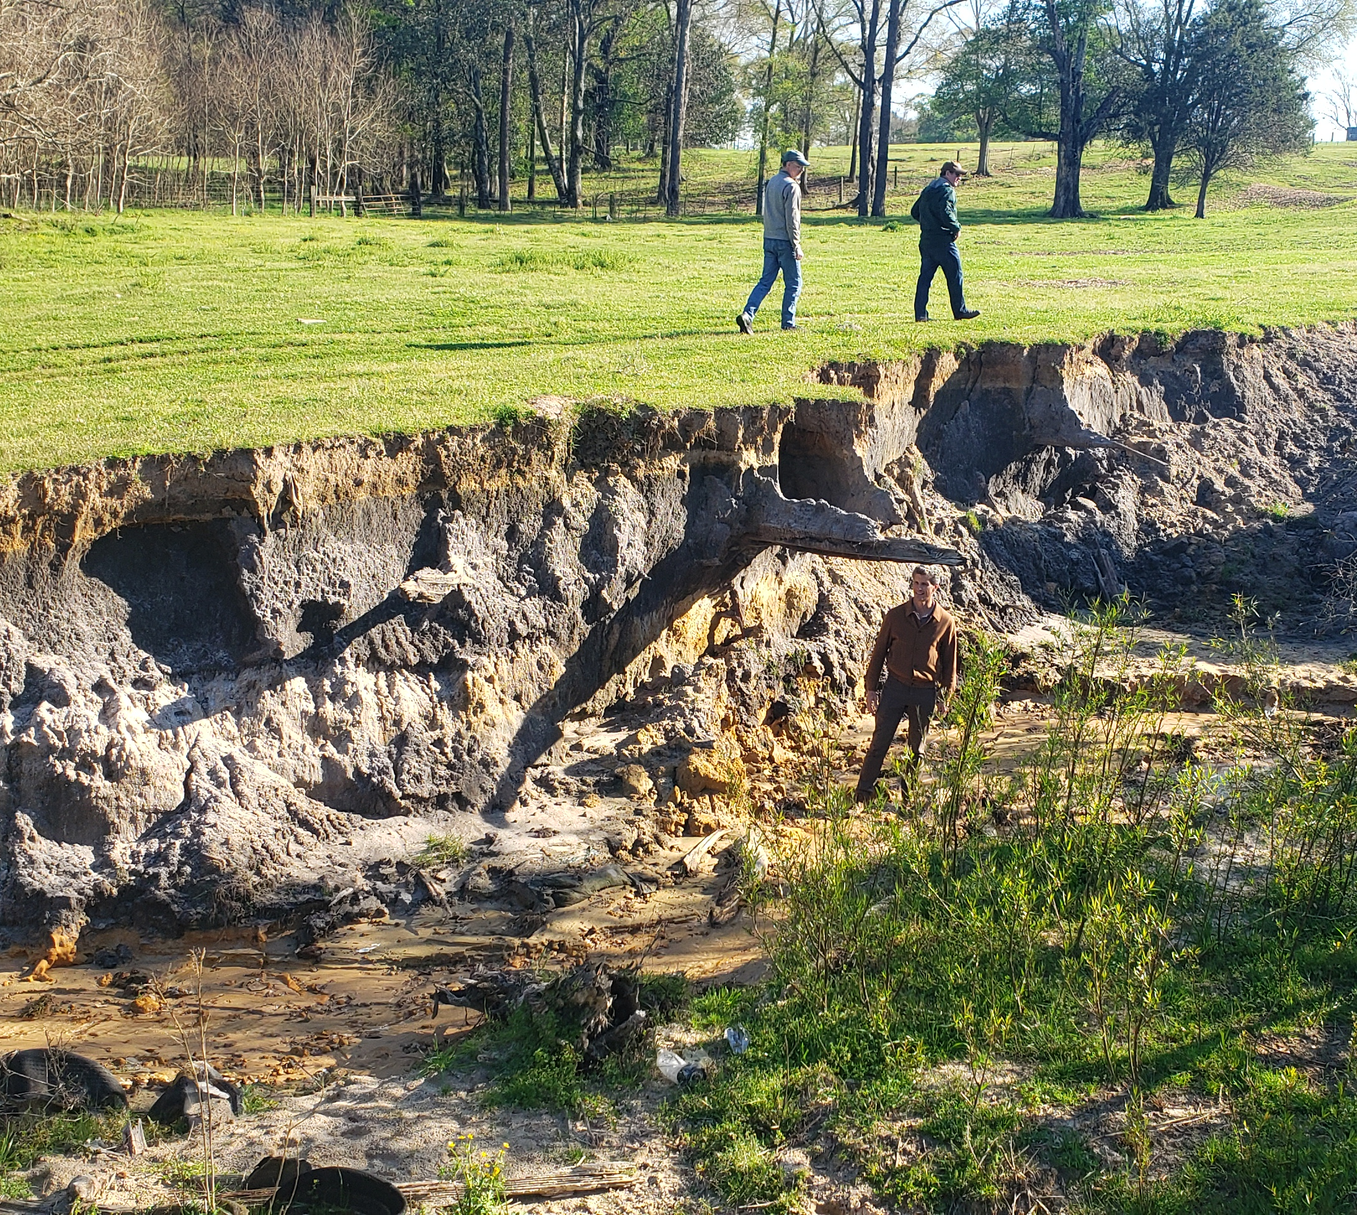
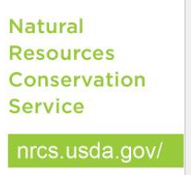
Gulf Coast Ecosystem Restoration Team

Slide 17
Why USDA….
Bipartisan Infrastructure Law (BIL)
Address watershed resource concerns
Bring potential high-hazard dams in compliance with current design safety and performance criteria
Fund fire recovery, flood assistance, and the purchase of floodplain easements in underserved communities.

Slide 18
Why USDA….
The Bipartisan Infrastructure Law provides $918 million for watershed programs
Watershed and Flood Prevention Operations Program
Watershed Rehabilitation
Emergency Watersheds Program

Slide 19
Why USDA….
NRCS has invested $803 million of Bipartisan Infrastructure Law funds into watershed programs
$589.5 million in 240 projects in 39 states for WFPO and REHAB
$213.7 million for 26 EWP projects.

Slide 20
Why USDA….
Inflation Reduction Act (IRA)
Will help producers stay on the farm
Help prevent producers from becoming ineligible for future assistance
Promote climate-smart agriculture by increasing access to conservation assistance

Slide 21
Why USDA….
Approximately $20 billion of Inflation Reduction Act funds will support USDA’s conservation programs
$8.45 billion for the Environmental Quality Incentives Program
$4.95 billion for the Regional Conservation Partnership Program
$3.25 billion for the Conservation Stewardship Program
$1.4 billion for the Agricultural Conservation Easement Program
$1 billion for the Conservation Technical Assistance Program

Slide 22
City of New Orleans Bayou Bienvenue Wetlands Restoration State of the Coast 2023

Slide 23
City IIJA Task Force
Multi-departmental team analyzing infrastructure needs from City departments and related agencies within New Orleans and the region
Chair: Office of Resilience & Sustainability
Chief Administrative Office
Office of Community Assets & Investment
Health Department
Homeland Security & Emergency Preparedness
Intergovernmental Relations
Project Delivery Unit

Slide 24
City IIJA Task Force
Tasks
Linking the 400+ projects that have been identified by Departments/Agencies to opportunities within IIJA
Thoroughly analyzing IIJA programs to identify other potential opportunities to address local needs
Expanding coordination and engagement with regional partners to identify projects that would benefit the region and/or state
Prioritizing projects based on the shared goals of the City and Federal Government
Equity, Resilience, Economic Development, and Sustainability
Engaging with the community, stakeholders, and partners to ensure we are ready to respond as funding becomes available

Slide 25
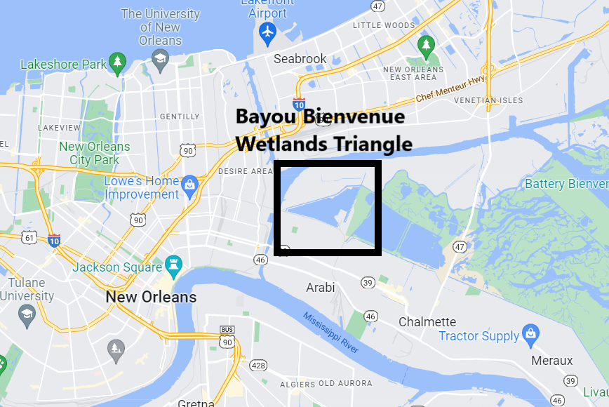
Bayou Bienvenue Wetlands Triangle
Just a 10 minute drive from the French Quarter…
400 acre ghost swamp located in Lower 9th Ward of New Orleans
Historically, habitat was a combination of fresh marsh, bottomland hardwood forest, and bald cypress and water tupelo swamp
Suffering from impacts from leveeing of Miss River, swamp logging, hurricane damage, and construction of MRGO
Today it is largely open-water and brackish marsh
Part of the Coastal Master Plan

Slide 26
Redevelopment Plan
Public outreach to stakeholders and Lower 9th Ward residents for feedback on a restoration plan options
Development of a feasible restoration plan
Design and engineering
Implementation

Slide 27
Funding Programs for Restoration
NCRF
National Coastal Resilience Fund – NFWF
To restore and strengthen natural coastal infrastructure that provide a first line of defense for coastal communities and ecosystems from increasing impacts due to rising sea levels and more intense storms.
2022 Award - $888,793 for Planning and Design

Slide 28
Funding Programs for Restoration
NOAA Underserved Communities
Coastal Habitat Restoration and Resilience Grants for Underserved Communities – NOAA
To engage underserved communities in habitat restoration activities that promote resilient ecosystems and communities and provide capacity for these communities to more fully participate in developing future transformational habitat projects.
2022 Award - $489,813 for Planning and Design

Slide 29
Funding Programs for Restoration
GOMESA
Gulf of Mexico Energy Security Act (GOMESA)
derived from oil and gas leasing revenues on the Outer Continental Shelf and disbursed to four Gulf producing states (Alabama, Louisiana, Mississippi, Texas), their coastal political subdivisions (CPS), among others
Direct annual funding to Orleans Parish and other coastal parishes
$500,000 for Bayou Bienvenue

Slide 30
Restoration Funding
Roughly $1.87 M in total funding now available to project
$150,000 for outreach and engagement
$200,000 for planning and feasibility
$1.3 M for engineering and design
$200,000 for permitting and lagniappe

Slide 31
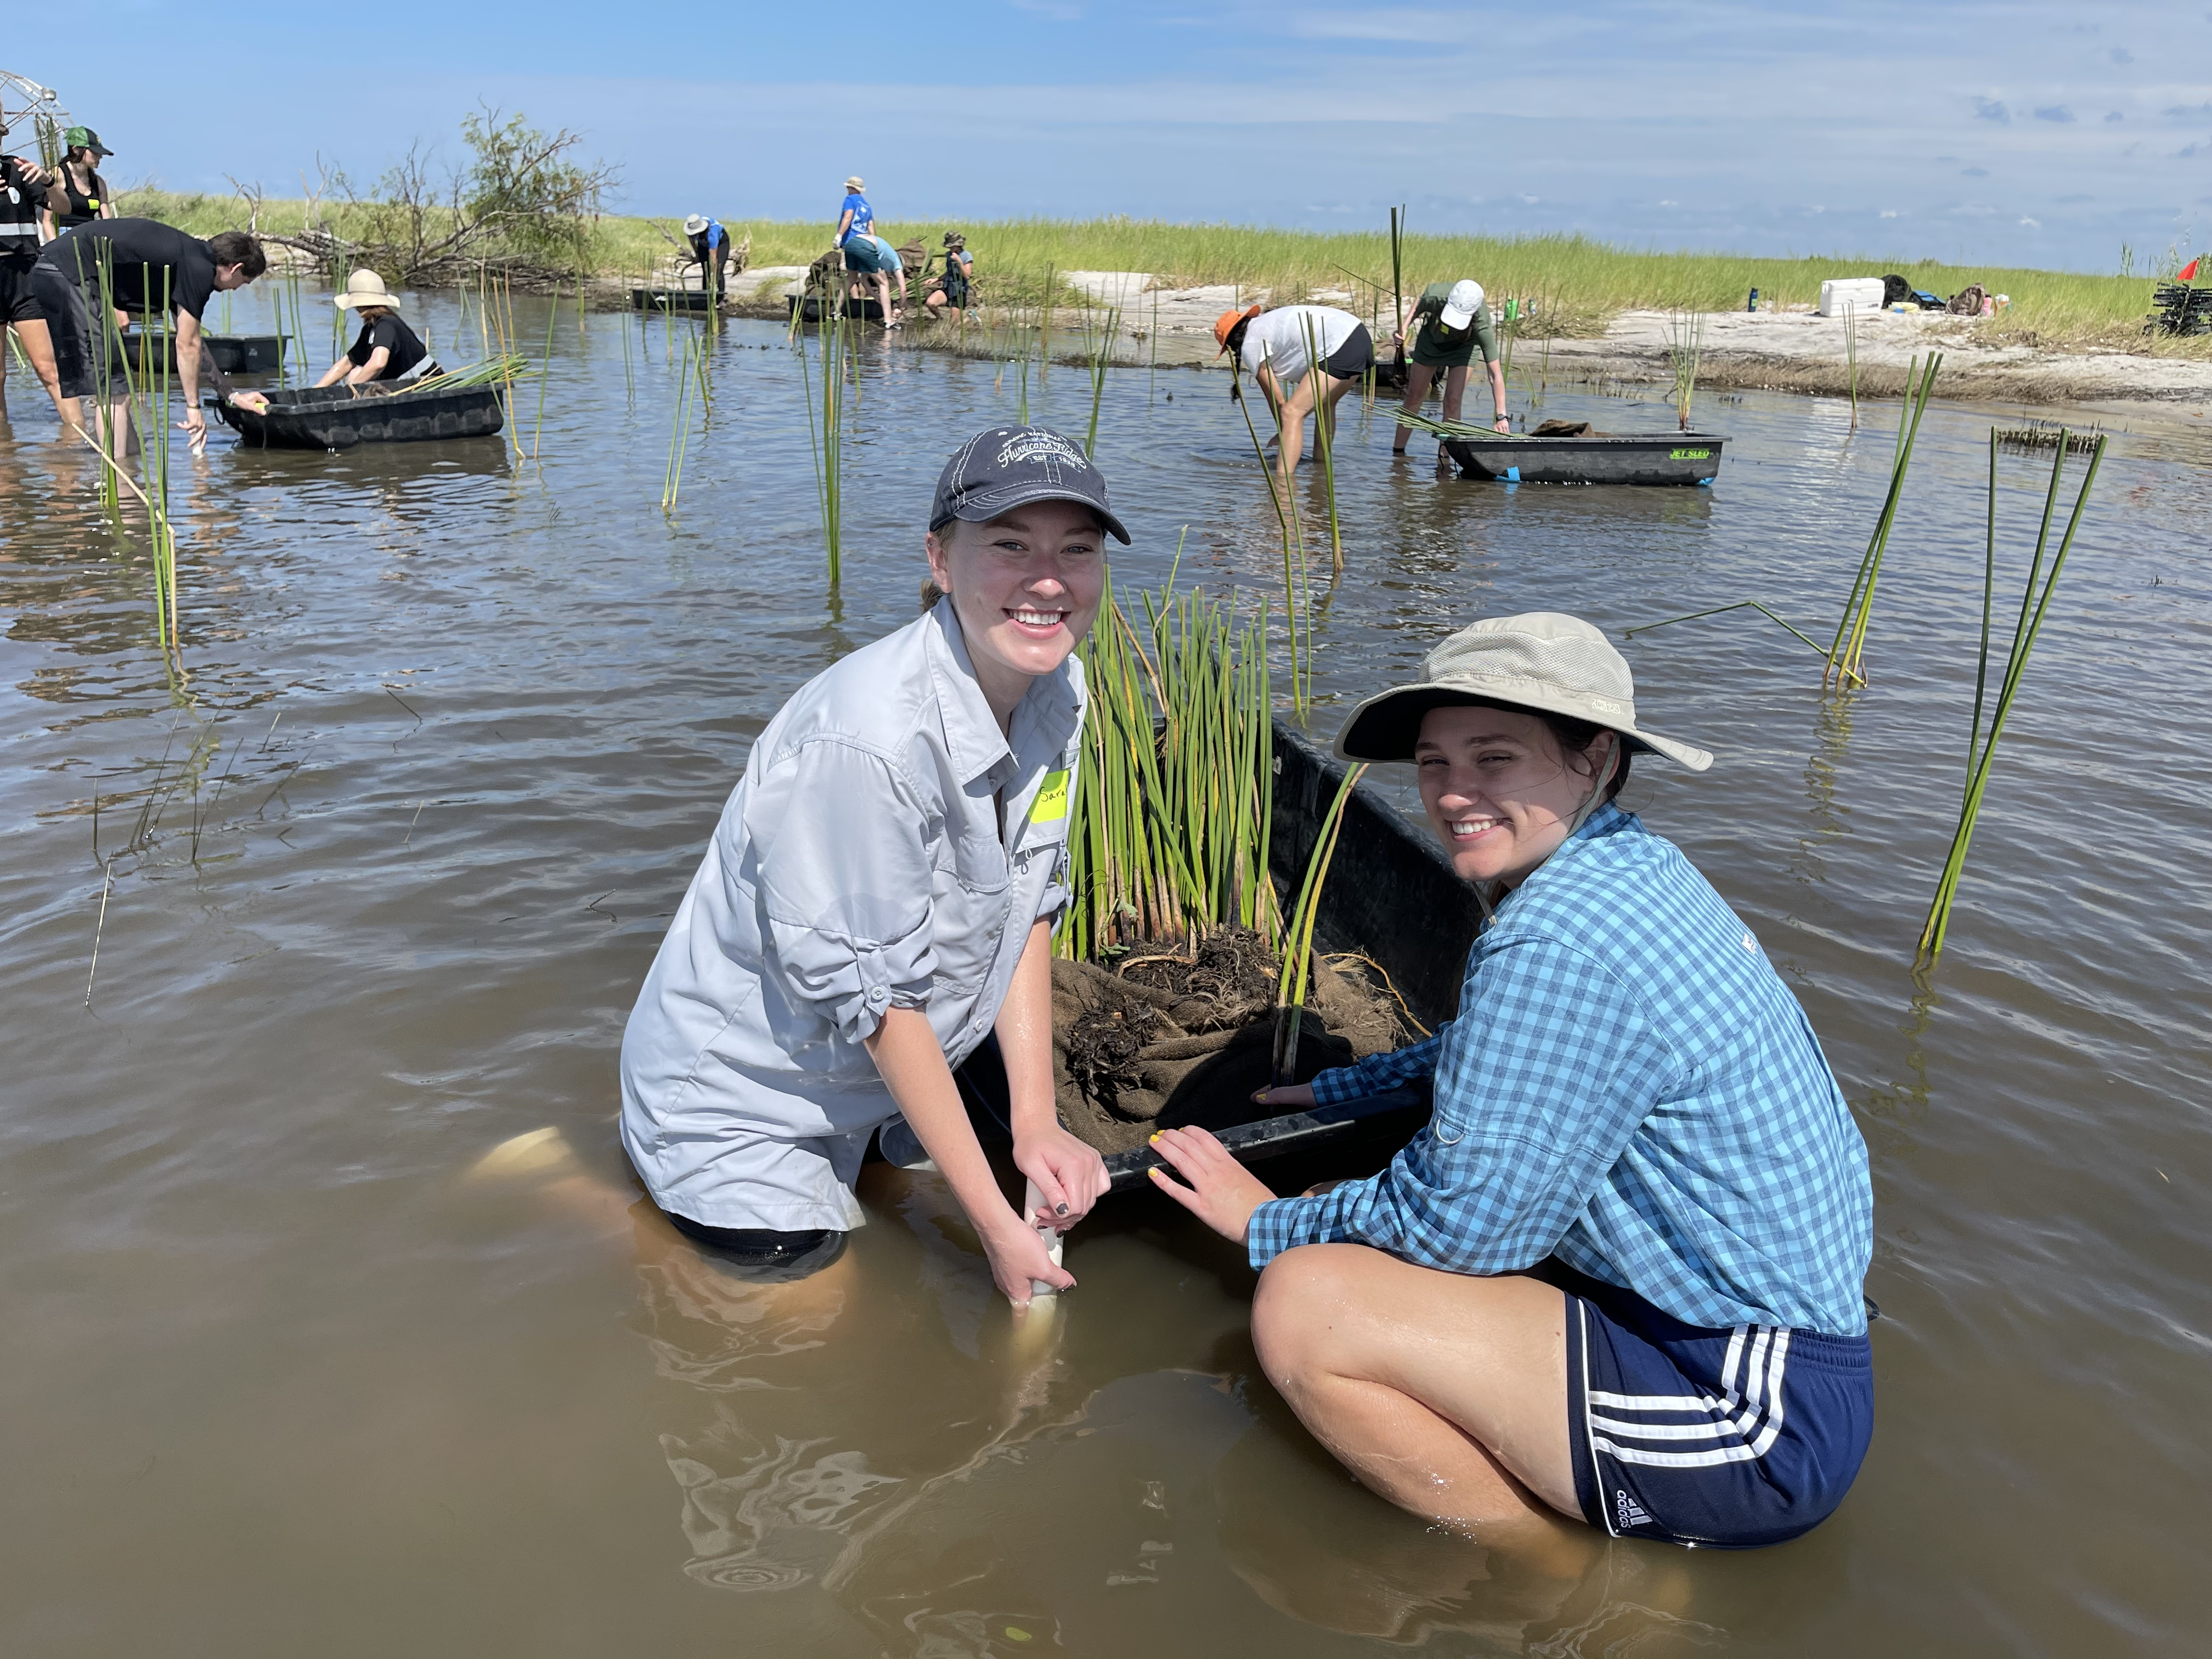
Accessing Federal Funds for Resilient Coasts and Communities
Michael Biros Restoration Programs Director
May 31, 2023

Slide 32
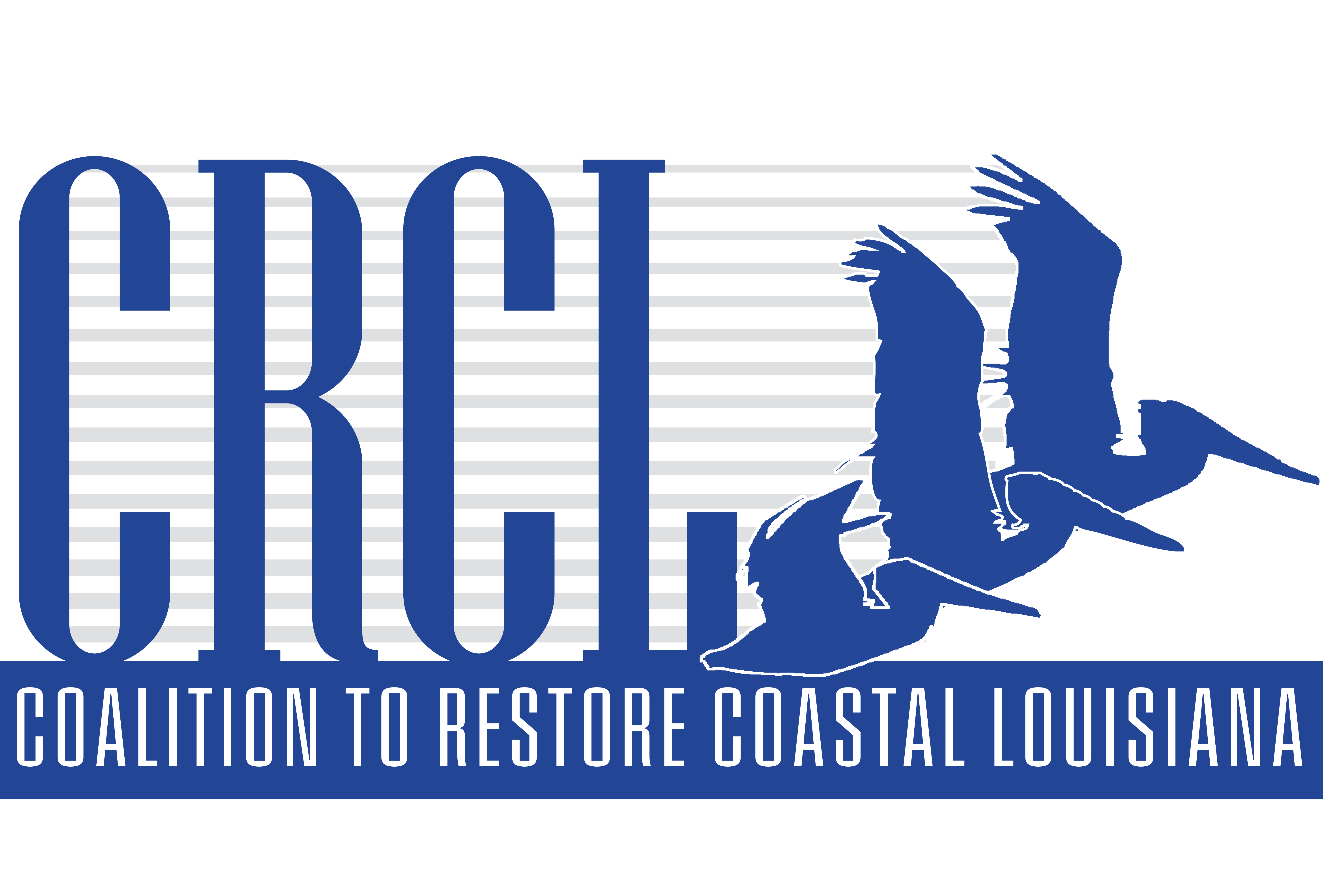
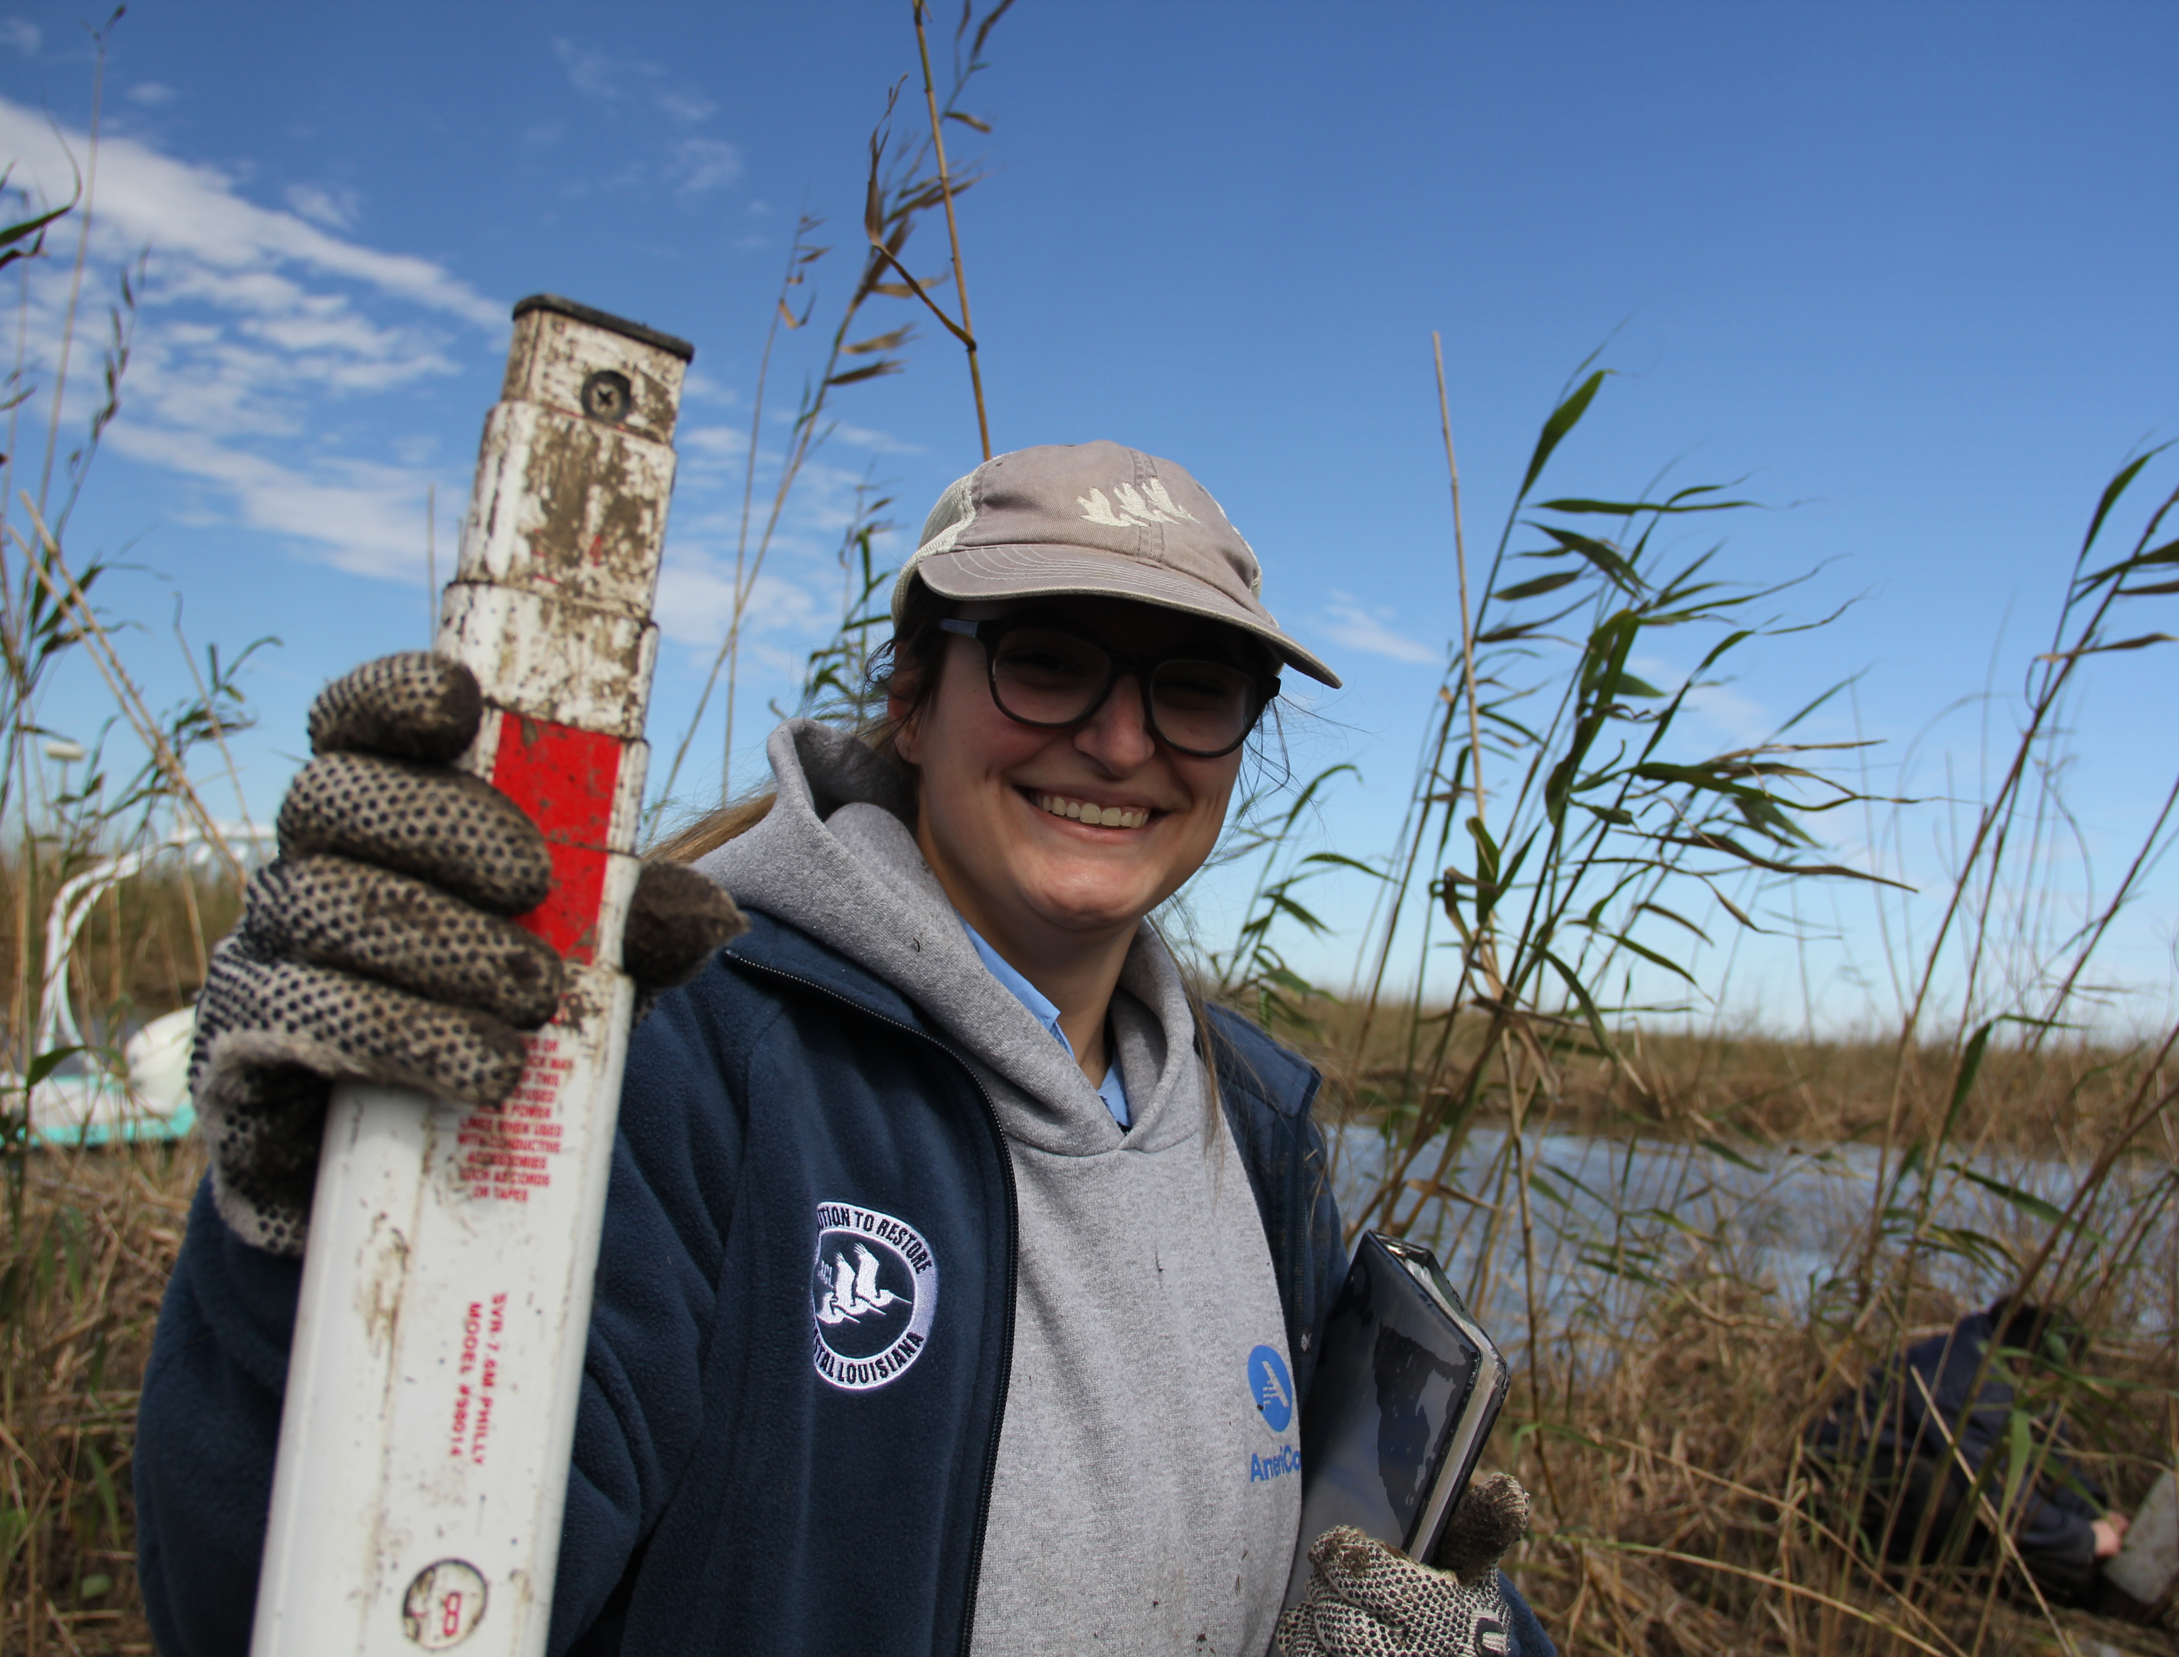
CRCL is Louisiana’s first statewide non-profit organization dedicated to addressing land loss and coastal restoration.
Mission: Unite people in action to achieve a thriving, sustainable Louisiana coast for all.

Slide 33
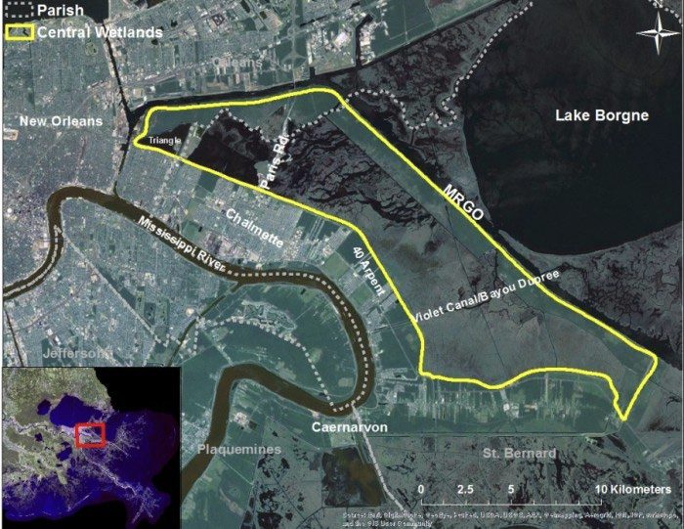
NOAA Coastal Habitat Restoration and Resilience Grants for Underserved Communities
Restoring Resilience Through Central Wetlands Reforestation Collective (CRWC)
CPRA Conservation and Restoration Partnership Fund
Underserved Communities
Lower 9th Ward
St Bernard Parish
Background
Historical environmental racism and injustices
MRGO – funneled salt water and storm surge
Loss of 30,000 acres of swamp and marsh ecosystems
Objectives
Reestablish cypress-tupelo bottomland hardwood forest
Build capacity of next generation to engage in coastal restoration advocacy for their communities
Healthy cypress tree planted by CRCL volunteers

Slide 34
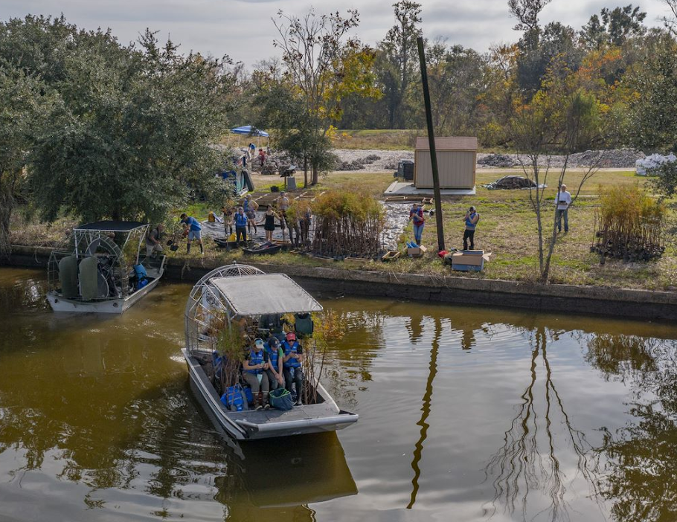
NOAA Coastal Habitat Restoration and Resilience Grants for Underserved Communities
Restoring Resilience Through Central Wetlands Reforestation Collective (CRWC)
CPRA Conservation and Restoration Partnership Fund
$1,407,000 (NOAA: $715,000 + CPRA: $405,000 + $287,000 match)
Partners
CRCL
Center for Sustainable Engagement & Development (CSED) of Lower 9th Ward
Common Ground Relief
Pontchartrain Conservancy
Meraux Foundation
Louisiana Department of Agriculture and Forestry
Healthy cypress tree planted by CRCL volunteers

Slide 35
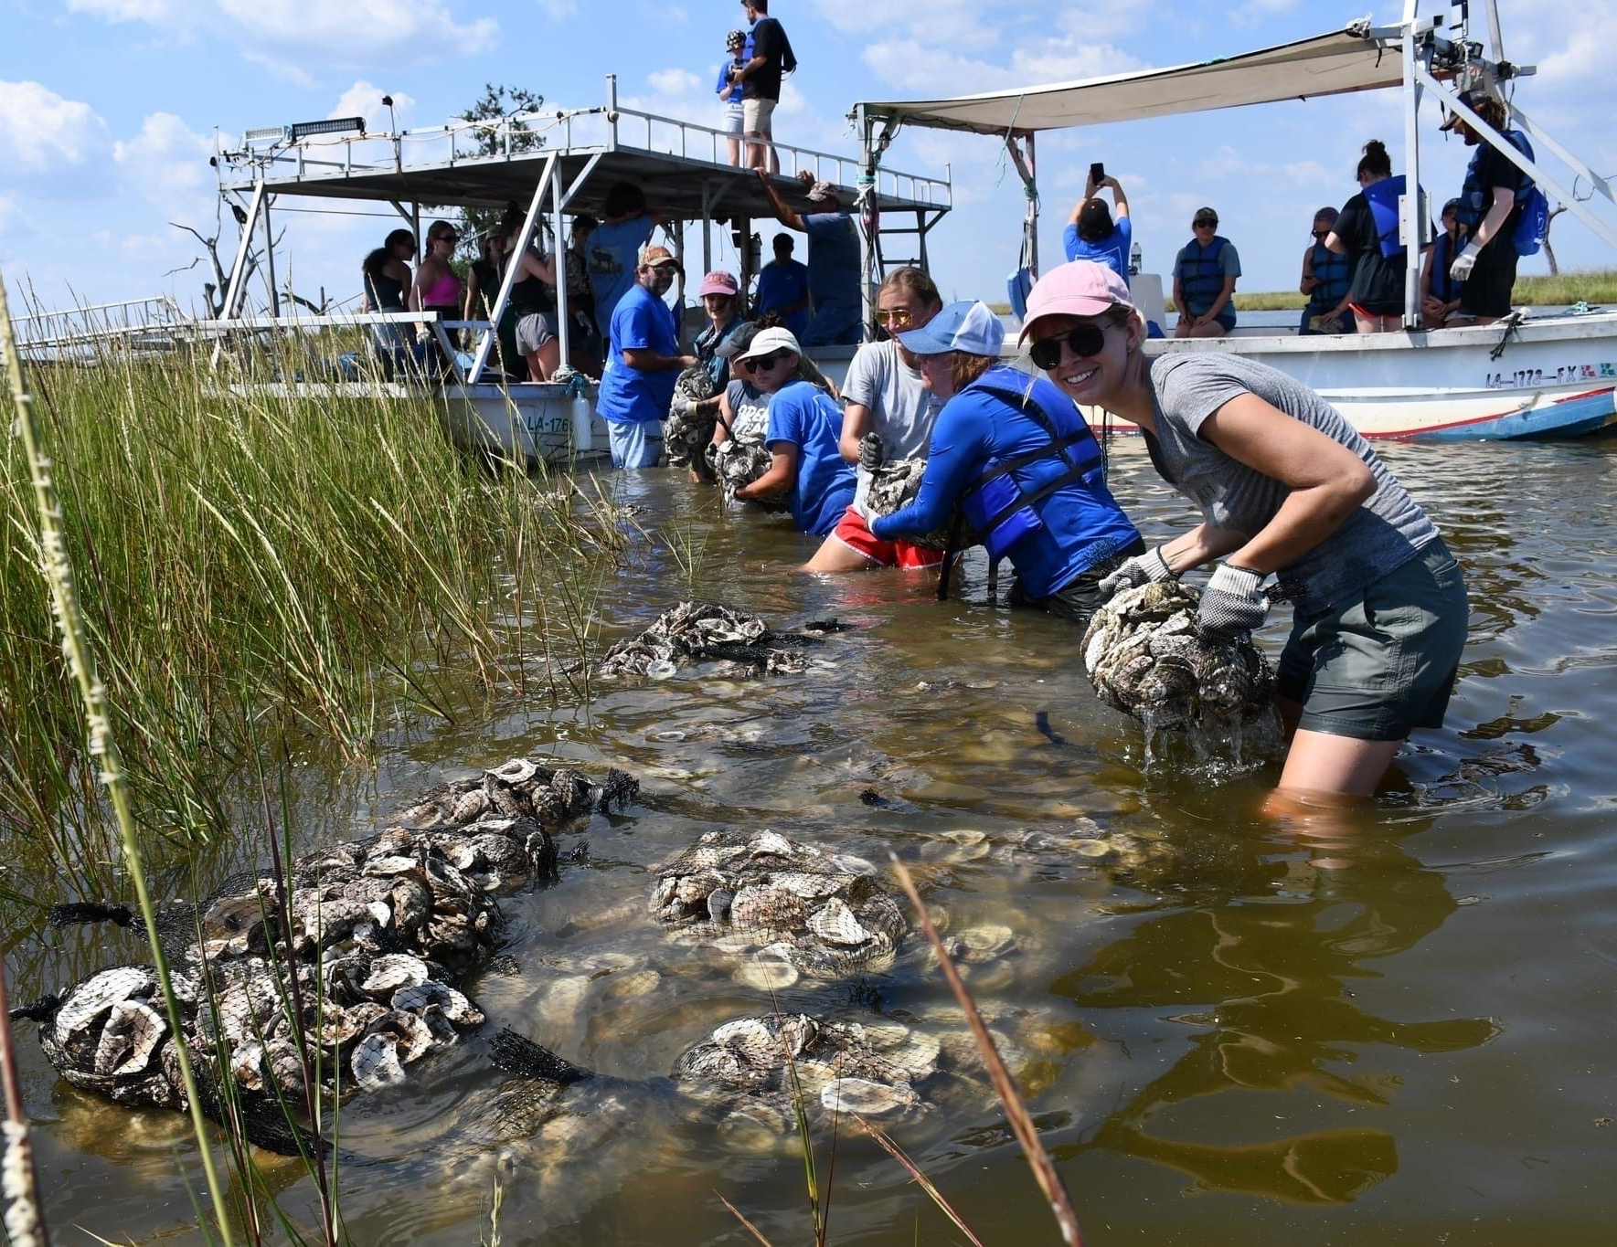
NOAA Transformational Habitat Restoration and Coastal Resilience Grants
Gulf of Mexico Community-based Oyster Recycling and Reef Restoration Network
Expansion of Oyster Shell Recycling Program
Increase volume of oyster shell collected
Partnerships with local communities and tribes to design restoration projects
Engage thousands of residents in boots-on-the-ground restoration
Construct one living shoreline per year to protect sacred sites
Plan for future state-wide oyster shell recycling
$4,900,000 (Across 5 organizations; $1,200,000 to CRCL)
Healthy cypress tree planted by CRCL volunteers

Slide 36
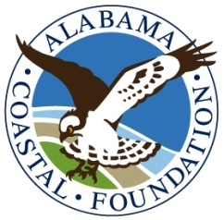
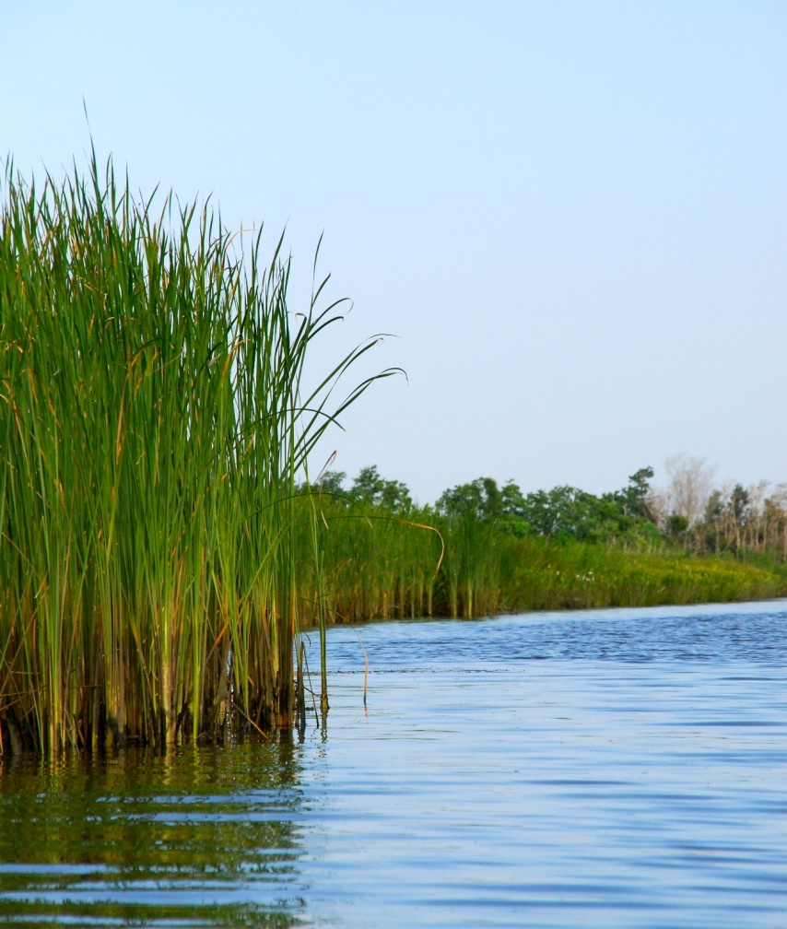
Alabama Coastal Foundation
Mission:
To improve and protect
Alabama’s coastal environment
through cooperation, education,
and participation.

Slide 37
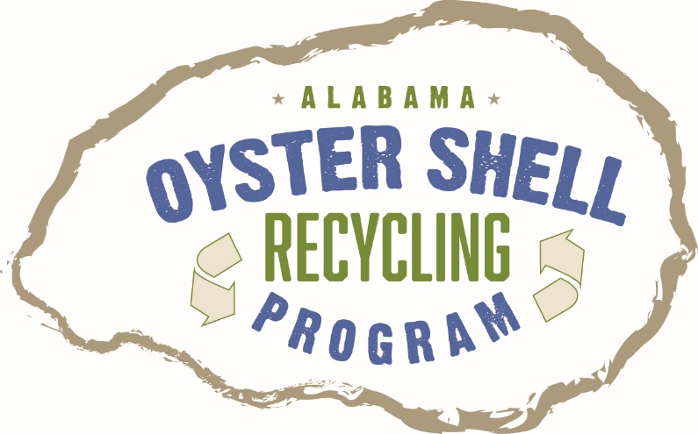
Oyster Shell Recycling Grant
2015: Outreach event.
2016: Grant from the National Fish and Wildlife Foundation’s Gulf Coast Conservation Grants Program.
Two main objectives:
Educate restaurants and the public about the importance of recycling shells.
Create a self-sustaining program.

Slide 38
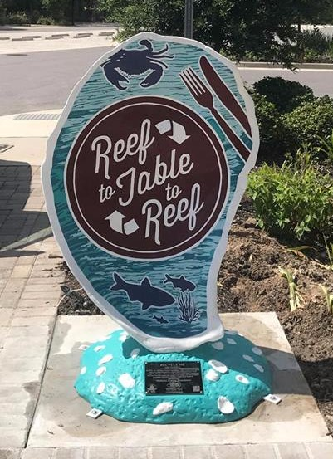
AOSR Program Education
"Recycle Me” Oyster Shell Statue
Festivals/Outreach events
Coastal IQ Program
Social Media
Restaurants: Customers and staff

Slide 39
Oyster Shell Recycling Grant
As of this month, the Alabama Oyster Shell Recycling Program has collected:
> 20.7 Million Shells =
326 Dump Trucks =
Weight of 433 elephants =
5,190 manatees =
3,925 Cubic Yards!
NEXT OBJECTIVES:
Expansion and Deployment

Slide 40
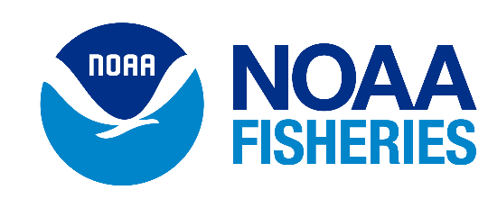
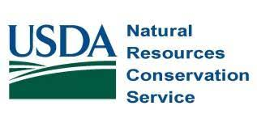
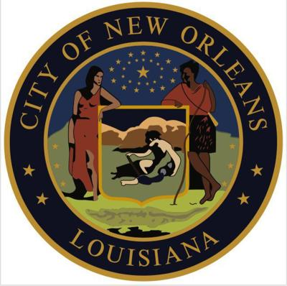
Thank You

