Slide 1
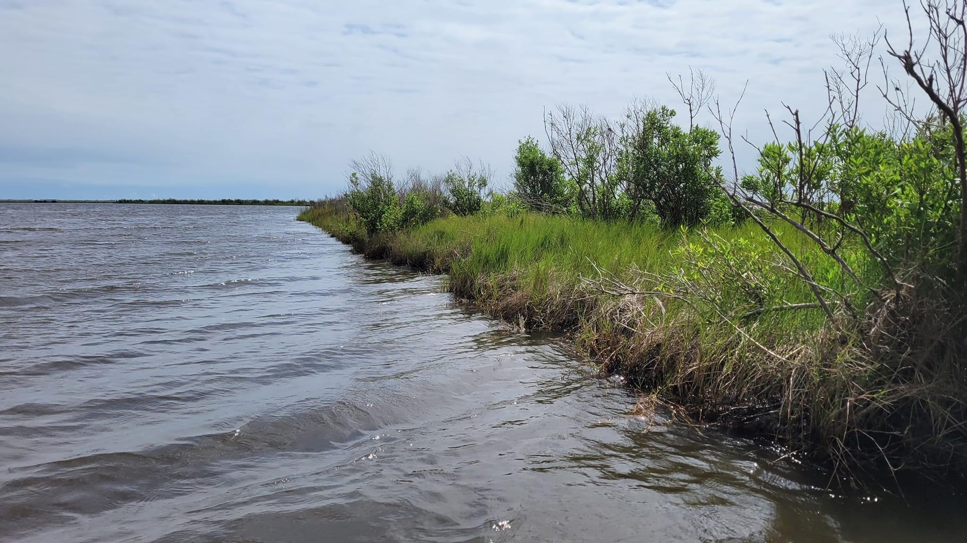


Comparison of Finfish and Crustaceans Among Established Marsh Terraces, New Marsh Terraces and Open Water in a Restored Brackish Marsh
Shasta Kamara, Allyse Ferrara, Gary LaFleur, Jonathan Willis, Quenton Fontenot
Department of Biological Sciences
Nicholls State University

Slide 2



Acknowledgments

Slide 3
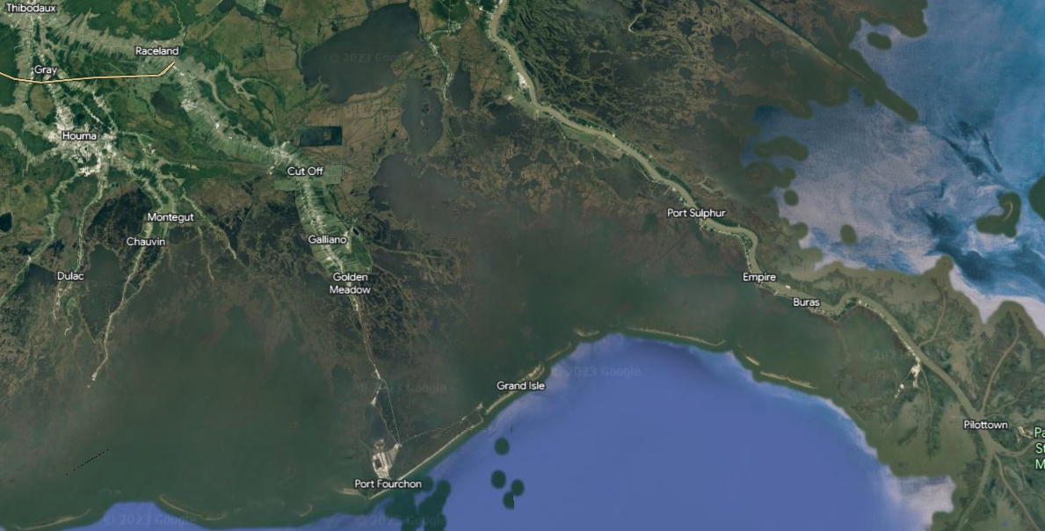
Obvious Coastal Land Loss

Slide 4
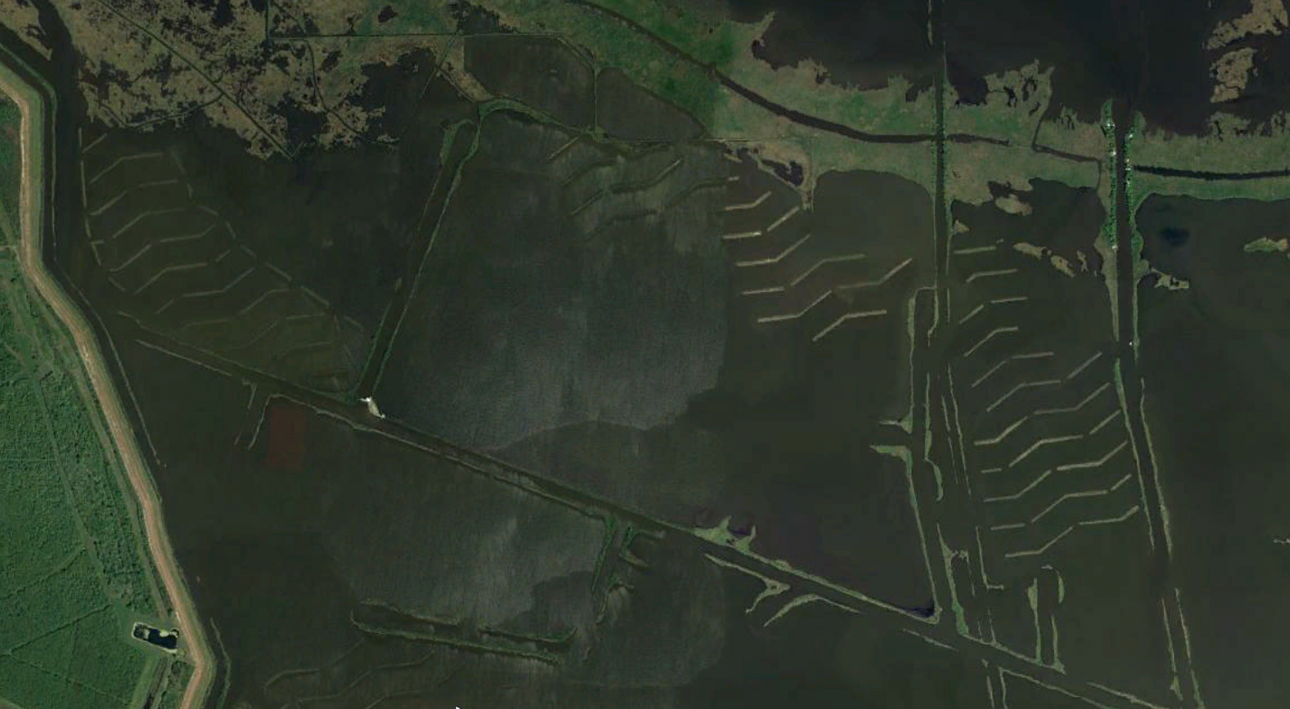
Marsh Terraces
Relatively inexpensive
Provide physical protection to existing marsh and ridge habitat
Provide edge habitat that can change over time
Underwood et al. 1991; LDNR 1993; Brasher 2015; Osorio et al. 2020; Photo Credit: Google Earth

Slide 5
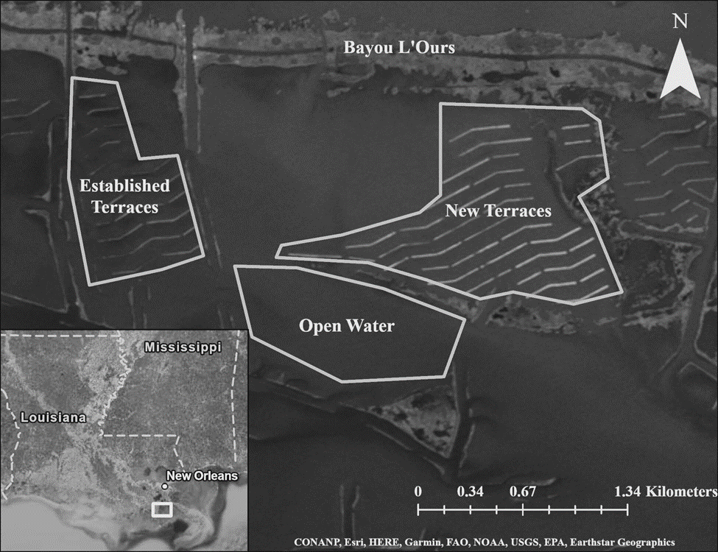
Brackish marsh
Tidal influence
3 Habitats
2017
2022

Slide 6
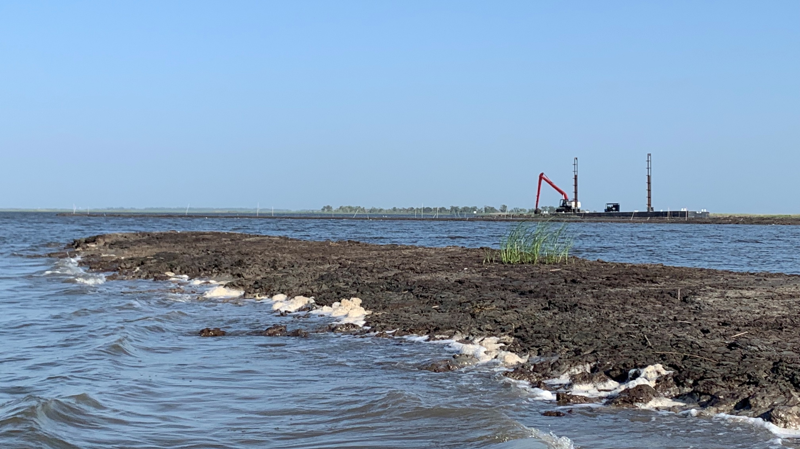
Hypothesis
Finfish and crustacean assemblages are different between terraces of different ages and terrace assemblages are different compared to an open water assemblage.

Slide 7
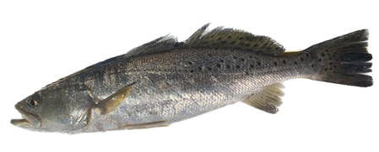
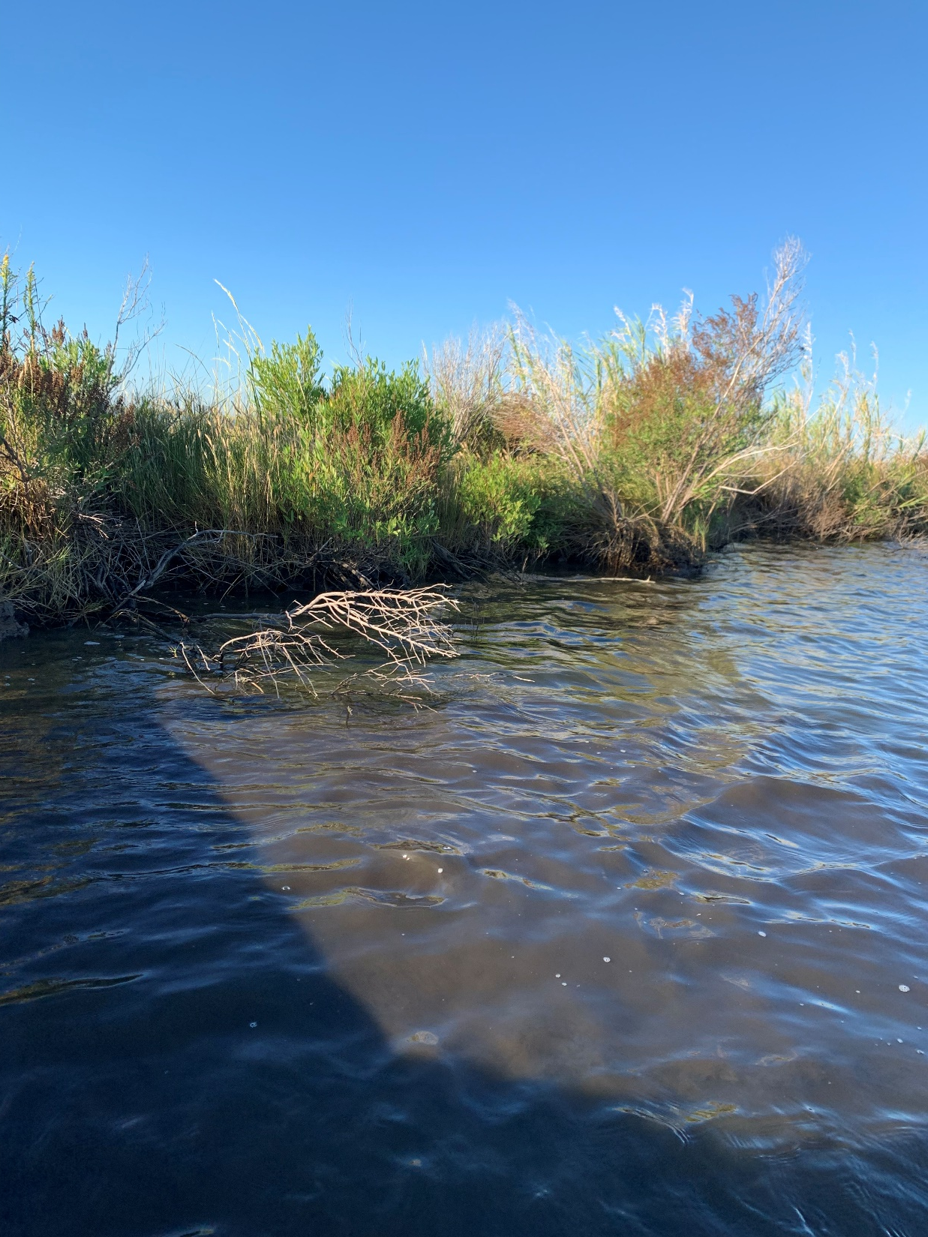
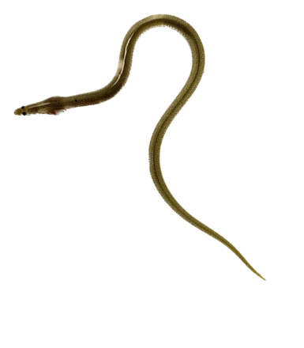
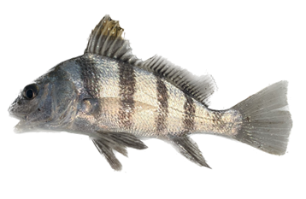
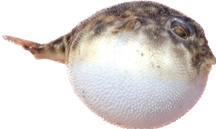
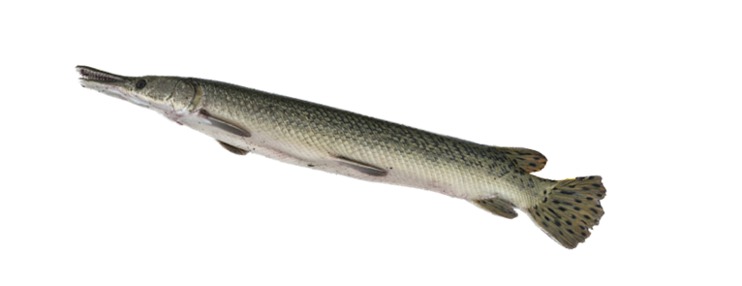
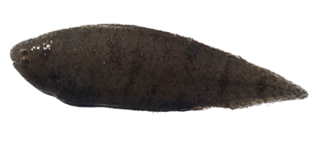
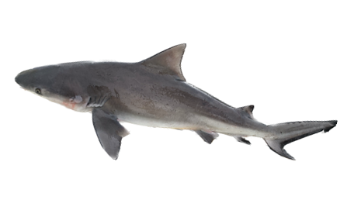
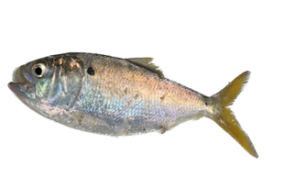
Objectives
Compare finfish and crustacean assemblages among habitat types
Compare finfish and crustacean catch among gear types

Slide 8
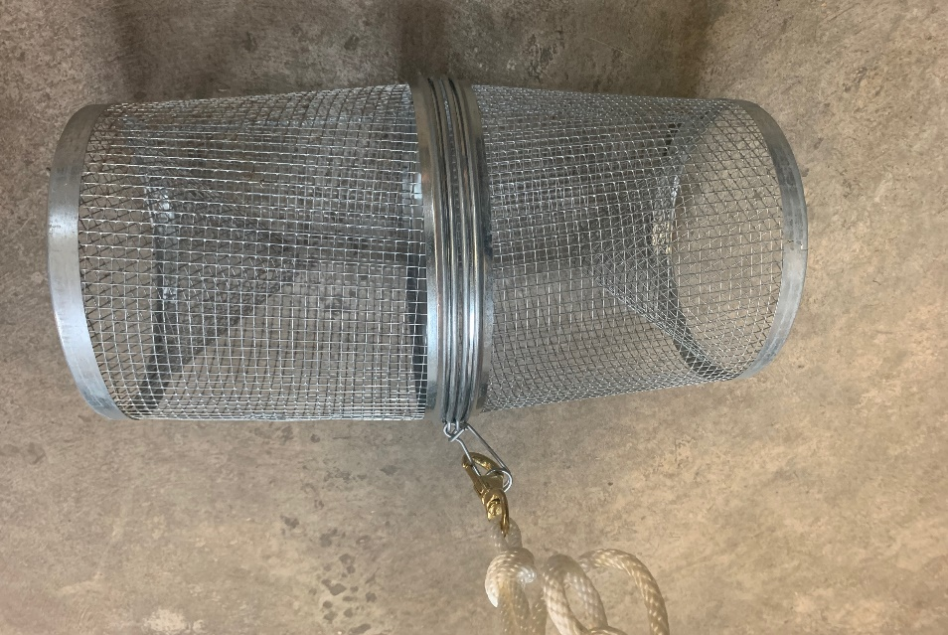
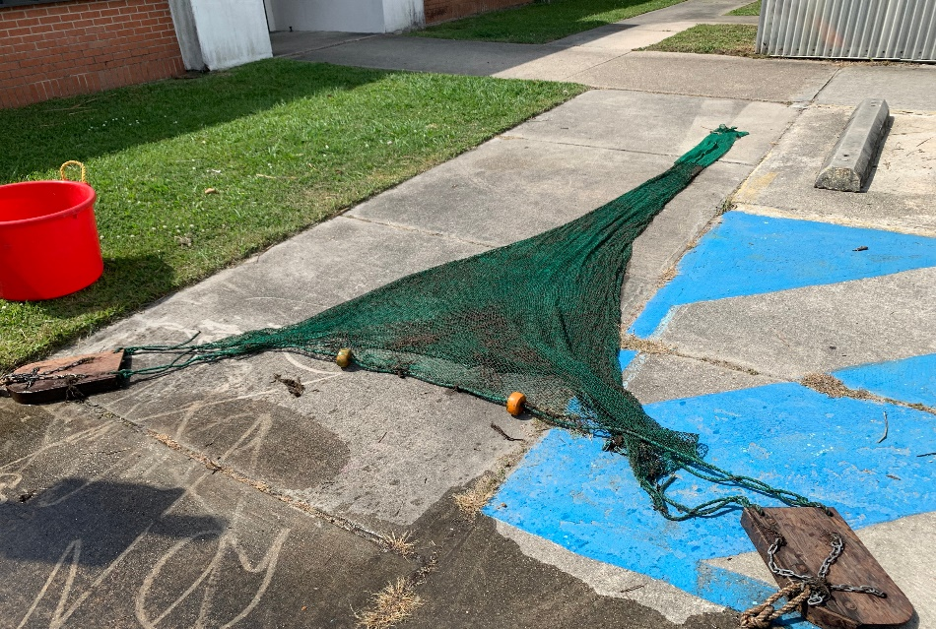
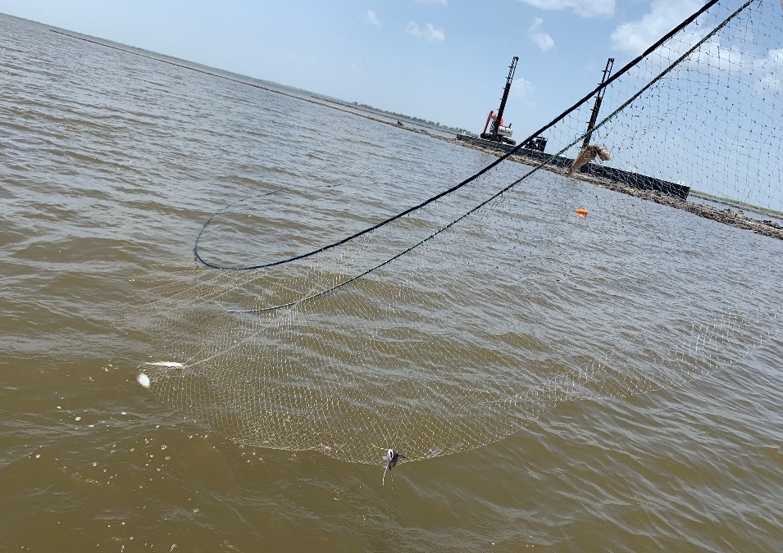
Three types of gear to sampled approximately twice a month May – October 2022 (n = 12)
Minnow Trap:
Target edge organisms
Deployed ~ 4 hours
Commercial dog food for bait
6 traps per date per habitat
CPUE = #/individuals/hour
Experimental Gill Net:
Target free swimming organisms in terrace channel and open water
3.8 & 7.6 cm mesh
Combined mesh size because = effort
3 nets per date per habitat
CPUE = #/individuals/hour
Trawl Net:
Target benthic organisms in terrace channel and open water
2m width; 1 cm mesh; 0.3 cm cod end mesh
3 5-min tows per date per habitat
CPUE = #/individuals/minute

Slide 9
Minnow Trap Finfish
n = 78
n = 10
Gulf Killifish
Gulf Killifish

Slide 10
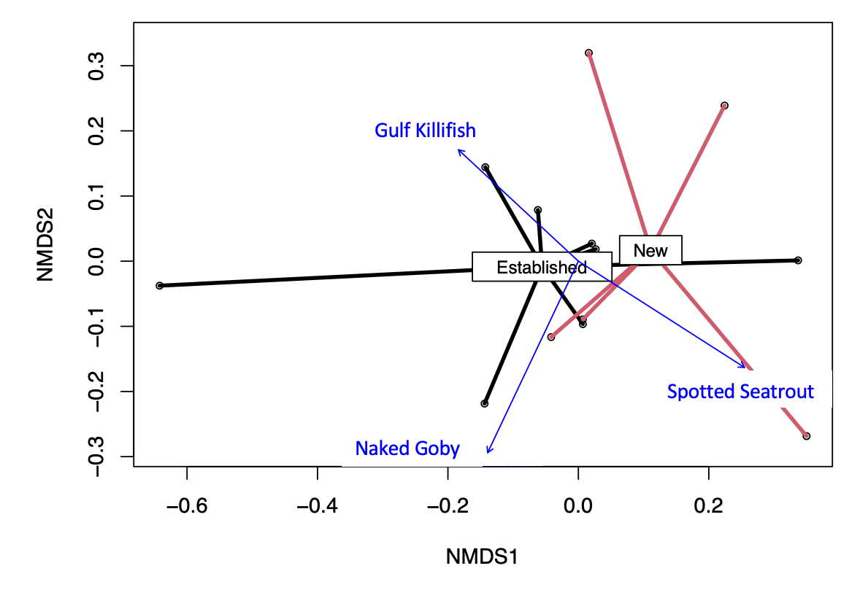
Minnow Trap Finfish
NMDS; Permanova
Stress = 11.13
pseudo-F _{1, 13} = 2.21
P = 0.04
Slight difference detected is likely due to a greater number of Gulf Killifish present in the Established Terraces (ANOVA: F_{1, 22} = 8.65, P = 0.01 )

Slide 11
Minnow Trap Crustaceans
n = 159
n = 178
Grass Shrimp
Grass Shrimp

Slide 12
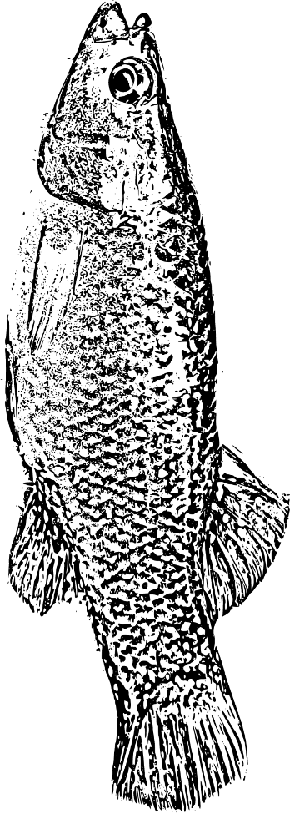
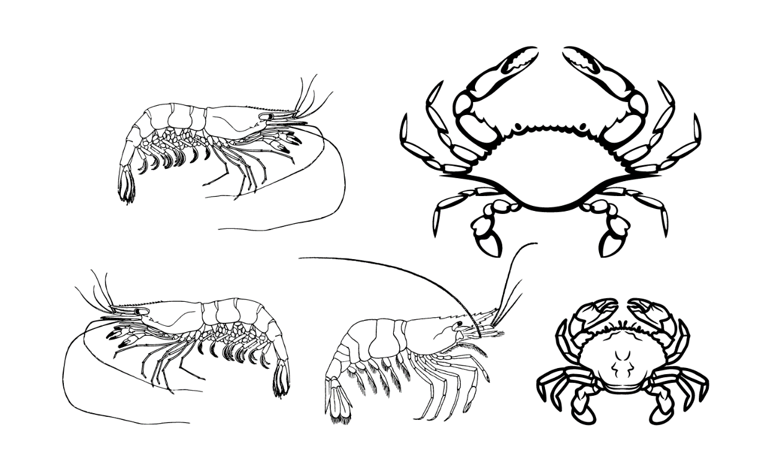
Established Terraces
New Terraces
≠
=

Slide 13
n = 19
n = 24
n = 37
Gill Net Finfish
Gafftopsail Catfish
Gafftopsail Catfish
Gafftopsail Catfish

Slide 14
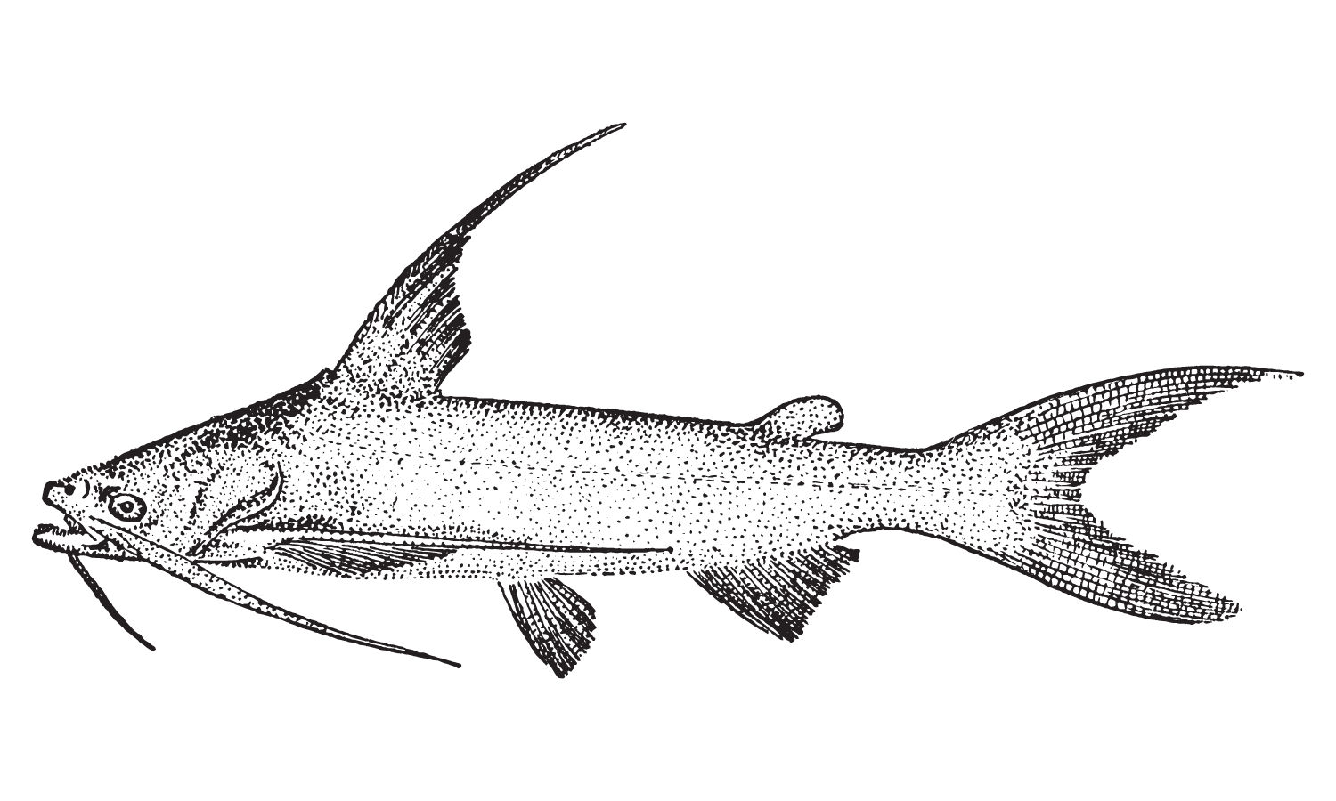
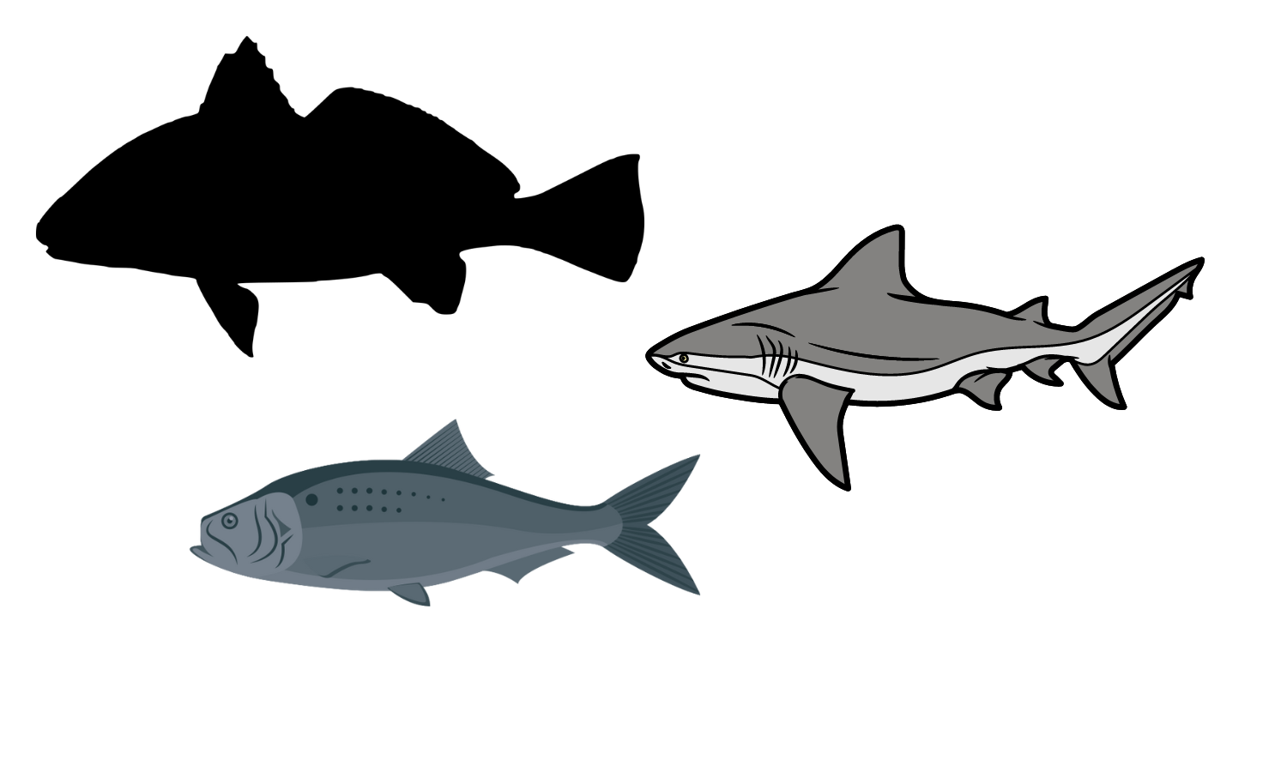
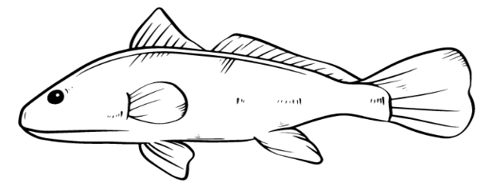
Gill Net Summary
Although Established Terraces had higher diversity, no statistical differences among assemblages were detected.
New Terraces and Open Water dominated by Gafftopsail Catfish
New Terraces
Open Water
Established Terraces

Slide 15
Trawl Finfish
n = 86
n = 117
n = 122
Bay Anchovy
Bay Anchovy
Bay Anchovy

Slide 16
Trawl Crustaceans
n = 451
n = 332
n = 248
White Shrimp
White Shrimp
White Shrimp
Note how few grass shrimp compared to minnow trap
Brown Shrimp
Brown Shrimp
Brown Shrimp

Slide 17

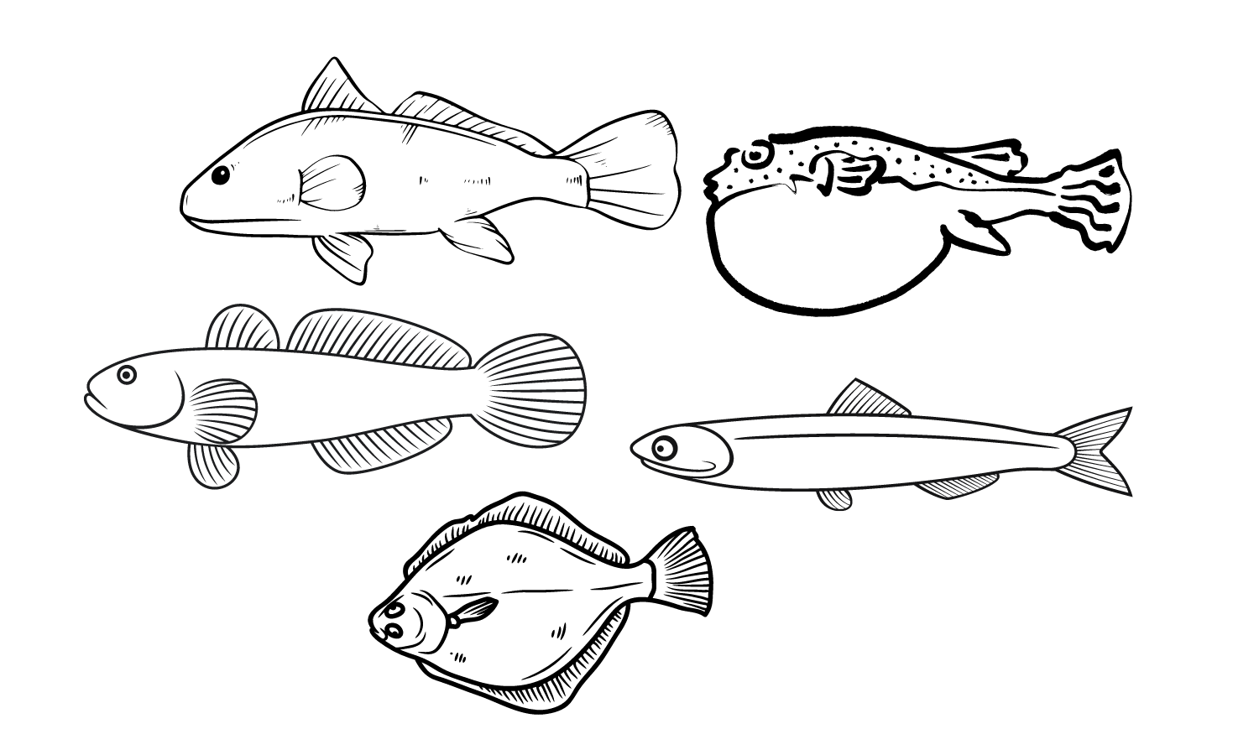
Trawl Assemblage Summary
Established Terraces = New Terraces = Open Water

Slide 18
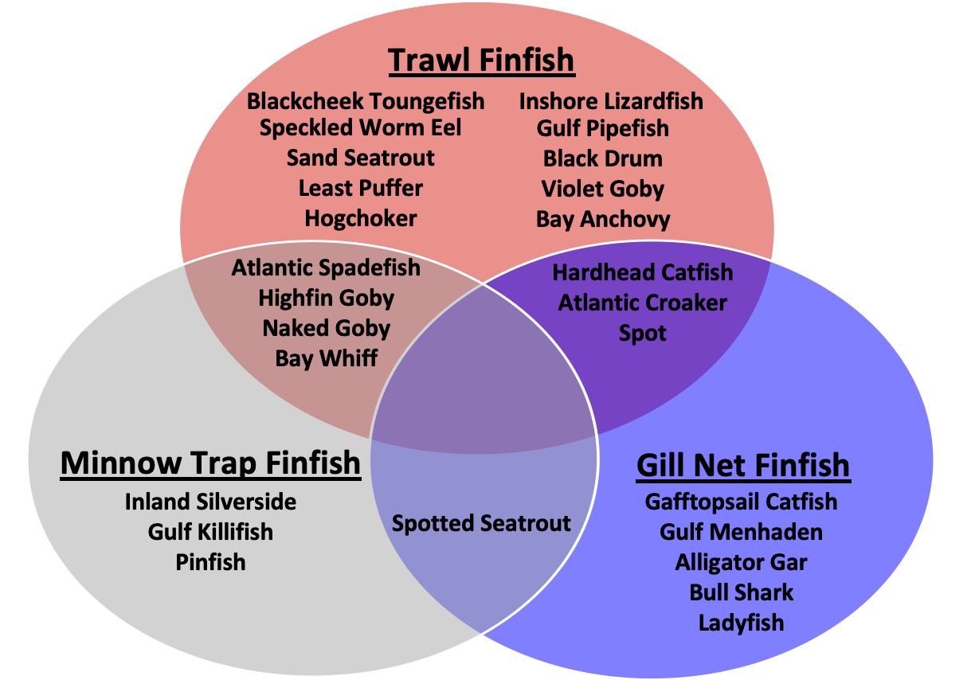
Gear Comparison: Finfish

Slide 19
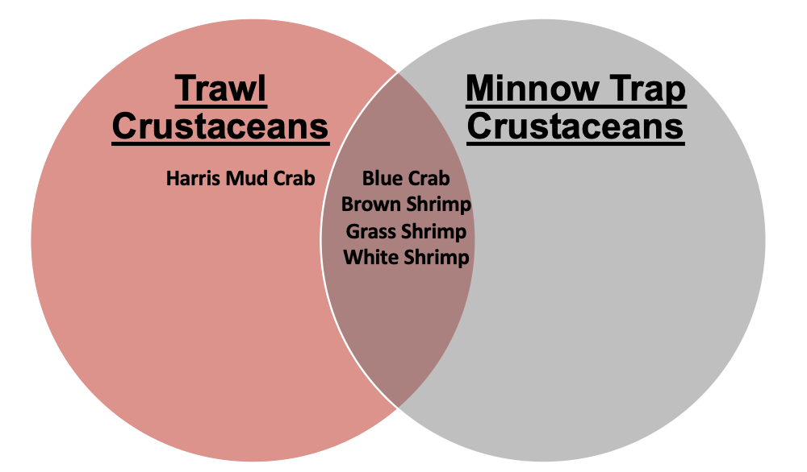
Gear Comparison: Crustaceans

Slide 20
Assemblage Summary
Vegetation of terrace edge changed over time
  Appears to benefit Gulf Killifish and Grass Shrimp based on minnow trap results
Established terraces had a higher species richness based on gillnet results
  New Terraces and Open Water dominated by Gafftopsail Catfish
Benthic species assemblages in channels between terraces were similar to open water habitat based on trawl samples
  Terraces do not exclude species that prefer open water habitat
Multiple gear provides a robust assessment of finfish and crustacean assemblage

Slide 21
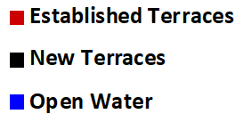
Bay Anchovy: Trawl
Kolmogorov-Smirnov:
Established terraces – New terraces; D = 0.30, P = 0.004 Established terraces – Open water; D = 0.54, P < 0.0001
New terraces – Open water; D = 0.31, P < 0.001

Slide 22
White Shrimp: Trawl
Kolmogorov-Smirnov:
Established terraces – New terraces; D= 0.16, P = 0.06 Established terraces – Open water; D = 0.35, P < 0.001
New terraces – Open water; D = 0.40, P < 0.0001

Slide 23
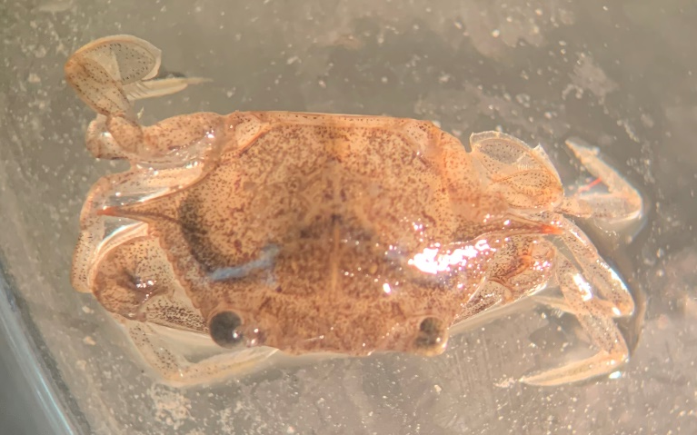
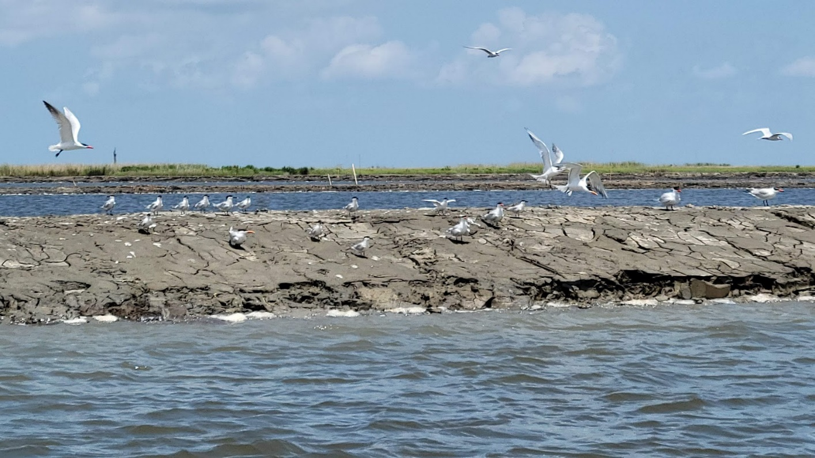
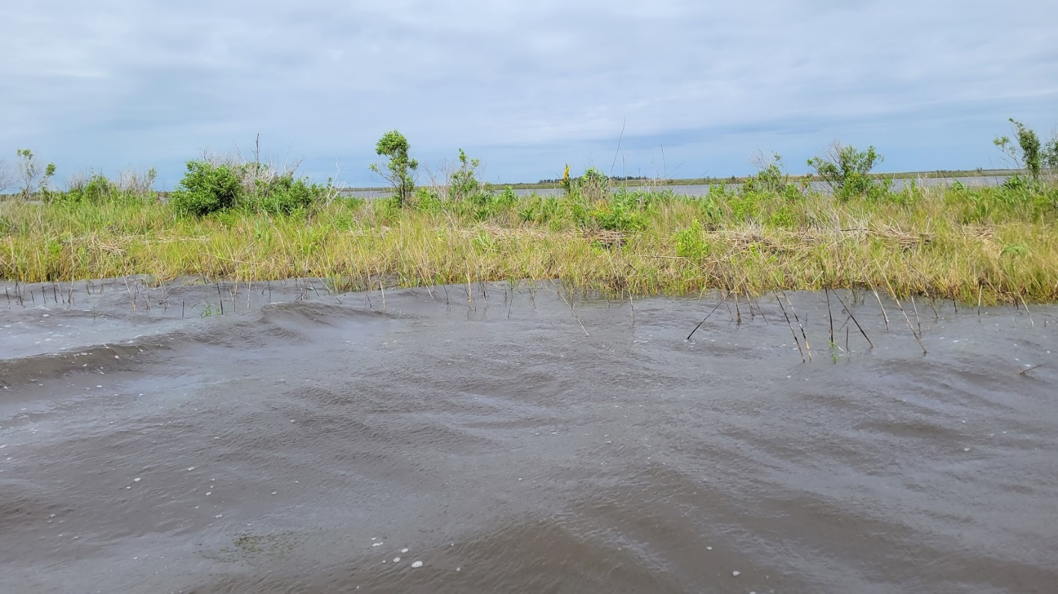
Nursery Habitat
It appears that small individuals of some species are more abundant in terrace habitat compared to open water.
Terraces may be a ‘source’ of important species for the estuary.

Slide 24
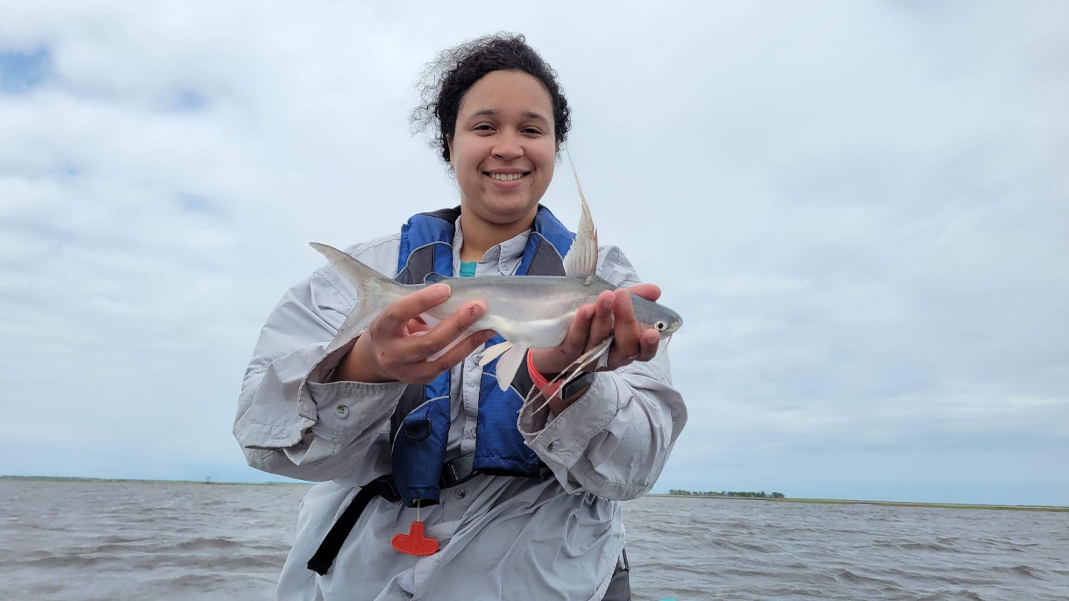
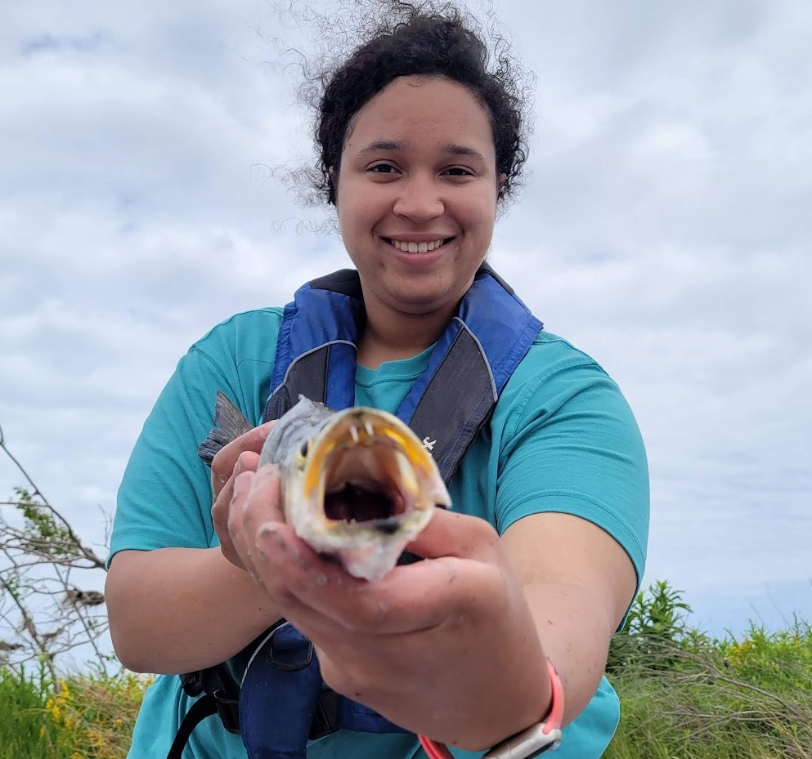
Summary
Terraces do not exclude estuarine species common in open water.
Vegetated edge habitat is likely used by edge-dependent species.
Multiple gear provides a robust assessment of finfish and crustacean assemblage.

Slide 25
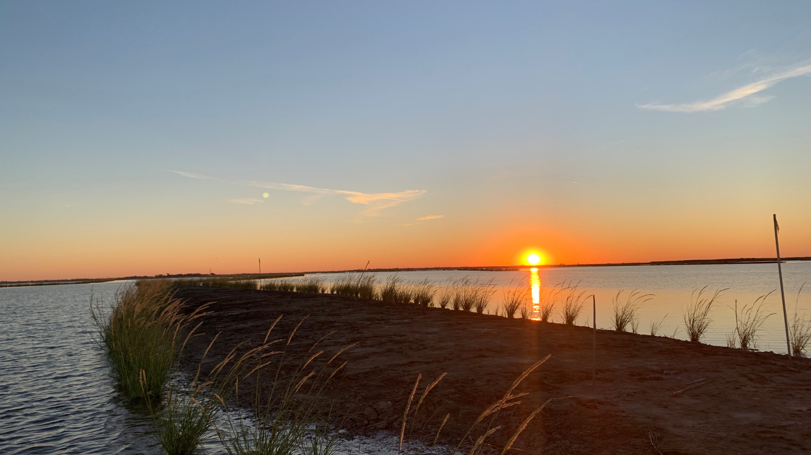
Thank you!
Please direct critical comments to chris.bonvillain@nicholls.edu

