Slide 1
Identifying Invasive Carp Spawning Locations Through Statewide Larval Fish Surveys
Quenton Fontenot¹, Shasta Kamara¹, April Simmons², Robby Maxwell³, and Rob Bourgeois³
¹Nicholls State University
²MI Department of Natural Resources
³LA Department of Wildlife and Fisheries

Slide 2
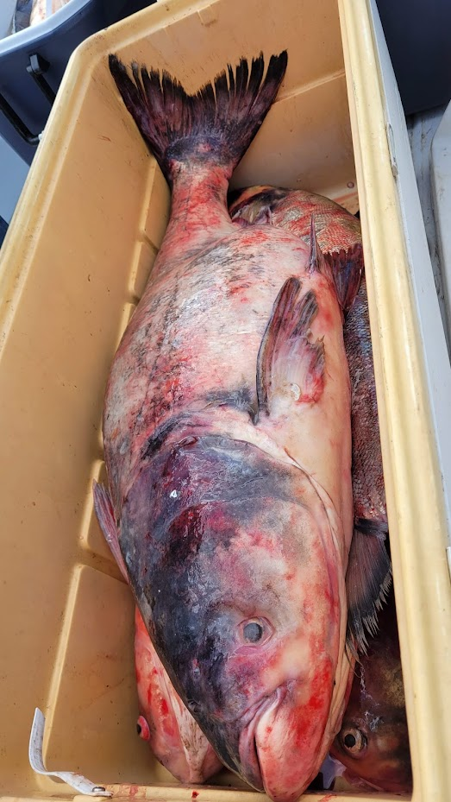
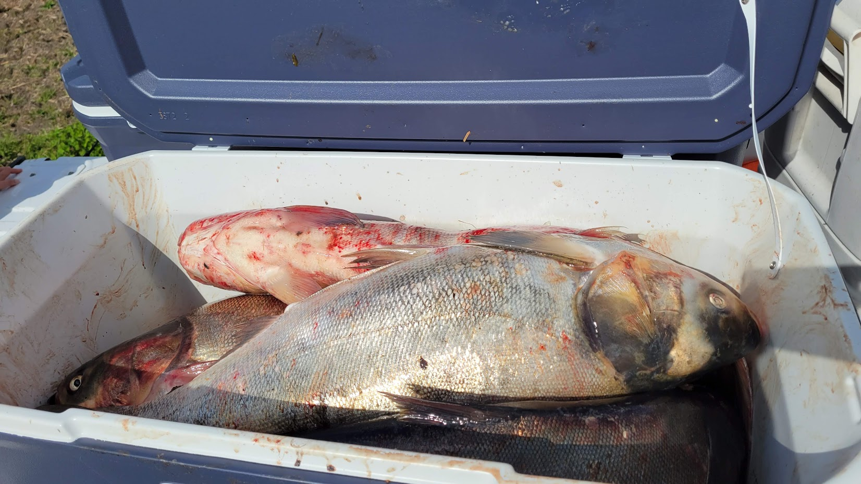
Invasive Carp
Self-sustaining population in LA
Potential to alter river ecology
Location of preferred spawning habitats may aid future control efforts

Slide 3
Statewide Sample Locations
Similar sites sampled each year
Goal was to identify spawning locations
Bonnet Carré Spillway
Gulf Intracoastal Waterway
Map created by Chris Bonvillain

Slide 4
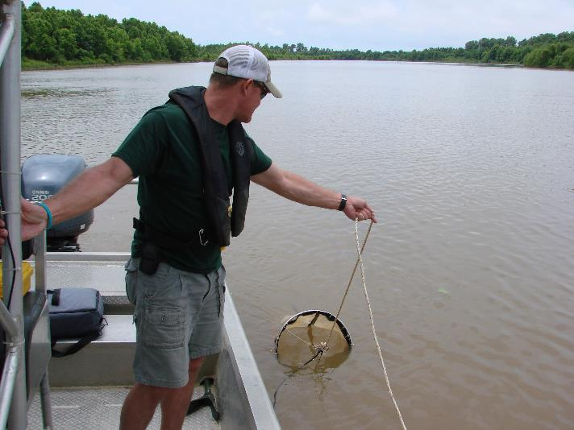
LDWF Statewide Larval Fish Surveys
Year | April | May | June | July
2013 |  | x | x | x
2014 | x | x | x
2019 |  | x | x
2021 | x | x | x
2022 | x | x | x
Inland Fisheries personnel
3 samples at each site (both banks and middle)
Target sample duration = 600 seconds (10 minutes)

Slide 5
Larvae Identified and Enumerated
Larvae identified to at least family
Cyprinids delineated as not invasive carp or as invasive carp (Silver, Bighead, and Black all combined)

Slide 6
Invasive Carp Larvae Locations
Larvae fairly prevalent in the Atchafalaya, Mississippi, Ouachita, and Red River Systems for all years.
Not present in SW LA or Northshore
Gulf Intracoastal Waterway
Map created by Chris Bonvillain

Slide 7
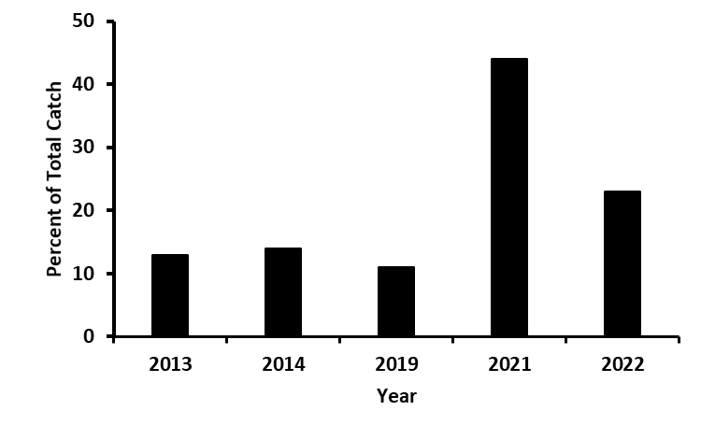
Percent of Total Catch: Statewide
*
44%
12.7 ± 1.5%
23%

Slide 8
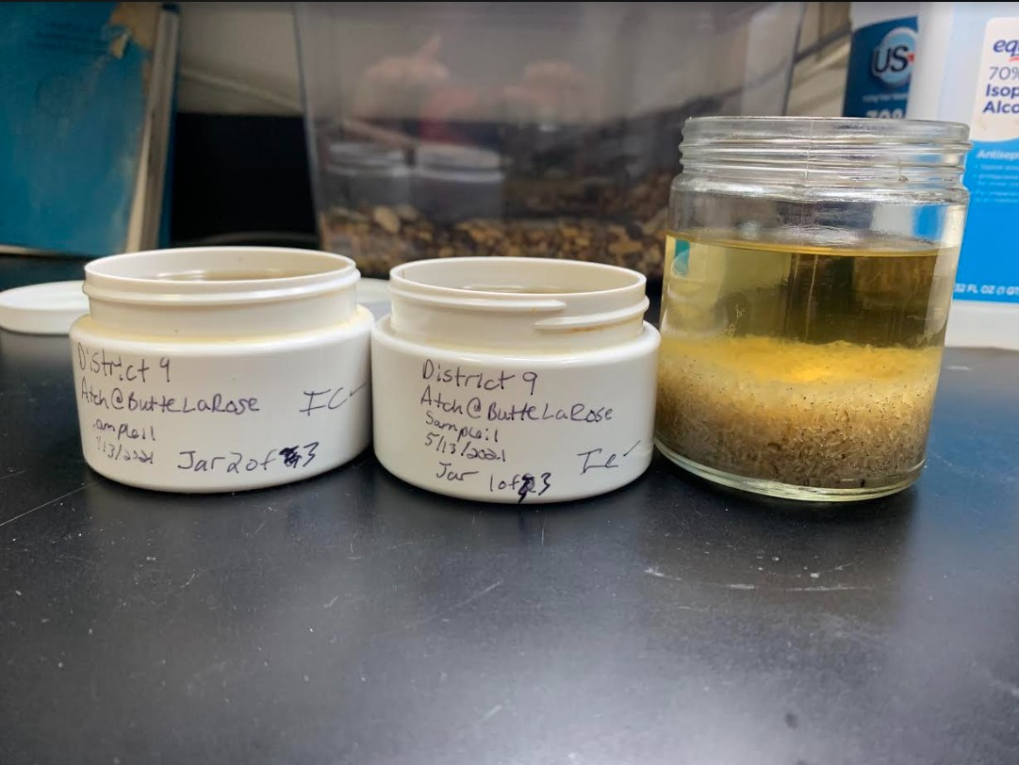
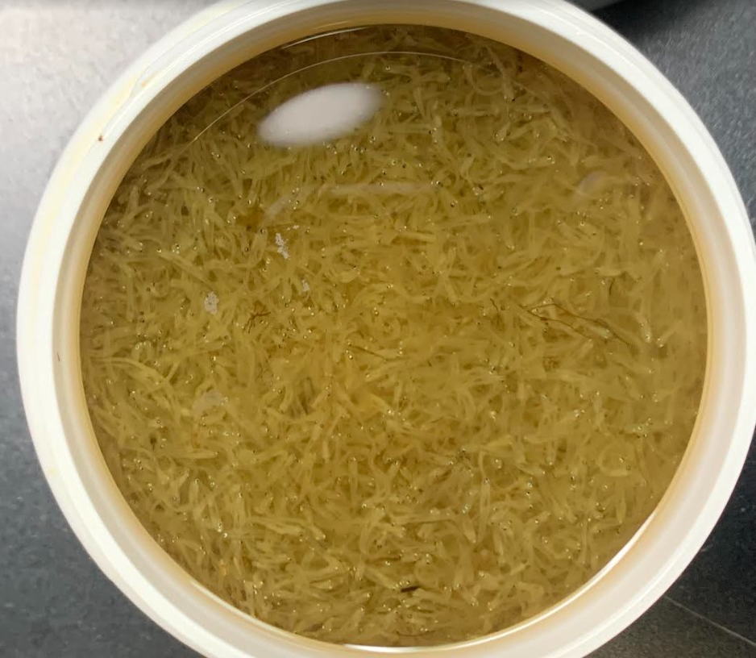
May 13th; 1 Sample From Butte LaRose
97,814

Slide 9
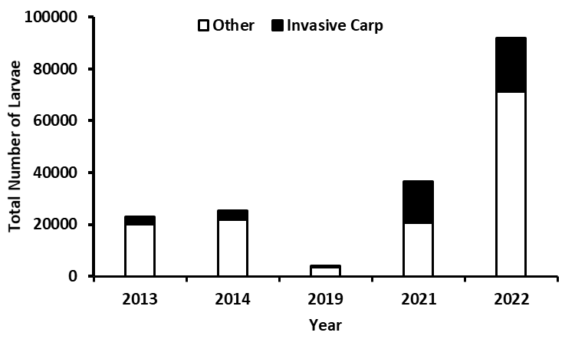
Invasive Carp as Part of the Total Catch
(N = 93,014)
*

Slide 10
Invasive Carp as Part of the Total Catch (With Clupeids)
*

Slide 11
Relative Abundance
For sites that had at least one Invasive Carp, we calculated:
Number of individuals collected per minute (CPUE)
Mean CPUE for each site (3 subsamples per site)
Only used the two subsamples from that >97,000 catch
Mean (± SE) CPUE for each month for each year
Used as a measure of relative abundance

Slide 12
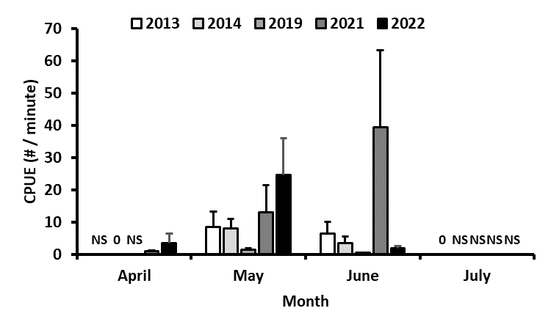
CPUE (#/minute) (Only for samples that contained at least one Invasive Carp)

Slide 13
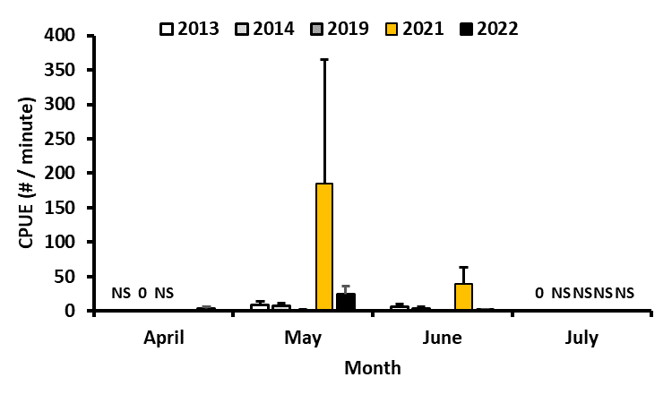
CPUE (#/minute) (*97,000+ Invasive Carp Larvae in One Sample)

Slide 14
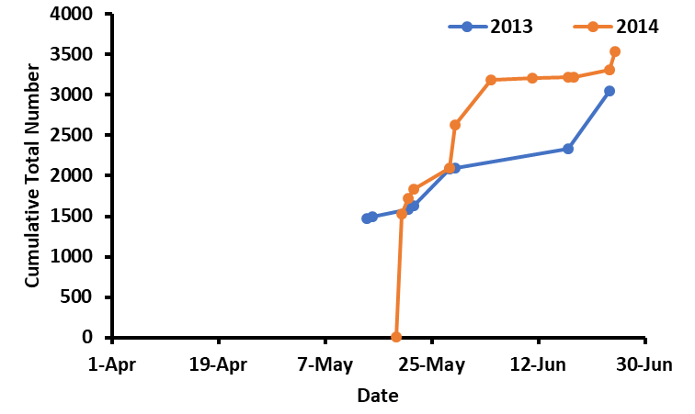
Cumulative Total Number

Slide 15
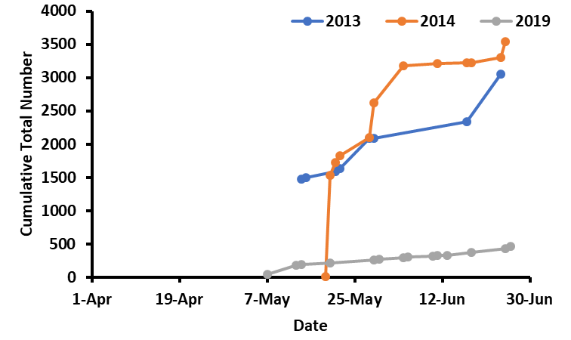
Cumulative Total Number

Slide 16
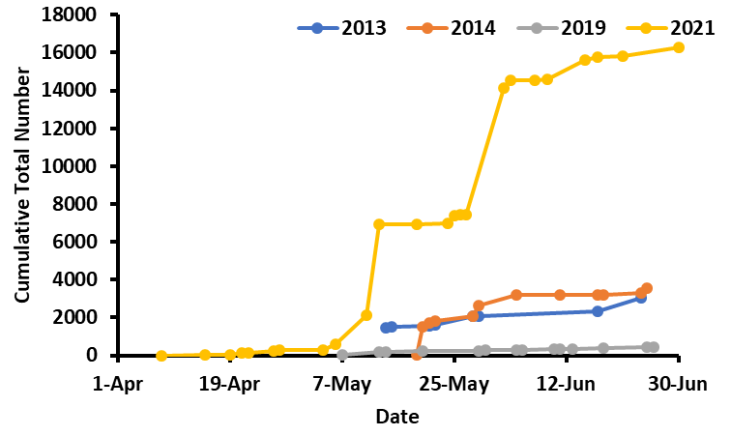
Cumulative Total Number

Slide 17
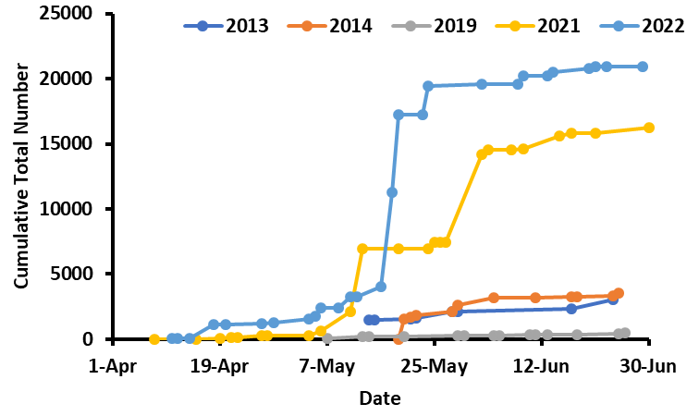
Cumulative Total Number

Slide 18
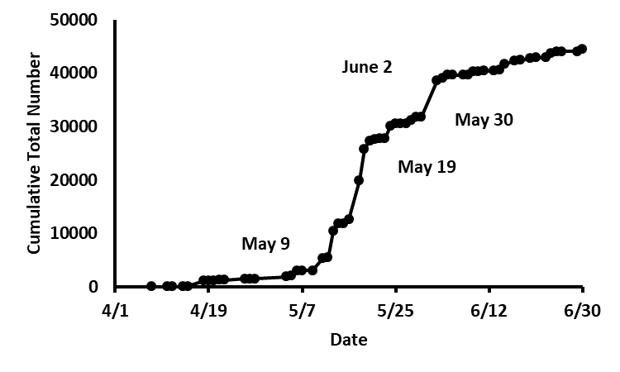
All Years Combined

Slide 19
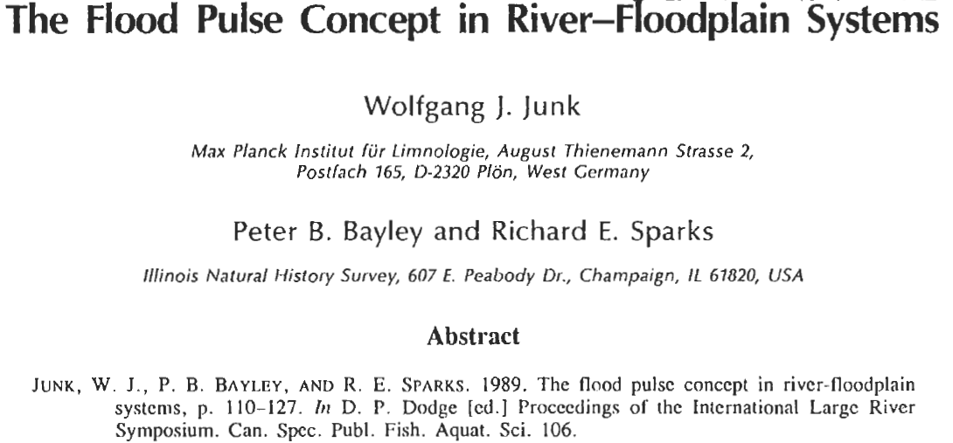
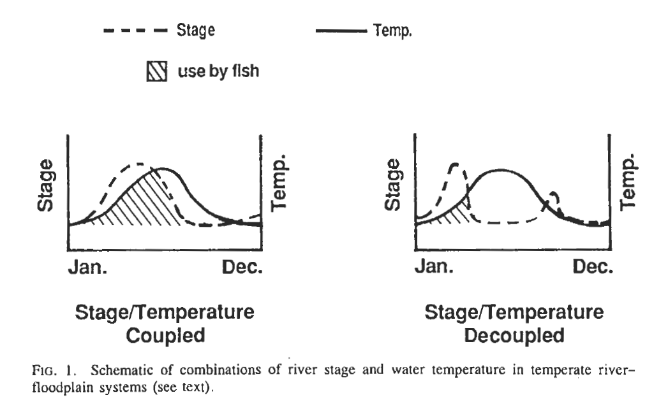

Slide 20
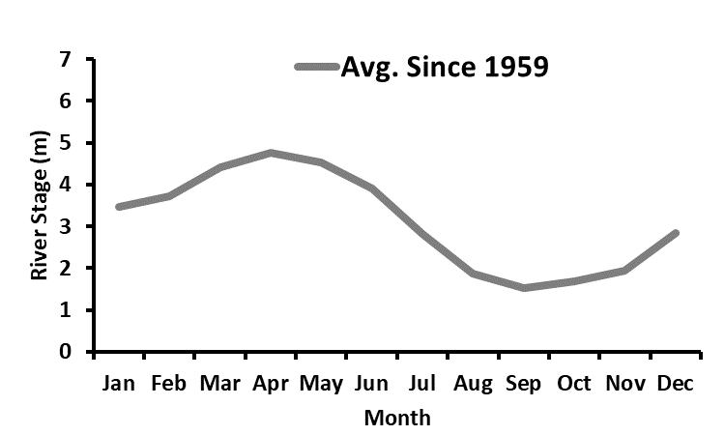
Typical Atchafalaya Flood Pulse (Mimics the Mississippi)
Peaks in April with lowest levels in September

Slide 21
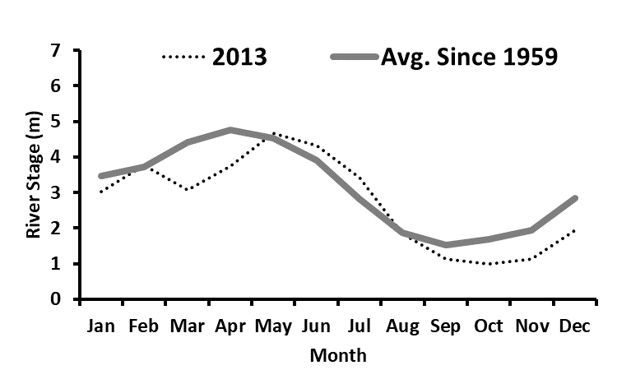
2013 Flood Pulse: Delayed
Delayed

Slide 22
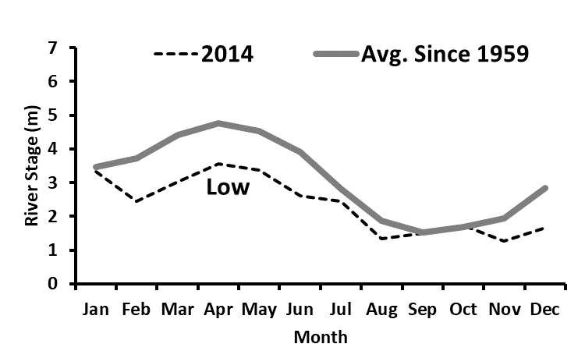
2014 Flood Pulse: Low

Slide 23
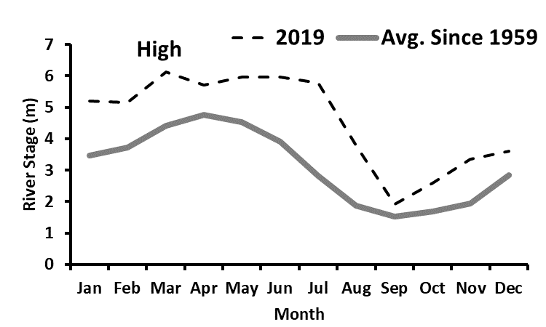
2019 Flood Pulse: High

Slide 24
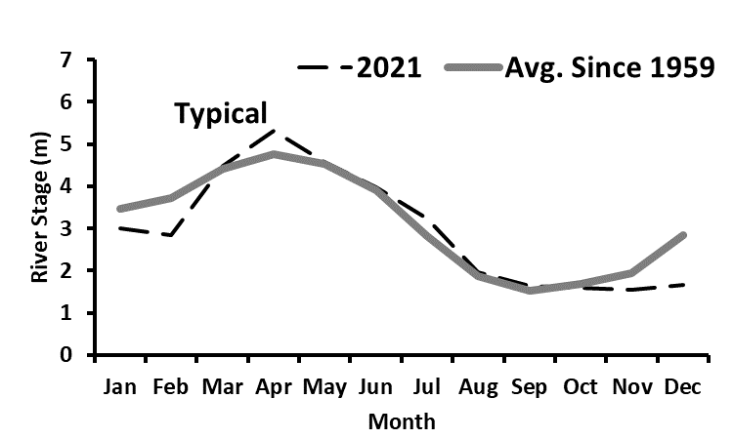
2021 Flood Pulse: Typical

Slide 25
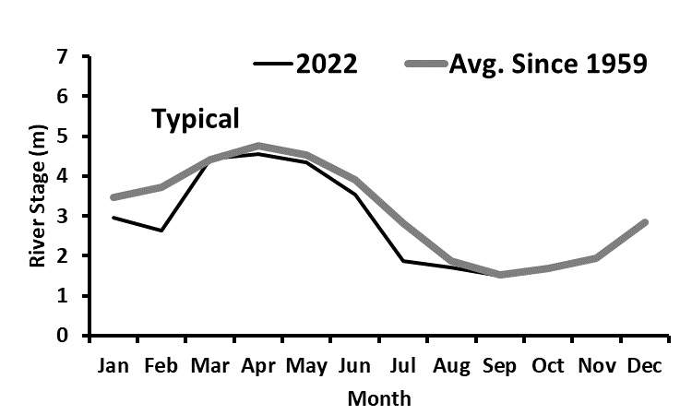
2022 Flood Pulse: Typical

Slide 26
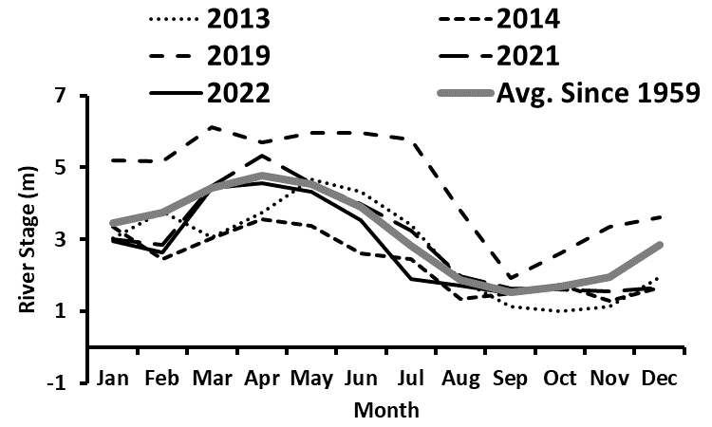
Timing, Duration, Intensity: Signal?
Used residual analysis to compare deviation from a ‘typical’ water level for each month (absolute value)
Absolute value of deviation compared to annual CPUE for Mississippi and Atchafalaya Samples

Slide 27
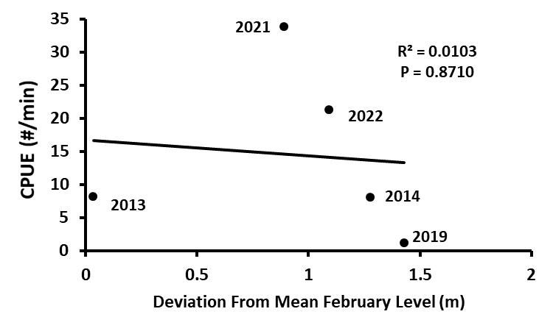
February ‘Signal’

Slide 28
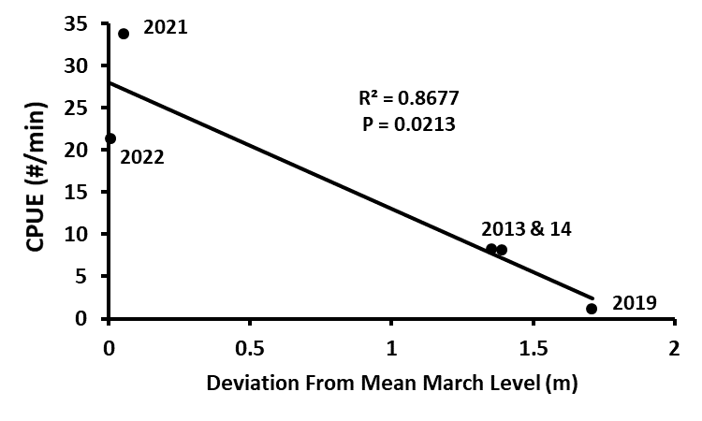
March ‘Signal’

Slide 29
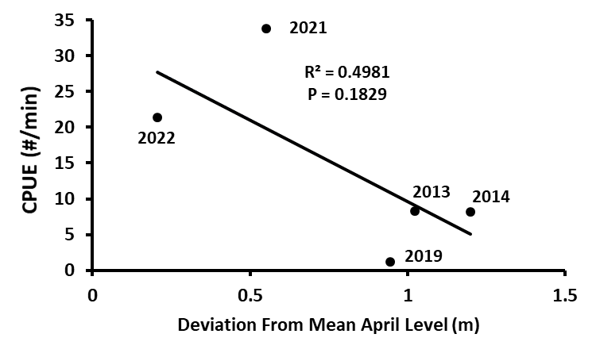
April ‘Signal’

Slide 30
Summary
Reproduction appears to be contained in the Atchafalaya / Mississippi / Ouachita / Red River systems
Relative abundance can fluctuate and can dominate the larval fish assemblage
Flood pulse level in March probably influences invasive carp reproductive output in the Mississippi and Atchafalaya Rivers

Slide 31
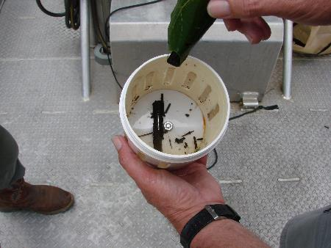
Acknowledgments
2013, 2014, and 2019 were funded through the State/Interstate Aquatic Nuisance Species Management Plan Program as administered by the United States Fish and Wildlife Service under the authorization of the Nonindigenous Aquatic Nuisance Prevention and Control Act of 1990
2021-22 funded through Mississippi River Basin 2020 Asian Carp Partnership Projects for USFWS Funding
All LDWF Inland Fisheries Biologists that collected and transported the samples
Nicholls State University

