Slide 1
June 2023
Maximizing Large-scale Project Benefits through Watershed-scale Planning
Katie Freer, Project Manager

Slide 2
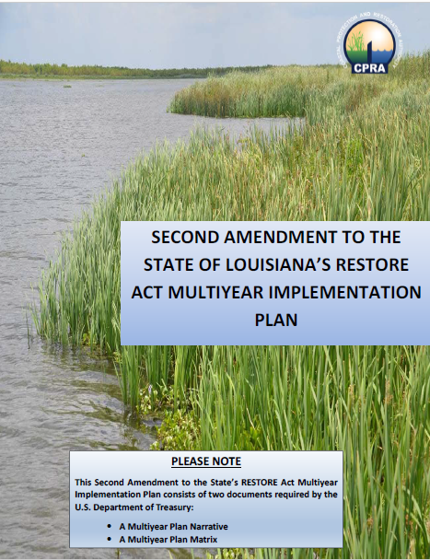
Calcasieu-Sabine Large-Scale Marsh and Hydrologic Restoration Project (CS-87)
Funding Source: RESTORE Act Direct Component (Bucket 1)
This project replaces the discontinued Calcasieu Ship Channel Salinity Control Measures Project
Full $260.97M Bucket 1 allocation for Louisiana dedicated to this project
Engineering & Design
Permitting
Construction
Operations & Maintenance of Drainage Structures
Monitoring and Adaptive Management

Slide 3
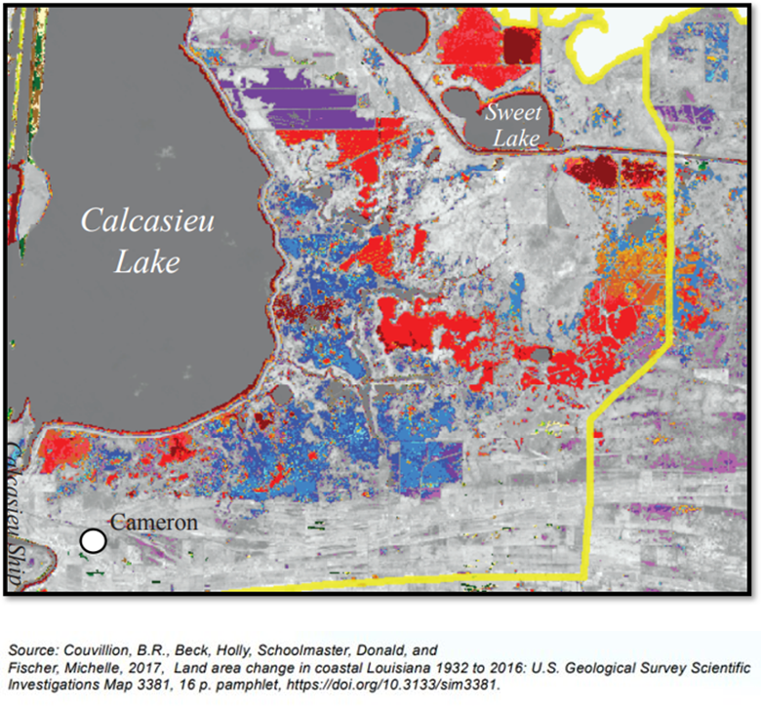
Project Purpose
Cameron Creole Watershed Land Loss, 1932 to 2016
PROJECT GOAL: Reduce land loss in the Calcasieu Sabine Basin
Project Objectives
Reduce marsh stress from flood inundation through:
Improved marsh drainage into Calcasieu Lake
Increased elevation capital with dredged sediment
Maintain marsh salinity levels achieved through existing CCW management practices
Land Loss Timing
Reds: 1932-1975
Oranges: 1975-1995
Blues: 1995-2008
Purples: 2008-2015

Slide 4
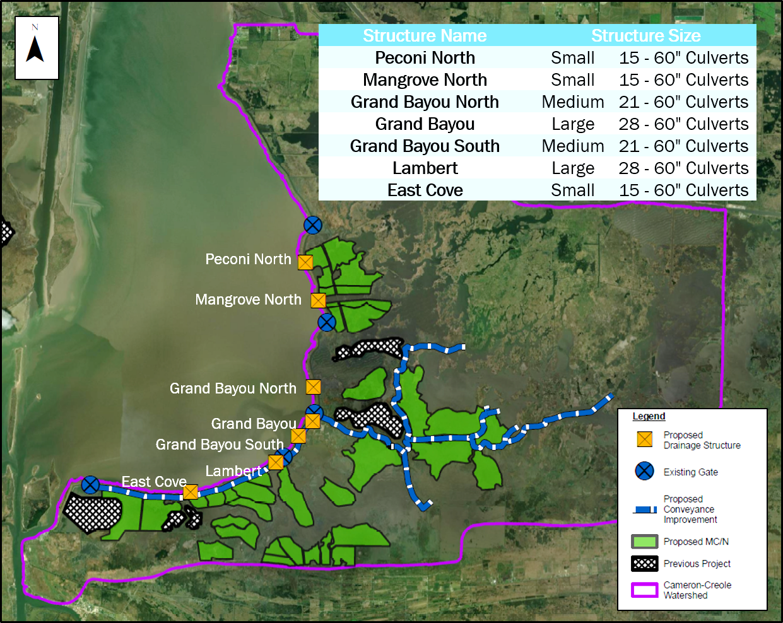
Project Features
Lake Rim Drainage
Seven (7) proposed gravity drainage structures with backflow prevention
Conveyance
Up to 18 miles of channel improvements
Improve drainage from back of the marsh to the Lake Rim
Marsh Creation
Over 3,000 of 7,000 shown acres to be built through CS-87
Using dredged material from channel improvements, CSC, and the Gulf of Mexico

Slide 5
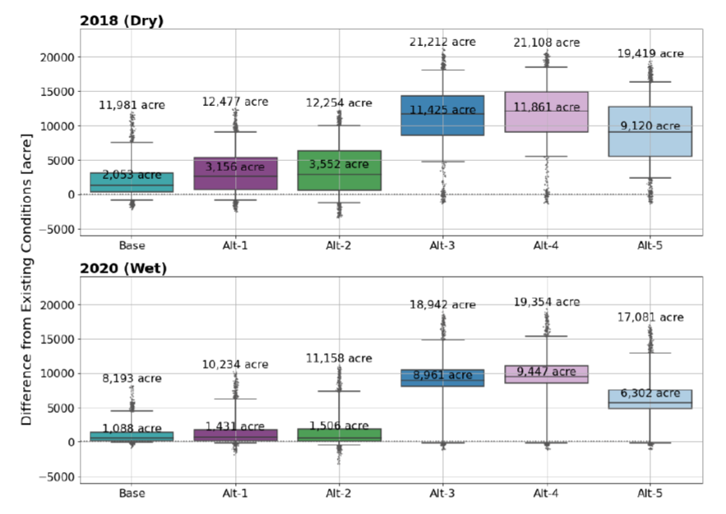
Project Benefits
Water level reductions in the marsh
Average 1.9 inches
Peak reduction of 17 inches after a high-water event
Increased total marsh area not under flood stress by 6,300 (2020) – 9,100 (2018) acres 50% of the time
Hourly Area Below Upper Target Water Level
Change from Existing Conditions
The box represents 25th, median, and 75th percentile values and whiskers represent 5th and 95th percentile limits.

Slide 6
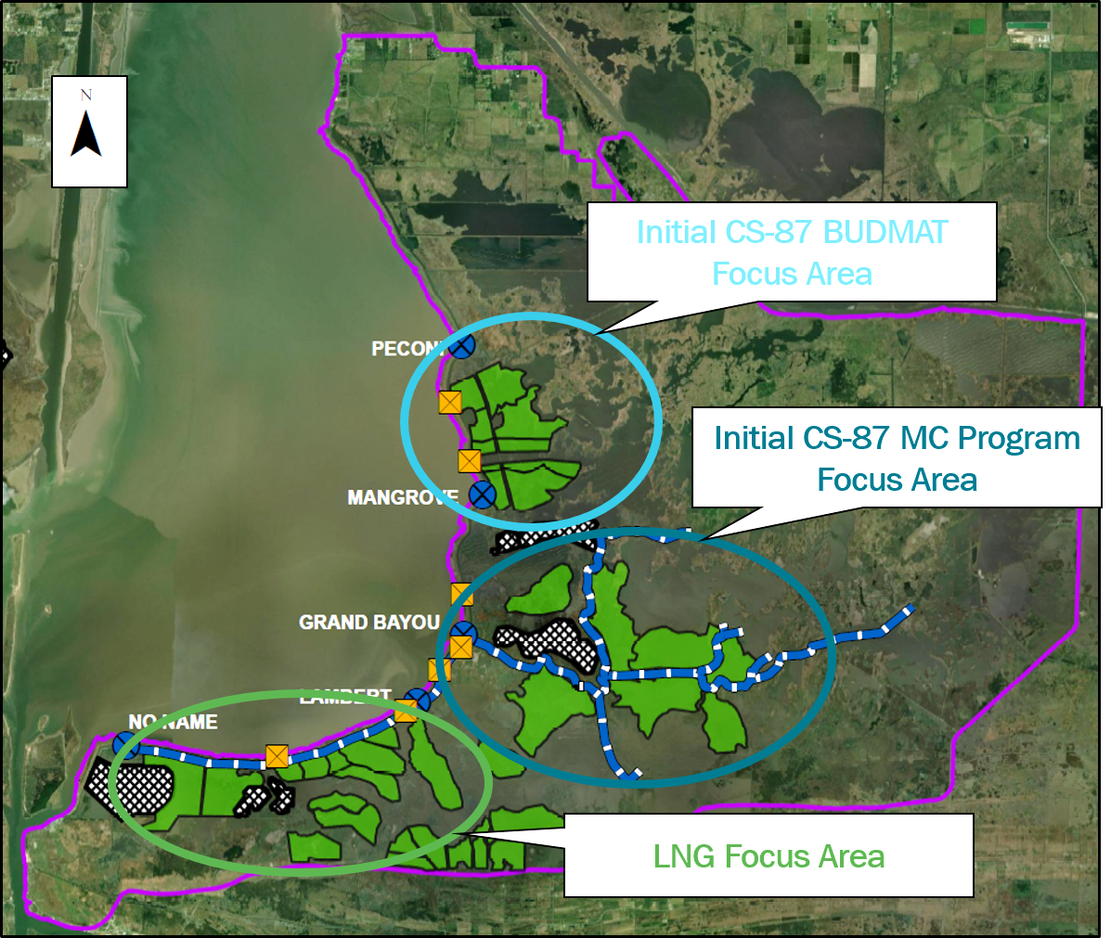
Multi-Program Synergies
Selected alternative provides a cohesive Cameron Creole Watershed restoration framework other programs can complement
USACE Beneficial Use of Dredged Material (BUDMAT) Program
600 to 1,200 acres
Est. construction in FY26 or FY28
Reduces CPRA’s cost per acre by ~80-90%
Establishes sediment conveyance corridor across Calcasieu Lake for use by future projects
Mitigation and other Beneficial Placement Opportunities
Ensure any spoil placed in Cameron Creole allows drainage to CS-87 structures
Initial CS-87 BUDMAT Focus Area

Slide 7
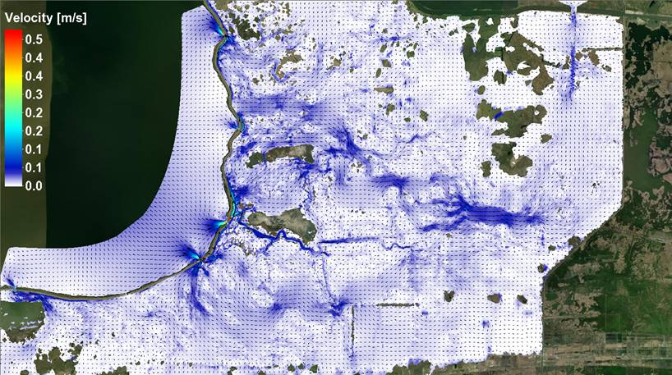
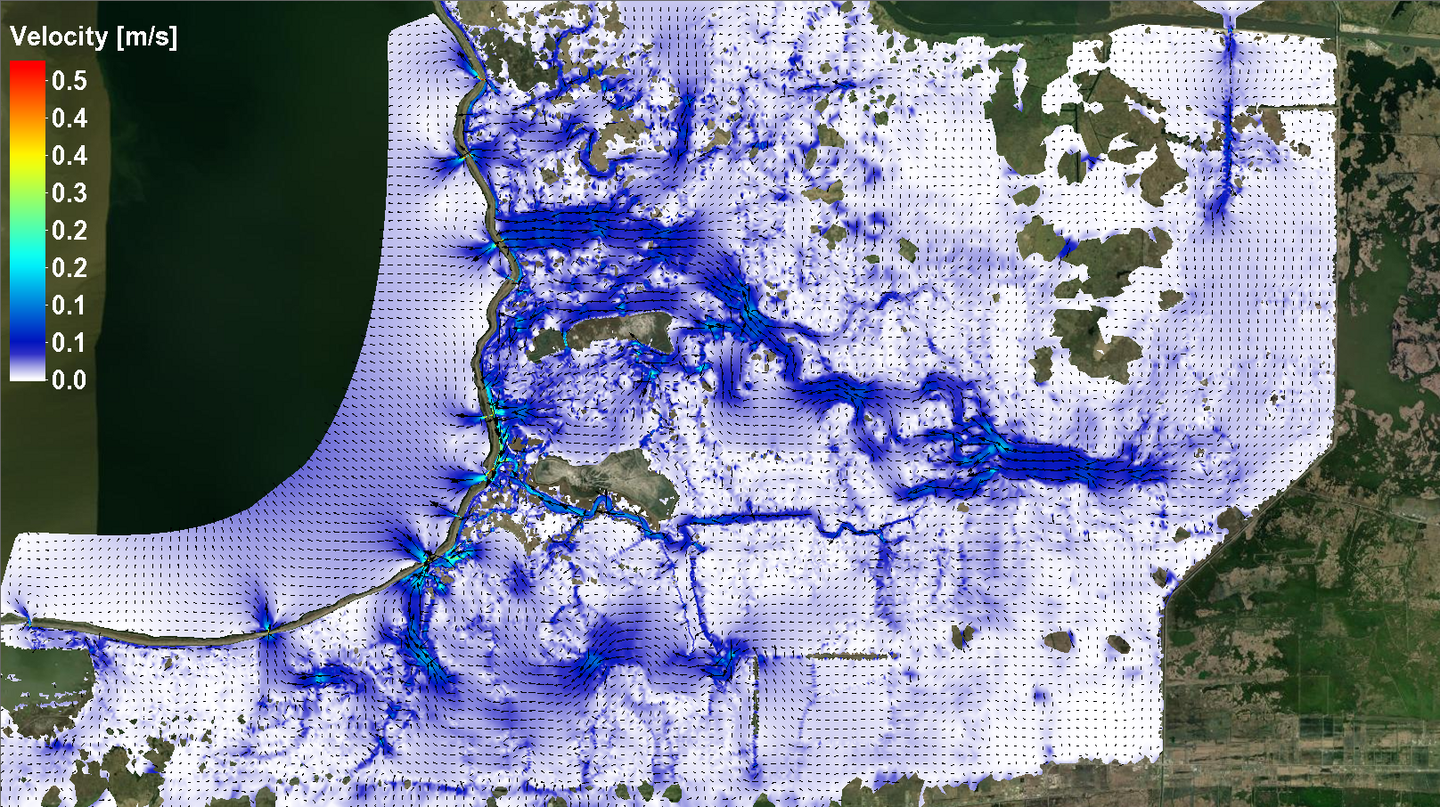
Multi-Program Synergies
CWPPRA and Ducks Unlimited Project Synergies
Enhanced performance of Cameron Creole Freshwater Introduction Project (CS-49)
Extends lifespan of constructed projects
Enables integration of future projects with watershed drainage framework
Existing Conditions
With Project Drainage Structures

Slide 8
Four Project Tracks for Efficiency
Milestone | Lake-Rim Drainage | MC/N with Conveyance Channel Borrow | MC/N with Nearshore Borrow | MC/N with BUDMAT
Design Optimization | July 2022 | July 2022 | July 2022
15% Design | Mid 2023 | Late 2023 | Early 2024
JPA Submittal | Mid 2023 | Mid - Late 2023 | Mid 2024
30% Design | Late 2023 | Early 2024 | Mid 2024
90% Design | Mid 2024 | Late 2024 | Early 2025 | 2024
Advertise for Bids | Mid/Late 2024 | Early 2025 | Mid 2025 | Fed FY 26 or FY 28
Current Project Phase

