Slide 1
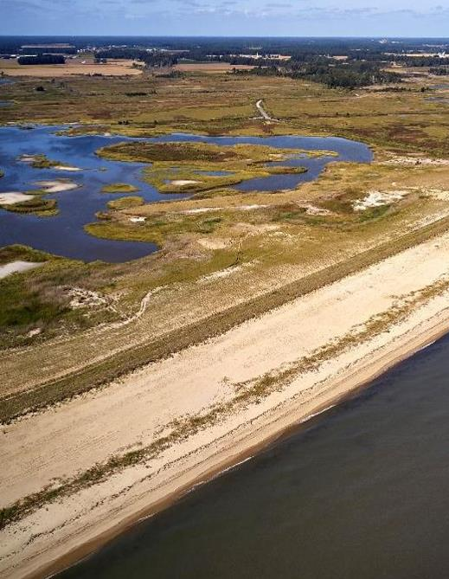
Ben Smith, MS, EIT
Carbon and Sustainability Analyst
Enhanced Biological Carbon Storage from Nature-based Solutions
Notes:
Talking about… nature-based solutions, particular biological carbon storage

Slide 2
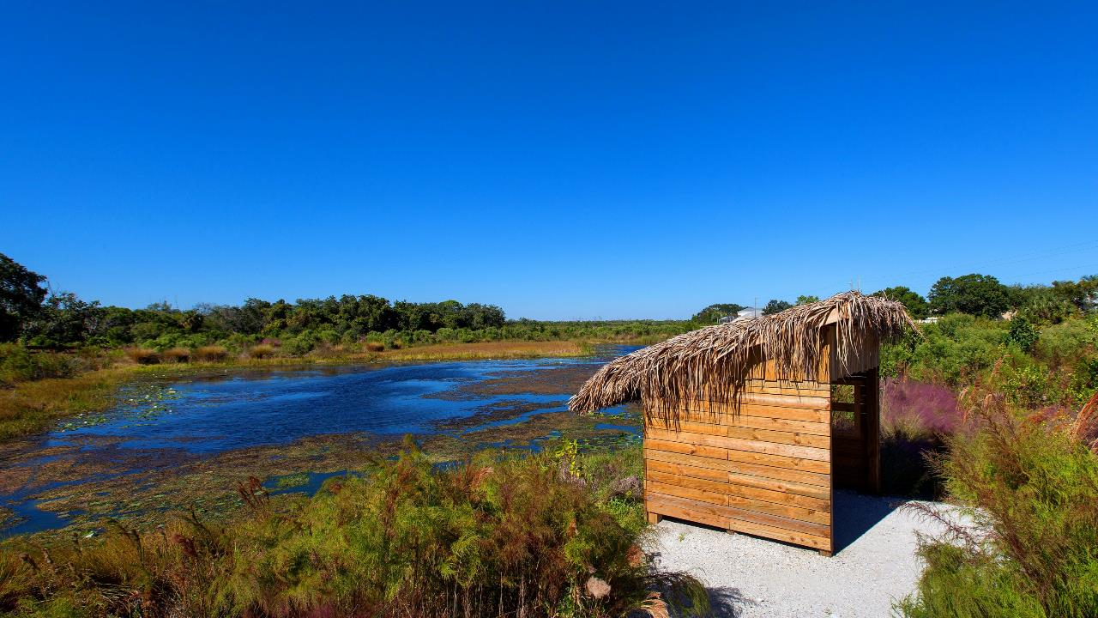
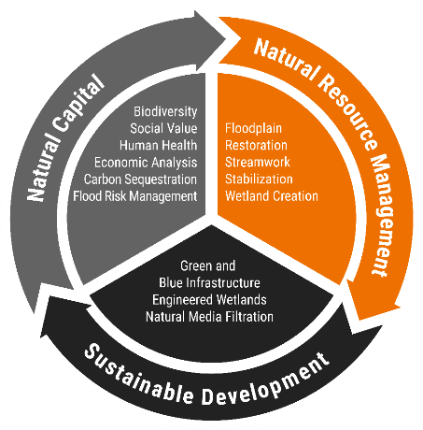
Nature-based Solutions for Ecosystem Restoration and Carbon Sequestration
Greenhouse Gases (GHGs) – gases that contribute to climate change in the atmosphere (CO₂, CH₄, N₂O).
Climate Mitigation/ Impact – the net removal (Mitigation) or addition (Impact) of GHGs to the atmosphere.
Carbon Sequestration – the storage of carbon in a non-atmospheric pool (plants, soils, geologic formations, etc.).
CO₂ Equivalent (CO₂e) – standardized unit used to represent sequestered carbon (C), CH₄, N₂O, and other GHGs as an equivalent quantity of CO₂ with respect to radiative forcing.
Notes:
Nature-based solutions include coastal restoration
Also includes floodplain restoration, streamwork, wetland creation, natural BMPs
Before diving into things, let’s define a few terms…
…so, nature-based solutions can be used to achieve “Climate Mitigation”
These systems tie into sustainable development by serving as green and blue infrastructure to enhance resilience
And they have quantifiable economic value through ecosystem services… natural capital

Slide 3
Resilience – A Layered Approach
Risk Reduction. Ecology. Social Value.
Notes:
Nature-based solutions are often used to achieve resilience
This is a figure from a “gray-green infrastructure” project that follows typical engineering-with-nature principles
By gray-green I mean, using traditional “hard engineering” methods in combination with natural systems
The goal of this project was shoreline stabilization and resilience
What this looked like was a layered approach consisting of earthened berms, hardened dune systems, shoreline plantings, forest restoration, and eco-revetments

Slide 4
Dune System
Reinforced sand dune
Beach grass planting
Continuous trails and beach access
Notes:
Reinforced dune system that provides resilience
Looks semi-natural and incorporates beach grass plantings which provide some value as habitat

Slide 5
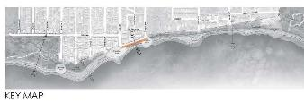
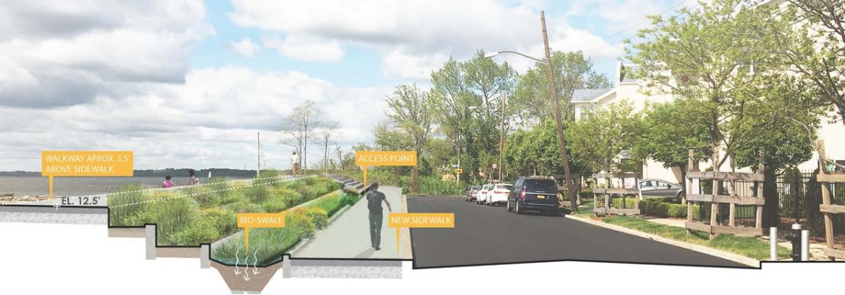
Eco-Revetment
Green infrastructure – bioswale
ADA access points and gathering spaces
Notes:
Eco-revetment provides resilience, but also includes planting locations and integrated green infrastructure (bioswale)
Both of which provide additional value by storing carbon in plant tissues and soils

Slide 6
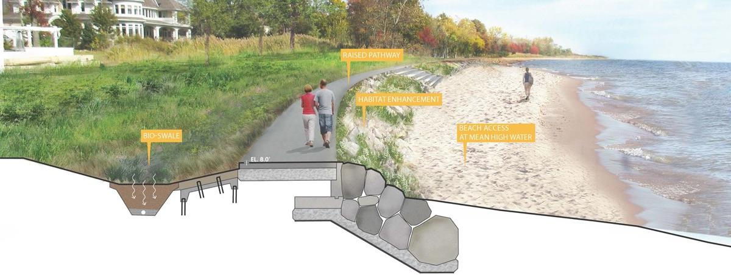
Raised Pathway
Green infrastructure – bioswale
ADA pathway and maintenance access
Habitat enhancement and shoreline stabilization
Notes:
Raised pathway provides resilience through shoreline stabilization
Also includes habitat enhancement areas and green infrastructure to capture the benefits of ecosystem services

Slide 7
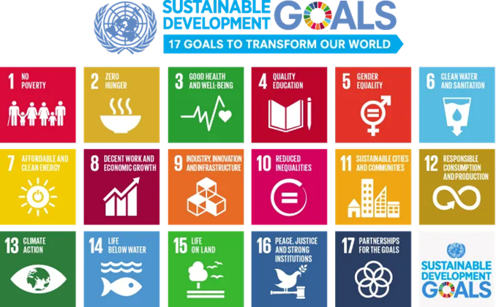
Natural Climate Solutions (NCS)
ECOSYSTEMS RELEASE AND CAPTURE DIFFERENT GREENHOUSE GASES
Can generate “offsets”
Natural Systems help combat climate change and generate a variety of co-benefits
Can be certified and generate assets
BLUE CARBON: Greenhouse gasses produced and captured by tidal saline and brackish marshes, mangroves, and seagrasses
https://www.un.org/sustainabledevelopment/blog/2015/12/sustainable-development-goals-kick-off-with-start-of-new-year/
Notes:
Transition to another concept
“Natural climate solutions” are a type of “nature-based solution” that specifically leverage ecosystems services to engage in climate action
These natural systems also generate co-benefits, which we sometimes consider terms of meeting various UN Sustainable Development Goals (pictured to the right)
Nature-based solutions often generate co-benefits satisfy the UN SDGs of…“(3) Good Health and Well-Being”, “(6) Clean Water and Sanitation”, “(11) Sustainable Cities and Communities”, “(13) Climate Action”, “(14) Life Below Water”, and “(15) Life On Land”
The co-benefits realized through these projects can be certified and turned into assets through mechanisms like CCB or SD-VISTA
Important term related to Natural Climate Solutions is “Blue Carbon” – coastal ecosystems such as tidal marshes, mangroves, and seagrasses which generally capture and store large amount of GHGs
Because of this, restoring, enhancing, or creating these ecosystems can play a big role in achieving climate mitigation

Slide 8
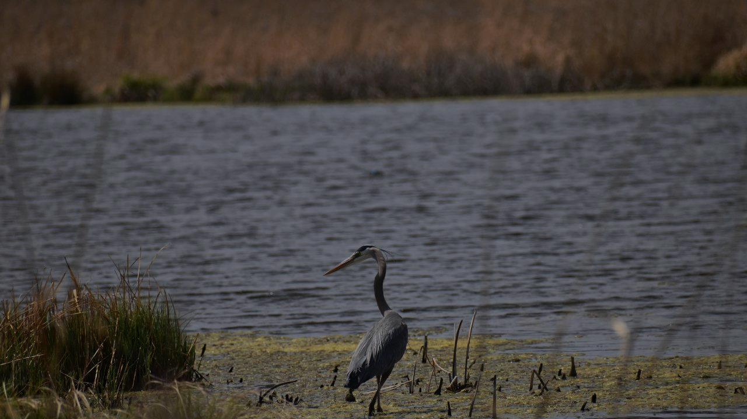
Prime Hook National Wildlife Refuge
Notes:
A great example of this is Prime Hook National Wildlife Refuge which is a coastal project that involved shoreline and marsh restoration
While this project didn’t include any hard-engineered measures, it was still able to bolster the resiliency
And after project completion, our team determined the resulting climate mitigation

Slide 9
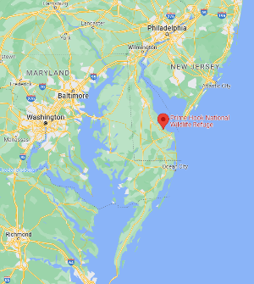
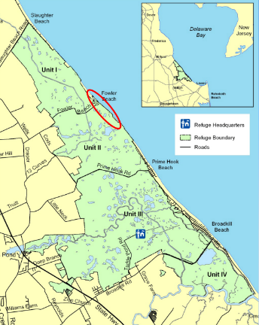
Prime Hook NWR
Milton, Delaware
10,000 acres of migratory bird habitat
Est. 1963, Migratory Bird Conservation Act
Important location on Atlantic Flyway
Salt marsh, freshwater marsh, ponds, swamps, upland grasslands, and upland forests
https://delawareestuary.s3.amazonaws.com/pdf/Summit15/BallA/W-Smith.pdf
Notes:
Prime Hook NWR is located in Milton, DE (Delaware Bay)
Established in 1963 under the Migratory Bird Conservation Act
~10,000 acres of diverse habitat, important location on Atlantic Flyway for migratory birds
Prime Hook National Wildlife Refuge | About Us | U.S. Fish & Wildlife Service (fws.gov)
PowerPoint Presentation (delawareestuary.s3.amazonaws.com)

Slide 10
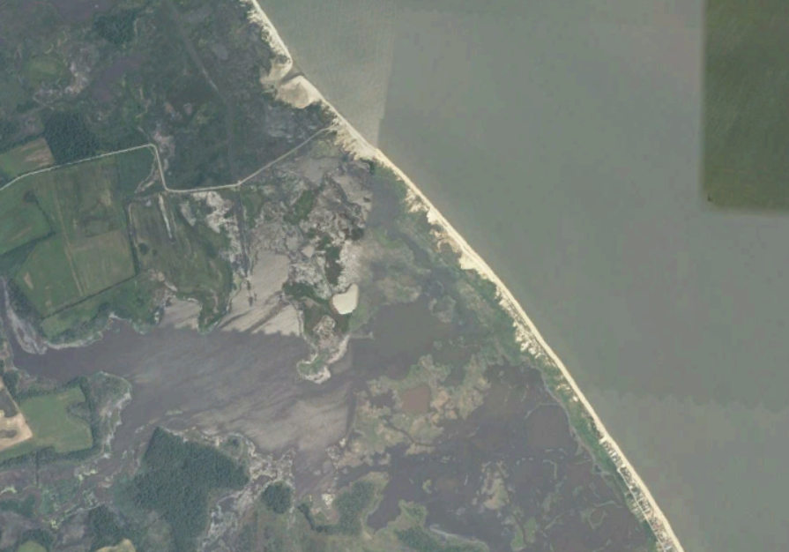
2009 Aerial – Pre Disturbance
Fowler Beach Road
Project Area
Freshwater Impoundment
Notes:
This aerial illustrates the beaches that constituted the project area
Much of the area behind these beaches had been converted to freshwater impoundments (1980s)

Slide 11
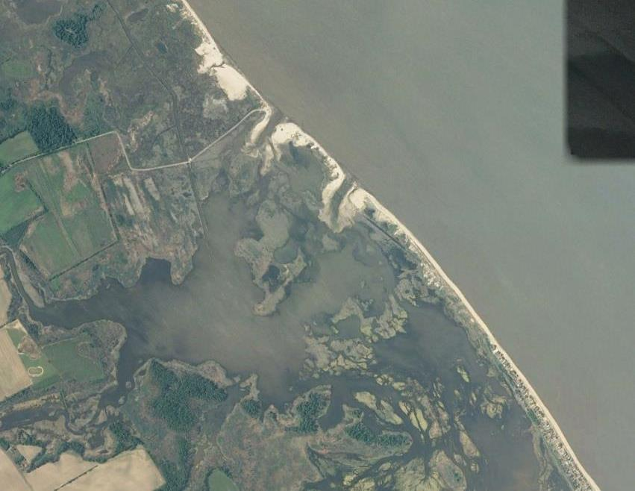
2011 Aerial – Two Breaches
Fowler Beach Road
Project Area
Notes:
As you can see from 2011 aerial
Two breaches formed following storms in 2009

Slide 12
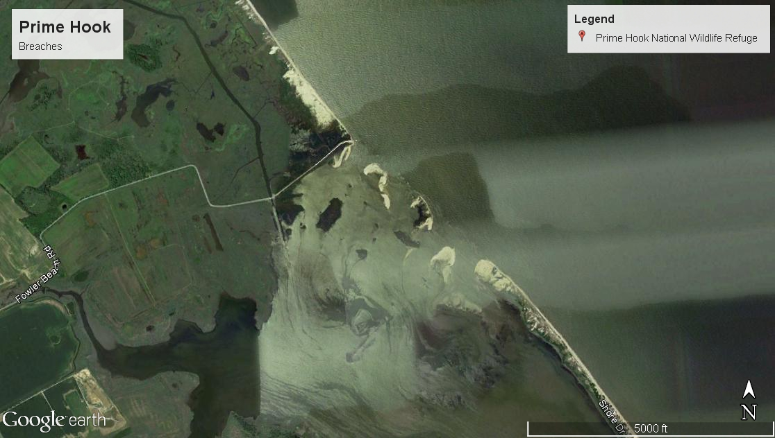
2012 – Hurricane Sandy
Two more large breaches
Total breached area nearly tripled
Fowler Beach Road
2015 Aerial
Post Sandy
Project Area
Notes:
Following Hurricane Sandy in 2011, two more breaches formed
A contributing factor was the freshwater impoundment which resulted in the beaches not being resilient to over wash and breaching
As a result, the rapid introduction of saltwater threatened the ecosystems behind the beaches

Slide 13
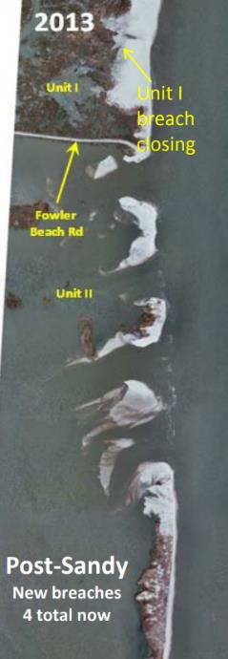
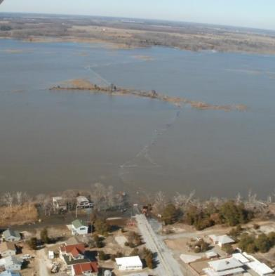
Project Details
Partnered with US FWS
Analyze hurricane impact and build protective beach barrier system
Enhance coastal resilience and critical habitat for birds, fish, and wildlife
Topographic and hydrographic surveys
Salinity and hydrodynamic modeling using Delft3D
Prime Hook Road
https://delawareestuary.s3.amazonaws.com/pdf/Summit15/BallA/W-Smith.pdf
Notes:
Stantec partnered with the US FWS
And analyzed the hurricane impact and worked to rebuild the protective beach barrier system, with the goal of enhancing coastal resilience and restoring critical habitat
Through this project, a variety of surveys and modeling were performed

Slide 14
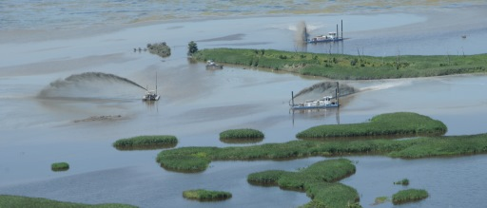
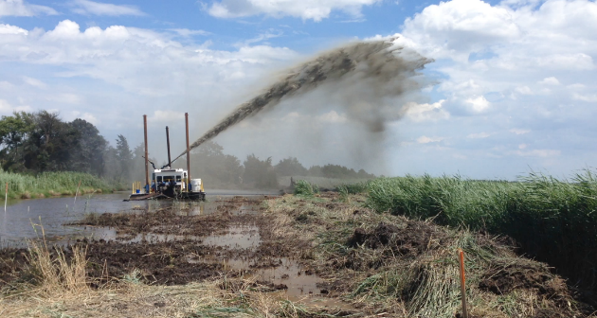
Project Details
Largest post-Hurricane Sandy recovery and restoration project
Construction cost - $40 mil
Restored 2 miles of shoreline
Restored 5,000 acres of marsh
Open water decreased from 87% to 59%
Marsh, bare ground, and other area increased from 13% to 41%
Notes:
To date, Prime Hook is the largest post-Hurricane Sandy recovery and restoration project
With a total construction cost of 40 million dollars
Through the project, 2 miles of shoreline and 5,000 acres of marsh were restored
And much of the freshwater impoundment areas were converted to marshes

Slide 15
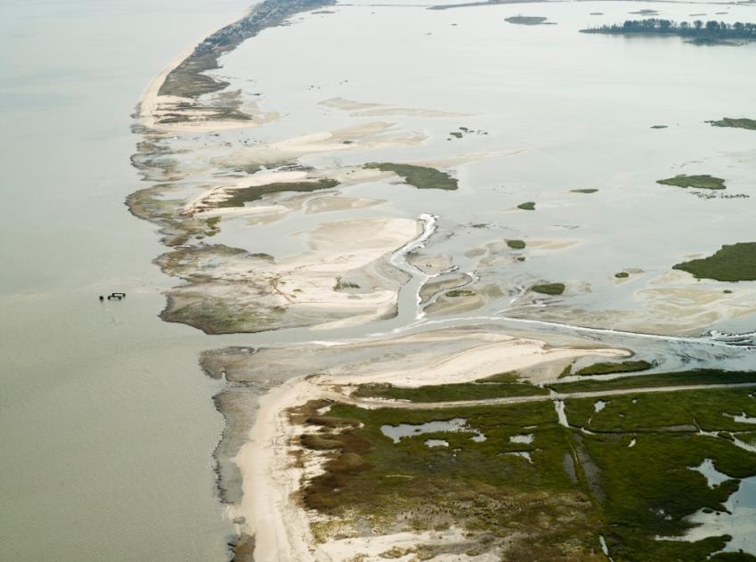
October 2016
Prior to
Construction
Notes:
This picture depicts the beach with breaches prior to construction

Slide 16
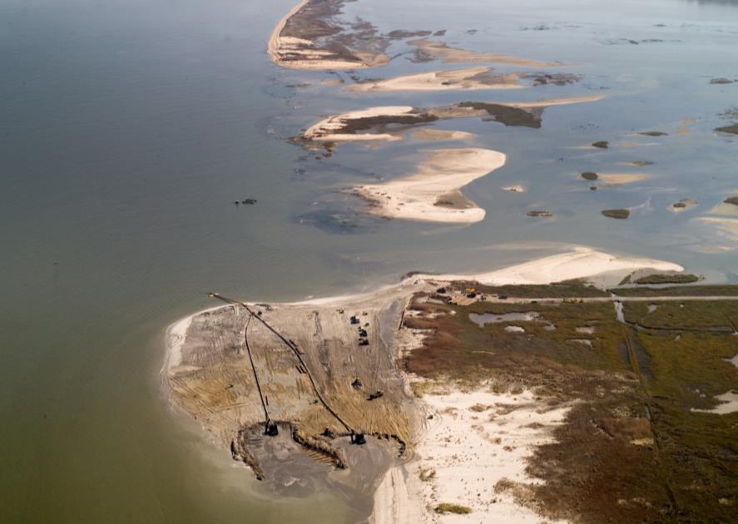
November
Notes:
Starting in November 2016, construction commenced

Slide 17
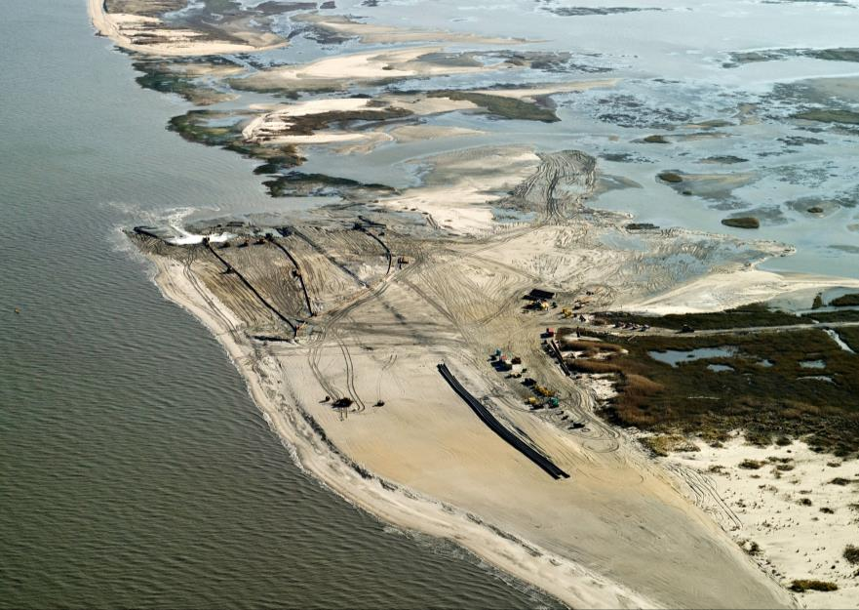
December

Slide 18
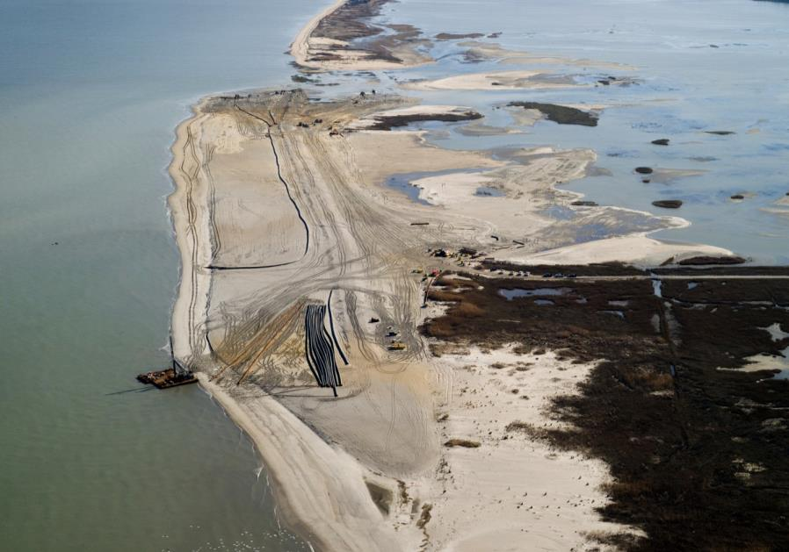
January

Slide 19
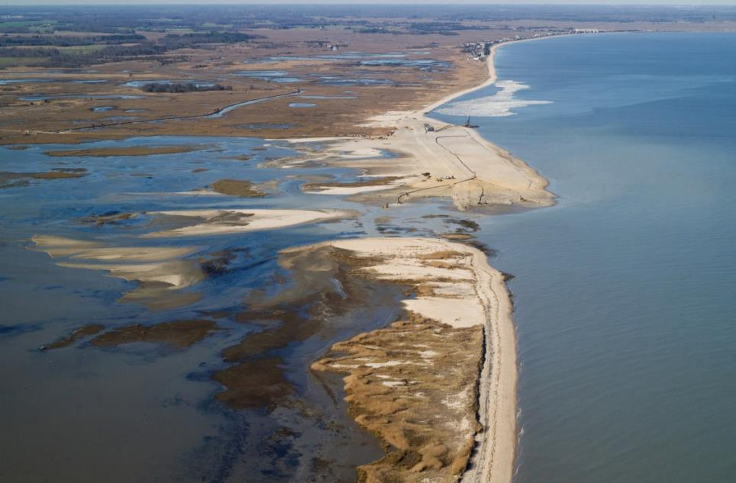
January

Slide 20
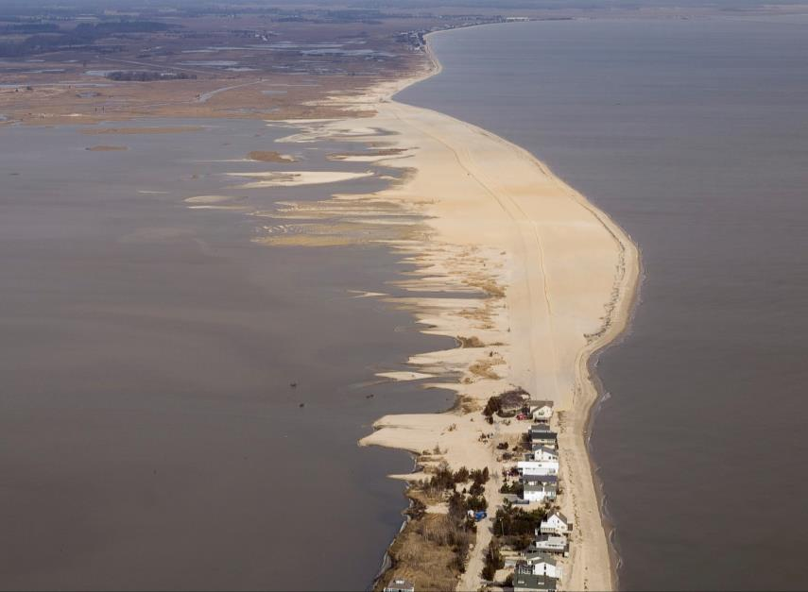
1.3 Million cy
Placed sand
March 2017 – Final Project
Notes:
After 5 months of construction and 1.3 million CY of sand, the breaches had been stopped and there was a contiguous beach

Slide 21
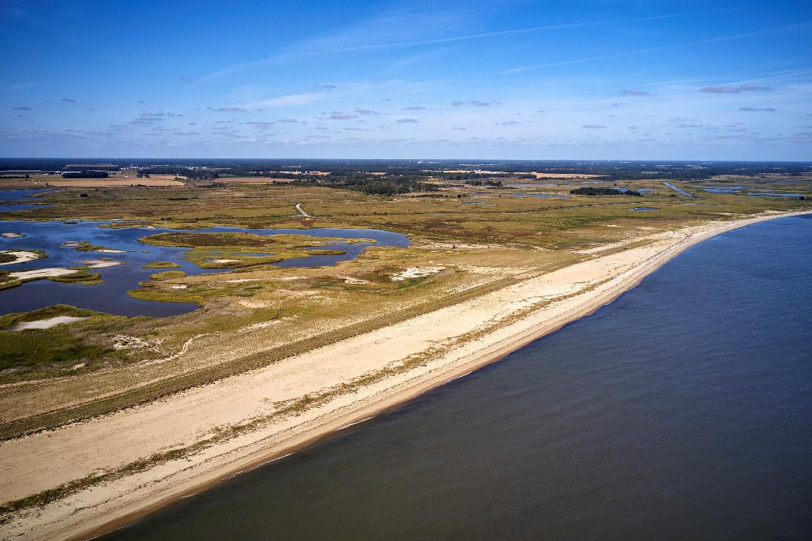
Sept 2019 – 2 Years Post-Construction

Slide 22
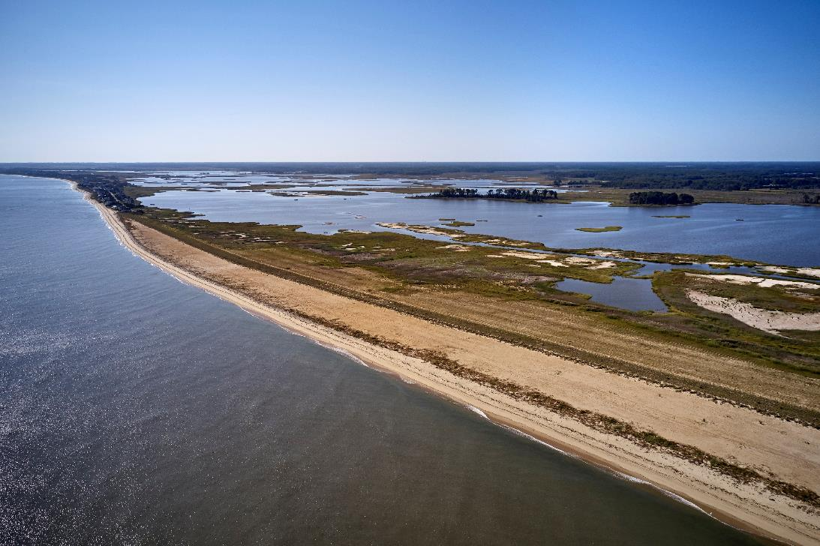
Sept 2019 – 2 Years Post-Construction

Slide 23
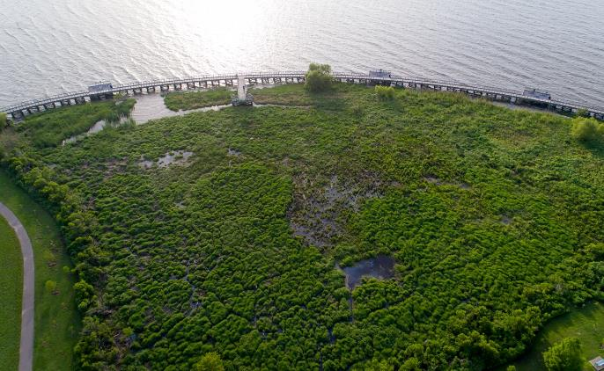
Approach to Quantifying Climate Mitigation
Baseline vs. Project scenario
Soil CO₂, CH₄, and N₂O flux
Above and belowground vegetation storage
Total climate mitigation = carbon sequestration - GHG emissions
Sequestration estimated based on monitoring data after project implementation
Notes:
…after project completion, we quantified climate mitigation
The basic technique for determining climate mitigation from a restoration project involves comparing a baseline scenario to a post-intervention project scenario
Typically we look at the fluxes from soil such as carbon, methane, and nitrous oxide
As well as the carbon stored in vegetation
From there, climate mitigation can be calculated by deducting GHG emissions from carbon storage
For this project, we performed these calculations using monitoring data from after the project was implemented

Slide 24
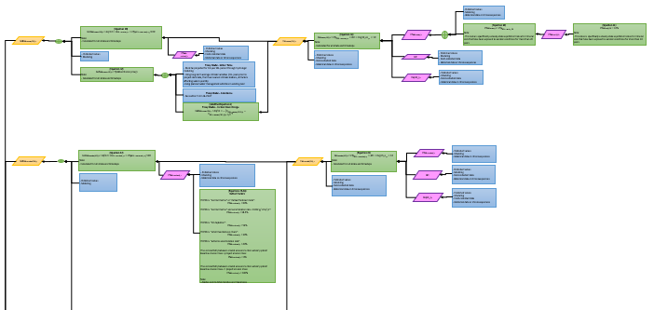
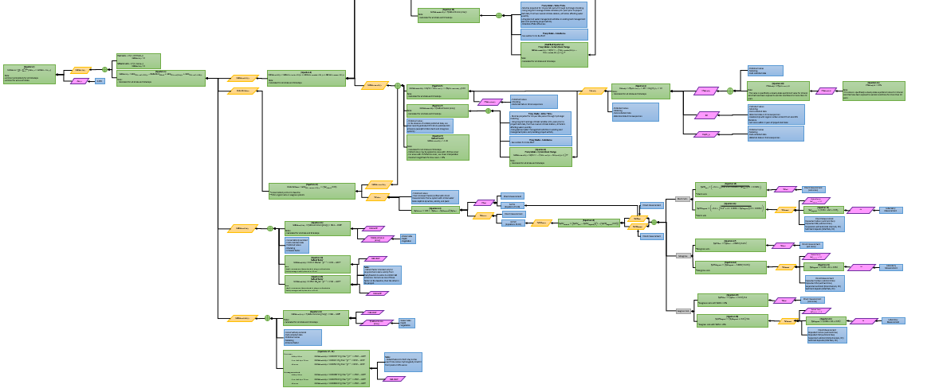
© 2023 by Stantec Consulting Services Inc., All Rights Reserved.
Notes:
While this sounds simple on it’s face, the methodologies used to quantify climate change mitigation, specifically through existing carbon markets, are extremely complex
This flowchart is 1/34 modules used in a Verra Blue Carbon crediting methodology, which quantifies the baseline climate impact associated with tidal wetlands
The pictured module consists of over 42 equations and 30 separate inputs
Stantec has been working on developing tools internally that streamline this process

Slide 25
Carbon Benefit
Year | Hectares | Change in Hectares | Tonnes of Carbon
Baseline | 412.38 | 0.00 | 0.00
2016 | 482.40 | 70.01 | 210.04
2017 | 691.22 | 208.82 | 208.82
2018 | 694.86 | 3.64 | 3.64
2019 | 628.09 | -66.77 | -66.77
Total (t C) |  |  | 355.73
Total (t CO₂e) |  |  | 1,304.33
Vegetation
Calculations of carbon sequestration in vegetation are based on default factors and monitoring data
Total improved vegetative sequestration to date is 1,304.33 t CO₂e
Soils
Enhanced carbon sequestration is derived from growing marsh area
Onsite emissions will vary depending on soil characteristics, salinity, inundation, vegetation, etc.
Does not factor in flux from open water areas
22,732 t CO₂e= 2,568,713 gallons of gasoline
Scenario | Hectares | t CO₂ ha⁻¹ yr⁻¹ | t CH₄ ha⁻¹ yr⁻¹ | t CO₂e ha⁻¹ yr⁻¹ | t CO₂e yr⁻¹ | Enhanced Carbon Sequestration (t CO₂e yr⁻¹)
Baseline | 412.38 | -7.66 | 0.16 | -3.31 | -1,365.54 | 714.26
Project | 628.09 | 70.01 |  |  | -2,079.80
https://coastalchangelab.files.wordpress.com/2019/01/finalreport_may_2018.pdf
https://link.springer.com/article/10.1007%2Fs13157-011-0197-0
Projection | Scenario | Marsh Area | 4 Year Emissions (t CO2e) |  |  | 30 Year Emissions (t CO2e) |  |  | 4-Year Offsets | 30-Year Offsets
 |  | Ha | Soil | Vegetation | Total | Soil | Vegetation | Total
Degraded to restored | Baseline | 412 | -5,462 | 0 | -5,462 | -40,966 | 0 | -40,966 | 4,161 | 22,732
 | Project | 628 | -8,319 | -1,304 | -9,624 | -62,394 | -1,304 | -63,698
Notes:
At Prime Hook, we utilized high level calculations to develop an estimate of climate change mitigation, shown here
Looked at the carbon sequestered in marsh vegetation, annual soil carbon storage, annual soil CH₄ emission.
In these calculations, we evaluated approximately 25% of the restored project area (1,200 acres)
In this area, marsh land had increased by 533 acres
Over a 30-year period, we determined that these newly created marsh areas would sequester 23k t CO2e
This climate mitigation is the equivalent of avoiding emissions from 2.5M gallons of gasoline
Big note: this project increased the resiliency of the ecosystems behind it, true for many coastal projects. The carbon benefit from this project extends outside the project area since it protects the carbon stored in other ecosystems and allows them to continue sequestering

Slide 26
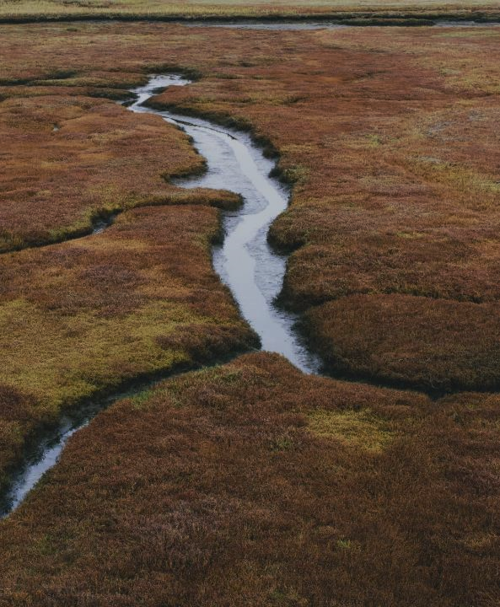
Blue Carbon is Important
Coastal ecosystems are effective carbon sinks
Blue carbon can finance restoration
There are barriers to blue carbon crediting in the Gulf
The future is bright, and we are working hard ☺
Notes:
Coastal ecosystems have an important relationship to the climate
Although they only occupy 5% of global land area (Crooks et al., 2019), they sequester 30% of all soil carbon (Nahlik and Fennessy, 2016).
“Blue Carbon” as a concept is important to restoration planning
Allows climate mitigation to be a driver or co-benefit of restoration, makes it possible to fund projects through carbon markets
Notably however, a variety of factors have prevented any blue carbon credit projects from being implemented in the Gulf
This stems from challenges related to scientific research and data gaps, cost issues, and how dynamic coastal ecosystems are in the Gulf
Nonetheless, Stantec and our partners view Blue Carbon ecosystems as having tremendous value and potential for climate mitigation, and we are working to develop Blue Carbon as a management tool in the Gulf
Earlier this week Stantec, TWI, CPRA, NOAA, and Restore America’s Estuaries hosted an initial Blue Carbon working group that aims to address these challenges
I encourage anyone who studies or does work related to (or adjacent to) Blue Carbon to reach out regarding that organization
There will be future meetings, and would appreciate more voices and perspectives

Slide 27
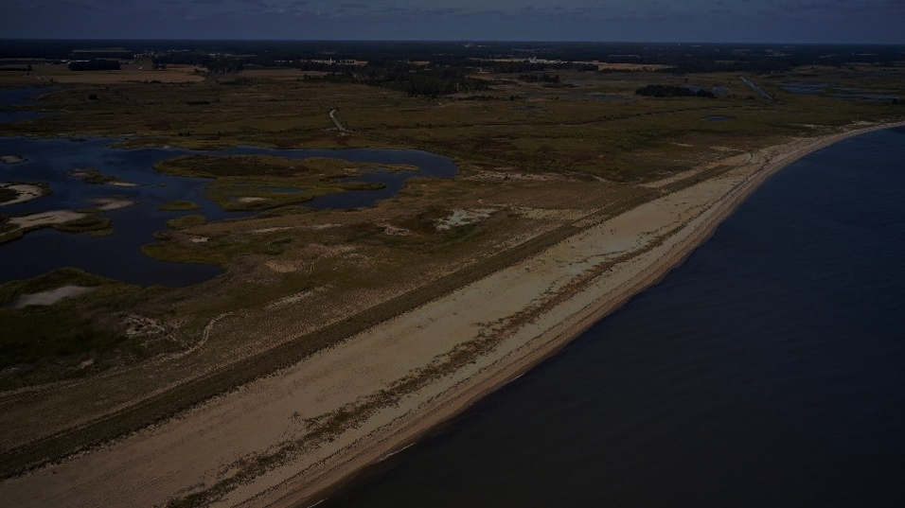
Questions?
Ben Smith
Ben.Smith@Stantec.com
Notes:
We have a couple of minutes for questions, but feel free to email me
This QR code will take you to a web page if you’d like to read more about Stantec’s “Nature Based Solutions” services

