Slide 1
DECISION MAKING UNDER UNCERTAINTY:
QUANTIFYING UNCERTAINTIES WITHIN THE LA MASTER PLAN MODELS
ERIC D. WHITE, PE
STATE OF THE COAST 2023
JUNE 2, 2023

Slide 2
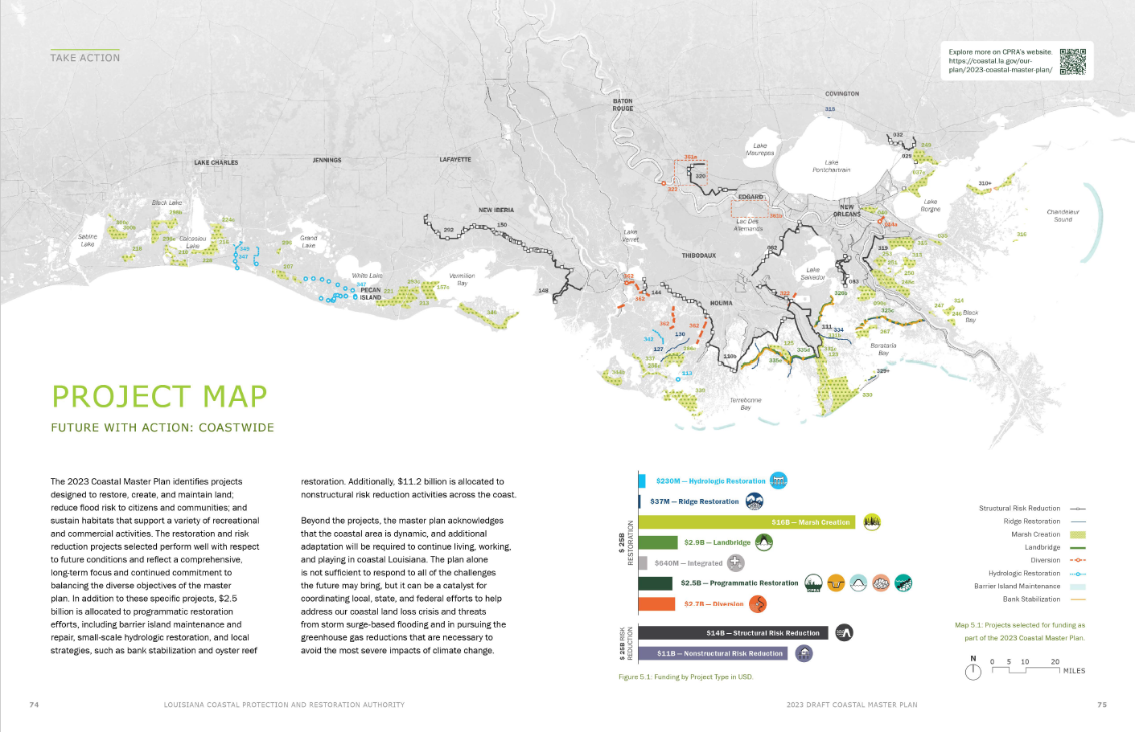
66 Restoration Projects
12 Structural Risk Reduction Projects
$11B for Nonstructural Risk Reduction
Notes:
Land change S06 YEAR 50

Slide 3
THE 2023 COASTAL MASTER PLAN
ACCOUNTING FOR UNCERTAINTY IN THE QUANTITATIVE DECISION MAKING PROCESS
Uncertainties handled in (at least) three specific ways for the 2023 Master Plan:
Model inputs and initial conditions are revisited/refreshed at the start of every master plan cycle.
geospatial/landscape data
spatiotemporal boundaries (tidal, tributary input, rainfall/atmospheric)
data-based input tables and statistical relationships
future environmental scenario design/selection
Robust * project selection across multiple future environmental scenarios
Model validation and parametric uncertainty analyses
* more on this later

Slide 4
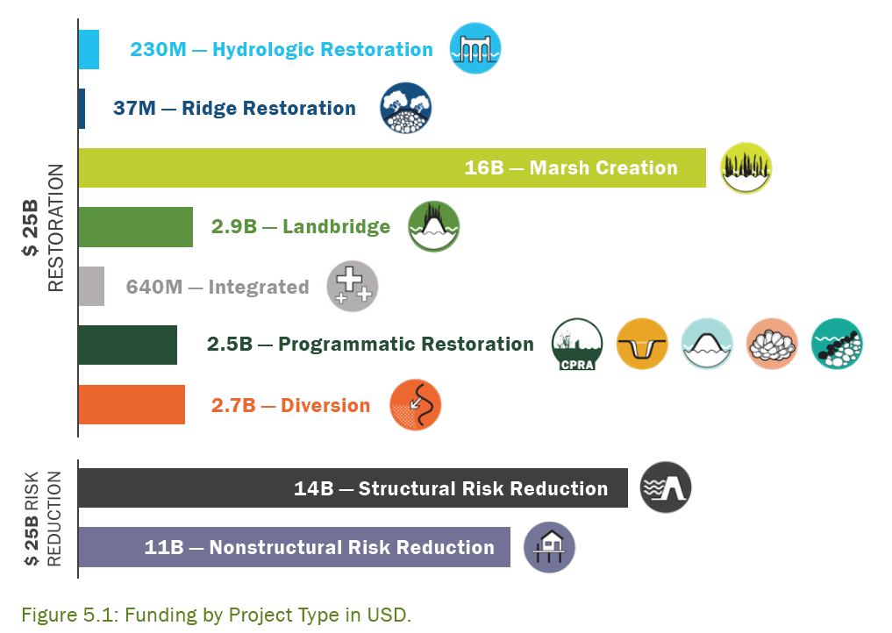
THE 2023 COASTAL MASTER PLAN
RESTORATION PROJECTS
Upper Basin Diversion Program
$19B in dredging projects
Ridge Restoration
$2.5B in Programmatic
Barrier Islands, small-scale hydrologic restoration, oyster reefs, shoreline protection

Slide 5
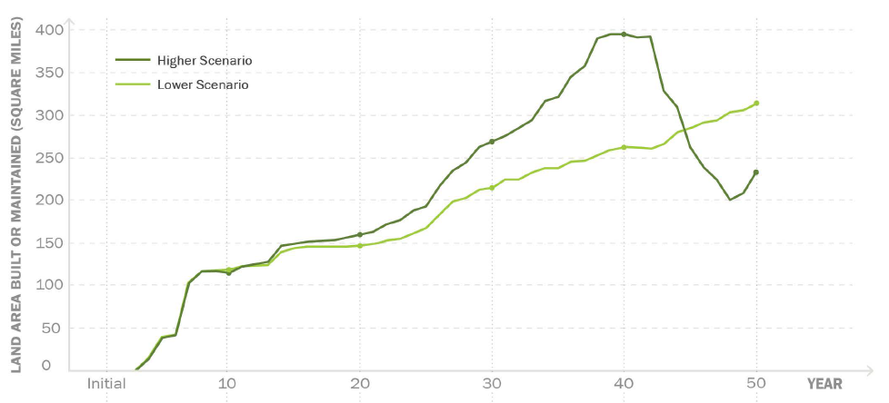

Slide 9
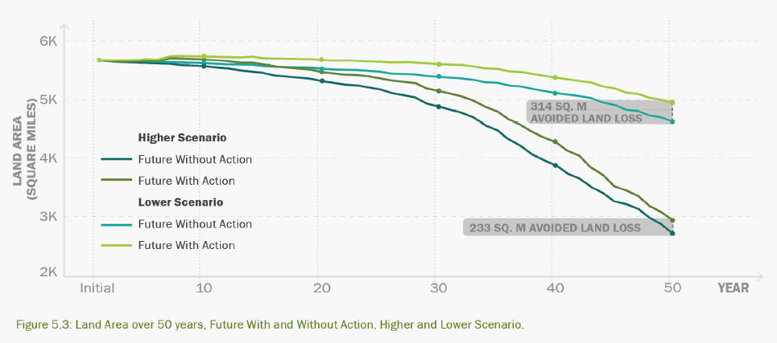
THE 2023 COASTAL MASTER PLAN
RESTORATION PROJECT BENEFITS
Under the lower scenario 314 sq mi of land is built or maintained that would have otherwise been lost by Year 50.
Under the higher scenario 233 sq mi of land is built or maintained at Year 50. We see a maximum benefit of 395 sq mi of additional land at Year 40 under this higher scenario, however the benefits of many of the early projects diminish in the final decade as they can no longer keep pace with subsidence and accelerated rates of sea level rise.

Slide 10
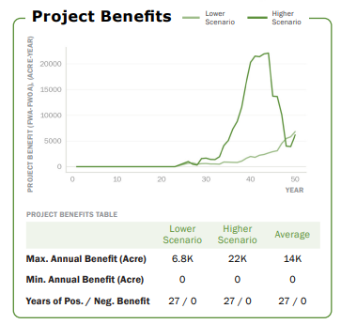
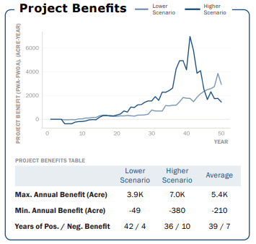
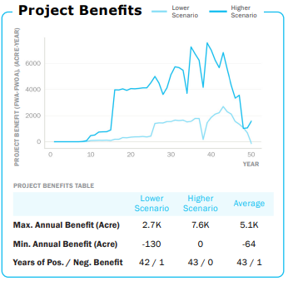
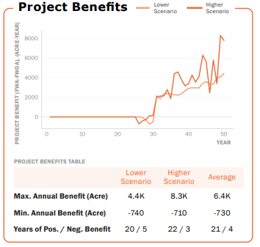
ADDRESSING UNCERTAINTIES WITH ROBUST PROJECT SELECTION
RESTORATION PROJECT BENEFITS - HANDLING OF UNCERTAINTIES
For selection in the MP, a project:
will be assessed via measuring benefits annually (rather than just Year 20 and 50 a la 2017 MP)
will be assessed on total cumulative benefit over the plan period
must have positive benefit under both project selection scenarios

Slide 11
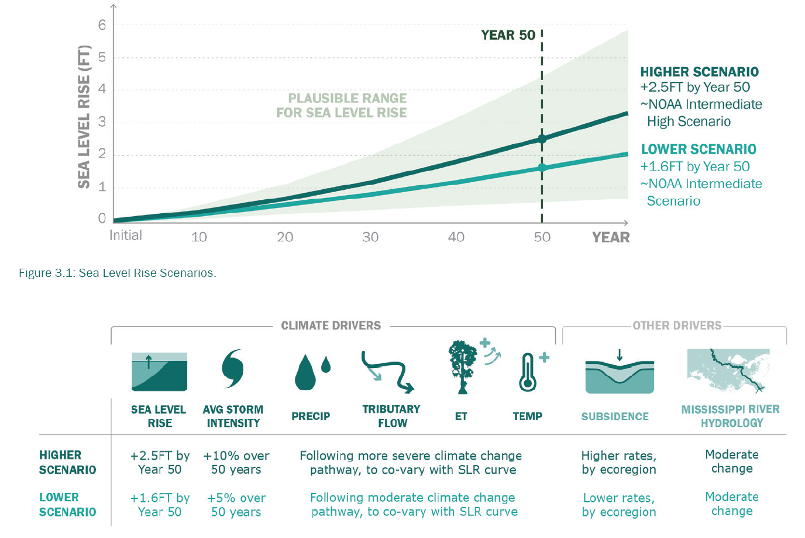
ADDRESSING UNCERTAINTIES WITH FUTURE SCENARIOS
FUTURE ENVIRONMENTAL SCENARIO UNCERTAINTY

Slide 12
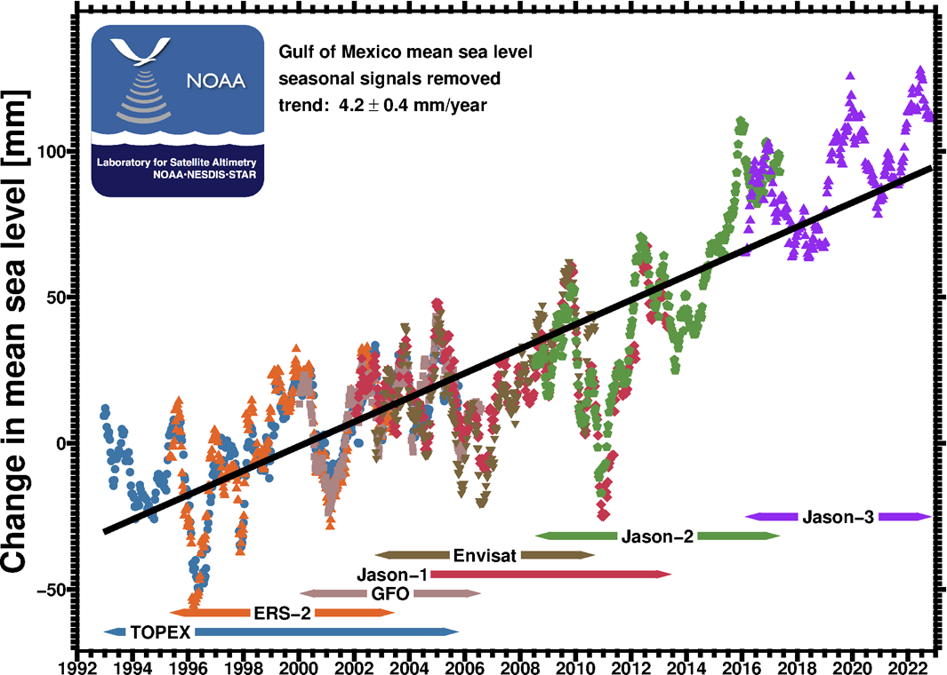
HISTORIC SEA LEVEL - GULF OF MEXICO
NOAA SATELLITE ALTIMETRY - 1992 TO 2023

Slide 13
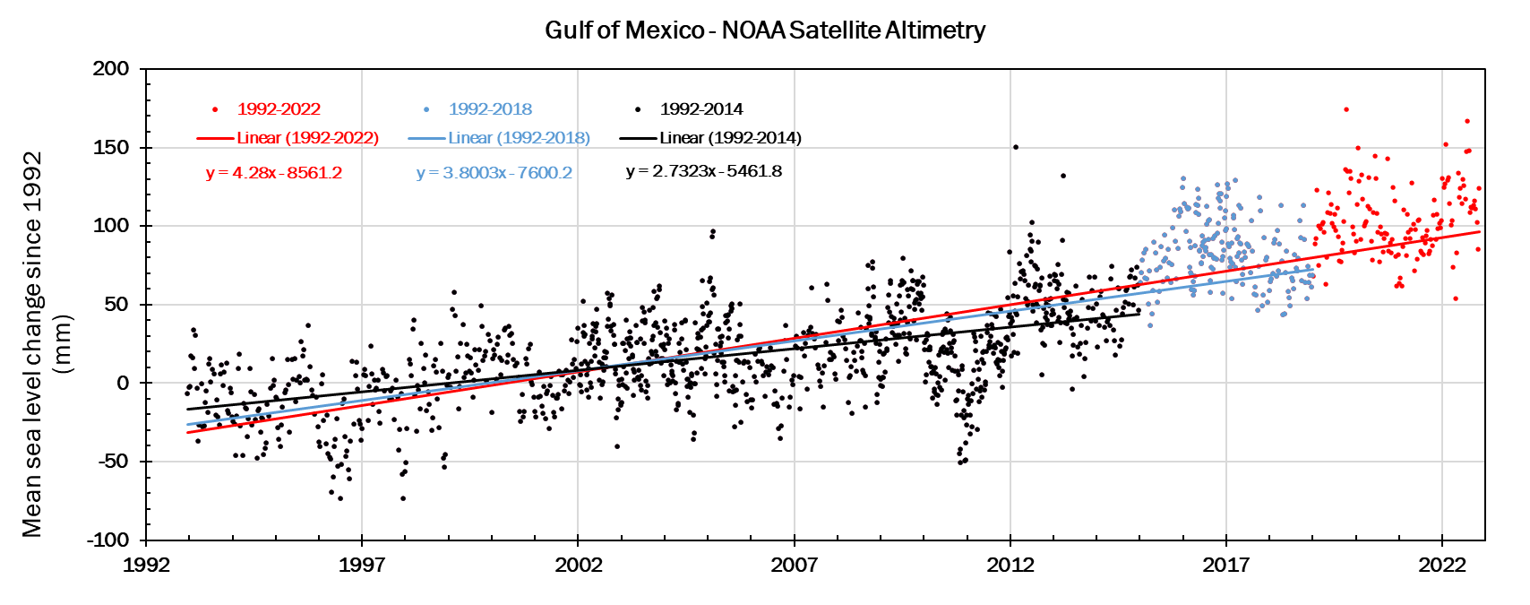
ADDRESSING UNCERTAINTIES BY REVISITING DATA & ASSUMPTIONS
NOAA SATELLITE ALTIMETRY - 1992 TO 2023 - GULF OF MEXICO
1992-2014 GOM SLR = 2.7 mm/yr
1992-2018 GOM SLR = 3.8 mm/yr
1992-2023 GOM SLR = 4.2 mm/yr

Slide 14
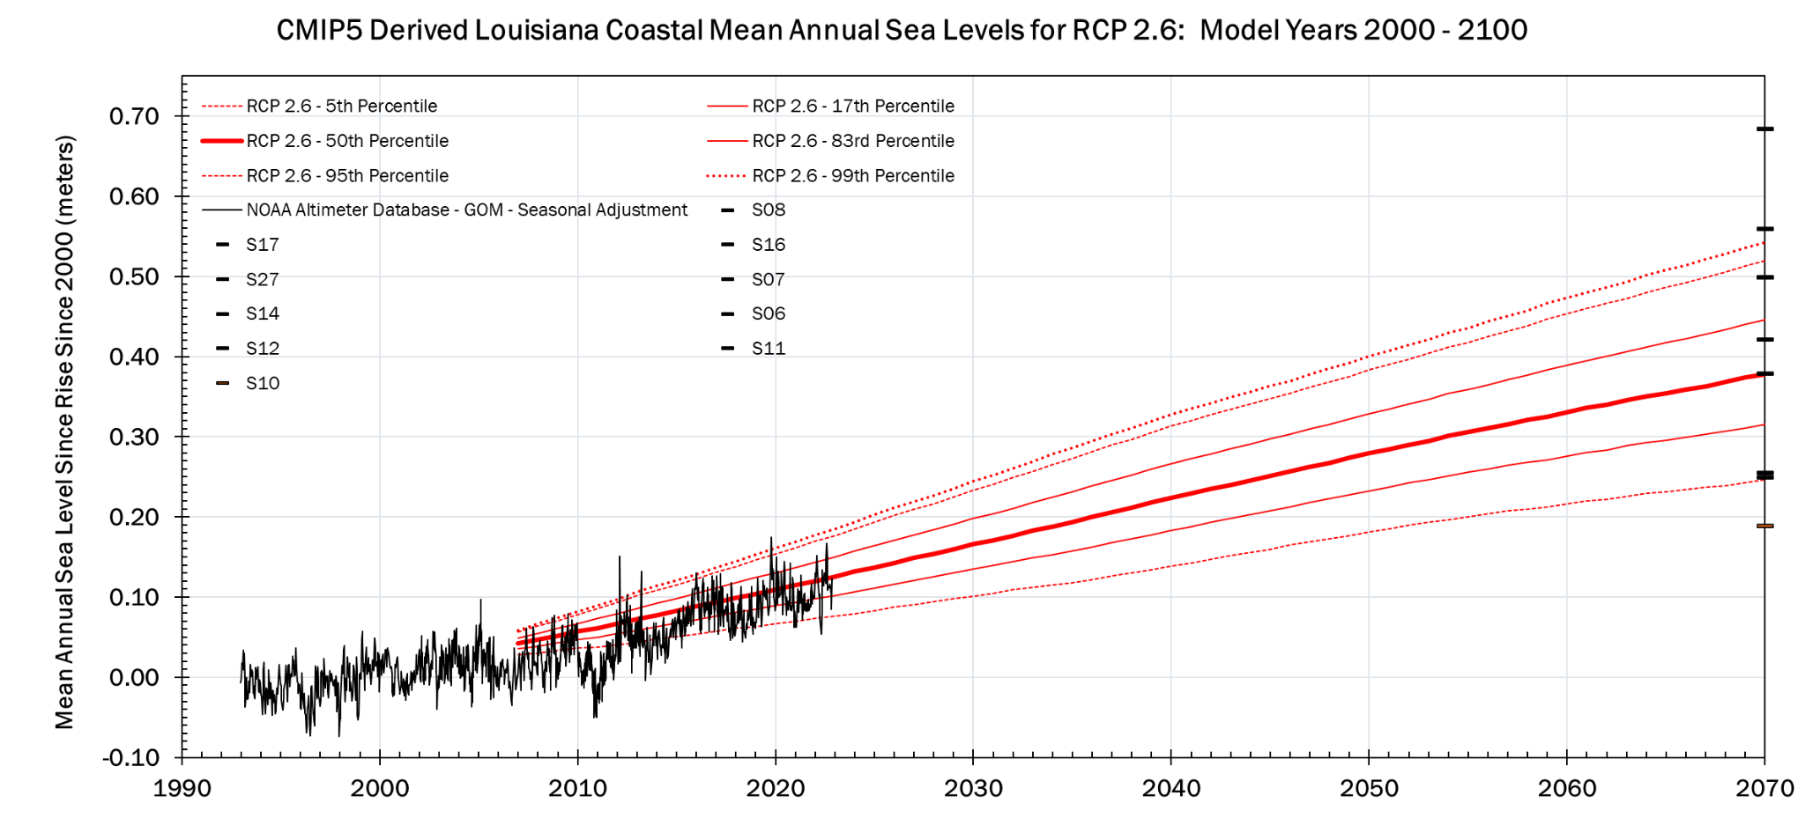
HISTORIC SEA LEVEL - GULF OF MEXICO
ENVIRONMENTAL SCENARIO UNCERTAINTY
ENVIRONMENTAL SCENARIOS FOR UNCERTAINTY ANALYSIS

Slide 15
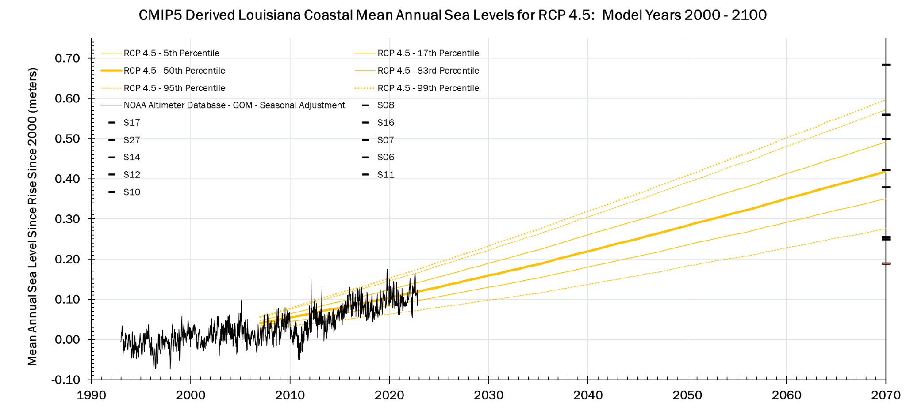
HISTORIC SEA LEVEL - GULF OF MEXICO
ENVIRONMENTAL SCENARIO UNCERTAINTY
ENVIRONMENTAL SCENARIOS FOR UNCERTAINTY ANALYSIS

Slide 16
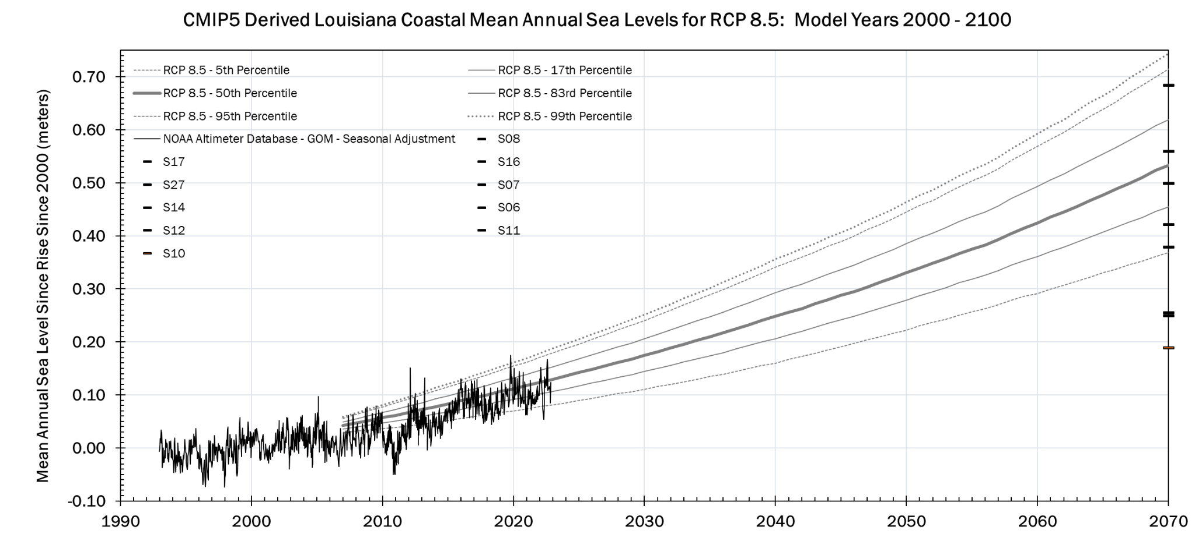
HISTORIC SEA LEVEL - GULF OF MEXICO
ENVIRONMENTAL SCENARIO UNCERTAINTY
ENVIRONMENTAL SCENARIOS FOR UNCERTAINTY ANALYSIS

Slide 17
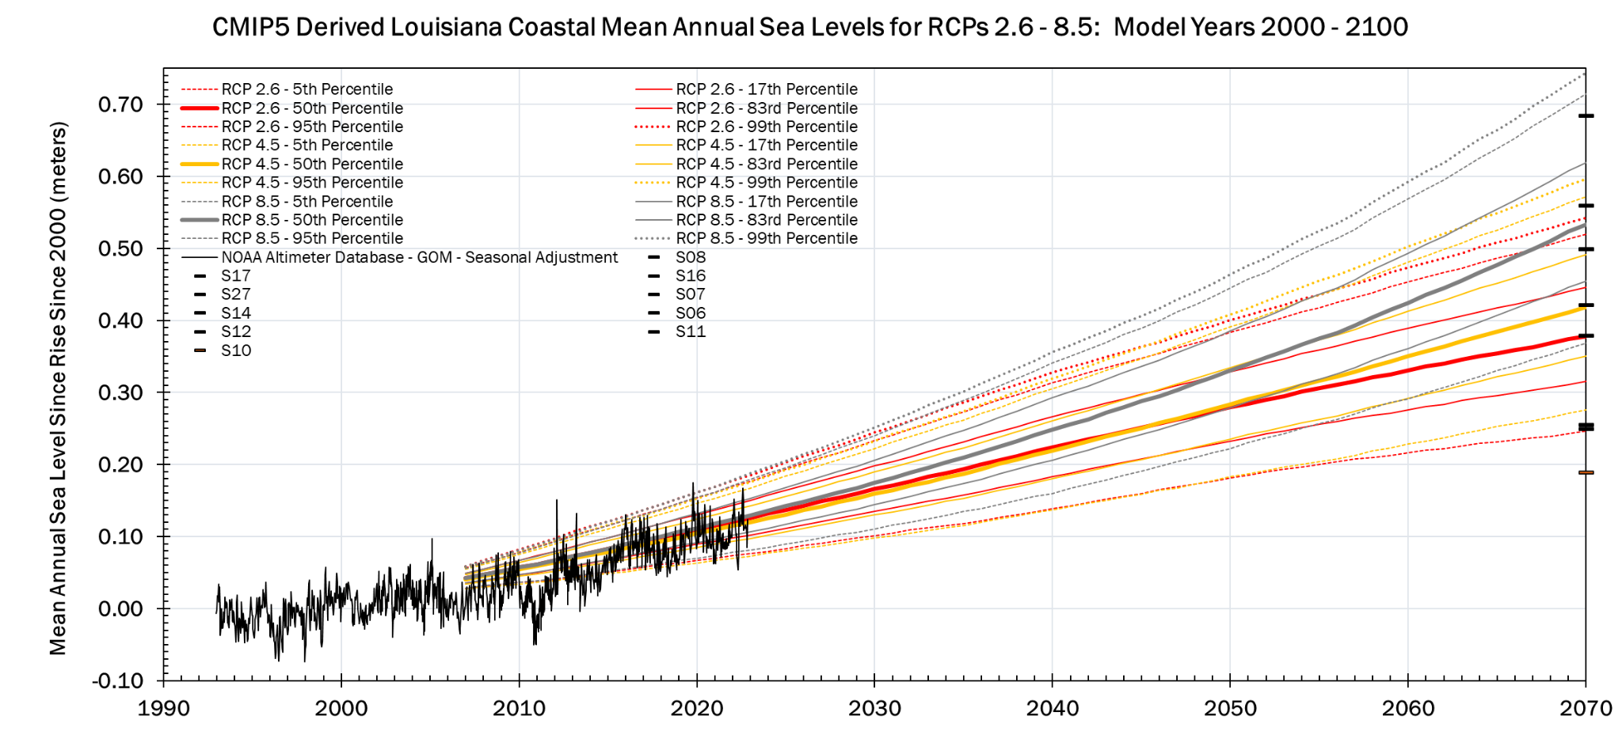
HISTORIC SEA LEVEL - GULF OF MEXICO
ENVIRONMENTAL SCENARIO UNCERTAINTY
ENVIRONMENTAL SCENARIOS FOR UNCERTAINTY ANALYSIS

Slide 18
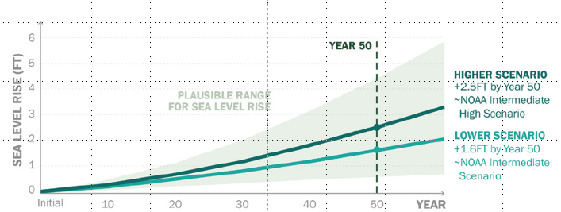
HISTORIC SEA LEVEL - GULF OF MEXICO
ENVIRONMENTAL SCENARIO UNCERTAINTY
ENVIRONMENTAL SCENARIOS FOR UNCERTAINTY ANALYSIS

Slide 19
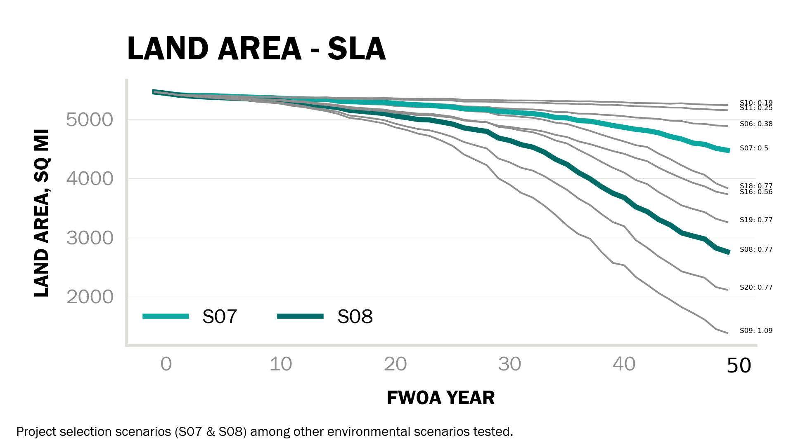
COASTAL LAND AREA
ENVIRONMENTAL SCENARIO UNCERTAINTY

Slide 20
THE 2023 COASTAL MASTER PLAN
EXPLORATORY ANALYSIS - ENVIRONMENTAL SCENARIO UNCERTAINTY
Subsidence Test
All variables held constant, except for subsidence. S08 environmental forcings.
Precip Test
All variables held constant, except for precipitation/tributary flows. Tests sensitivity to precipitation under very low rates of RSLR (e.g., when system will be most sensitive to precipitation changes).
Temp Test
All variables held constant, except for temperature/evapotranspiration. Tests sensitivity to temperature under very low rates of RSLR (e.g., when system will be most sensitive to temperature changes).
5 runs
RCPs - low subsidence
Best representation of IPCC Representative Climate Pathways - all run with low subsidence rates. There are repeats for all RCP8.5 simulations; with and without coupled MR hydrographs.
RCPs - high subsidence
Best representation of IPCC Representative Climate Pathways - all run with high subsidence rates. There are repeats for all RCP8.5 simulations; with and without coupled MR hydrographs.
2 runs
2 runs
MR Hydro Test - low subsidence
Two RCP8.5 scenarios with low subsidence rates; each run with the RCP8.5 ensemble Mississippi River hydrograph and the RCP4.5 ensemble Mississippi River hydrograph. Tests sensitivity to river hydrograph - can be coupled to additional ensemble hydrograph tests.
MR Hydro Test - high subsidence
Two RCP8.5 scenarios with high subsidence rates; each run with the RCP8.5 ensemble Mississippi River hydrograph and the RCP4.5 ensemble Mississippi River hydrograph. Tests sensitivity to river hydrograph - can be coupled to additional ensemble hydrograph tests.
8 runs
8 runs
ESLR Test - low subsidence
All variables held constant, except for ESLR rates. Tests sensitivity to ESLR under lower rates of subsidence. S06/S07 environmental forcings.
ESLR Test - high subsidence
All variables held constant, except for ESLR rates. Tests sensitivity to ESLR under lower rates of subsidence. S08/S09 environmental forcings.
4 runs
4 runs
3 runs
5 runs

Slide 21
THE 2023 COASTAL MASTER PLAN
EXPLORATORY ANALYSIS - ENVIRONMENTAL SCENARIO UNCERTAINTY
ESLR Test - low subsidence
All variables held constant, except for ESLR rates. Tests sensitivity to ESLR under lower rates of subsidence. S06/S07 environmental forcings.
ESLR Test - high subsidence
All variables held constant, except for ESLR rates. Tests sensitivity to ESLR under lower rates of subsidence. S08/S09 environmental forcings.
3 runs
5 runs

Slide 22
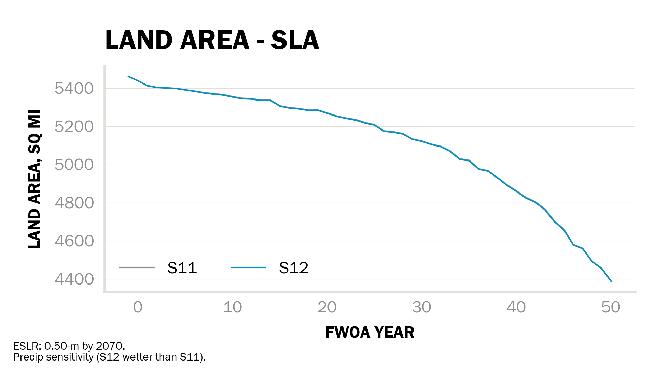
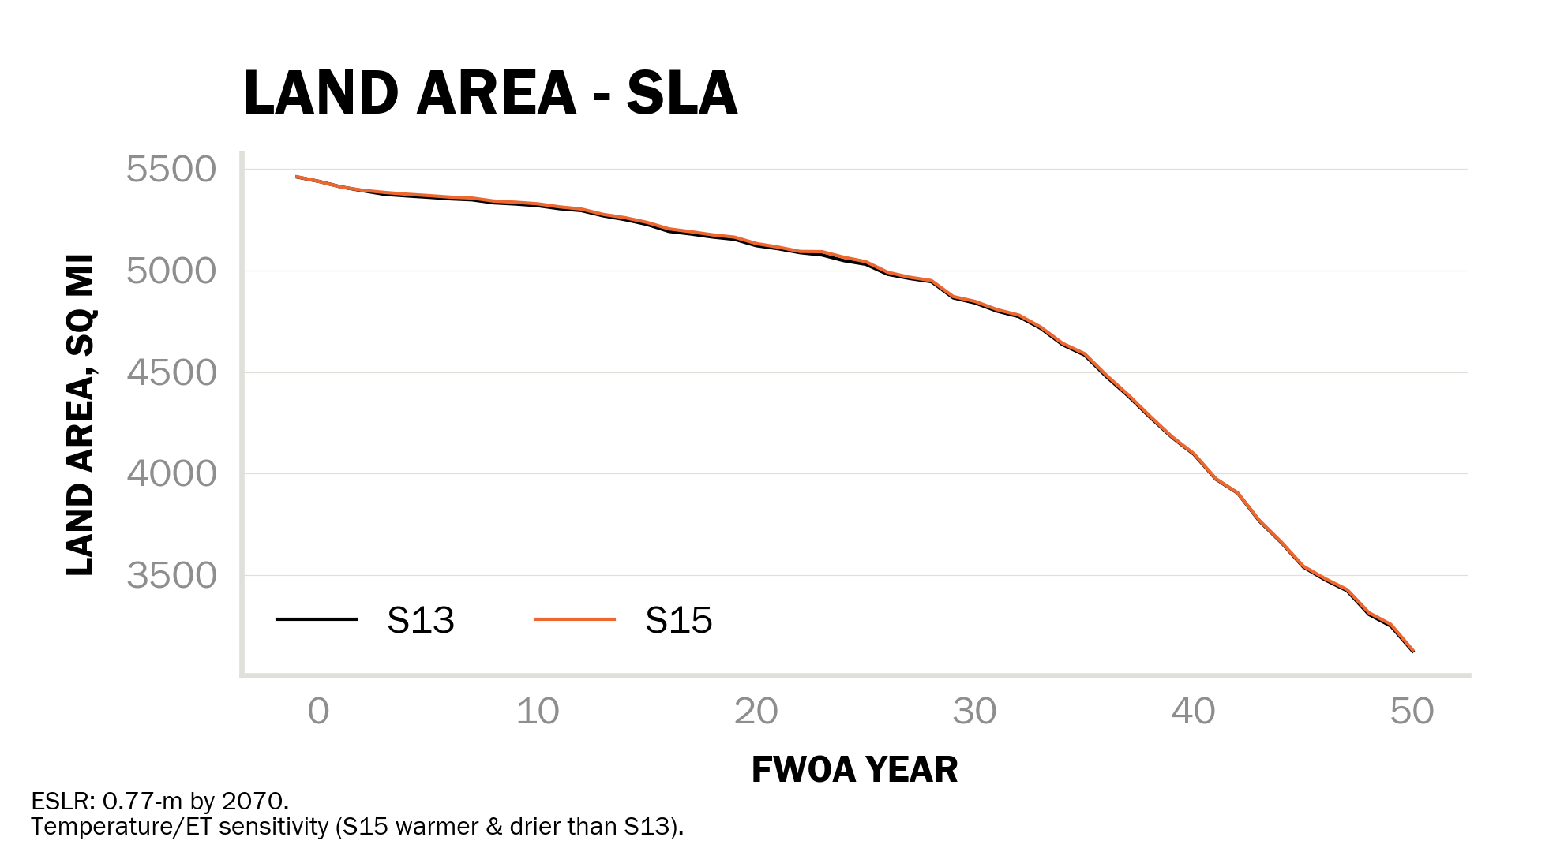
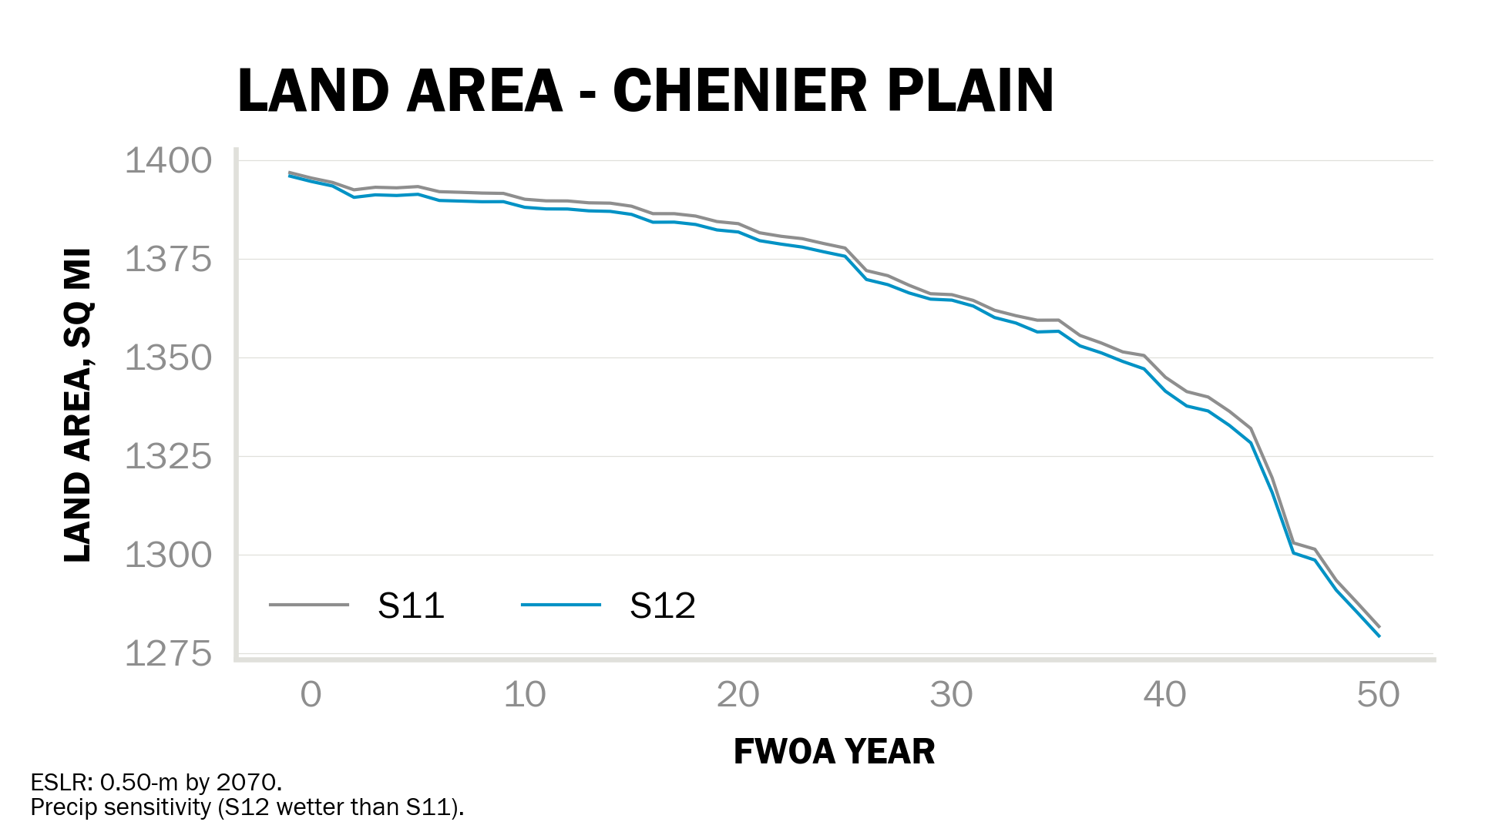
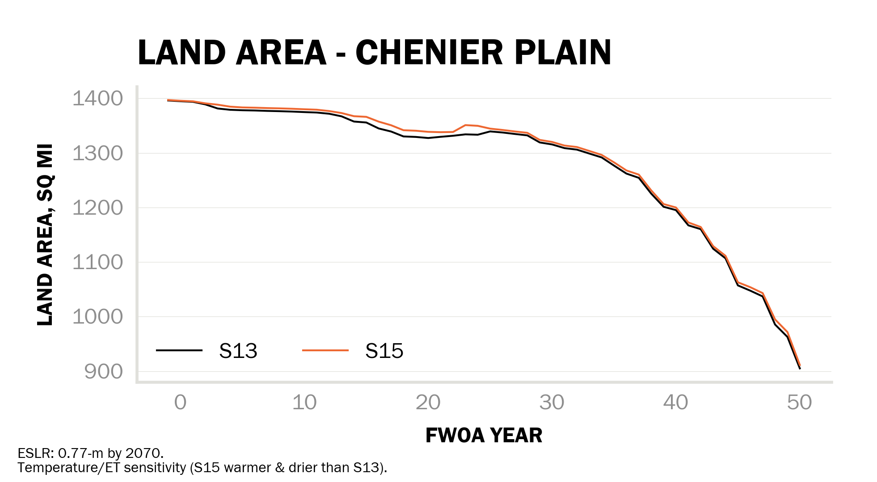
THE 2023 COASTAL MASTER PLAN
EXPLORATORY ANALYSIS - ENVIRONMENTAL SCENARIO UNCERTAINTY
Precip Test
All variables held constant, except for precipitation/tributary flows. Tests sensitivity to precipitation under very low rates of RSLR (e.g., when system will be most sensitive to precipitation changes).
Temp Test
All variables held constant, except for temperature/evapotranspiration. Tests sensitivity to temperature under very low rates of RSLR (e.g., when system will be most sensitive to temperature changes).
2 runs
2 runs

Slide 24
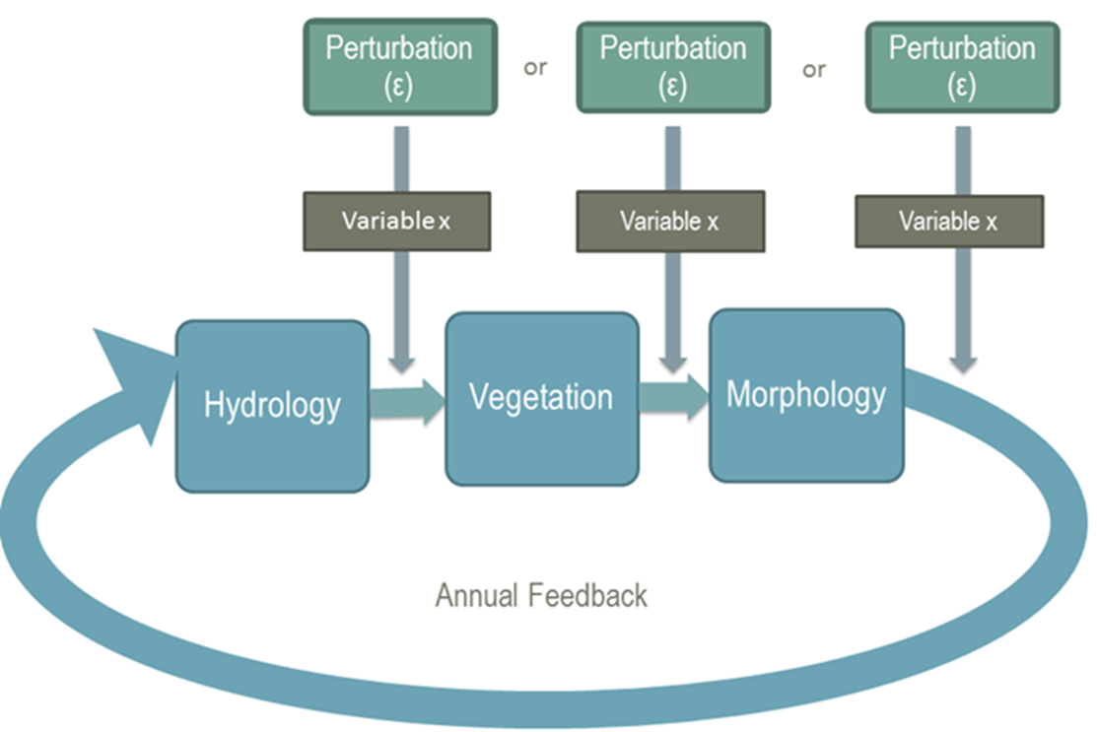
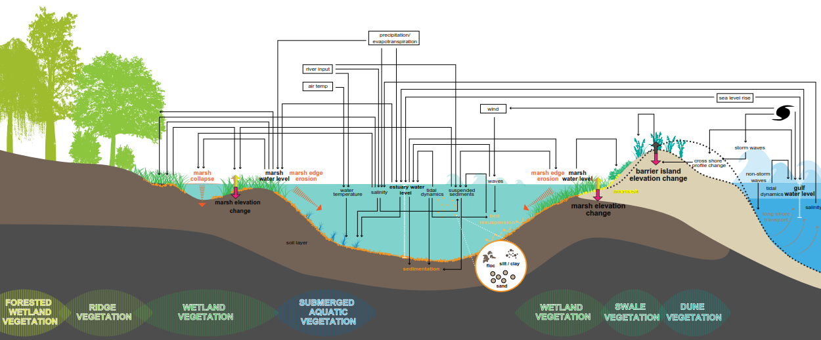
THE 2023 COASTAL MASTER PLAN
PARAMETRIC / MODEL ERROR UNCERTAINTY

Slide 25
THE 2023 COASTAL MASTER PLAN
PARAMETRIC / MODEL ERROR UNCERTAINTY
Following Meselhe et al. (2021) parametric uncertainty will be tested via composite perturbations where combinations of parameter values are adjusted all at the same time
16 combinations (water level, water level variability, salinity, organic accretion)
magnitude of perturbation term is set using model validation statistics
perturbations will be applied to multiple environmental scenarios
Meselhe, E.A., White, E.D., Wang, Y., and Reed, D.J. (2021). Uncertainty Analysis for Landscape Models Used for Coastal Planning. Estuarine, Coastal and Shelf Science. 256 (2021). https://doi.org/10.1016/j.ecss.2021.107371

Slide 26
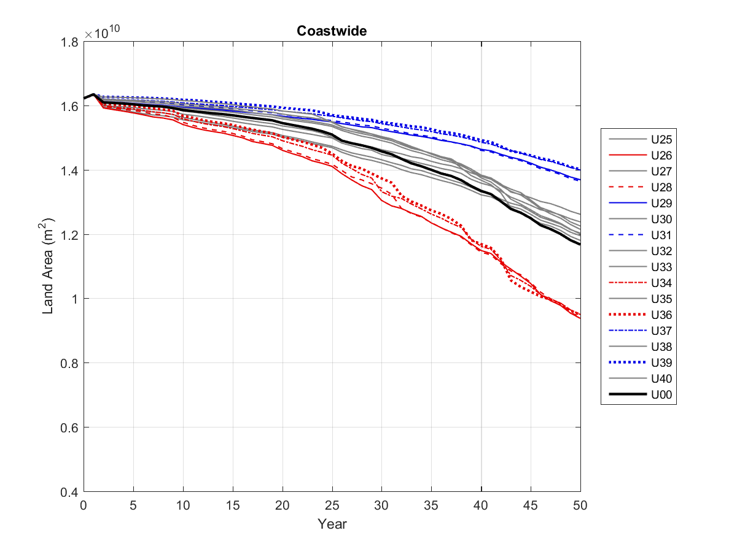
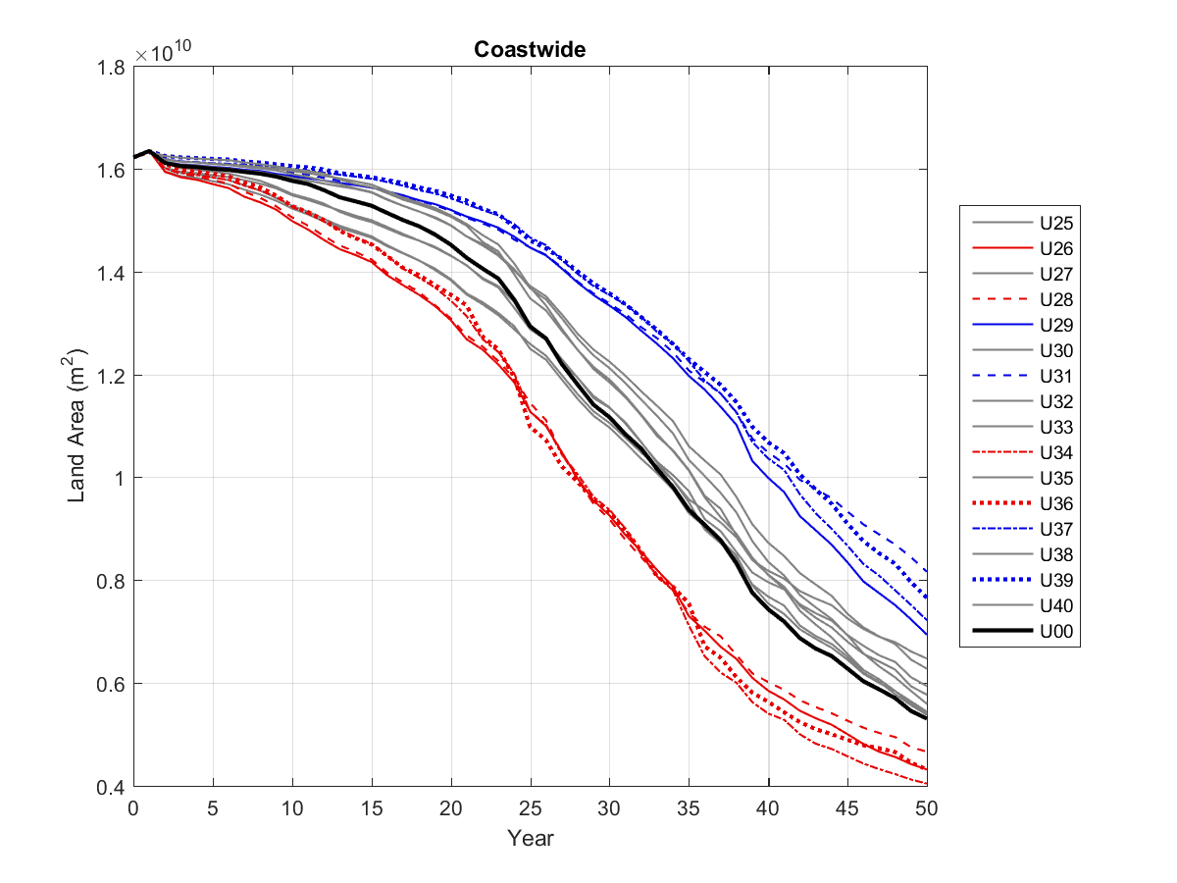
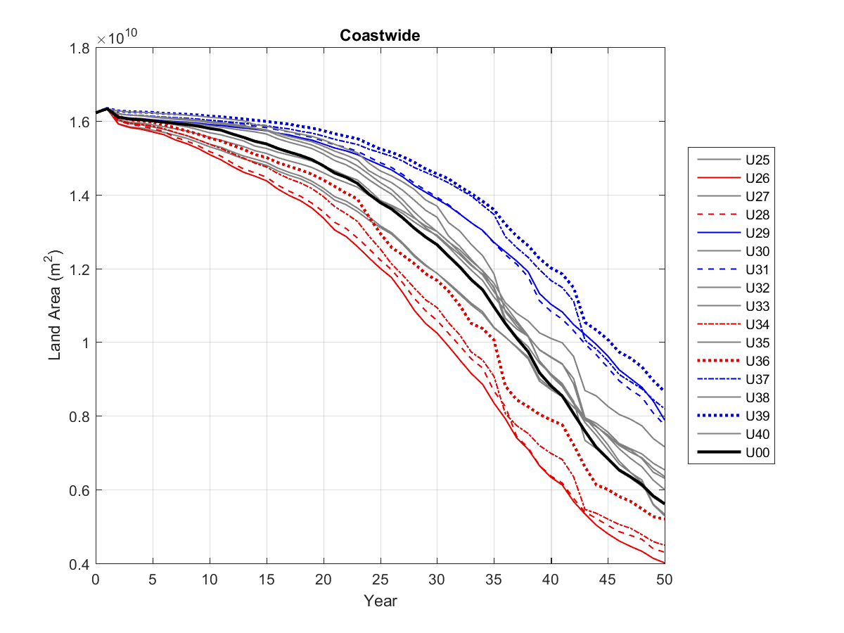
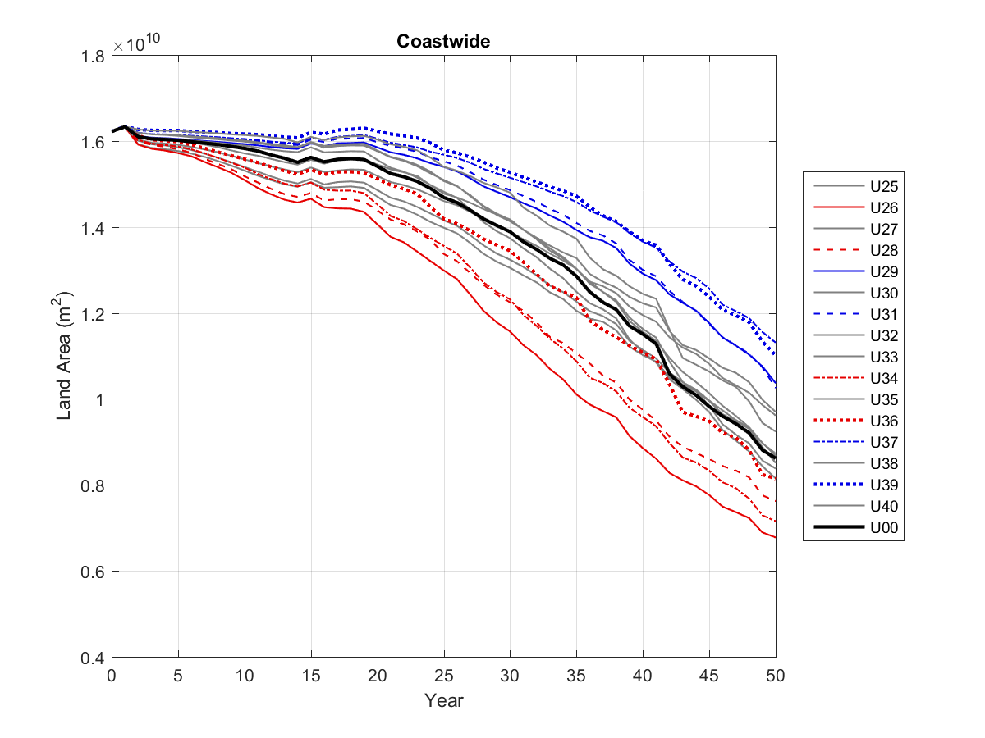
THE 2017* COASTAL MASTER PLAN *2023 analysis currently underway
PARAMETRIC / MODEL ERROR UNCERTAINTY
S01 G001
S03 G001
Black line:
Baseline case
Blue lines:
Mean water level was reduced
Organic accretion was increased
Red lines:
Mean water level was increased
Organic accretion was decreased
Gray lines:
Other combinations of mean water level, accretion, salinity, and water level variability
Low Scenario
Future Without Action
High Scenario
Future Without Action
S03 G300
S03 G400
High Scenario
Future Without Action v3
High Scenario
Draft Master Plan

Slide 27
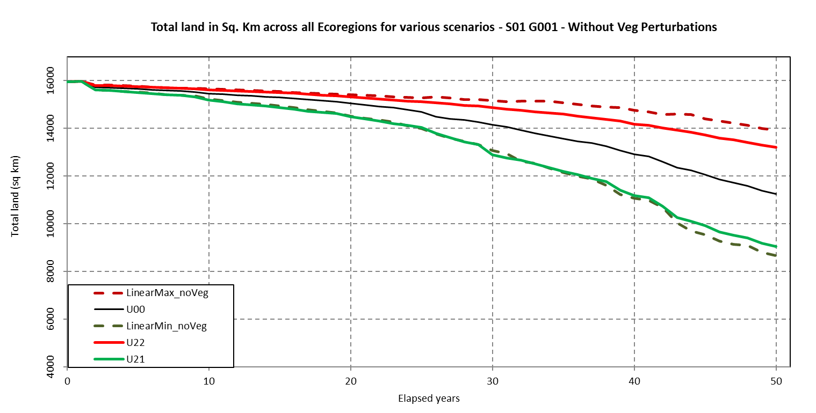
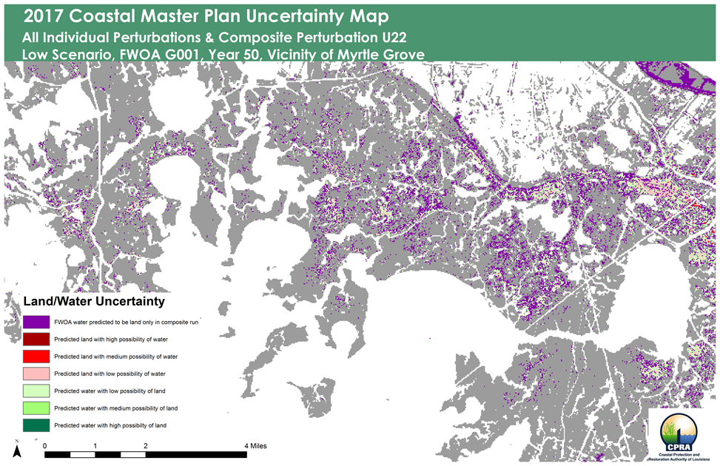
THE 2017* COASTAL MASTER PLAN *2023 analysis currently underway
PARAMETRIC / MODEL ERROR UNCERTAINTY
Two composite perturbations:
Perturb all variables by value that had resulted in a land area prediction greater than baseline
Perturb all variables by value that had resulted in a land area prediction less than baseline
Redundancies and synergies identified in composite perturbation runs:
Some individual perturbations had ‘collapsed’ the same pixel (redundant loss)
Some borderline pixels that hadn’t collapsed in individual perturbation now susceptible to loss when perturbations are combined (synergistic loss)

Slide 28
NEXT STEPS
FORMALLY INCORPORATING UNCERTAINTIES INTO THE PROJECT SELECTION PROCESS
Similar to future scenario uncertainty map, combine parametric uncertainty outputs into a single spatial surface
Overlay MP2023 project benefit surfaces with two uncertainty surfaces
Tabulate benefit areas per land-outcome uncertainty categories
Work with analysts at RAND to explore how the Planning Tool methodology could utilize these uncertainty surfaces when assessing/optimizing master plan benefits (e.g. robust project selection v2.0)

Slide 29
THANK YOU!

