Slide 1
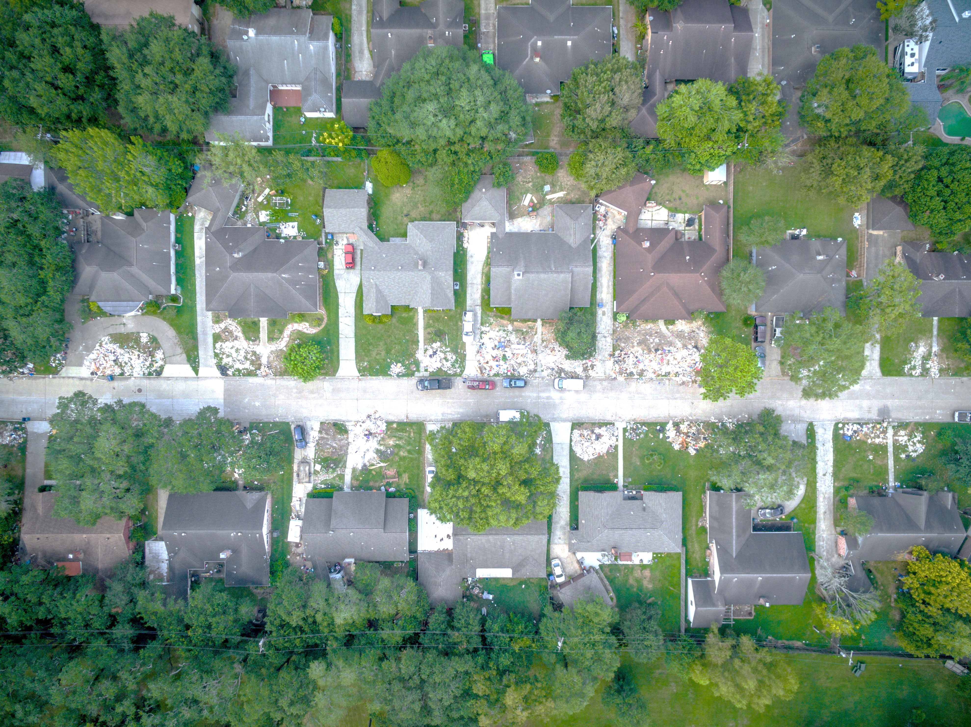

Coalition for Sustainable Flood Insurance
Overview
State of the Coast June 2, 2023

Slide 2



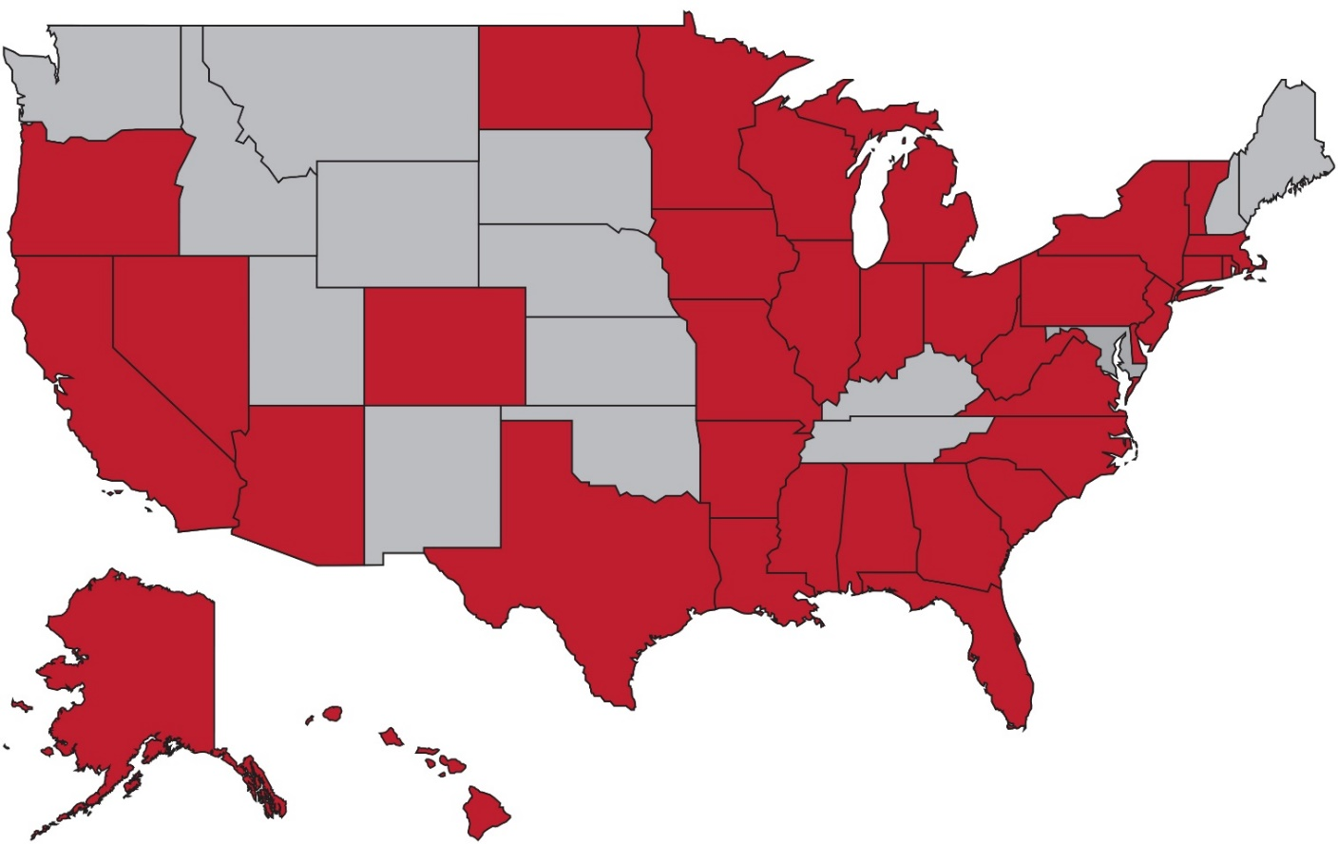
The Coalition for Sustainable Flood Insurance
The Coalition for Sustainable Flood Insurance (CSFI) was formed by GNO, Inc. in 2013, and grew to be national in scope.
Since its inception,
CSFI has worked with over 250 organizations and individuals in 35 states.

Slide 3
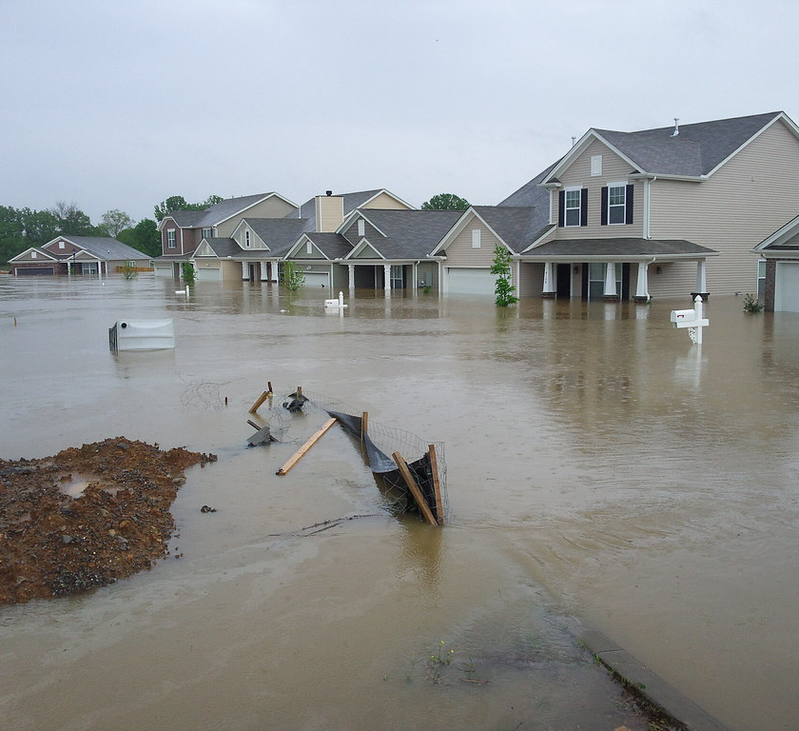
Risk Rating 2.0 Affordability Challenges
Risk Rating 2.0 (RR 2.0) – implemented in full on April 1, 2022 – represents the greatest overhaul of NFIP rates since its establishment in 1968. In year one, an estimated 77% of policyholders nationwide will see an increase. In following years, all policyholders will increase. According to the Congressional Research Service*, impacts of RR 2.0 include:
50% of policies will be at full-risk rate after 5 years; 90% will be at full-risk rate after 10 years.
Affordability challenges for homeowners on limited incomes, with adverse impact on low- and moderate-income households
Difficulty in selling homes with high premiums
Drops in coverage resulting in unprotected homeowners and lower program participation
*“Options for Making the National Flood Insurance Program More Affordable,” Congressional Research Service, December 2021

Slide 4
Rate Explanation Guide
The Rate Explanation Guide identifies specific characteristics of properties which are used as rating factors for input into premium calculation.
“Where it is built” (Geographic Factors)
  Distance to flooding sources (coast, ocean, rivers, and Great Lakes)
  Ground elevation
  “Other characteristics” (Base Rate, Drainage Area, Levee Quality, HUC12)
“How it is built” (Property Factors)
  Building occupancy
  Foundation type
  First floor height
  Number of floors
  Unit location
  Construction type
  Flood openings
  Machinery & equipment
“What is built and covered” (Contract Factors)
  Building replacement cost value
  Building and contents coverage
  Building and contents deductible

Slide 5
Discount Explanation Guide
The Discount Explanation Guide provides impacts of implementing mitigation measure, in terms of percentages, on certain rating variables (not total premium):
First Floor Height
  Differs based on foundation type
  “For example, a building with a crawlspace foundation and FFH of 3 feet above adjacent grade corresponds to a 22.1% discount compared to the same building having a FFH of 0.”
Flood Openings
  Differs based on foundation type and first floor height
  “For example, a building Elevated with Enclosure Not on Posts, Piles, or Piers with a FFH measurement of 9 feet above the adjacent grade corresponds to a 11.8% mitigation discount”
Machinery & Equipment
  “5% mitigation discount if certain covered Machinery and Equipment…are elevated to at least the elevation of the floor above the building’s first floor.”
Also references Floor of Interest, Statutory Discount, and CRS Discounts

Slide 6
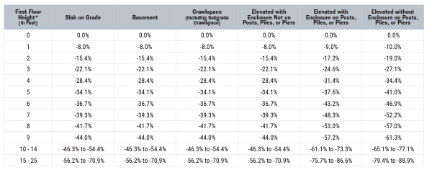


FEMA Discount Explanation Guide
1. First Floor Height & Foundation Type

Slide 7
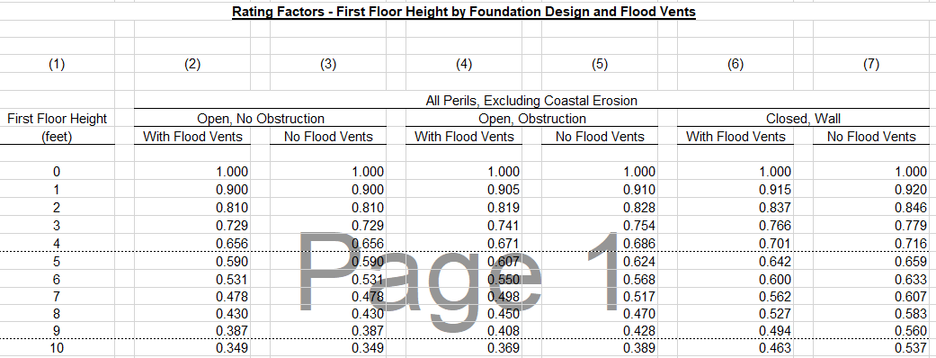
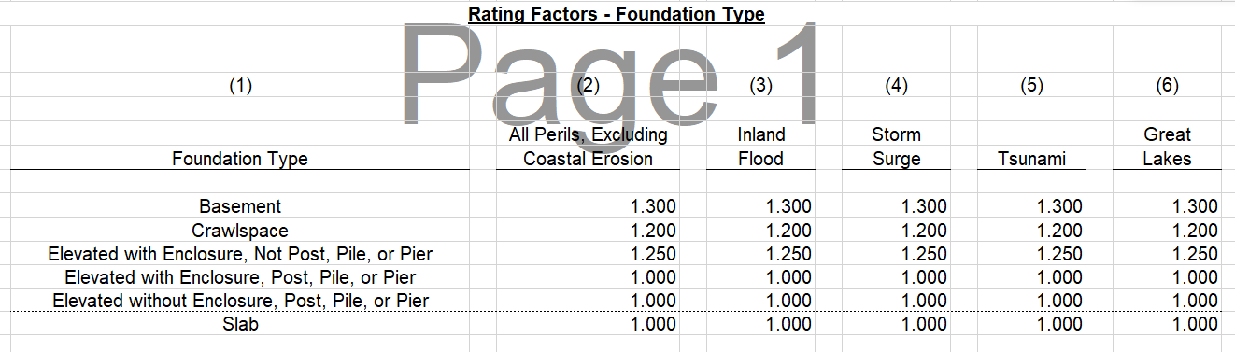



FEMA Appendix D – Rating Factor Tables
1. First Floor Height & Foundation Type

Slide 8
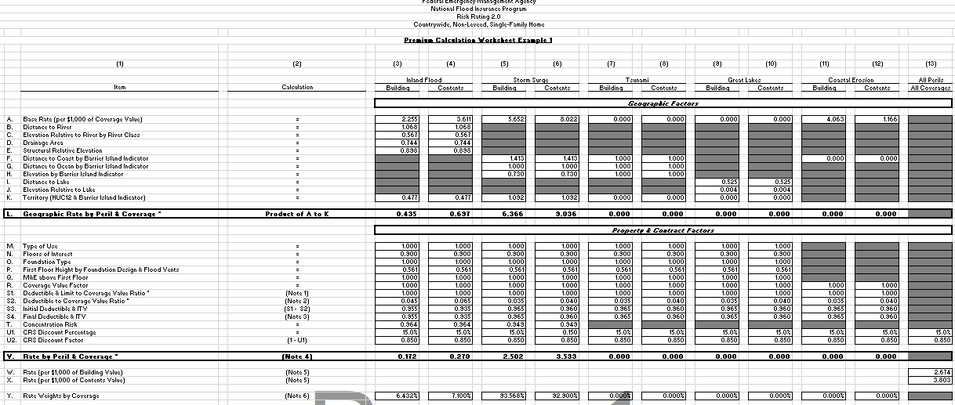
FEMA “Premium Calculation Worksheet”
https://www.fema.gov/sites/default/files/documents/fema_risk-rating_PCW_Rating_Examples.xlsx

Slide 9
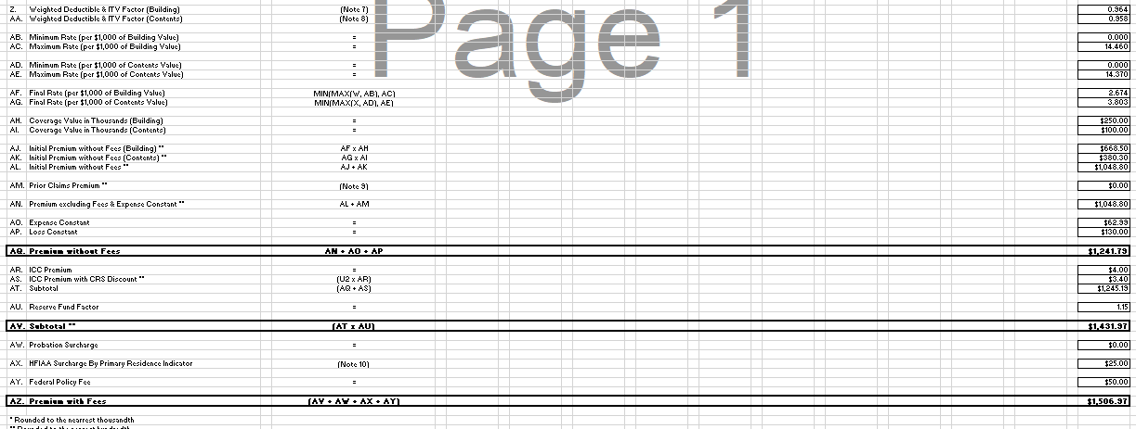
FEMA “Premium Calculation Worksheet”

Slide 10
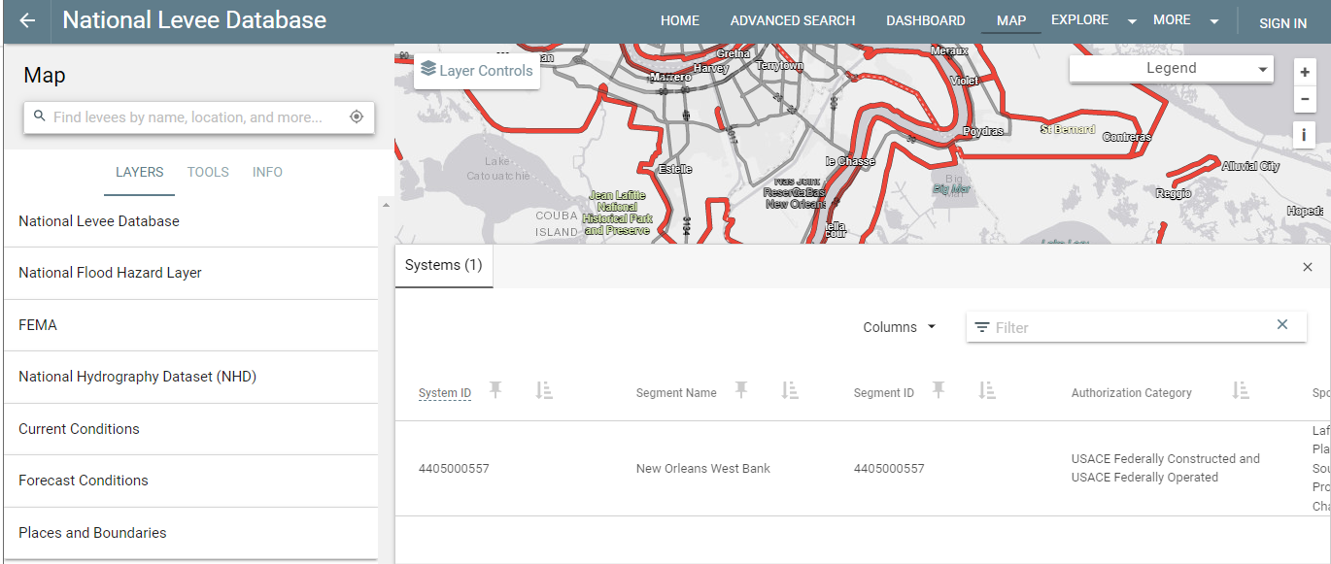
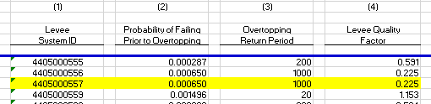
FEMA Appendix D – Levee Quality

Slide 11
Risk Rating 2.0 – Emerging & Pressing Issues
Greater transparency in development of rates
Widespread communication to various audiences, including flood plain managers, policyholders, realtors, bankers, homebuilders
Data Reliability – Clarity on formulas used for weighing of risk factors and calculation of mitigation credits
Affordability – No cap on premiums relative to income; Homeowners Flood Insurance Affordability Act instructed FEMA to minimize number of policies with annual premiums that exceed 1% of total coverage provided by policy
Appropriate Credit for Flood Protection and Mitigation – Risk is lowered from coastal restoration, elevation, or flood protection, but measures are not reflected
NFIP Policy Lapses – Can’t assume policy or benefit from glidepath if policy wasn’t renewed
Continuous Coverage – Ability to buy private and return to NFIP with glidepath

Slide 12
RR2.0 Examples
Town | Zone | Replacement Cost | Square Footage | 1.0 Premium | 2.0 Premium | % Increase
Belle Chasse, LA | AE | $393,985 | 3,050 | $572 | $8,828 | 1443%
Picayune, MS | AE | $250,000 | 1,800 | $900 | $4,823 | 436%
Key West, FL | X | N/A | N/A | $914 | $3,595 | 293%
Scituate, MA | AE | $250,000 | 1,800 | $650 | $1,297 | 100%
Hatteras, NC | AE | N/A | N/A | $643 | $3,153 | 390%
Long Island, NY | AE | $250,000 | N/A | $535 | $3,614 | 576%

Slide 13
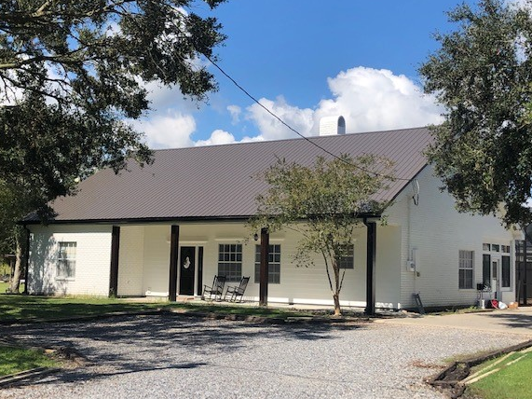
COALITION OR SUSTAINABLE FLOOD INSURANCE
RR2.0 Examples
Town | Zone | Replacement Cost | Square Footage | 1.0 Premium | 2.0 Premium | % Increase
Belle Chasse, LA (Plaquemines) | AE | $393,985 | 3,050 | $572 | $8,828 | 1443%

Slide 14
NFIP Participation – September 2021 to January 2023

Slide 15
NFIP Participation – September 2021 to March 2023
 | State | Sep-21 | Mar-23 | % Change
ALL | TOTAL | 4,899,114 | 4,732,747 | -3.4%
1 | FLORIDA | 1,689,300 | 1,673,435 | -0.9%
2 | TEXAS | 785,395 | 701,423 | -10.7%
3 | LOUISIANA | 508,043 | 478,794 | -5.8%
4 | CALIFORNIA | 202,111 | 192,841 | -4.6%
5 | SOUTH CAROLINA | 201,296 | 203,745 | 1.2%
6 | NEW JERSEY | 198,219 | 207,967 | 4.9%
7 | NEW YORK | 165,623 | 167,604 | 1.2%
8 | NORTH CAROLINA | 137,296 | 133,312 | -2.9%
9 | VIRGINIA | 100,013 | 95,219 | -4.8%
10 | GEORGIA | 79,268 | 75,912 | -4.2%
11 | MARYLAND | 63,488 | 63,820 | 0.5%
12 | MISSISSIPPI | 60,882 | 57,410 | -5.7%
13 | HAWAII | 59,810 | 57,327 | -4.2%
14 | MASSACHUSETTS | 54,812 | 54,927 | 0.2%
15 | ALABAMA | 51,658 | 50,106 | -3.0%

Slide 16
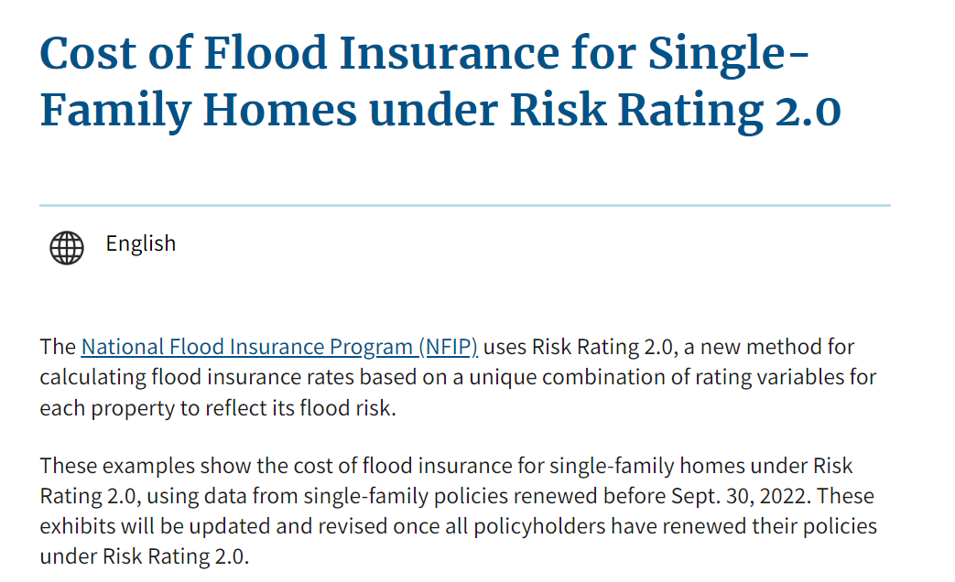
Full-Risk Rates Released on April 19, 2023

Slide 17
Full-Risk Rates by State
 | State/Territory | Average Current Cost of Insurance | Average Risk-based Cost of Insurance | % Premium Increase | X Premium Increase
ALL | ALL STATES AND TERRITORIES | $ 888 | $ 1,808 | 103.6% | 2.03
1 | HAWAII | $ 1,437 | $ 3,653 | 154.1% | 2.54
2 | WEST VIRGINIA | $ 1,133 | $ 3,074 | 171.2% | 2.71
3 | CONNECTICUT | $ 1,590 | $ 3,000 | 88.6% | 1.89
4 | MAINE | $ 953 | $ 2,700 | 183.2% | 2.83
5 | NEW HAMPSHIRE | $ 1,216 | $ 2,545 | 109.2% | 2.09
6 | VERMONT | $ 1,449 | $ 2,248 | 87.7% | 1.88
7 | FLORIDA | $ 1,197 | $ 2,213 | 131.1% | 2.31
8 | KENTUCKY | $ 958 | $ 2,201 | 107.6% | 2.08
9 | NEW YORK | $ 1,060 | $ 2,197 | 85.5% | 1.86
10 | MISSISSIPPI | $ 1,184 | $ 2,137 | 149.1% | 2.49

Slide 18
Full-Risk Rates by State
 | State/Territory | Average Current Cost of Insurance | Average Risk-based Cost of Insurance | % Premium Increase | X Premium Increase
ALL | ALL STATES AND TERRITORIES | $ 888 | $ 1,808 | 103.6% | 2.03
11 | NEW JERSEY | $ 1,081 | $ 2,129 | 97.0% | 1.97
12 | MASSACHUSETTS | $ 1,269 | $ 2,097 | 65.2% | 1.65
13 | SOUTH DAKOTA | $ 937 | $ 2,062 | 120.0% | 2.20
14 | PENNSYLVANIA | $ 1,075 | $ 2,060 | 91.6% | 1.92
15 | ALABAMA | $ 927 | $ 2,051 | 121.3% | 2.21
16 | MISSOURI | $ 978 | $ 2,038 | 108.3% | 2.08
17 | OREGON | $ 936 | $ 1,969 | 110.4% | 2.10
18 | LOUISIANA | $ 813 | $ 1,904 | 134.1% | 2.34
19 | MINNESOTA | $ 943 | $ 1,832 | 94.2% | 1.94
20 | WASHINGTON | $ 918 | $ 1,782 | 94.2% | 1.94

Slide 19
Full-Risk Rates by State
 | State/Territory | Average Current Cost of Insurance | Average Risk-based Cost of Insurance | % Premium Increase | X Premium Increase
ALL | ALL STATES AND TERRITORIES | $ 888 | $ 1,808 | 103.6% | 2.03
41 | WISCONSIN | $ 878 | $ 1,331 | 51.6% | 1.52
42 | NEBRASKA | $ 824 | $ 1,323 | 60.6% | 1.61
43 | OHIO | $ 883 | $ 1,303 | 47.6% | 1.48
44 | VIRGINIA | $ 743 | $ 1,077 | 44.9% | 1.45
45 | MICHIGAN | $ 811 | $ 1,068 | 31.7% | 1.32
46 | NEVADA | $ 715 | $ 1,031 | 44.1% | 1.44
47 | UTAH | $ 645 | $ 953 | 47.7% | 1.48
48 | PUERTO RICO | $ 543 | $ 757 | 39.3% | 1.39
49 | MARYLAND | $ 608 | $ 742 | 22.0% | 1.22
50 | ALASKA | $ 454 | $ 543 | 19.8% | 1.20
51 | D.C. | $ 404 | $ 407 | 0.8% | 1.01

Slide 20
Full-Risk Rates by County
 | ID | County | Average Current Cost of Insurance | Average Risk-based Cost of Insurance | Premium Increase
 | ALL | ALL STATES AND TERRITORIES | $ 888 | $ 1,808 | 103.5%
1 | LA | PLAQUEMINES PARISH | $ 842 | $ 5,431 | 545.3%
2 | LA | ST. MARY PARISH | $ 1,074 | $ 5,226 | 386.3%
3 | FL | FRANKLIN COUNTY | $ 1,664 | $ 5,195 | 212.3%
4 | FL | MONROE COUNTY | $ 1,759 | $ 4,622 | 162.7%
5 | CA | SONOMA COUNTY | $ 1,404 | $ 4,464 | 217.9%
6 | ME | YORK COUNTY | $ 1,128 | $ 4,247 | 276.4%
7 | FL | COLLIER COUNTY | $ 1,053 | $ 3,980 | 277.9%
8 | FL | LEE COUNTY | $ 1,285 | $ 3,965 | 208.6%
9 | LA | LAFOURCHE PARISH | $ 929 | $ 3,909 | 320.6%
10 | FL | CHARLOTTE COUNTY | $ 1,428 | $ 3,687 | 158.2%

Slide 21
Full-Risk Rates by County
 | ID | County | Average Current Cost of Insurance | Average Risk-based Cost of Insurance | Premium Increase
 | ALL | ALL STATES AND TERRITORIES | $ 888 | $ 1,808 | 103.5%
11 | LA | VERMILION PARISH | $ 1,035 | $ 3,673 | 254.7%
12 | CA | MARIN COUNTY | $ 1,413 | $ 3,652 | 158.5%
13 | LA | TERREBONNE PARISH | $ 873 | $ 3,536 | 304.9%
14 | CA | SANTA CRUZ COUNTY | $ 1,408 | $ 3,502 | 148.7%
15 | HI | HONOLULU COUNTY | $ 1,549 | $ 3,377 | 118.1%
16 | CT | NEW HAVEN COUNTY | $ 1,635 | $ 3,259 | 99.3%
17 | FL | PINELLAS COUNTY | $ 1,538 | $ 3,258 | 111.9%
18 | NJ | PASSAIC COUNTY | $ 1,826 | $ 3,162 | 73.1%
19 | LA | IBERIA PARISH | $ 918 | $ 3,160 | 244.2%
20 | FL | CITRUS COUNTY | $ 1,492 | $ 3,147 | 111.0%

Slide 22
Full-Risk Rates by ZIP Code
 | State | City | ZIP Code | Average Current Cost of Insurance | Average Risk-based Cost of Insurance | Premium Increase
 |  | ALL | ALL STATES AND TERRITORIES | $ 888 | $ 1,808 | 103.5%
1 | FL | Naples | 34102 | $ 2,228 | $ 8,067 | 262.1%
2 | FL | Boca Grande | 33921 | $ 1,681 | $ 7,766 | 362.1%
3 | FL | Marco Island | 34145 | $ 1,601 | $ 7,553 | 371.8%
4 | FL | Clearwater Beach | 33767 | $ 2,999 | $ 7,402 | 146.8%
5 | FL | Key Biscayne | 33149 | $ 3,423 | $ 7,097 | 107.3%
6 | FL | Longboat Key | 34228 | $ 2,358 | $ 7,058 | 199.4%
7 | LA | Des Allemands | 70030 | $ 784 | $ 6,677 | 751.8%
8 | FL | Cocoa Beach | 32931 | $ 771 | $ 6,638 | 761.1%
9 | FL | Sarasota | 34242 | $ 2,871 | $ 6,453 | 124.8%
10 | FL | Fort Pierce | 34949 | $ 1,112 | $ 6,428 | 478.0%

Slide 23
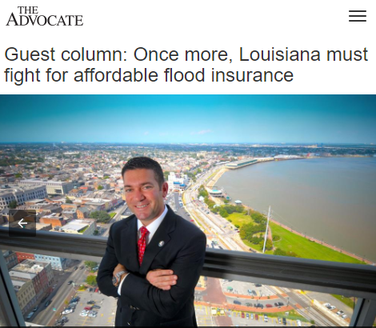
CSFI Action Plan
Standing coalition calls, including stakeholders and congressional staffers
Building partnerships with trade associations and industry groups across county
Attending relevant conferences and presenting on RR2.0 to spread awareness
Conducting fly-ins to D.C., virtual meetings with congressional staff
Ongoing media engagement, including Advocate op-ed:
Highlights 3 key CSFI recommendations:
Affordability – limit max increase, create caps linked to coverage limits and means-tested provisions
Mitigation – additional weight for undertaking measures and assure CRS discounts
Transparency – rate calculator for better financial planning and building decisions

Slide 24
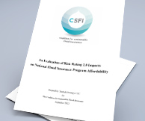
CSFI Affordability White Paper Overview
Now available on www.csfi.info:
History of NFIP, Risk Rating 2.0
Literature review of past academic studies
Effectiveness of cap on annual increases
Analysis of proposed affordability programs
Profiles of select markets – FL, OH, SC, TX
Recommendations:
FEMA should disclose the factor by which premiums are changing
FEMA should clearly disclose planned premium rate increase velocities
FEMA should counter the known negative relationship between price and participation by adopting a low-rate annual premium increase plan
Congress should carefully consider the limitations of affordability frameworks relying solely on income ratios…housing burden should be an additional tool
Congress should pursue legislative enactment of an affordability program

Slide 25
CSFI Reauthorization Priorities
Mandate Release of Full-Risk Rates and a Public-Facing Rate Calculator – Congress should require that FEMA publish additional data on premiums and provide a cost calculator that policyholders can publicly access.
Enact a Means-Tested Affordability Program with Housing Burden as a Targeting Factor – Congress should mandate that FEMA apply a housing burden factor to target discounts and equitably distribute benefits
Lower Annual Premium Increases to Nine Percent – Congress should cap single-family primary residential rate hikes to a maximum of 9% each year, as a bridge to a permanent affordability program.
Forgive NFIP’s Debt or Freeze Interest Payments – Congress should forgive NFIP’s debt, or at the least forgive interest payments over a defined period of time, while requiring that lower premiums be offered.

Slide 26




2023 Recent & Upcoming Events
House Financial Services Committee Hearing
“How Do We Encourage Greater Flood Insurance Coverage in America?”
March 10, 2023
House Committee on Homeland Security Hearing
Department of Homeland Security FY24 Budget Request
April 19, 2023
House Financial Services Committee Hearing
“The Reauthorization of NFIP: FEMA’s Perspective”
April 28, 2023
Senate Banking Committee Hearing
“Reauthorization of NFIP: Improving Community Resilience”
May 2, 2023
NFIP’s Authorization Expires
September 30, 2023

Slide 27
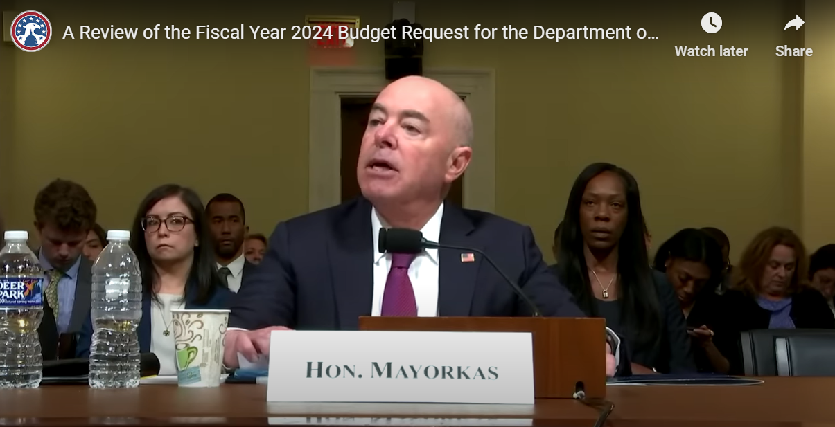
House Committee on Homeland Security FY24 Budget Hearing
Sec. Mayorkas: “We are reviewing, and need to continue to review, the Risk Rating 2.0 given the concerns being expressed with it. And I can assure you that we are doing so, and will report out our results”
Rep. Carter: “This is not a done deal.”

Slide 28
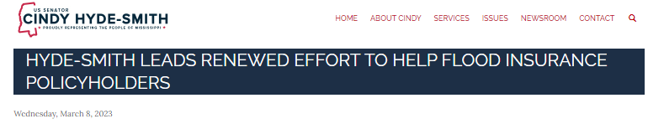
Homeowner Flood Insurance Transparency and Protection Act
The Homeowner Flood Insurance Transparency and Protection Act (S.721) would allow policyholders to retain previous NFIP premium rates rather than Risk Rating 2.0 rates, until FEMA satisfies:
  Public notice and comment
  Established policyholder premium appeals process
  Economic impact analysis
  Independent peer review
  Assurance of data reliability
Cosponsored by Senators Kennedy, Cassidy, and Cruz

Slide 29
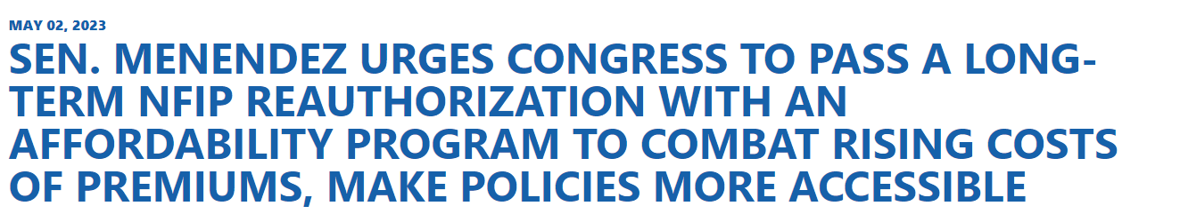
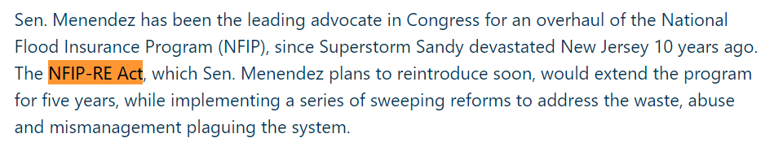
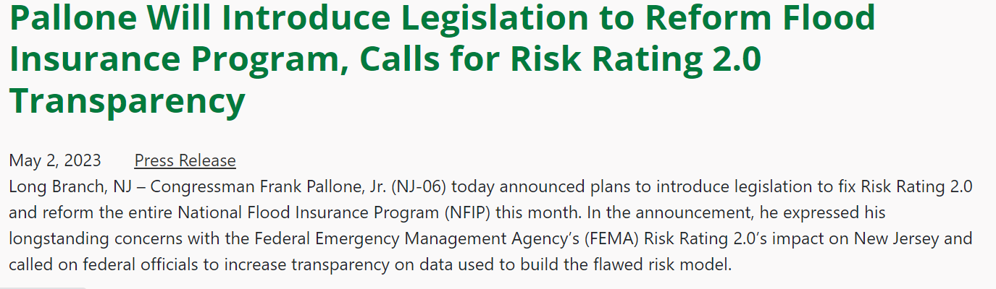
NFIP Reauthorization Legislation

Slide 30
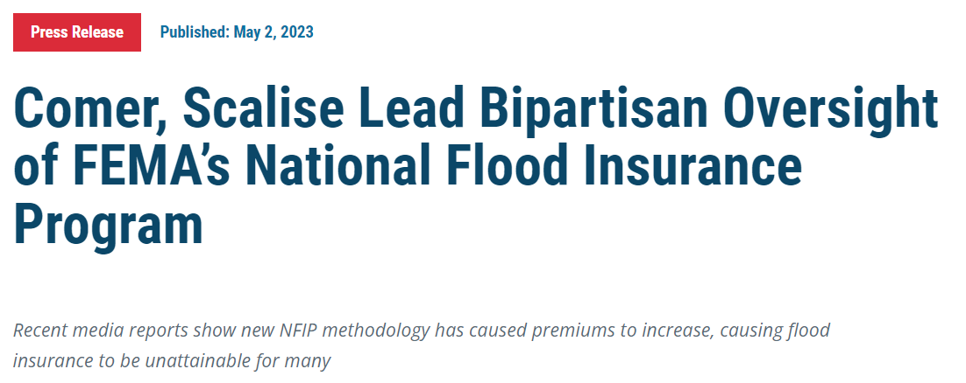

Committee on Oversight and Accountability Letter
The Committee on Oversight and Accountability is the principal oversight committee of the U.S. House of Representatives and has broad authority to investigate “any matter” at “any time” under House Rule X.
51 Members of Congress signed a letter to FEMA Secretary Dianne Criswell to request certain documents and information on RR2.0, and to request a staff-level briefing as soon as possible on the effects.

Slide 31
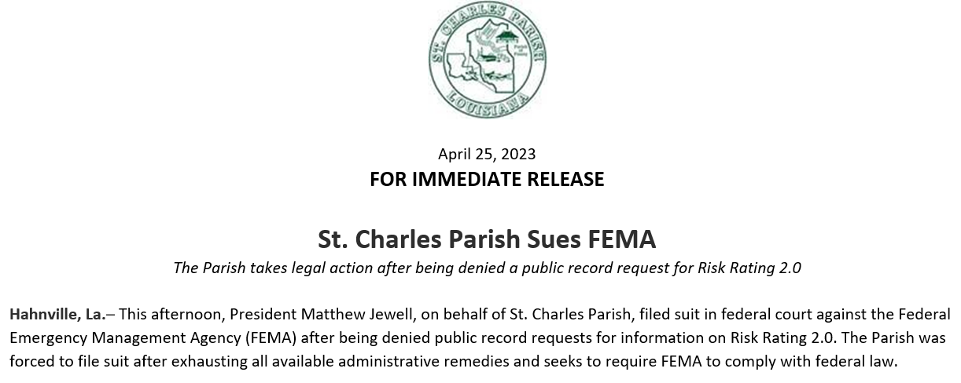
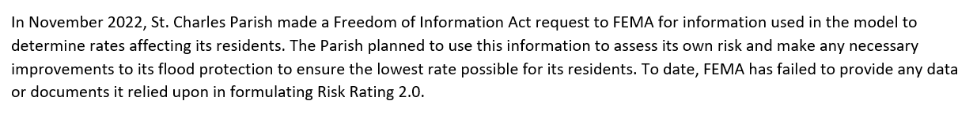
St. Charles Parish Files Suit

Slide 32

Louisiana Office of the Attorney General

Slide 33
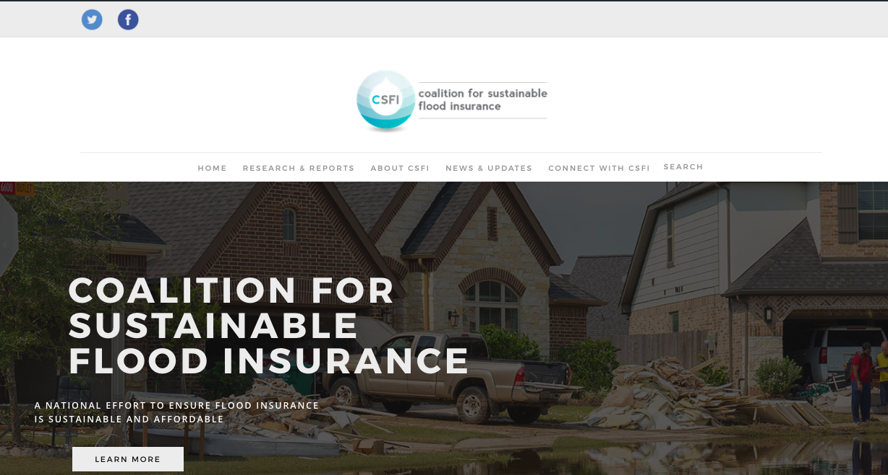


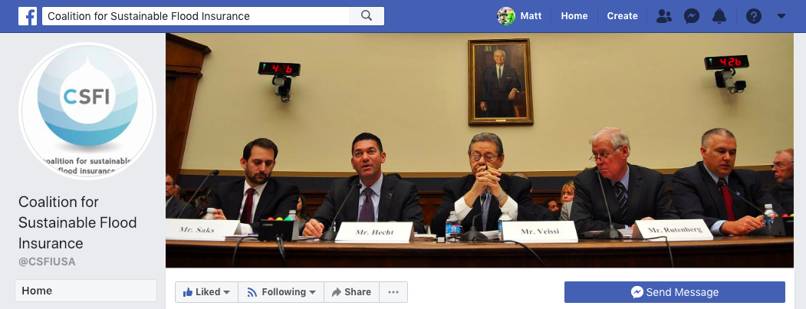
Join Us
Become a CSFI member, and stay up to date!
Join CSFI by visiting csfi.info or emailing pwaggonner@gnoinc.org
Sign up for email updates
Follow us on social media
@csfiusa
@CSFIUSA

