Slide 1
How the NFIP is Influencing the Face of the Coast: NFIP Reg Reform, ESA and VE Zones
Molly Lawrence
June 2, 2023

Slide 2
Three (non RR 2.0) Topics:
NFIP Regulatory Reform
NFIP-Endangered Species Interface
VE Zones
Also watch for Federal Flood Risk Management Standard (FFRMS)
Notes:
Heard a lot about Risk Rating 2.0
Going to cover other pending changes in NFIP that also likely to impact the coast

Slide 3
Part 1: NFIP Reg Reform

Slide 4
NFIP Regulation of Development
To participate in the NFIP, local governments are required to adopt flood hazard regulations for development at least as stringent as FEMA minimum standards, 44 C.F.R. §60.3
Applies to all “development,” which is defined as:
“any man-made change to improved or unimproved real estate, including but not limited to buildings or other structures, mining, dredging, filing, grading, paving, excavation or drilling operations or storage of equipment or materials.”
Notes:
Result: All local codes integrate at least FEMA’s minimum standards, and often much more.
Applies to all development

Slide 5
Changes Coming to NFIP Minimum Floodplain Development Standards
ASFPM and National Resources Defense Council petition to FEMA for regulatory reform
https://www.floods.org/whats-new/as-flooding-from-climate-change-worsens-groups-seek-to-change-outdated-federal-rules-for-building-homes-and-infrastructure/
FEMA Request for Information - Regulations.gov, Docket ID: FEMA-2021-0024
Comments due 1/27/22; 370 comments received
Next steps – changes pending
Notes:
NFIP regulations have not been updated in 45 years
FEMA is seeking public input on two topics:
Comments/suggestions for revising the NFIP’s minimum floodplain development standards “to better align with the current understanding of flood risk and flood risk reduction approaches.”
Comment/suggestions on how the NFIP can better promote protection of and minimize any adverse impact to threatened and endangered species, and their habitats.
Series of questions:
Should FEMA expand regulation from the 100 year floodplain to 500 year floodplain
Should FEMA limit fill? Require compensatory storage?
What additional considerations should FEMA incorporate into the NFIP minimum standards to promote the protection and conservation of T&E species and their designated habitat?
Should FEMA consider limiting construction in the SFHA? Or in any identified riparian buffer zone?
Note: Washington State Dept of Ecology submitted comment
Floodplain by Design, TNC and American Rivers
All calling for more regulation including ESA protections

Slide 6
Potential Concerns
Limitations on fill
Increased elevation requirements
Expansion of the regulatory floodplain
Expansion of the floodway (zero rise floodway) and floodway standards
Compensatory storage requirements
Expansion of T&E species protected areas
VE zone standards (prohibition on new overwater structures)
Treatment of mitigation or benefit projects
Notes:
Limitations in fill – impact to levees
Elevation requirements – integration with facilities outside of the FP
Compensatory storage – has been a bit issue/problem when measured on property by property/project by project basis
VE zones
Floodway standards – no rise, limitations on habitat and restoration projects
T&E – limitations applied to entire floodplain although no or limited designated critical habitat in the floodplain

Slide 7
Part 2: NFIP-ESA Interface

Slide 8
NFIP Evolution due to ESA Challenges
Series of suits around the country challenging FEMA’s ESA compliance
Monroe County, Florida (1990s-2008) re: Key Deer
Washington State (2004), Oregon (2009), and California (2010, 2019) re: T&E salmon/steelhead, delta smelt, Orca whales
Ordered to consult under Section 7(a)(2) regarding the effect of the NFIP on T&E species and designated critical habitat
Settlements in other states – including California, Oregon, Arizona, New Mexico
Notes:
Basic trade of NFIP under attack through several ESA-based challenges (flood insurance for development regulations)
ESA Section 7(a)(2) requires federal action agency – FEMA – to ensure that its programs do not jeopardize the continued existence of T&E species or destroy or adversely modify critical habitat.
FEMA sued around country for failing to consult re NFIP.
Started in Florida in 1990s – environmental groups sued FEMA for failure to consult regarding impacts of floodplain development on Florida Key Deer.
Issue: enabling development of floodplains = loss of habitat and mobility (fences)
Ultimately FEMA consulted: more than a decade of litigation regarding the resulting BiOp
Included injunction against sale of flood insurance in Monroe County, FL, for nearly 2 yrs
Second suit in Washington – NWF sued FEMA for failing to consult re impacts of NFIP on T&E fish and orca whales.
FEMA ordered to consult.
NFMS issued BiOp in September 2008. Found jeopardy.
Included 7 element RPA. Most important for us – RPA Element 3 – directing changes to FEMA’s minimum standards and development regulations in FP in the Puget Sound region

Slide 9
Key Considerations from Washington and Oregon BiOps
Consultation between FEMA and NMFS – but resulting requirements imposed on state and local governments
Entirely new and undefined regulatory metrics – not defined by NFIP or ESA:
“No adverse effect” standard in Washington
“Beneficial gain” standard in Oregon
FEMA skipped any form of rulemaking; enforcing new standards directly against NFIP participating jurisdictions and permit applicants
Notes:
Imposing new standards on state/local government with NO involvement by jurisdiction or public.
FEMA subject to Section 7(a)(2) consultation requirement. FEMA required to avoid jeopardy or destruction or adverse modification of designated critical habitat.
Jeopardy means “to engage in an action that reasonably would be expected, directly or indirectly, to reduce appreciably the likelihood of both the survival and recovery of a listed species in the wild by reducing the reproduction, numbers or distribution of that species.”
Destruction or adverse modification = direct or indirect alteration that appreciably diminishes the value of critical habitat for both the survival and recovery of a listed species. Includes adversely modifying any of those physical or biological features that were the basis for determining the habitat to be critical. 50 CFR 402.02
Local government, by comparison, only subject to Section 9 take standard.
Take includes “to harass, harm, pursue, hunt, shoot, wound or kill.” Harm defined to include “significant habitat modification or degradation where it actually kills or injures wildlife by significantly impairing essential behavioral patterns, including breeding, feeding or sheltering.” 50 CFR 17.3 and 222.102.
Difficult to demonstrate take. Plaintiff must prove: (1) there is or will be death or actual injury (ii) to an identifiable member of a listed species (iii) that is proximately caused by the action in question.
BiOp suddenly applies Section 7 standards to local governments.
Federalizes what has up until now been state/local land use decision
Not clear what “avoid and minimize to the maximum extent practicable adverse effect” means. Not from ESA.
In Washington, FEMA went through extensive discussion with NMFS trying to determine meaning of “no adverse effect”
Stelle letter – Adverse effects = changes in habitat that decrease the value of the habitat for listed species. (Look at how project alter habitat, and how those alterations will affect species.)
FEMA in Washington has related it to NLAA as part of Section 7 consultation.
Again, purely local permits NOT subject to Section 7 consultation.
Judge Martinez held that in absence of clear direction/definition from NMFS, FEMA right to try to fill void with guidance and “fashion a workable program.”

Slide 10
LOMRs & CLOMRs Suspended in California
Since 2016, FEMA has required documentation of ESA-compliance for LOMR-Fs and CLOMR-Fs.
Community Acknowledgement Form
2023 Development: Effective July 1, 2023, FEMA has suspended all LOMR-Fs and CLOMR-Fs in California pending Consultation
Notes:
.
Captured in the Community Acknowledgment Form
Recent development in CA.

Slide 11
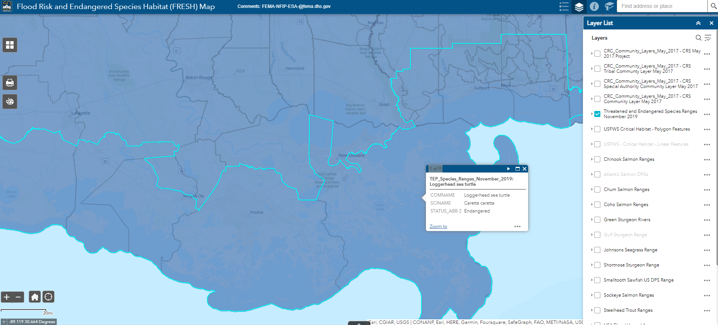
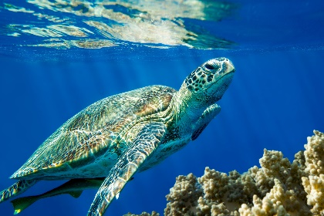
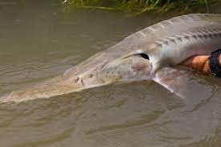
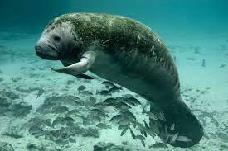
FEMA’s Flood Risk and ESA Habitat Map https://www.fema.gov/floodplain-management/wildlife-conservation/fresh-mapping-tool
Nine Listed Species on Louisiana Coast: 4 Turtles, 2 Sturgeon, West Indian Manatee, Piping Plover, and Red Knot
Notes:
Tool to identify overlap betw ESA species/habitat and floodplains
Help in making effects determination
Nine threatened or endangered species in Louisiana:
Loggerhead sea turtle
Kemp’s Ridley sea turtle
Hawksbill sea turtle
Leatherback sea turtle
Pallid Sturgeon
Gulf Sturgeon
West Indian Manatee
Piping Plover
Red Knot
Potential vehicle for suit against FEMA for failing to consider effects on ESA-listed species for floodplain development

Slide 12
Part 3: Coastal High Hazard Zones (VE/V)

Slide 13
Implications of V/VE Zones
Standards set forth in 44 CFR 60.3(e)
Siting limitations
No “new construction” waterward of the MHT
No “new construction” or “substantial improvements” waterward of the shoreline setback
Elevation Requirements
New construction and substantial improvements required to elevate to BFE or above
Elevation in VE zone measured from the lowest structural member of the lowest floor
Not intended to keep Ports from using existing piers – but is intended to trigger upgrades
Notes:
Meeting with FEMA:
Very limited variances regarding location
No variances re elevation
Punchline: only development allowed in VE is non-substantial improvement to existing structure where addition does not change to non-water dependent use

Slide 14
SFHA Maps: Seattle, WA
1995 FIRM
2020 FIRM
Notes:
Numerous overwater structures mapped into the FP
Changed from AE to VE zone – coastal high hazard

Slide 15
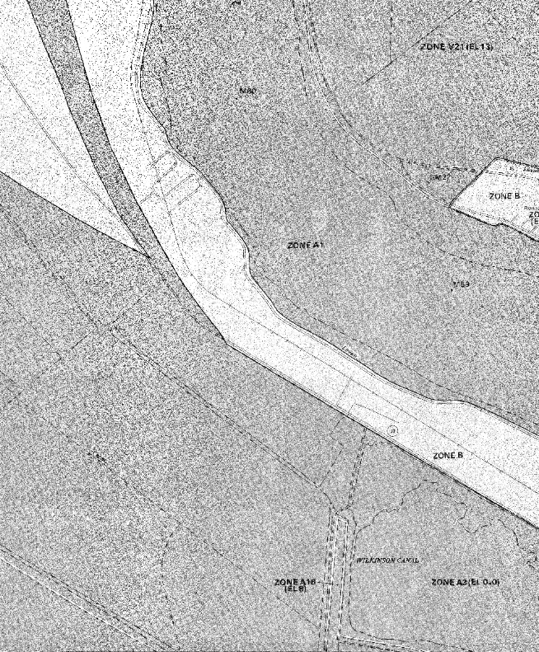
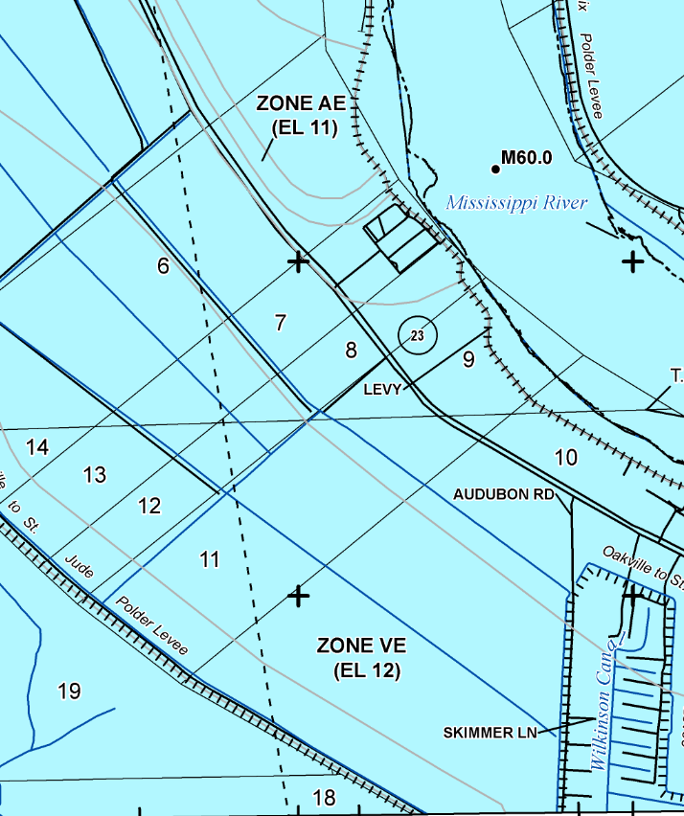
SFHA Maps: Ironton, LA
1985 FIRM
2021 FIRM
Notes:
Went from Zone B with no BFE
To Zone VE with 12 ft BFE
Consequence – post-Ida, unable to qualify for HMPG grant funds to restore
Running directly into WH’s EJ agenda
As new maps come out – PAY ATTN

Slide 16
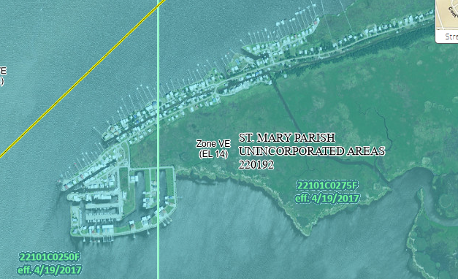
SFHA Maps: Cypremort Point, St. Mary Parish, LA
2017 FIRM

Slide 17
For more information:
MOLLY LAWRENCE
206-623-9372
Mol@vnf.com

