Slide 1
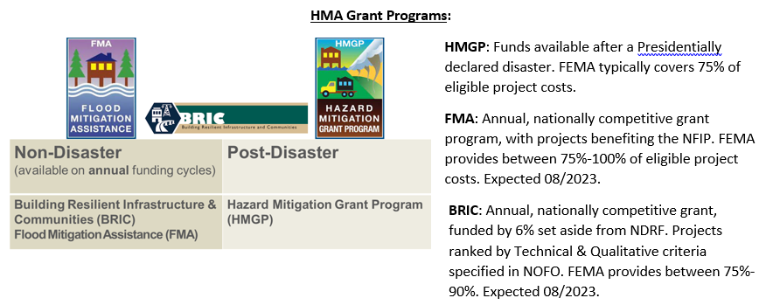
Hazard Mitigation Assistance

Slide 2
Other Hazard Mitigation Assistance Initiatives
SWIFT Flood Mitigation Assistance (SWIFT FMA)
  $40M made available to Louisiana for application in FY22 (inaugural year)
  13 approvals to date for $20M Federal share
  Unknown when next application period will open, is disaster-dependent
Safeguarding Tomorrow through Ongoing Risk Mitigation (STORM Act) Revolving Loan Fund (RLF)
  FEMA will provide capitalization grants to eligible Applicants to establish revolving loan funds that provide low interest loans to local governments for projects that mitigate impacts from natural hazards.
  GOHSEP issued Public Notice March 10, 2023, seeking project proposals from local jurisdictions; ended April 21, 2023.
  The GOHSEP Intended Use Plan (IUP) draft was released for Public Comment on April 14, 2023; ended April 21, 2023.
  State application for the STORM RLF submitted to FEMA for $15m Federal share
L-PDM: Congressionally Directed Spending; project proposals submitted to local Senator’s office for consideration
HMGP Competitive Funding
  DR-4611 (Ida) $25m set aside
  Open to all eligible subapplicants statewide
  NOI period has closed, with applications due to GOHSEP July 31, 2023

Slide 3
Hazard Mitigation, Eligible Activities
HMGP/BRIC
FMA
Community drainage projects
  Retention/Detention Ponds
  Drainage canal improvements
Community safe rooms
Wind retrofit projects
Mitigation Plan updates
Generator projects
Project Scoping
Residential Elevation/Acquisition projects
Residential elevation projects
Residential acquisition projects
Community drainage projects
  Retention/Detention Ponds
  Drainage canal improvements

Slide 4
HMA Insurance Requirements
HMGP & BRIC:
  The property owner must obtain and maintain flood insurance for the life of the structure, regardless of transfer of ownership, in an amount at least equal to the project cost or to the maximum limit of coverage made available with respect to the mitigated property, whichever is less.
FMA:
  All applicants and subapplicants must be participating in the NFIP, and not be withdrawn, on probation, or suspended.
  Structures identified in the subapplication must have an NFIP policy (including a Group Flood Insurance Policy [GFIP]) in effect prior to the opening of the application period and the policy must be maintained throughout the life of the structure, regardless of transfer of ownership of such property.

