Slide 1
Benefits and Costs of Freeboard for Louisiana Homes
Carol Friedland, PhD, PE (WY), CFM
LaHouse Research and Education Center, LSU AgCenter
State of the Coast 2023
June 1, 2023

Slide 2
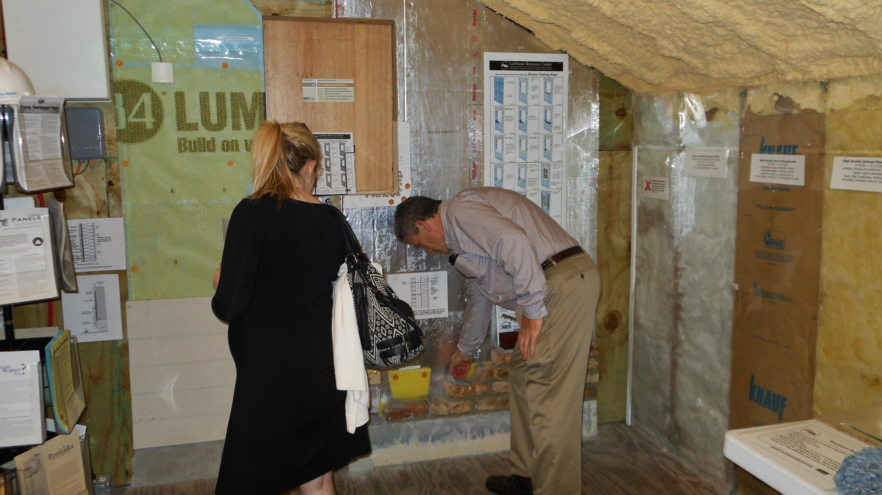
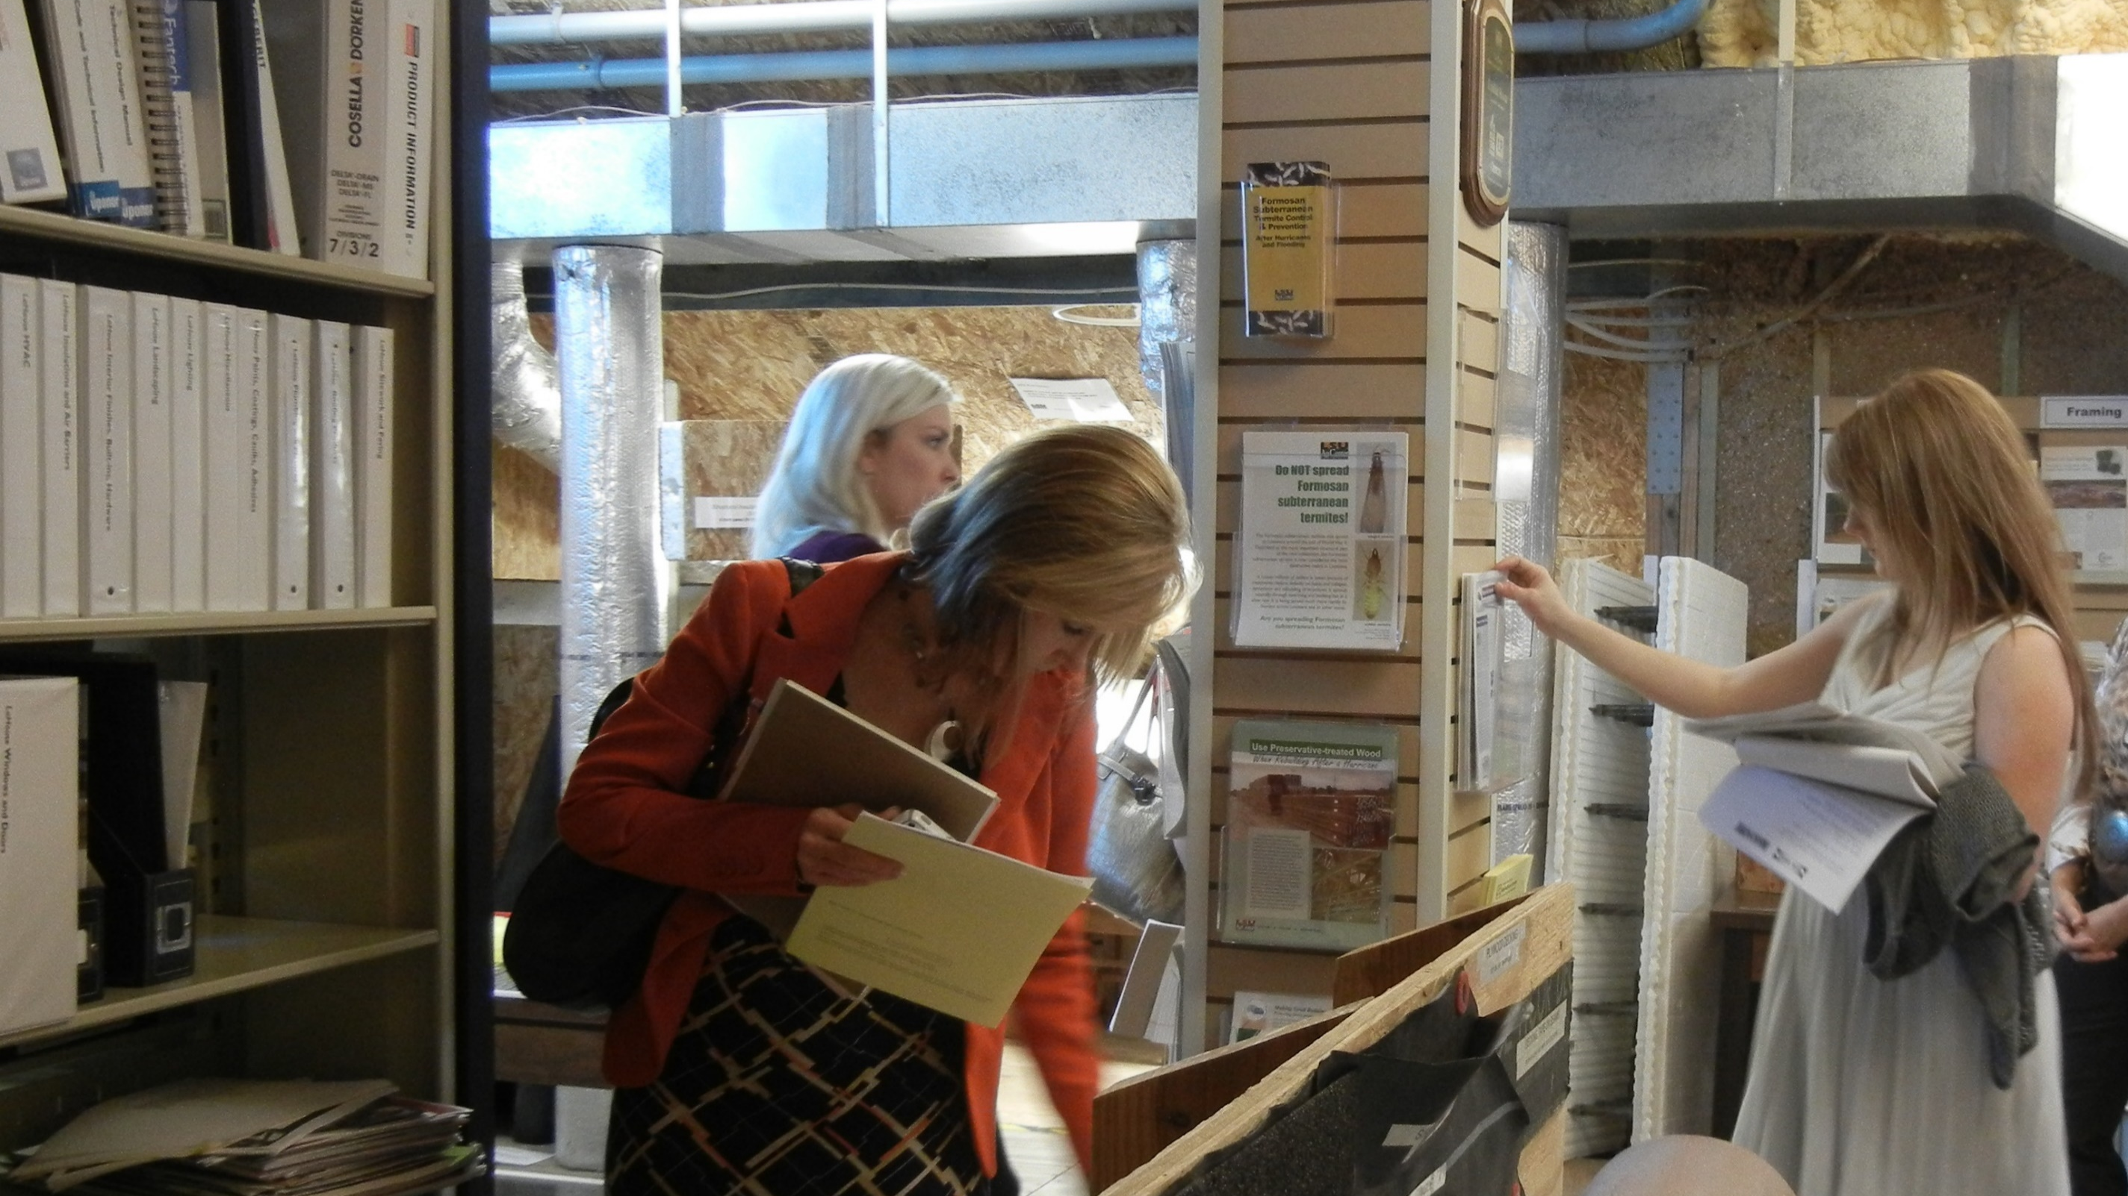
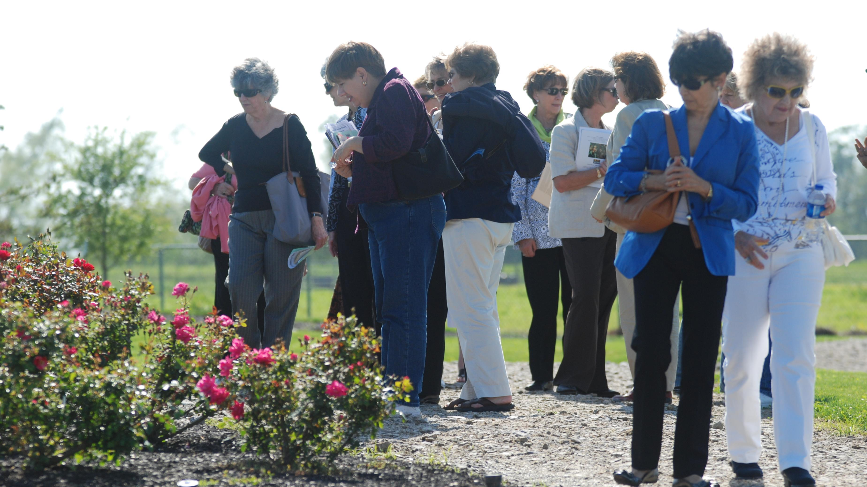
LaHouse Research and Education Center: Resilient, Sustainable and Healthy Homes

Slide 3
Flood Hazards
In the 100-year floodplain:
65% of Louisiana’s land area
25% of Louisiana’s population and structures
The 100-year flood has a 50% probability of occurring at least once in 70 years

Slide 4
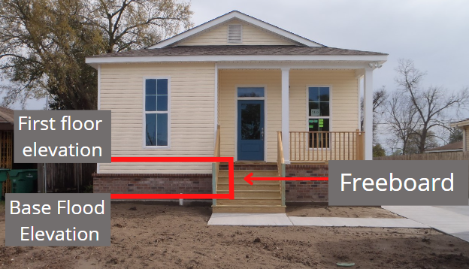
Freeboard

Slide 5
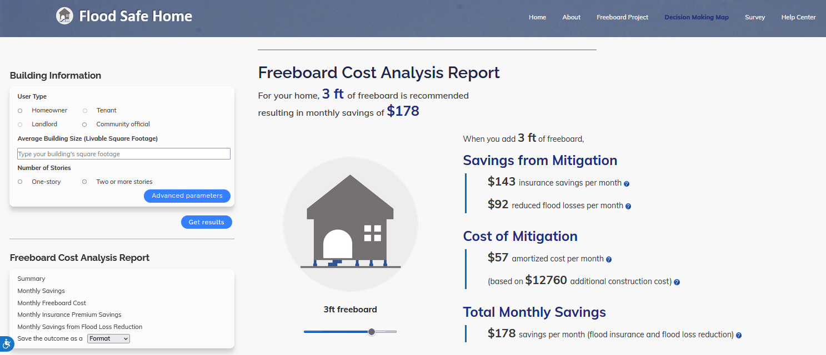
Individualized Analysis & Recommendations
https://floodsafehome.lsu.edu/

Slide 6
History
2014 ASCE 24 – 1’ of freeboard
2015 ICC model codes
2018 Adoption of 2015 ICC model codes
LSUCCC Freeboard Task Force, council vote
August 2023 adoption
Parishes objecting…
Legislative oversight…?

Slide 7
FloodSafe Home
Incentives & Barriers to Increased Freeboard to Enhance Flood Resilience in New Construction
Economic, Social and Policy Pathways to Freeboard Adoption for Existing Homes

Slide 8
Louisiana’s Coastal Parishes
Notes:
And on this slide you can see the three parishes in darker green – Terrebonne, Jefferson, and St. Tammany, that Flood Safe Home serves in its first attempt.

Slide 9
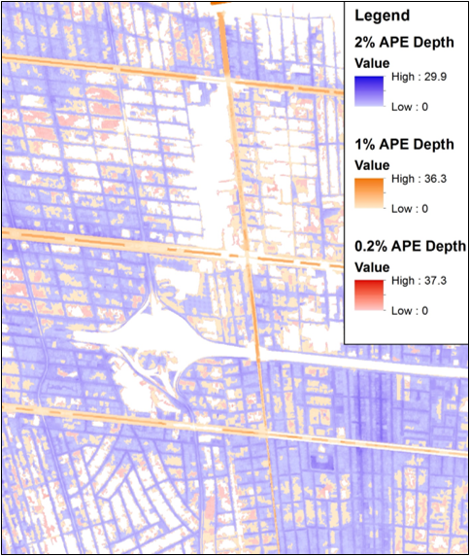
We Determine Flood Risk
Probability of occurrence
x
Consequences
Summed over all probable events

Slide 10
Annual Flood Risk (Community Level)

Slide 11
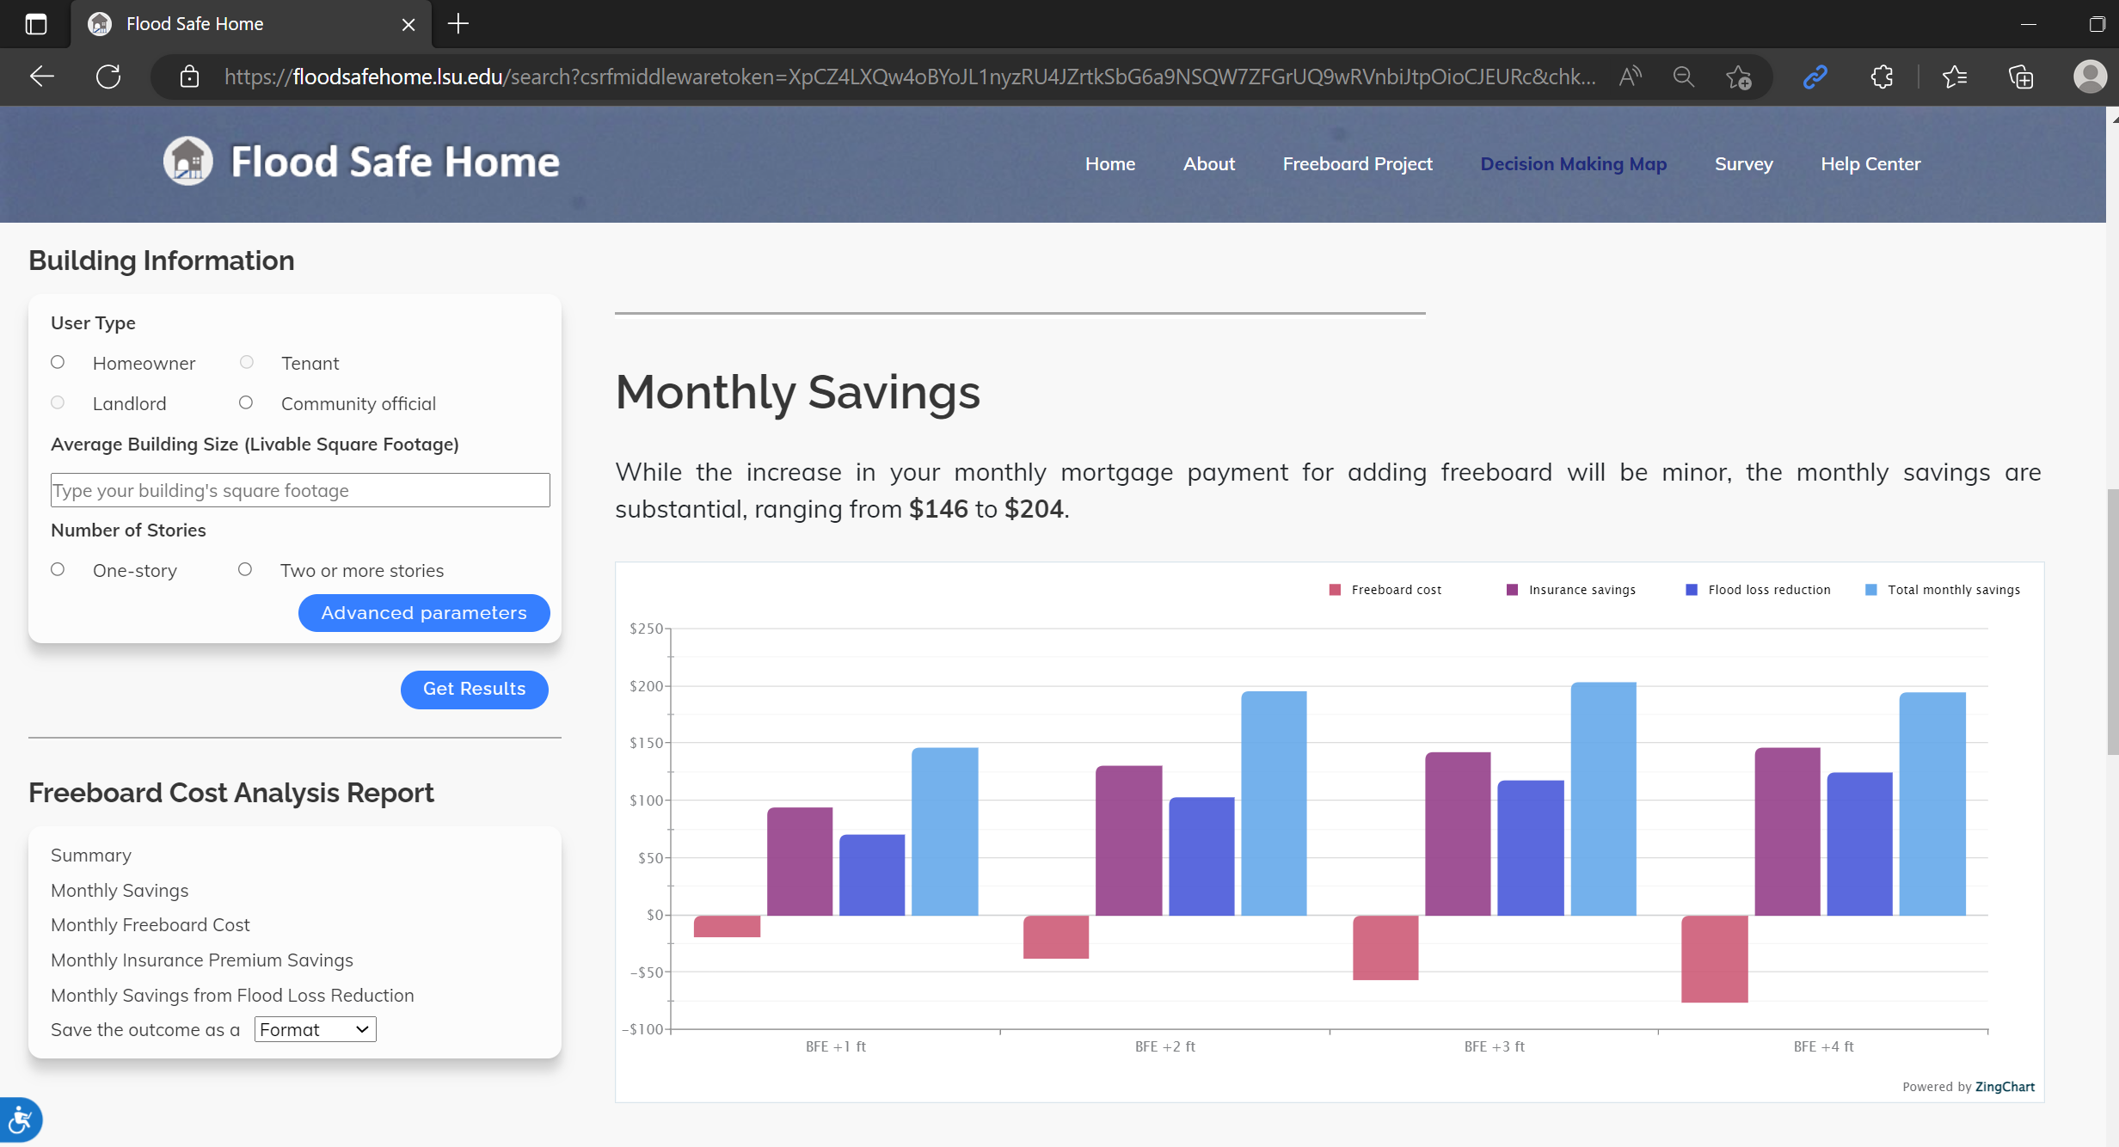
Challenges
Rapid changes in construction cost
Risk Rating 2.0
Simplifying complex topic
Tailoring tools for multiple perspectives

Slide 12
Contributors and Funding
Carol J Friedland, Yongcheol Lee, Rubayet Bin Mostafiz, Jiyoung Lee, Shifat P Mithila, Robert V Rohli, Md Adilur Rahim, Ehab Gnan and Monica Teets Farris
This project was funded by the Louisiana Sea Grant College Program (Omnibus cycle 2020–2022; Award Number: NA18OAR4170098; Project Number: R/CH-03 and Omnibus cycle 2022–2024; Award Number: NA22OAR4170105; Project Number: R/CH-05)

Slide 13
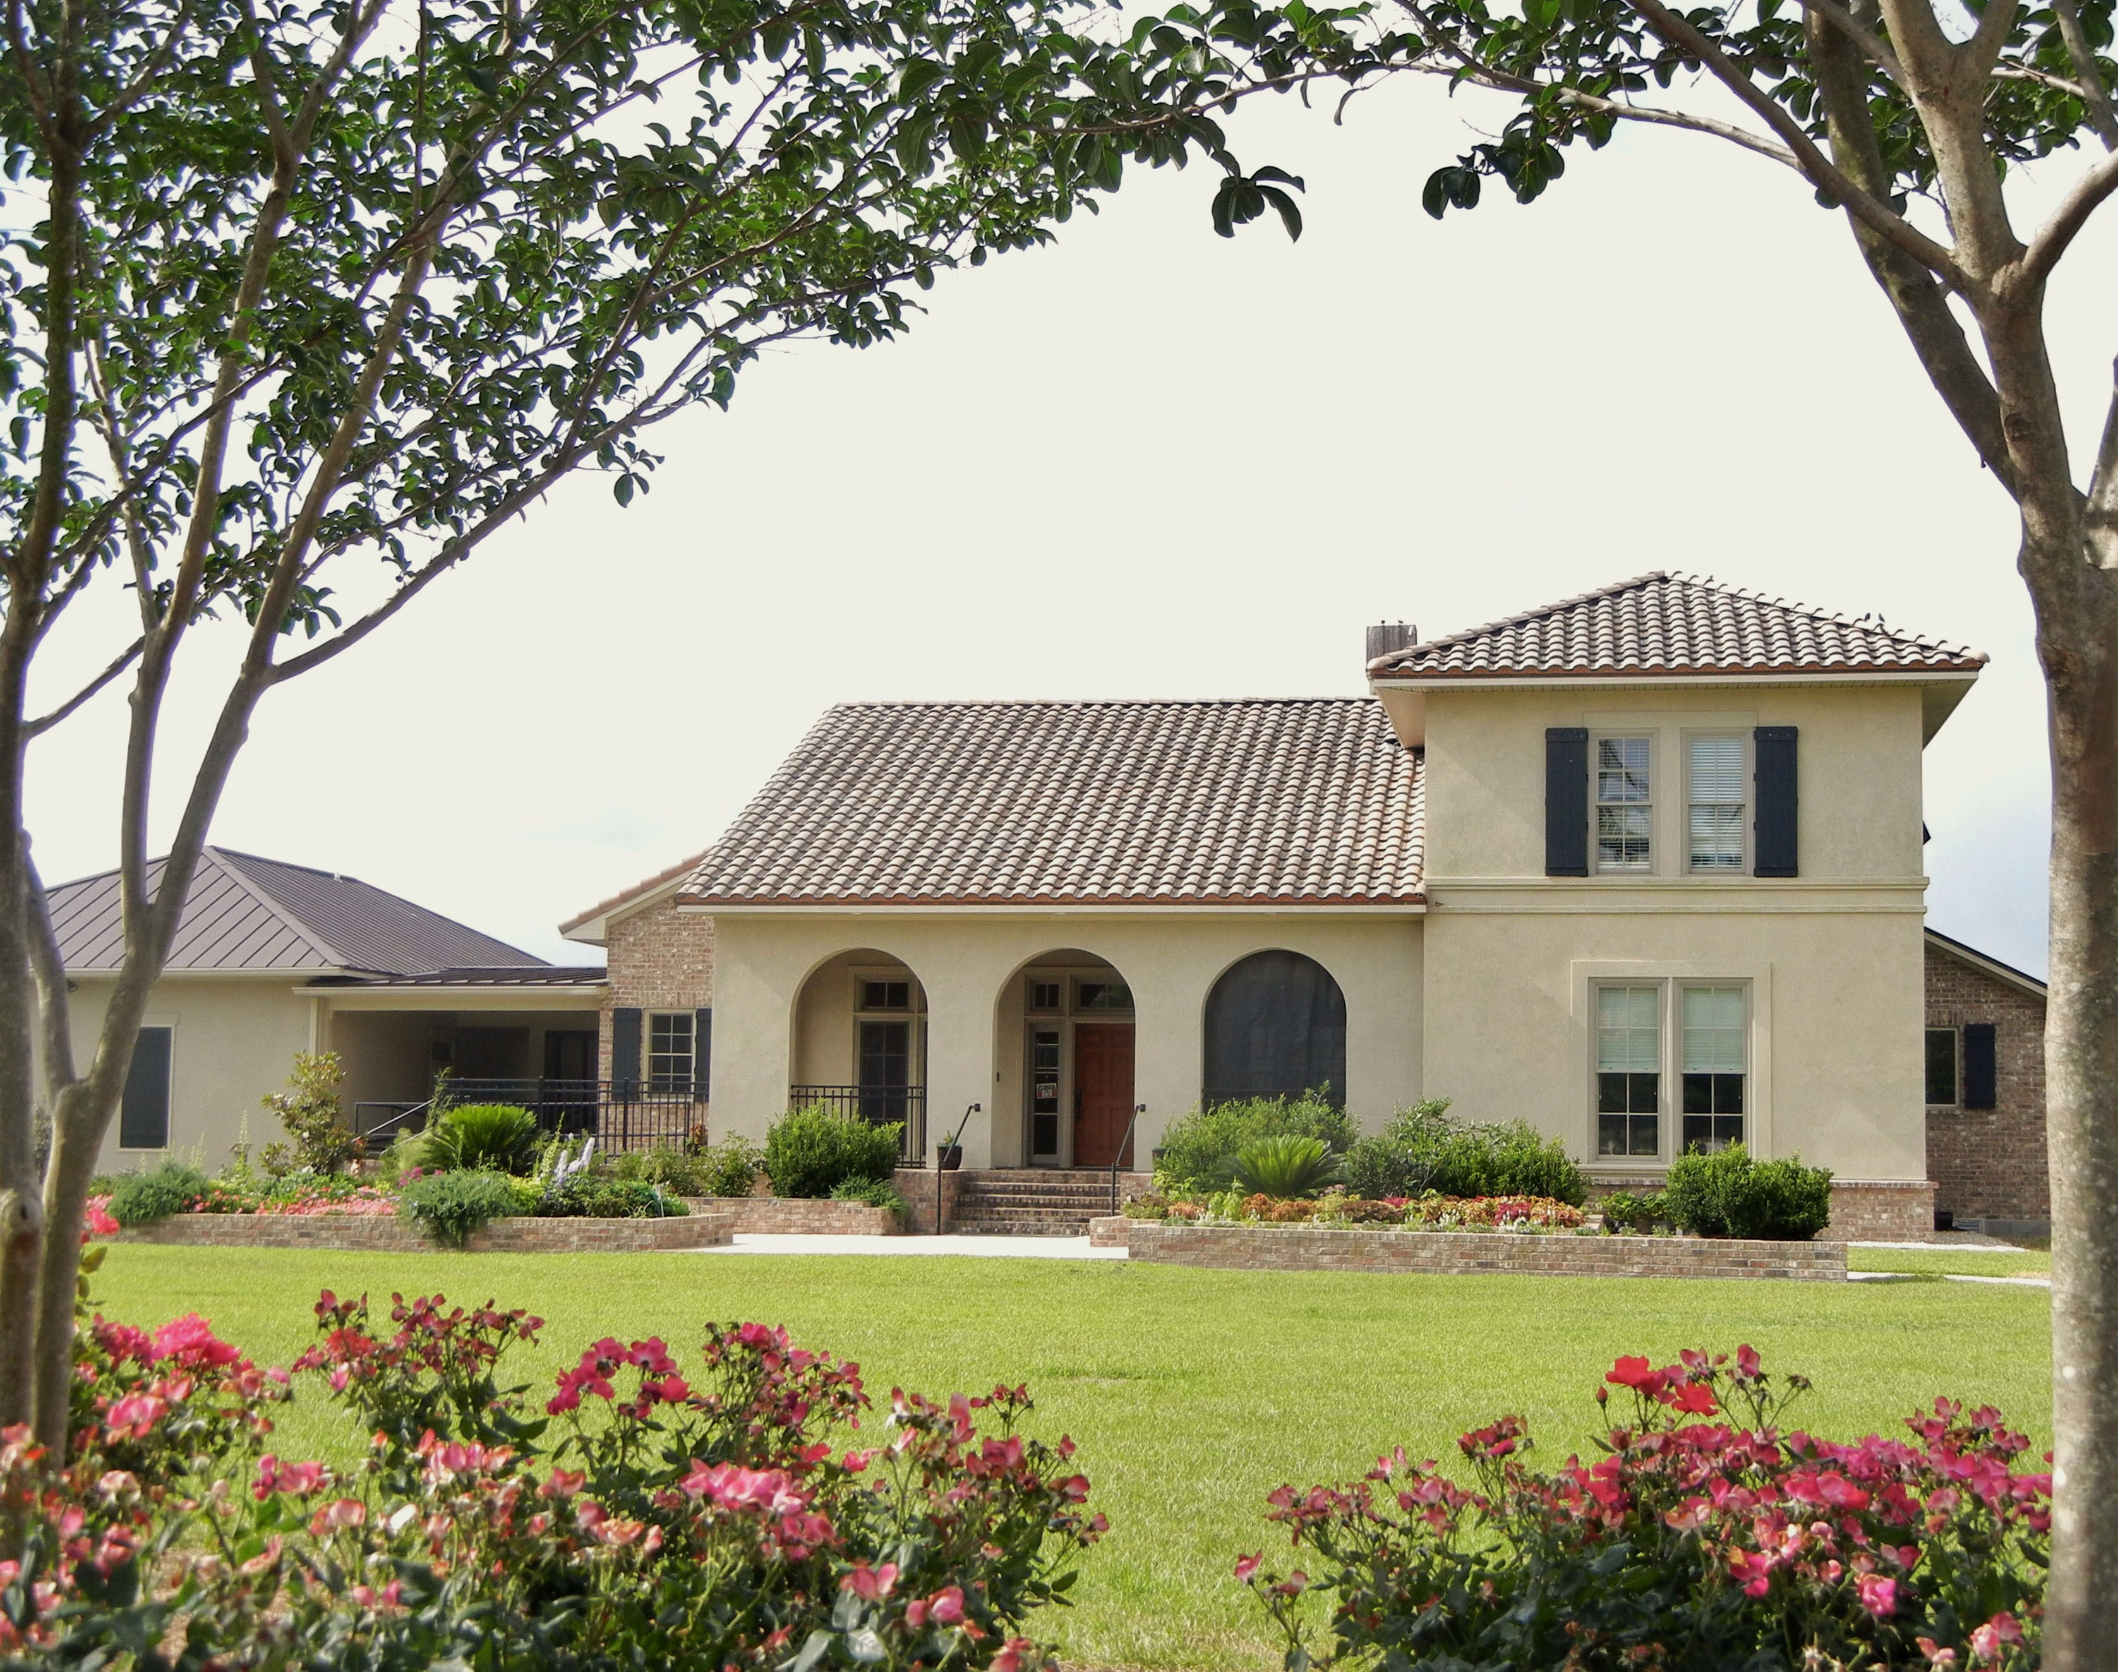
LaHouse Research and Education Center: Solutions for Resilient, Sustainable, Healthy Homes
CFriedland@agcenter.lsu.edu
225-578-7913

Slide 14
FloodSafeHome
Feedback
t.ly/fVqV

