Slide 1

Developing and Leveraging Communities of Practice to Advance Blue Carbon Science to Support Policy Decisions
Hilary Stevens
June 2, 2022

Slide 2
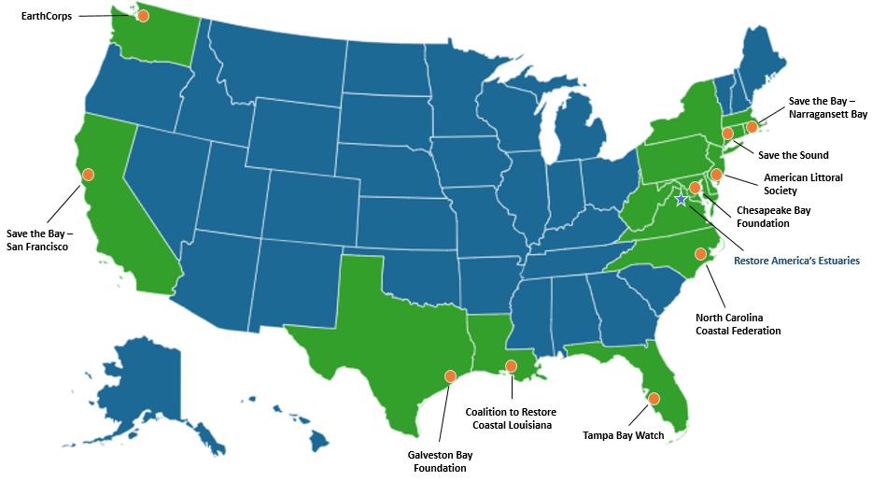
Restore America's Estuaries is dedicated to the protection and restoration of bays and estuaries as essential resources for our nation.
Affiliate Members
Ducks Unlimited | Atlantic Coastal Fish Habitat Partnership | Womens Aquatic Network
Billion Oyster Project | The Nature Conservancy | The Wetlands Institute | Buzzards Bay Coalition

Slide 3
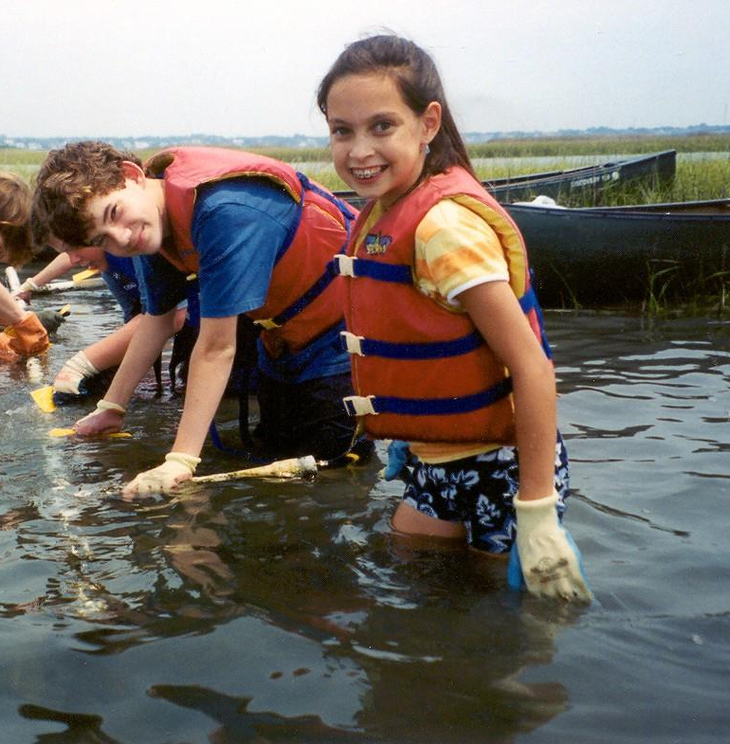
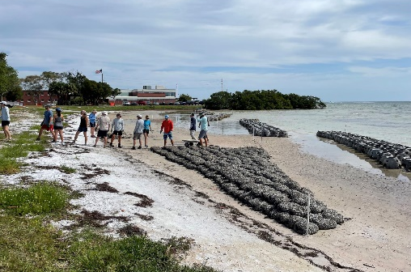
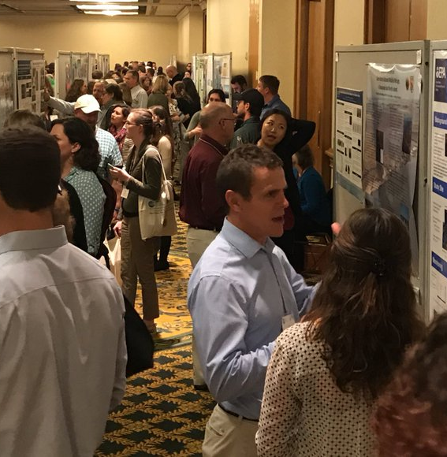
What we do
Grants programs
Outreach and education
  Living Shorelines
  Water Quality
  Blue Carbon
Biennial National Summit
National Estuaries Week
Notes:
RAE – members, advocate, NEW, LS, National Summit and Blue Carbon

Slide 4
Background for Blue Carbon Collaboration
RAE hosts Blue Carbon National Working Group: 2015, 2018, 2021
Establishing a Blue Carbon Network for the Gulf Coast – NERRS Science Collaborative project 2015-2017
Coordinated a Blue Carbon Roundtable with experts and Capitol Hill staffers
Developing and Leveraging Communities of Practice to Advance Blue Carbon Workshop – at RAE Summit in December 2022

Slide 5
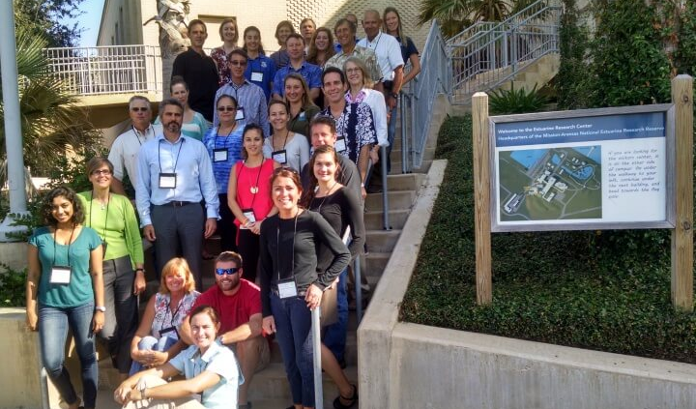
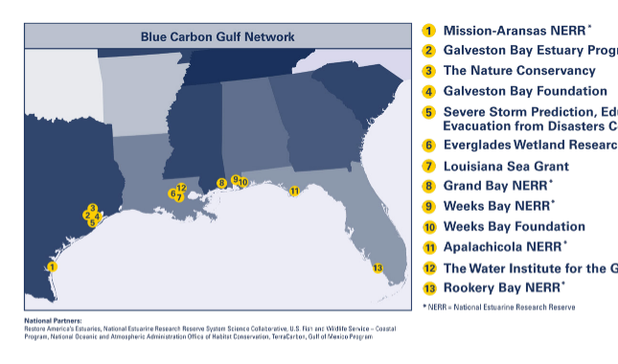
Establishing a Blue Carbon Network for the Gulf Coast
NERRS Science Collaborative project 2015-2017
Regional partnership
Meeting in Baton Rouge in 2016- Land owner disinterest due to lack of incentives

Slide 6
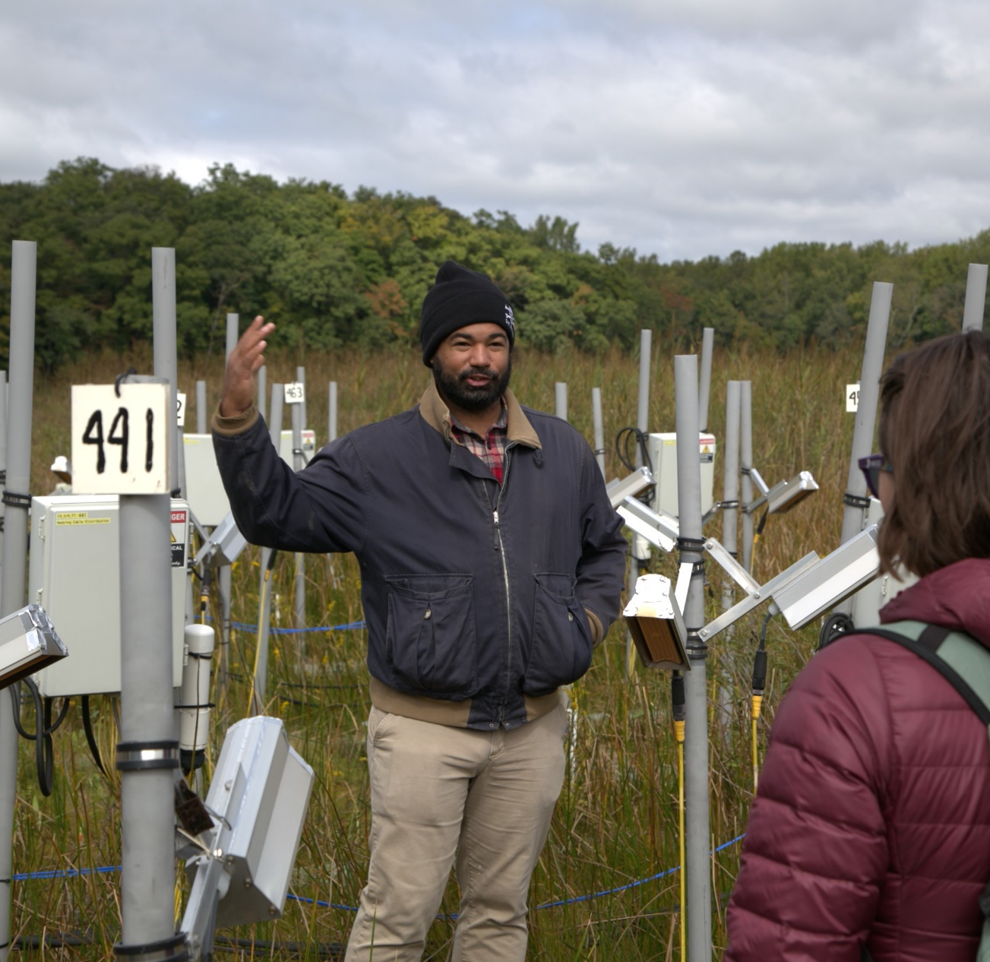
Blue Carbon Roundtable
Training on science communications
Meeting with Capitol Hill staffers
Field trip to Smithsonian Environmental Research Center

Slide 7
National Working Group Findings
Database of parameters to support landscape-level accounting
Develop pilot projects and capture lessons learned
Integrate blue carbon into ecosystem service models
Need to improve modeling to bring down costs
Better target communications and fundraising
Need training on methodology
Investigate issues on federal land
Notes:
.

Slide 8
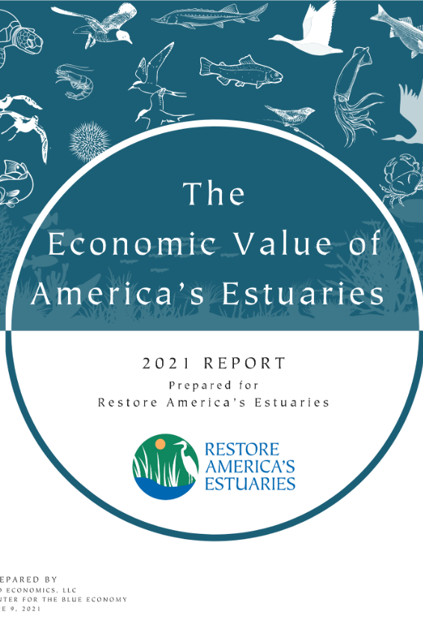
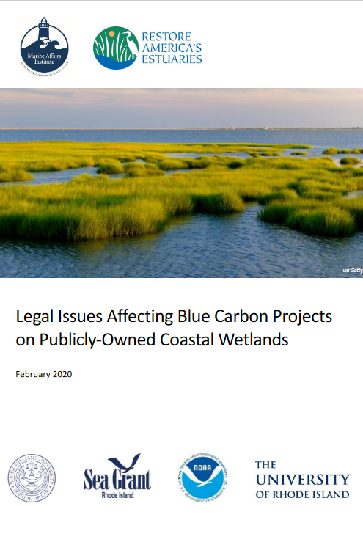
Reports Built on National Working Group Input

Slide 9
National Policy Recommendations from 2021 Meeting
“All of government” approach through dedicated resources and coordination, including a research agenda
Strengthen protections for BC ecosystems
Remove barriers to BC restoration projects
Advance policies for climate-related financing

Slide 10
Summit Workshop Discussion Points
Groups currently at international, national and regional level
Promote communication and collaboration
Wide range of organization structures and outputs
Northern Gulf of Mexico is a geographic gap

Slide 11
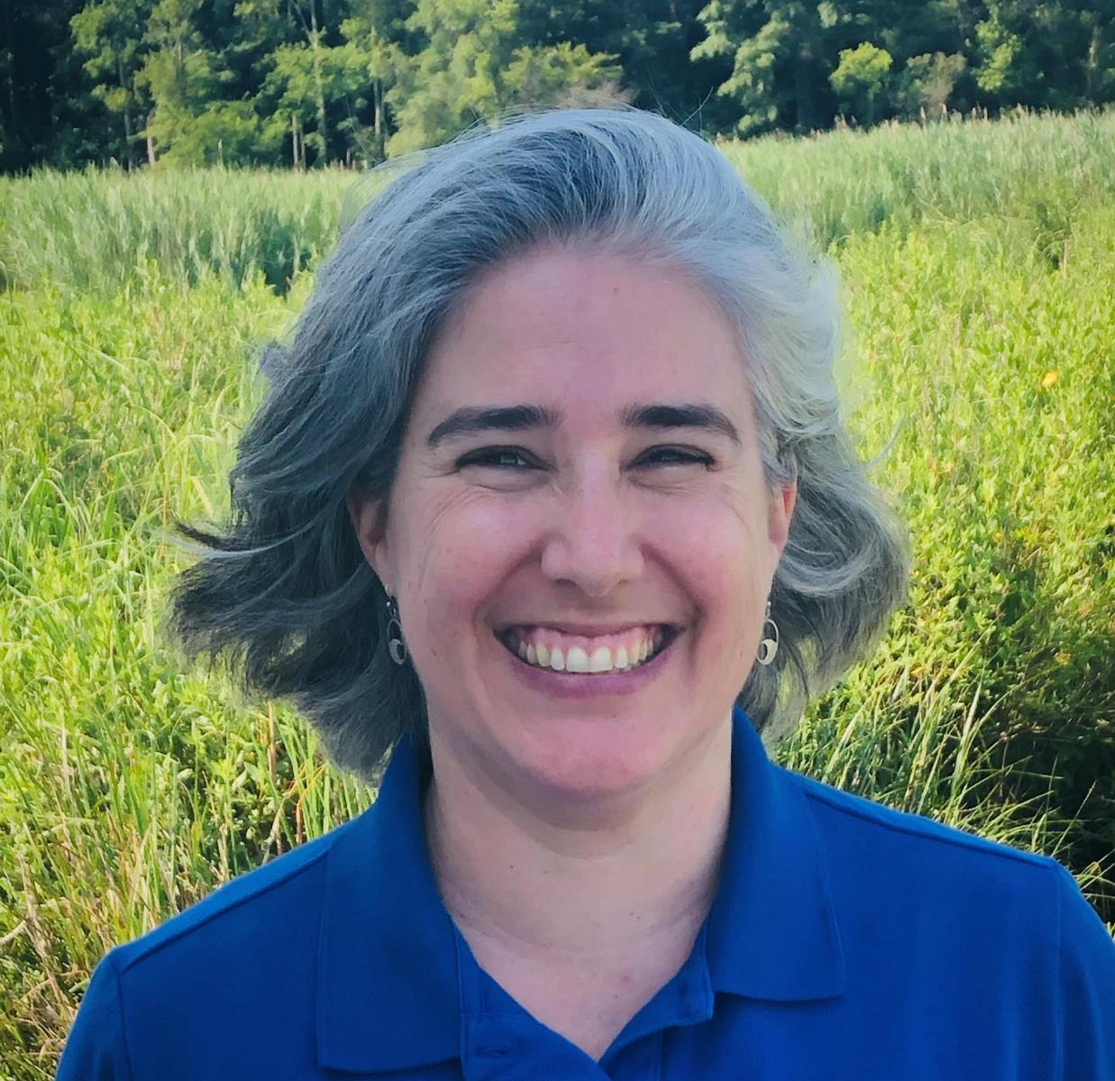
Thank you!
  Hilary Stevens
  Coastal Resilience Senior Manager
  Restore America’s Estuaries
  HStevens@estuaries.org
  www.estuaries.org/bluecarbon
Notes:
And please also consider me as a resources – feel free to email me for help in messaging, access to slides and other resources, or if you want to do a webinar or presentation. I hope this was helpful and that you can feel a bit more comfortable when talking about blue carbon.

