Slide 1
Surrogate models to predict storm surge hydrodynamics over evolving landscapes and climate forcings
Mohammad Ahmadi, David Johnson.
State of Coast 2023, New Orleans.
May 30- June 2, 2023

Slide 2
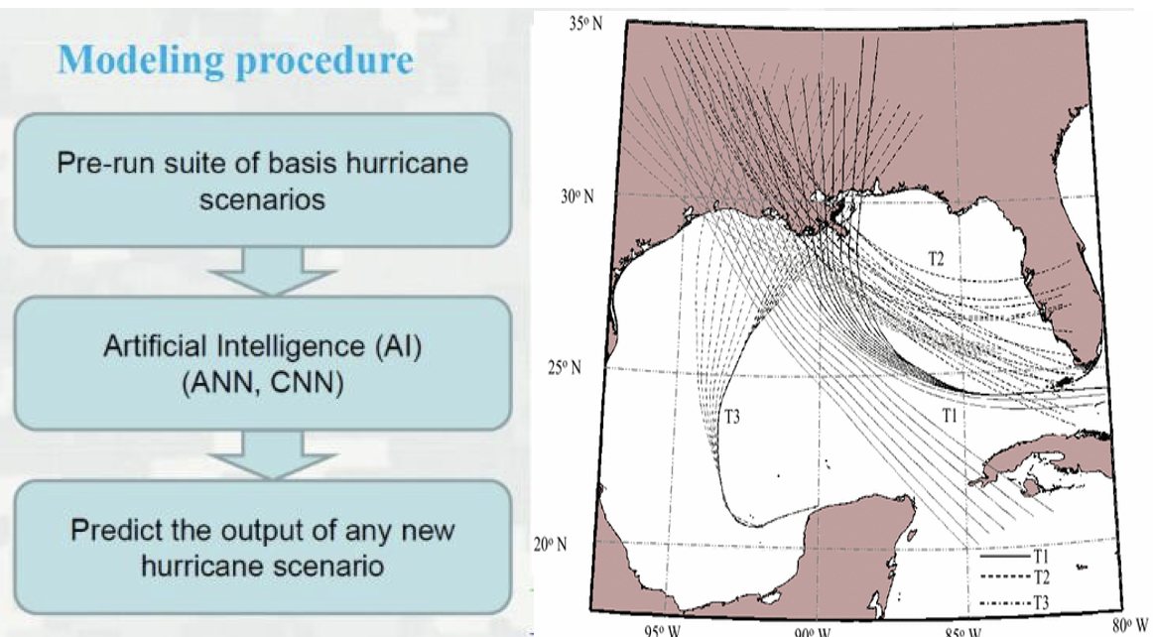
Introduction & Methodology
Surrogate modeling
How risk will change over time under different SLR trajectories
Using AI/ML as scenario generator
Disadvantages of Physical-based models:
Estimates of storm surge hazard rely on computationally expensive hydrodynamic simulations
Costly computations
Thousands of cores
Biases
(Jia et al., 2016)

Slide 3
Methodology
Artificial neural network prediction model
Grid points
Storm Params
Landscape
SLR
Lat, Lon
Strength & Track
Elev, roughness
Low, High
Surge predicted at 94,013 points across coast
Model trained using current conditions (2020) and 2023 Coastal Master Plan’s Lower and Higher environmental scenarios
Storm parameters: track, central pressure, radius of maximum wind speed, forward velocity
Landscape parameters: lat/lon, topobathy elevation, Manning’s n, canopy, $z_{0}$
Boundary conditions: eustatic sea level
Scenario | Year | Sea Level (NAVD88 ft)
Low | 2030 | 1.43
Low | 2040 | 1.71
Low | 2050 | 2.03
Low | 2060 | 2.41
Low | 2070 | 2.83
High | 2030 | 1.52
High | 2040 | 1.91
High | 2050 | 2.40
High | 2060 | 3.02
High | 2070 | 3.71

Slide 4
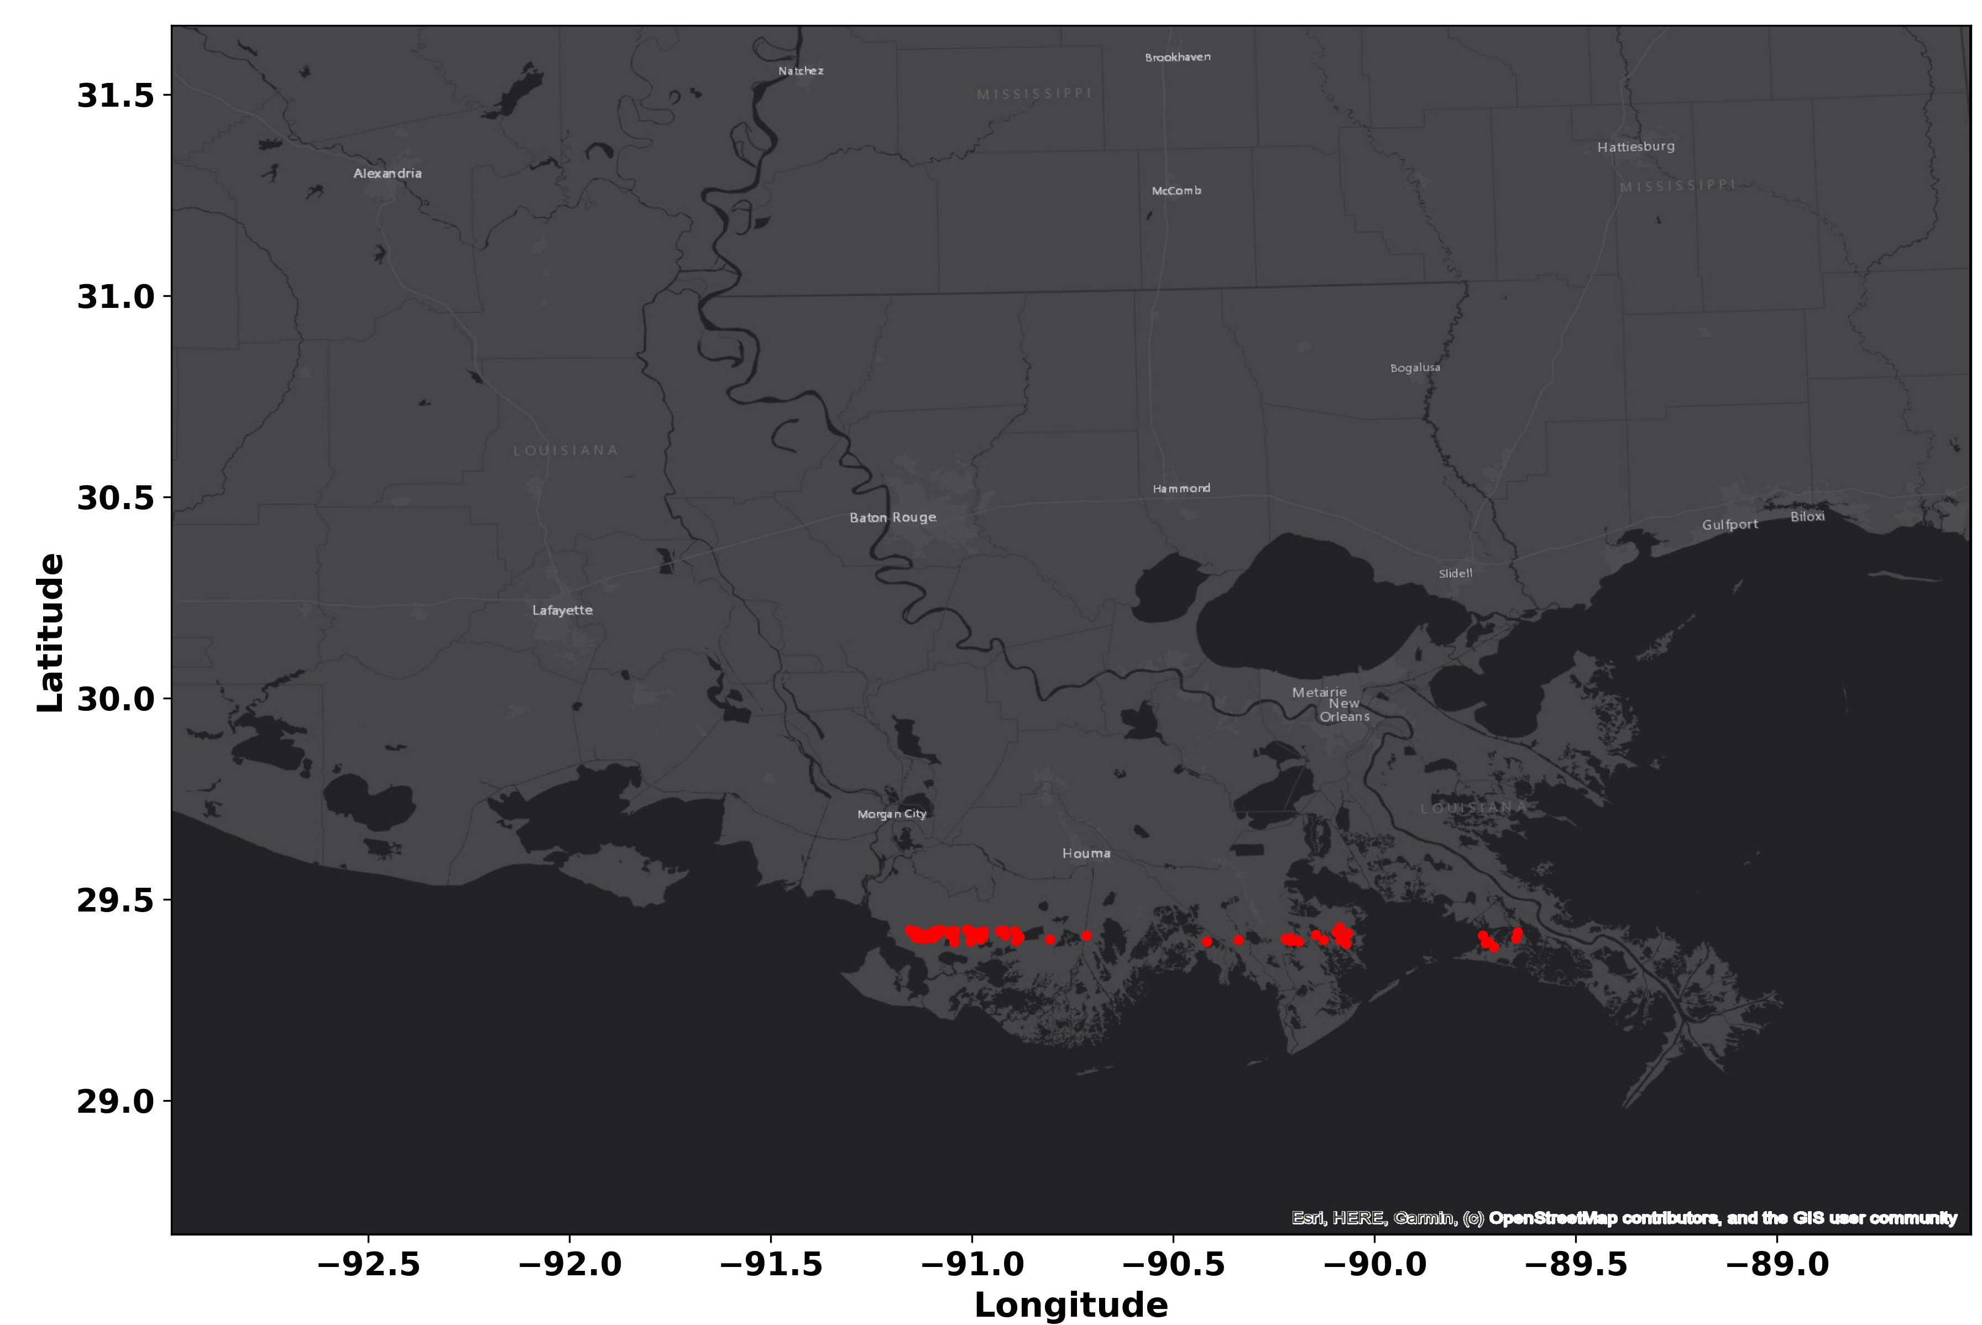
Prediction of Storm Surge for the current condition

Slide 5
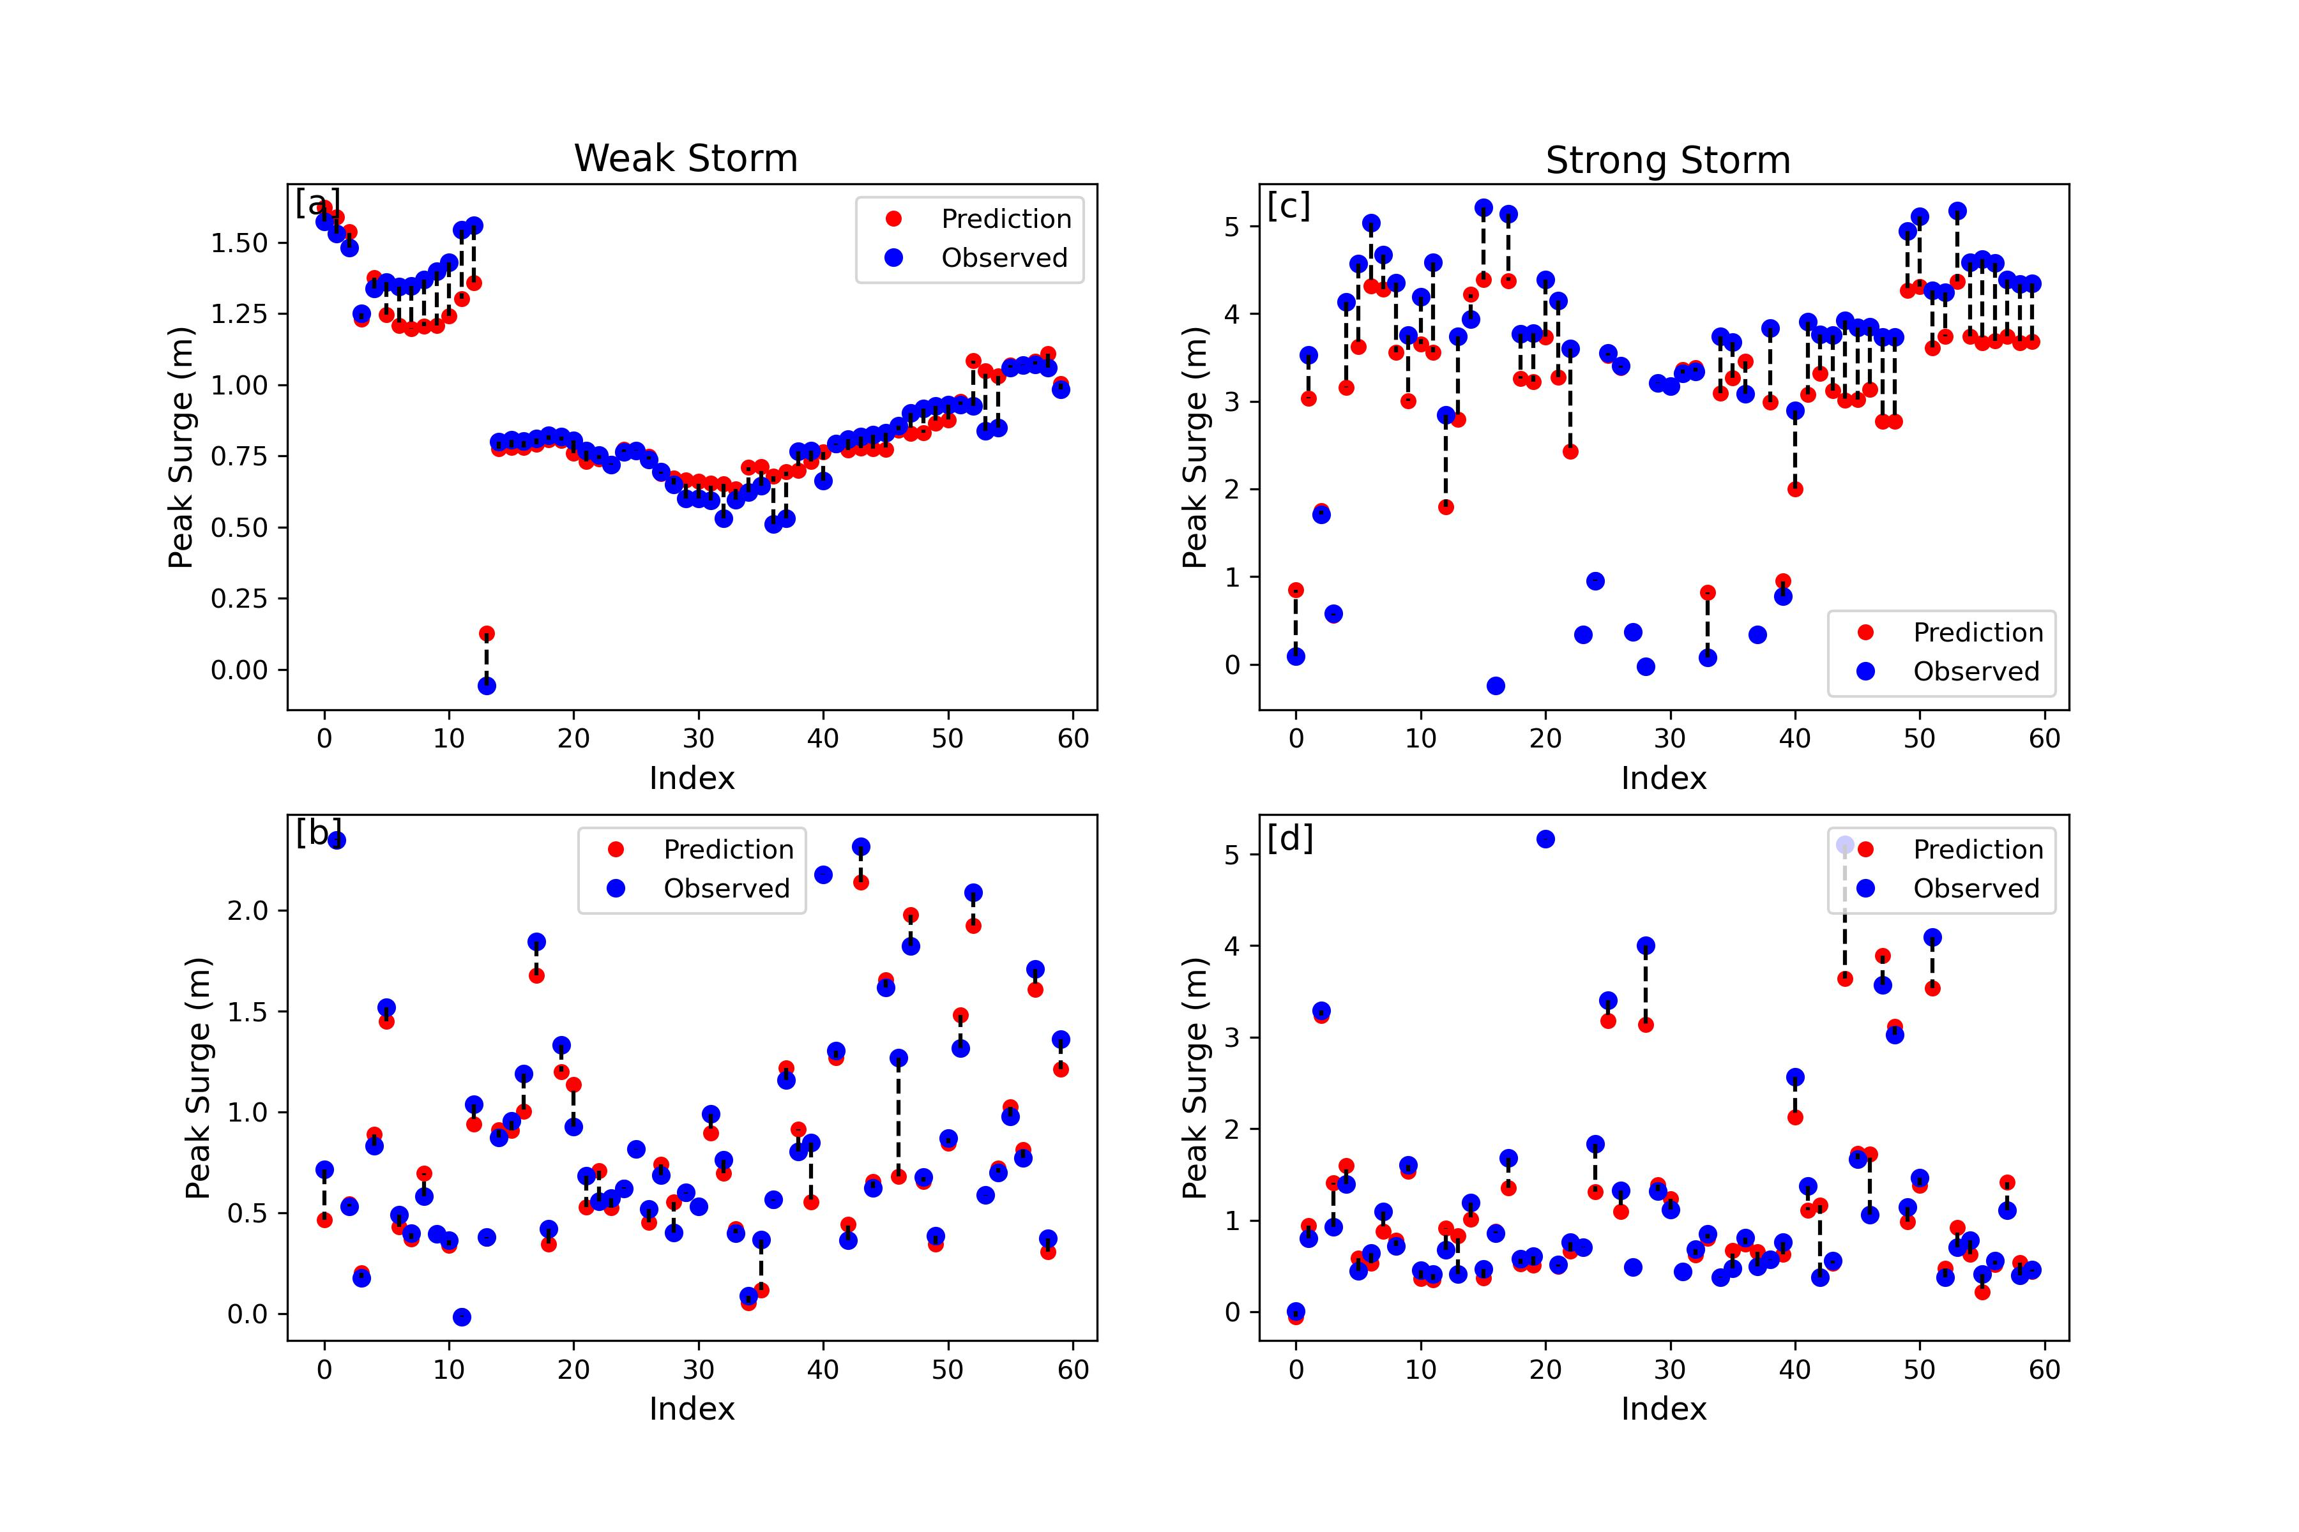
Prediction of Storm Surge for the current condition
Storm surge prediction for the case where the ANN model input only includes storm parameters [a, c] and [b, d] which also includes the landscape parameters.

Slide 6
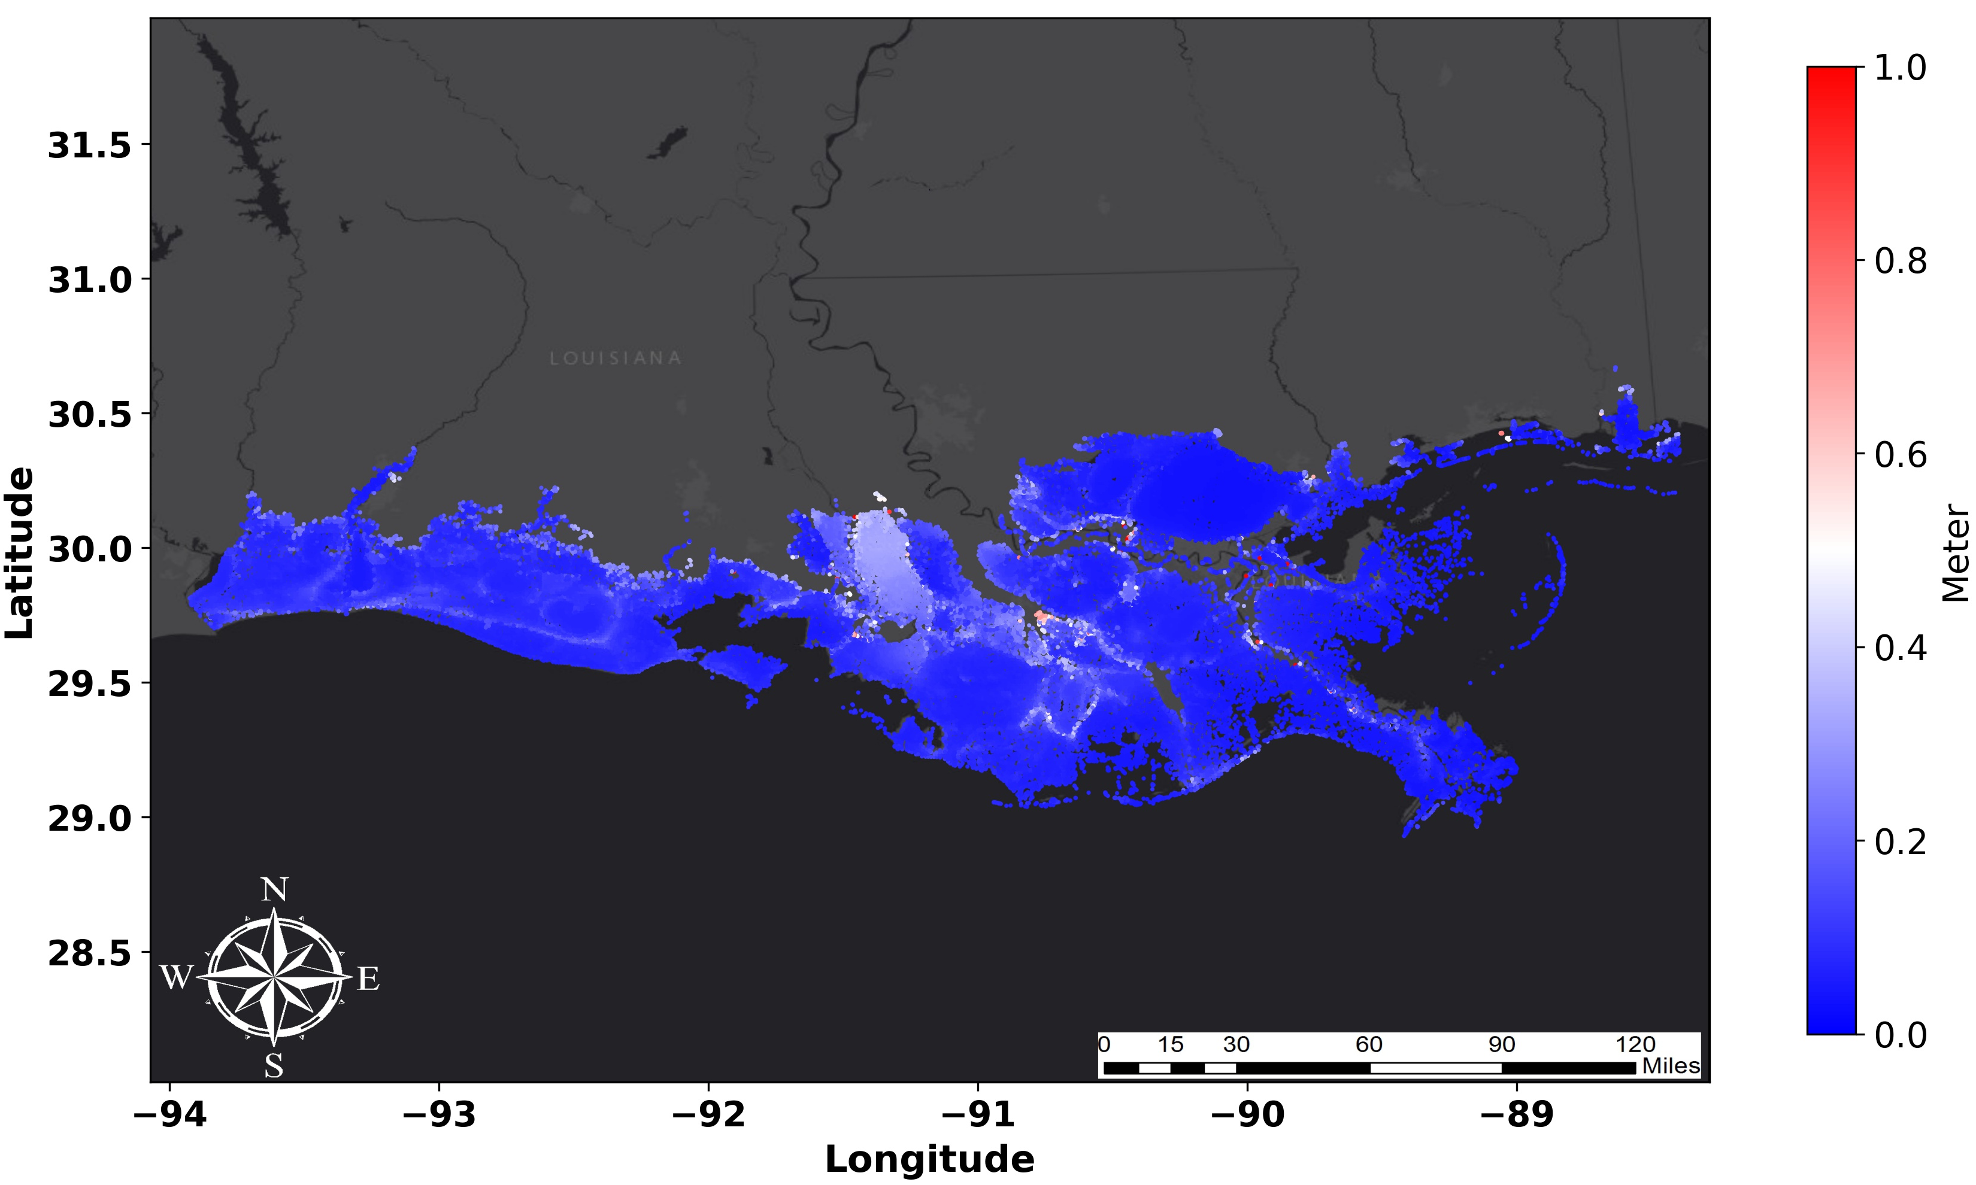
RMSE Map
Scatter plot of average RMSE values across all scenarios in the entire domain for all grid points.

Slide 7
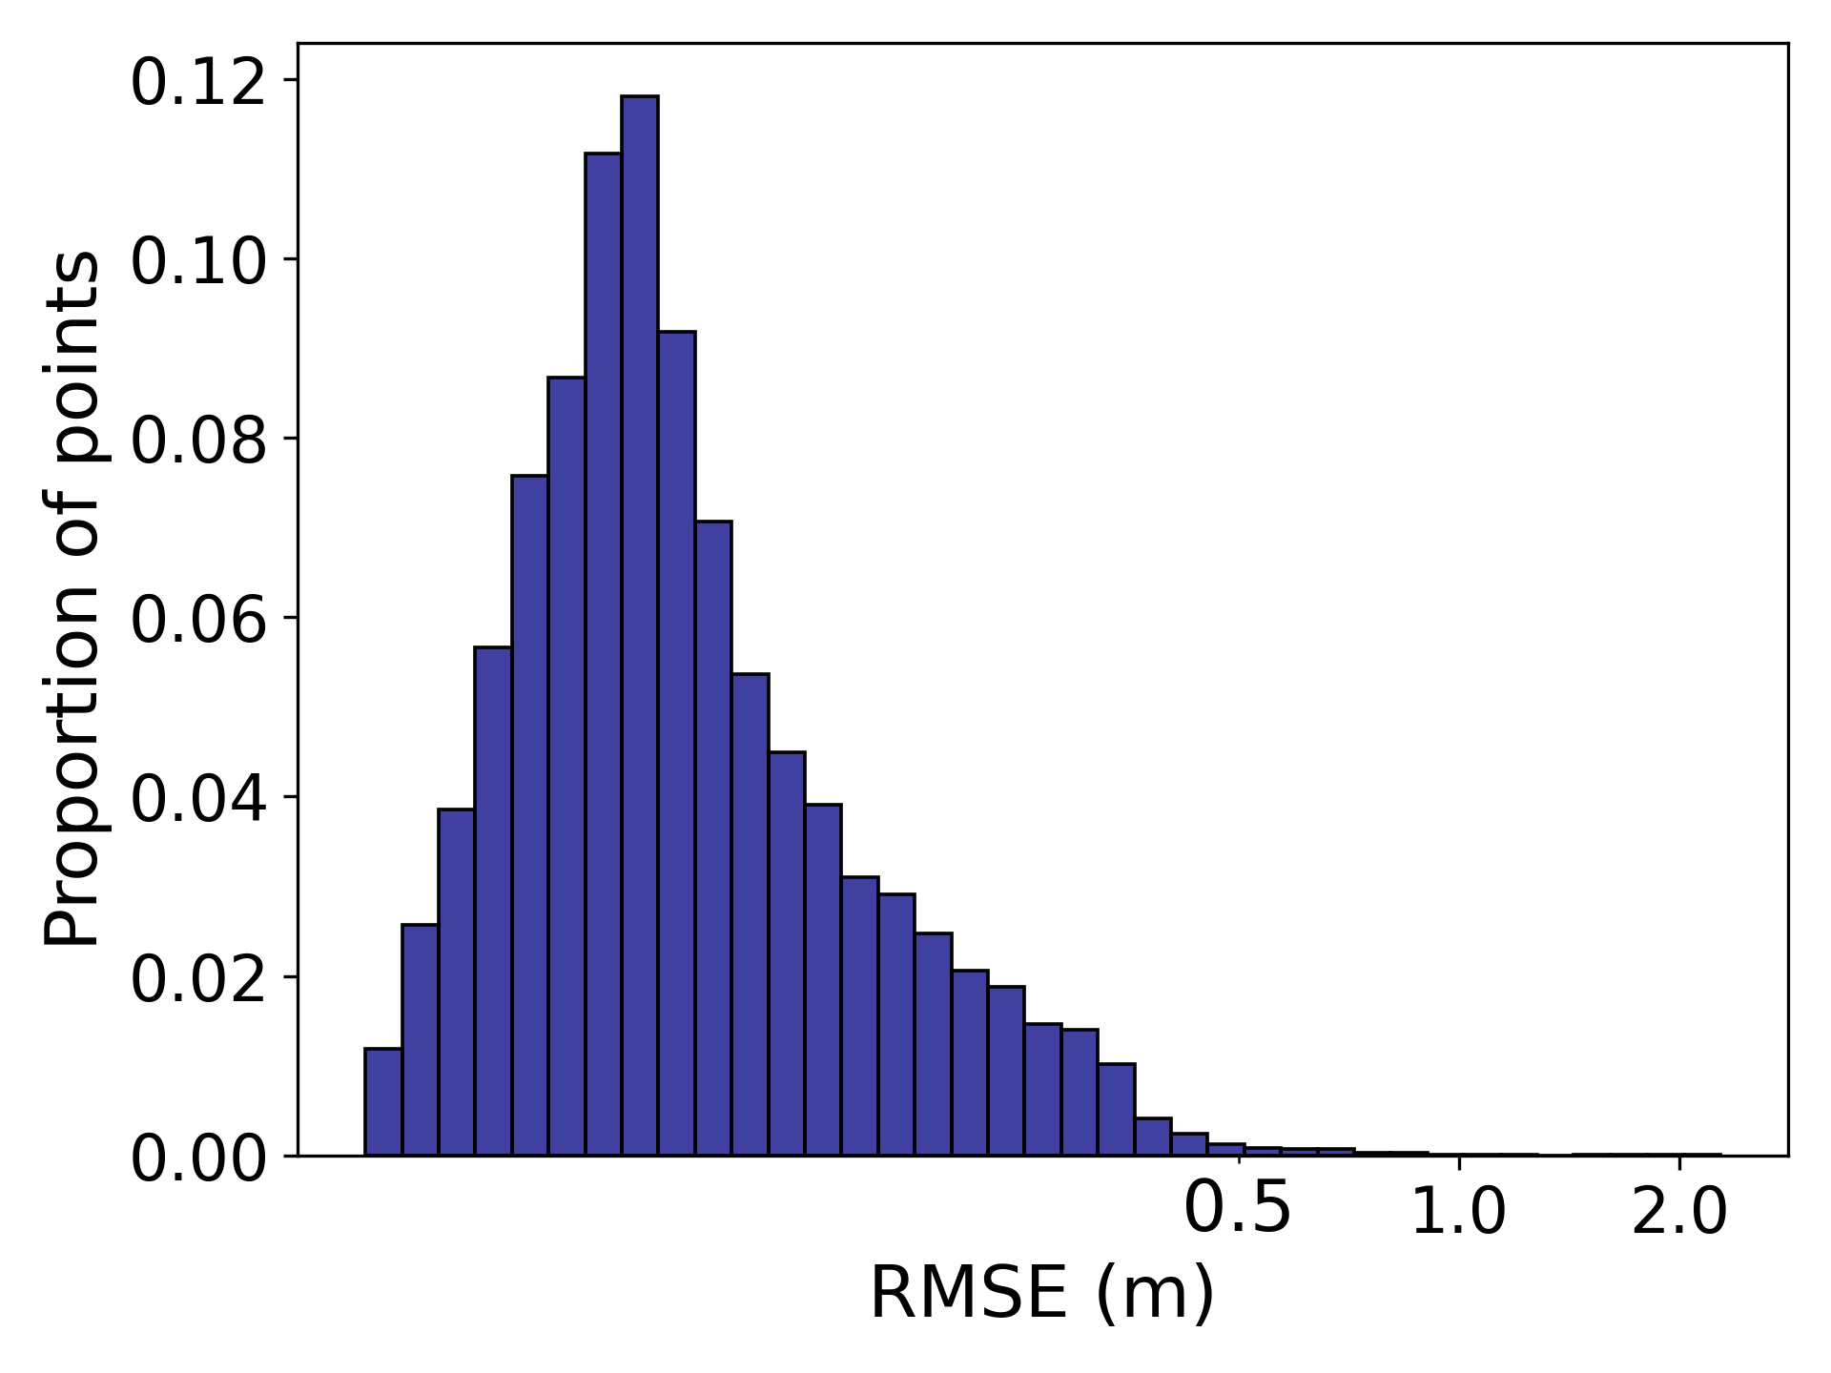
Histogram of Average RMSEs
Histogram of average RMSE values across all scenarios in the entire domain for all grid points.

Slide 8
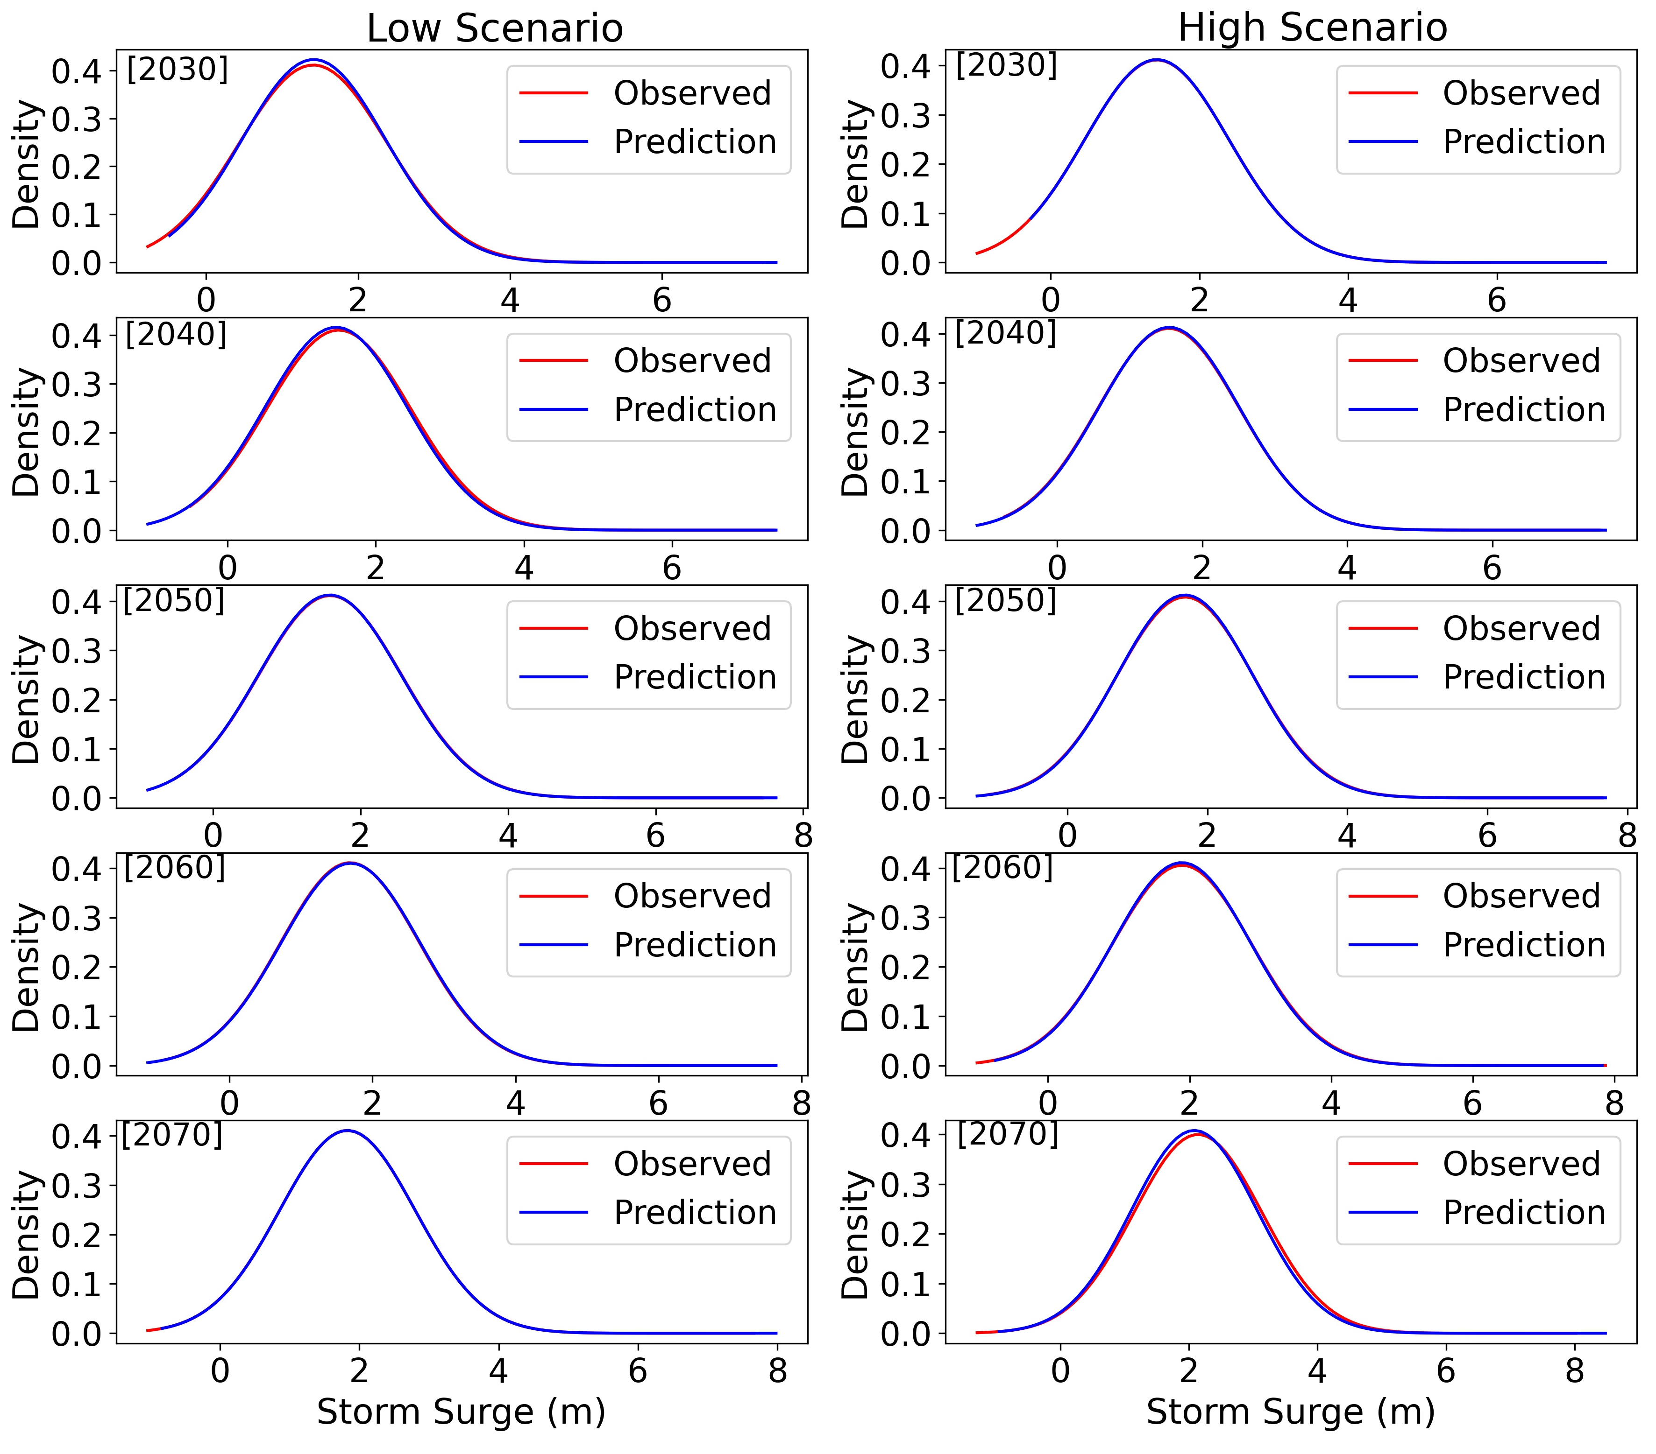
PDFs of Storm Surge Prediction
PDFs of storm surge for all future scenarios.

Slide 9
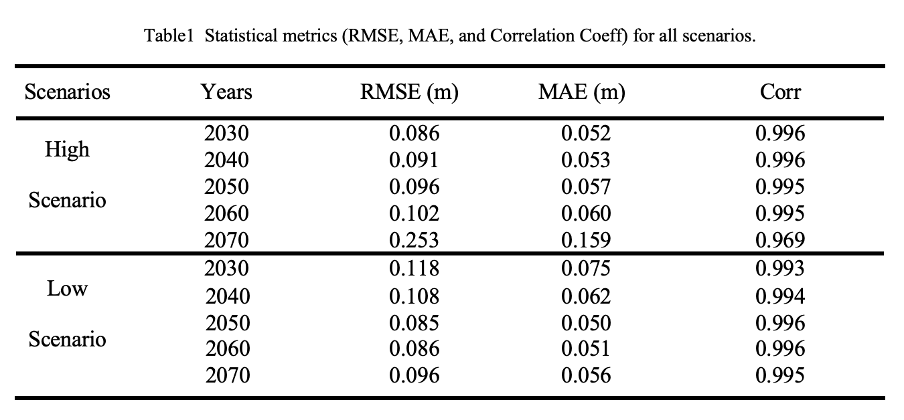
Statistical Metrics

Slide 10
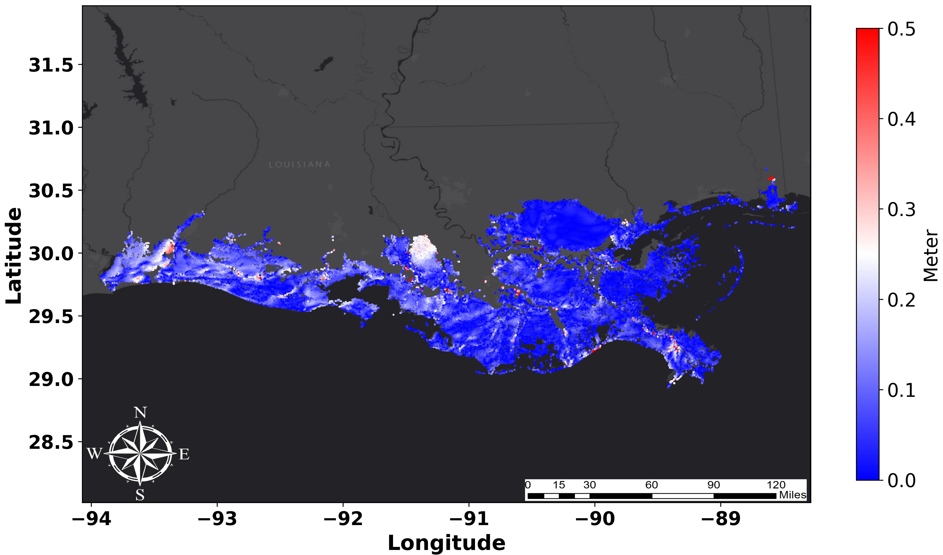
Conclusion
Efficiency of Surrogate modeling (NN) on storm surge prediction.
Quantification of the impact of Climate change on Landscape parameters and sea level rise on storm surge prediction.
Predictive accuracy that is on par with the magnitude of bias and uncertainty in the ADCIRC model.
Scenario generator to explore
alternative landscape
Storm surge difference map for a single storm between observation and prediction

Slide 11
ACKNOWLEDGEMENTS
Funding:
NSF I-GUIDE
Input Data:
2023 Coastal Master Plan (funded by Louisiana CPRA)

Slide 12
Thank You

