Slide 1
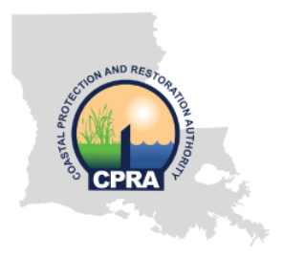
River Reintroduction into Maurepas Swamp & West Short Lake Pontchartrain Risk Reduction Project Combined Project Overview & Challenges
presented by: Leah B. Read, PE AECOM

Slide 2
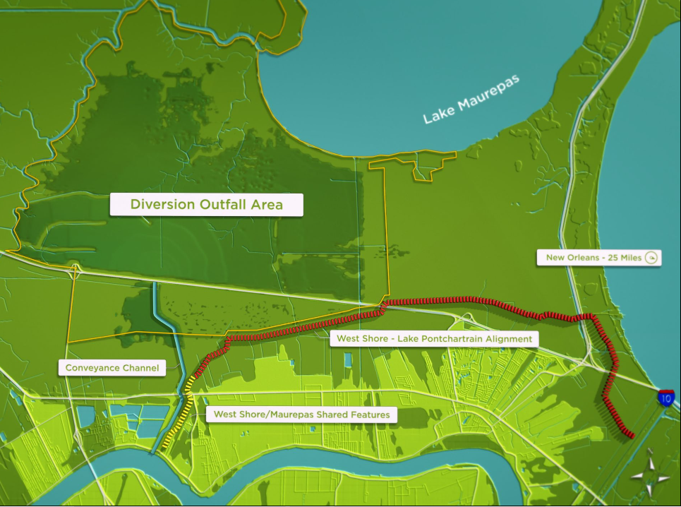
Maurepas / WSLP
Big Picture
Maurepas runs 5 ½ miles N - S
WSLP-111, -112 & -113
Share Common N-S Corridor
New Orleans 25 miles
Separate 2500-ft N of US-61
Maurepas Continues North, WSLP Heads East
WSLP Separate Alignment
Conveyance Channel
WSLP / Maurepas Shared Features
Maurepas Purpose is to combat Saltwater Intrusion
Gramercy
Garyville
CPRA

Slide 3
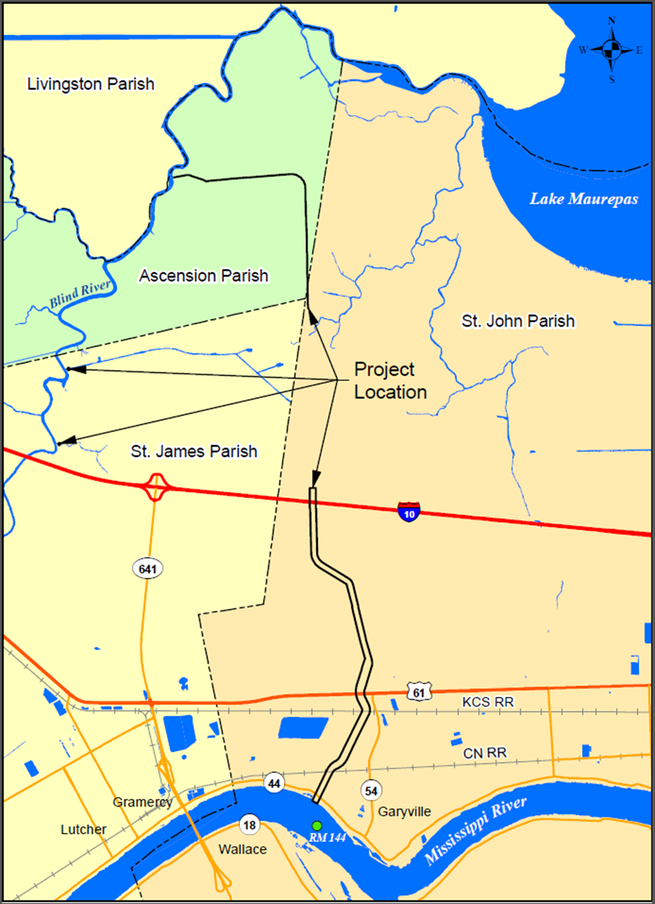
Maurepas Project History
- First discussed / planned in 1990’s
- First major design phase in early 2000’s
- LDNR’s significant design effort started post-Katrina
Utility Corridor
- Shifted to CPRA (OCPR) and restarted ~2010, paused ~2013
Camp
- Formally tied (as mitigation) to WSLP Project this year
CPRA

Slide 4
Maurepas Project Overview
- 2,000-cfs Freshwater Diversion from MR to Maur. Swamp
- Intended to Benefit ~45,000 acres
- Affects St. John the Baptist
& St. James Parishes
- Miss River Intake Structure
Utility Corridor
- 2 Railroad Crossings
- 2 Roadway Crossings (River Rd. & Airline Hwy.)
Camp
- 1 Interstate Crossing
CPRA

Slide 5
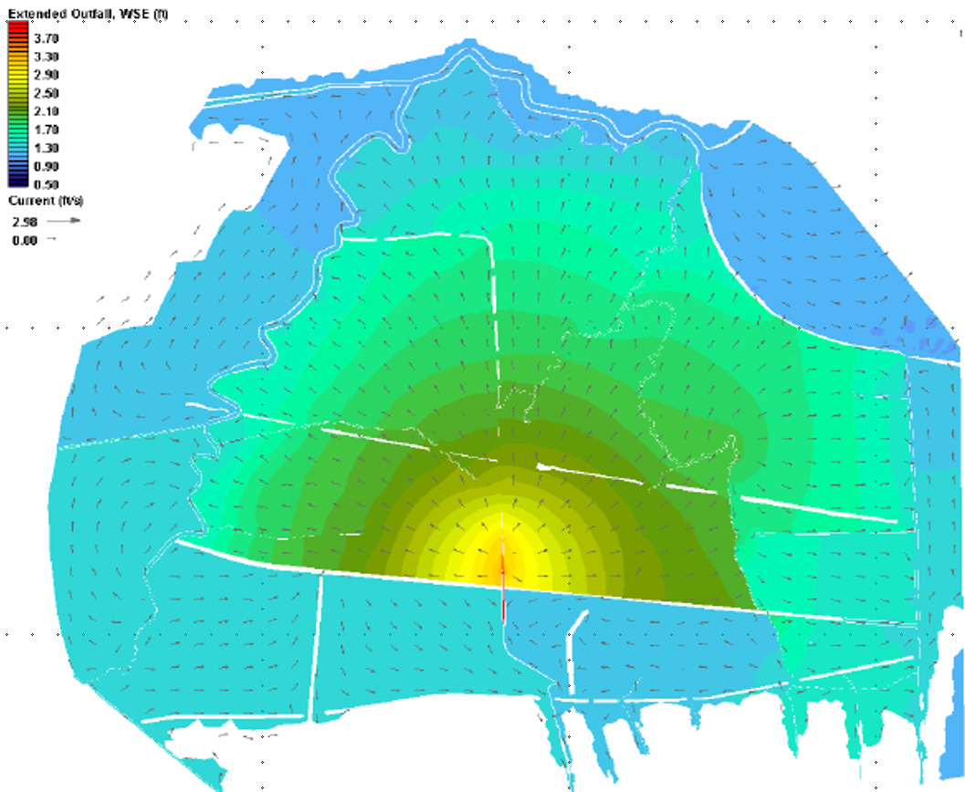
Maurepas Project Overview
- Primary aim is to reintroduce freshwater and nutrients into swamp. Some sediment will also be introduced.
- Extensive calibration & examination of ADCIRC modeling to determine dispersal.
- Total Nitrogen, Total Phosphorous, & Salinity are the primary nutrients/properties examined.
CPRA

Slide 6
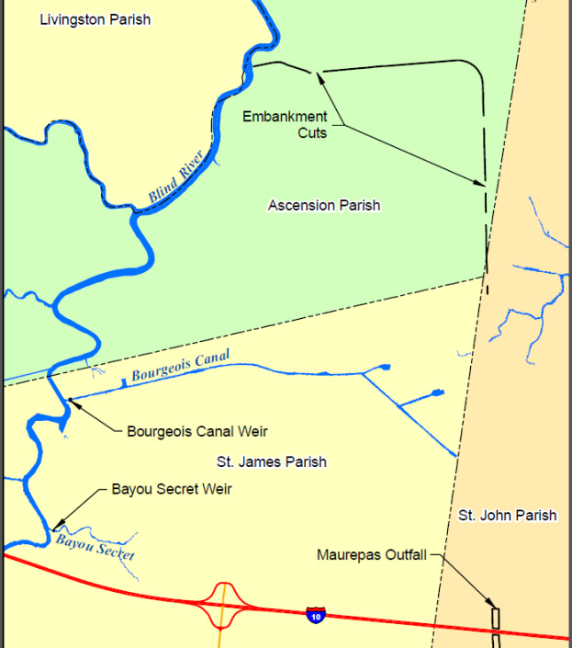
Maurepas Project Overview
- Embankment cuts in existing logging RR spur to promote water circulation.
- Weirs to be installed at Bourgeois Canal & Bayou Secret at Blind River discharge points. Purpose is to avoid short-circuiting of diversion’s output into river (would reduce retention time in target improvement zone).
CPRA

Slide 7
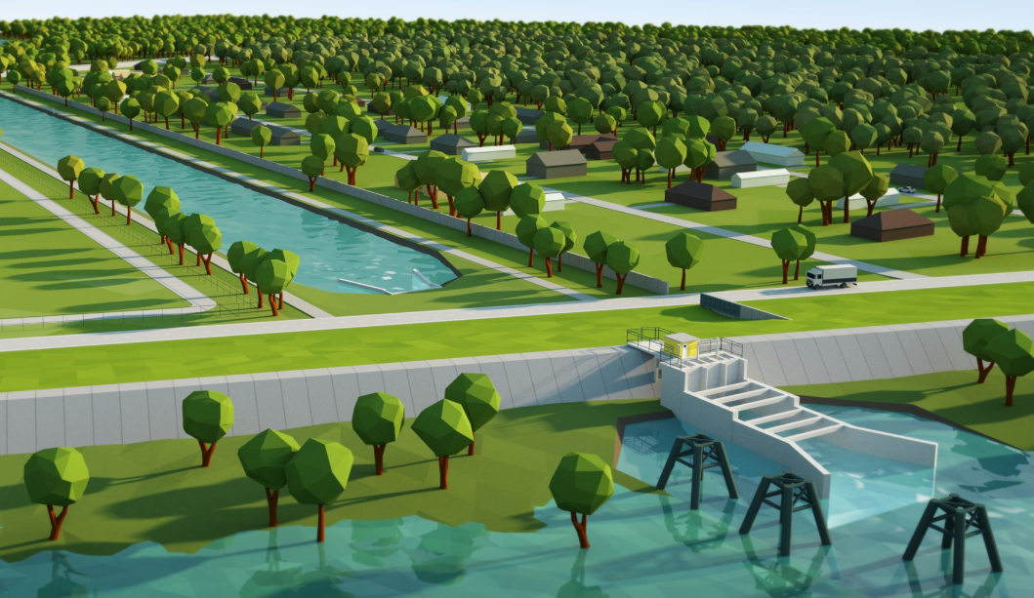
Project Challenges – Mississippi River
- Headworks housing 3 – 10ft x 10ft sluice gates to be constructed within MR Levee via cofferdam system
River Rd. Crossings
- River Rd. construction for channel & WSLP features to be phased
Sedimentation Basin
Intake Headworks
CPRA

Slide 8
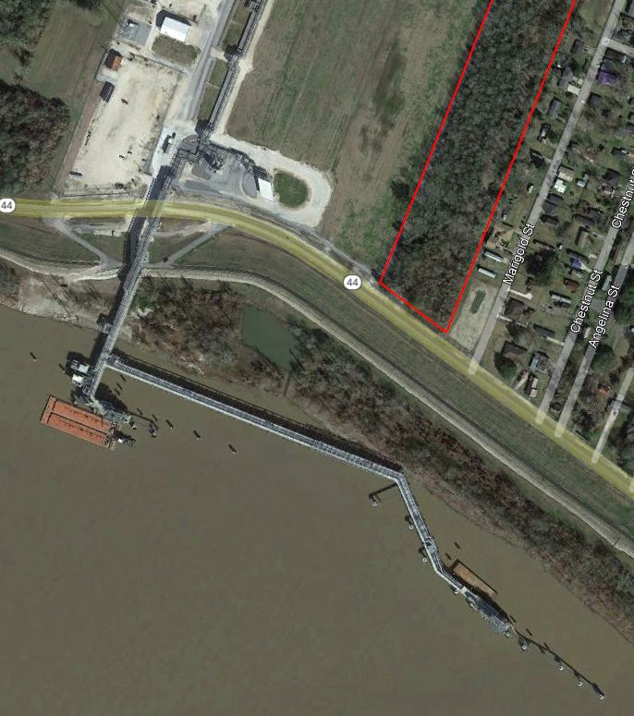
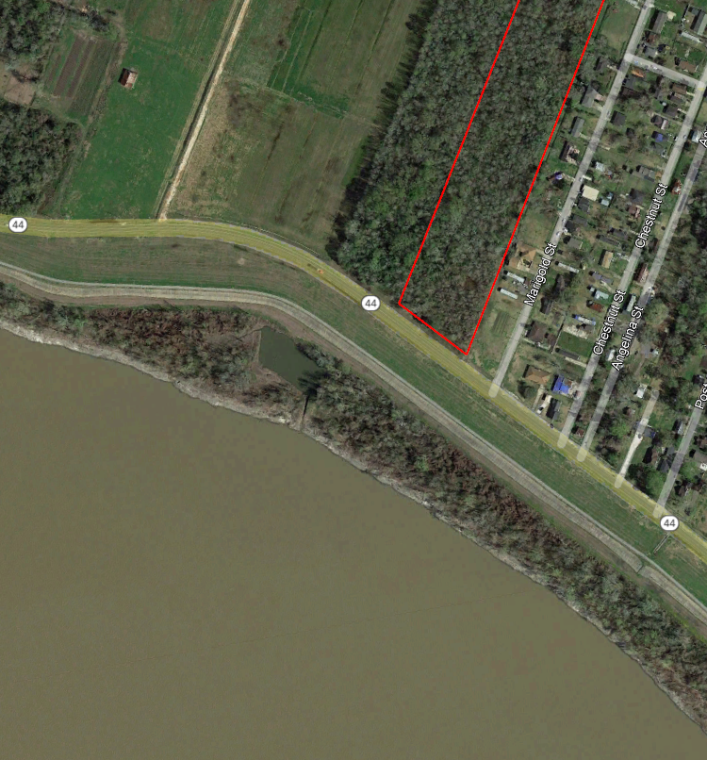
Project Challenges – Industrial Development
2013 Miss River Headworks Location
Current Miss River Headworks Location
CPRA
AECOM

Slide 9
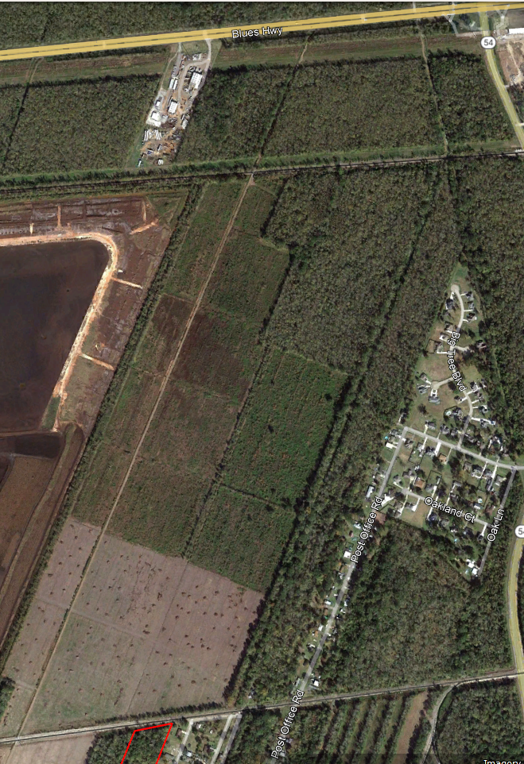
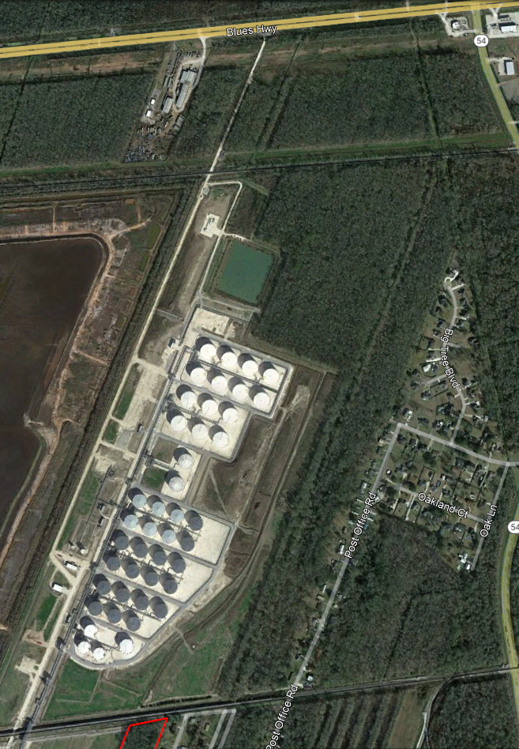
Project Challenges – Industrial Development
KCS RR merged with CP.
Crossing expanded from 1 to 2 lines, including future Amtrak
CN RR to Airline Hwy, 2013
CN RR to Airline Hwy, Current
CN RR crossing expanded to 4 rail lines
previously 2
CPRA

Slide 10
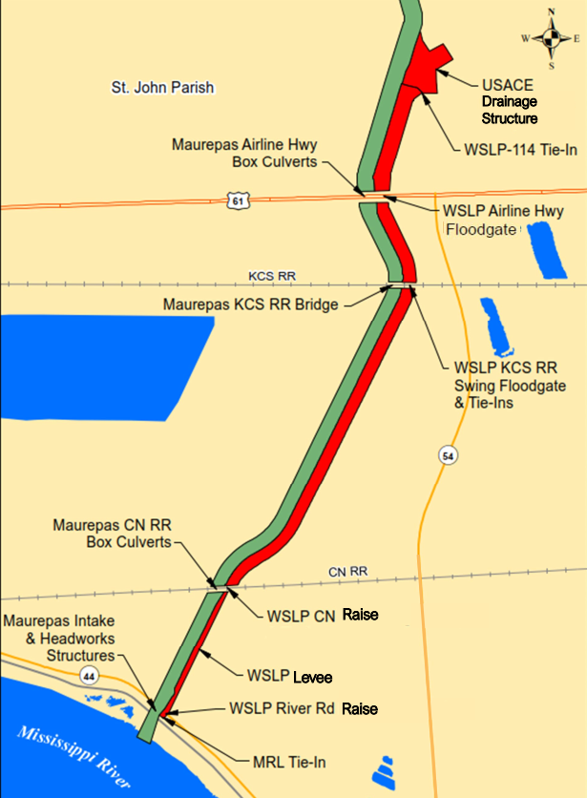
Project Challenges – WSLP Integration
- All features must fit within same 300-ft ROW.
- Many drainage patterns developed for Maurepas Project must be re-routed, and additional infrastructure added, because of WSLP Flood Risk Reduction features.
- Stability of many features must be re-examined because of addition of adjacent levee / floodwall.
CPRA

Slide 11
River Reintroduction into Maurepas Swamp & WSLP Risk Reduction Project Combined Project Overview & Challenges Thank You! Contact Information: Leah B. Read, PE leah.read@aecom.com (504) 586 – 8111 (office)
CPRA

